Slide 1


Lesson 8
Assignment
csinschools.com

Slide 2
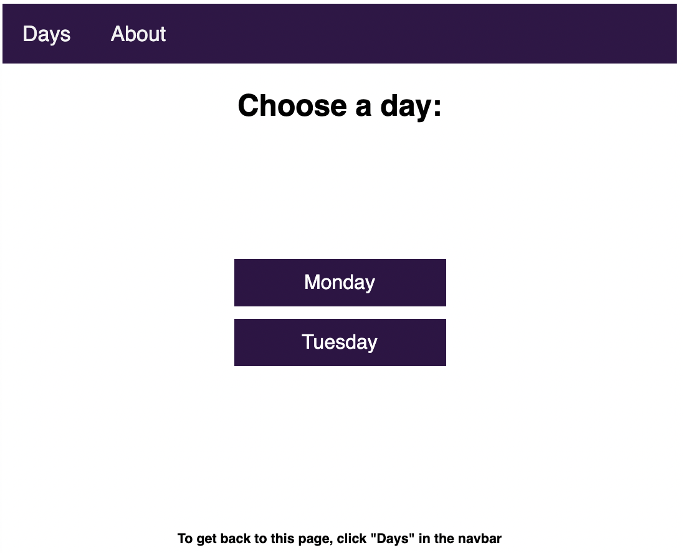
Assignment - Continued…
Check out your Assignment Sheet
  This contains all the information you need to know
If you are after a step-by-step guide on getting started with the Template Code, check out this Worksheet
This is your Assignment Rubric
‹#›

