Slide 1


Lesson 4
Colours
csinschools.com

Slide 2




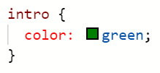
Previously, on CS in Schools...
What is wrong with the style.css file?
index.html
style.css
‹#›
Notes:
Answer:
The selector should be #intro as the paragraph has been given an id.

Slide 3
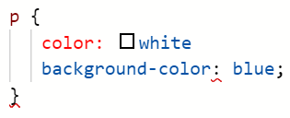
Previously, on CS in Schools...
What is the problem with the following CSS code?
style.css
‹#›
Notes:
Answers:
There needs to be a semi-colon after color:white

Slide 4
Learning objectives
By the end of the lesson you will be able to:
Understand how to represent colours in RGB format
Understand how to represent colours as a hex triplet
Understand how to choose a colour palette for your website
Use a colour palette to style your web page with CSS
‹#›

Slide 5

RGB - Red, Green Blue
255 |  | 255 |  | 255
0 |  | 0 |  | 0
 | R |  | G |  | B
Computer monitors display colour by mixing its three colour channels:
R G B
Each channel ranges from 0-255
‹#›

Slide 6
RGB - Red, Green Blue
255 |  | 255 |  | 255
0 |  | 0 |  | 0
 | R |  | G |  | B
R = 255
‹#›

Slide 7
RGB - Red, Green Blue
255 |  | 255 |  | 255
0 |  | 0 |  | 0
 | R |  | G |  | B
G = 255
‹#›

Slide 8
RGB - Red, Green Blue
255 |  | 255 |  | 255
0 |  | 0 |  | 0
 | R |  | G |  | B
B = 255
‹#›

Slide 9
RGB - Red, Green Blue
255 |  | 255 |  | 255
0 |  | 0 |  | 0
 | R |  | G |  | B
R = 255
G = 255
B = 000
Screen Colour: Yellow
‹#›

Slide 10
RGB - Red, Green Blue
255 |  | 255 |  | 255
0 |  | 0 |  | 0
 | R |  | G |  | B
R = 255
G = 255
B = 255
Screen Colour:
White
‹#›

Slide 11
RGB - Red, Green Blue
255 |  | 255 |  | 255
0 |  | 0 |  | 0
 | R |  | G |  | B
R = 000
G = 000
B = 000
Screen Colour:
Black
‹#›

Slide 12

RGB - Red, Green Blue
255 |  | 255 |  | 255
0 |  | 0 |  | 0
 | R |  | G |  | B
R = 255
G = 000
B = 255
Screen Colour: Magenta
HEX: #ff00ff
0 Represents Empty
255 Represents Full
‹#›

Slide 13
Mixing our own colours
255 |  | 255 |  | 255
0 |  | 0 |  | 0
 | R |  | G |  | B
R = 181
G = 040
B = 101
Screen Colour: Plum
HEX: #b52865
181
101
40
0 Represents Empty
255 Represents Full
‹#›

Slide 14
RGB - Equal Values
If the red, green, and blue values are equal, you will get a shade of grey. The closer to 0 the numbers, the darker the shade, the closer to 255, the lighter the shade.
255 |  | 255 |  | 255
0 |  | 0 |  | 0
 | R |  | G |  | B
164
164
164
‹#›

Slide 15

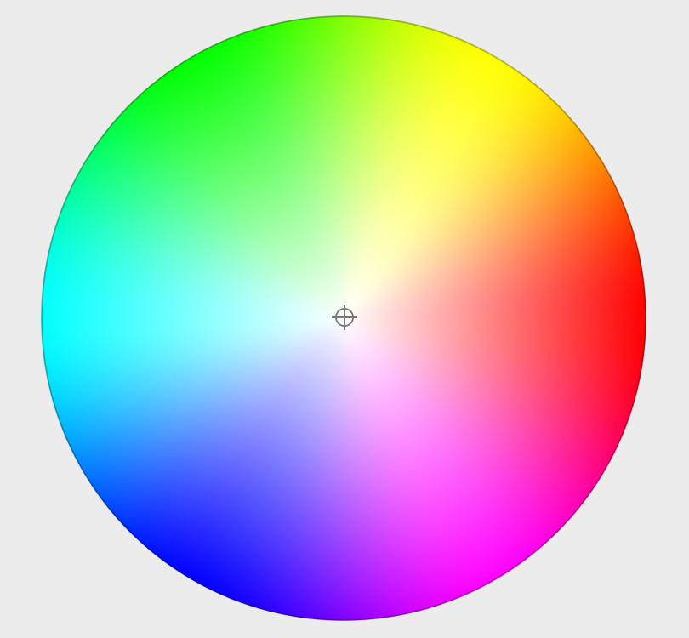
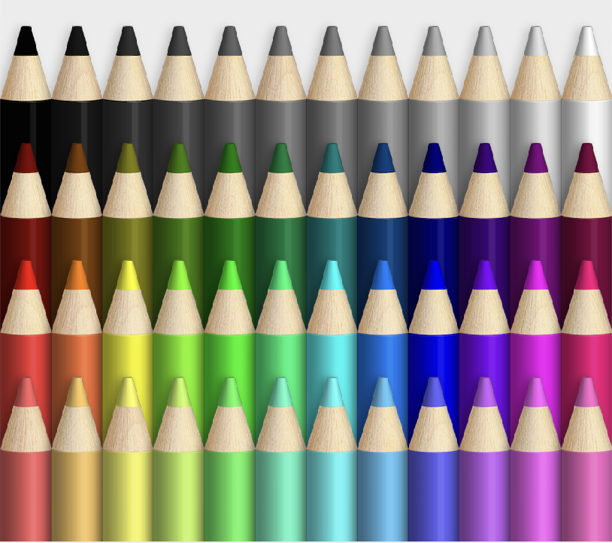

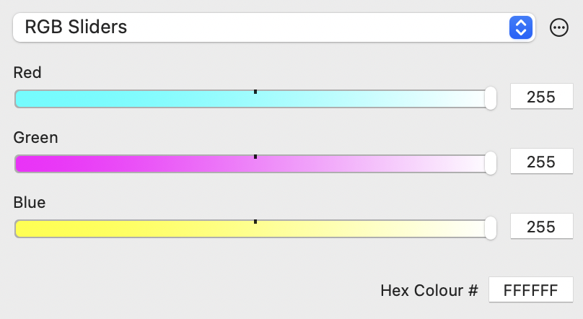
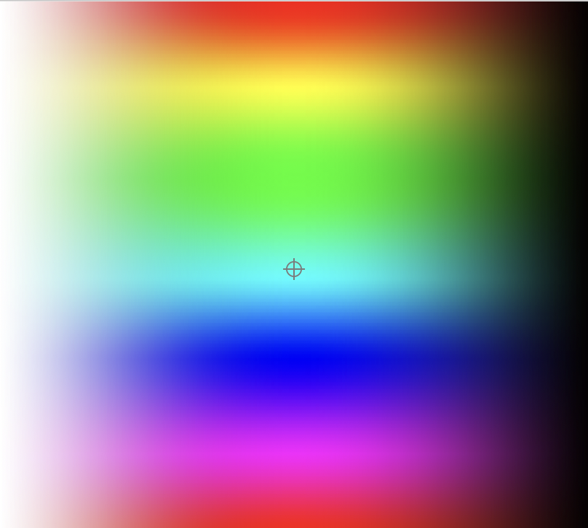
Not sure which colour to choose?
Remember...
We can have from 0-255 colour shades for RED, GREEN and BLUE
By mixing the the R G B channels, we are able to create a vast range of colours:
256 x 256 x 256 =
16,777,216 colours
(We include 0 as part of the colour scale, that is why there is 256 parts of each RGB component)
‹#›

Slide 16

Industry Connection: Thinktank Time...
Look at the following Slides
Class Discussion: “Company: Who Am I?”
‹#›

Slide 17












Industry Connection: Company Who am I?
1
2
3
4
5
6
7
8
10
11
12
9
‹#›

Slide 18
Industry Connection: Thinktank Time...
Now look at the following Slides in colour
Worksheet: “Company: Who Am I?”
‹#›

Slide 19












Industry Connection: Company Who am I?
1
2
3
4
5
6
7
8
10
11
12
9
‹#›

Slide 20
Industry Connection: Thinktank Time...
Does colour make a difference?
How important are colours for brand recognition?
What are the common characteristics of each logo you identified?
Why would this be a consideration in designing websites?
‹#›

Slide 21
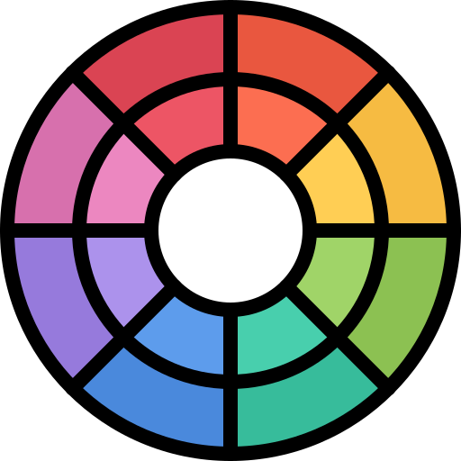
Hexadecimal Numbers
The word hexadecimal means 16
In decimal we count using the digits 0 to 9
In binary we count using the digits 0 and 1
In hexadecimal we count using the digits 0 to F!
‹#›

Slide 22
So...What the Hex?
Remember...
Earlier, on slide 12, you were introduced to a HEX code
Screen Colour: Magenta
HEX: #ff00ff
Just like any other code, we can crack this one too - we just need the key!
‹#›

Slide 23
So...What the Hex?
HEX: #ff00ff
# ff 00 ff
R
G
B
‹#›

Slide 24
And...Why the letters?
Remember…
We can have from 0-255 colour shades for RED, GREEN and BLUE
Let's do the sums:
We need a system that can deal with 256 numbers in 2 digits
(0-255 = 256 numbers...including the 0)
Question:
What is the biggest group we can make that adds up to 256?
Answer:
16 groups of 16 or
16 x 16 = 256
HEX = #ff00ff
# ff 00 ff
R
G
B
NB: HEX codes are not case sensitive (you can interchange capitals and lowercase letters)
‹#›

Slide 25
And...Why the letters?
Because HEX digits have 16 possible values, our single digit decimal numbers (0-9) are not enough. So, we need to 'borrow' letters and assign them as numbers:
Notice A is 10, B is 11, C is 12 and so on?
HEX = #ff00ff
0 | 1 | 2 | 3 | 4 | 5 | 6 | 7 | 8 | 9
 |  | A⁽¹⁰⁾ | B⁽¹¹⁾ | C⁽¹²⁾ | D⁽¹³⁾ | E⁽¹⁴⁾ | F⁽¹⁵⁾
# ff 00 ff
R
G
B
‹#›

Slide 26
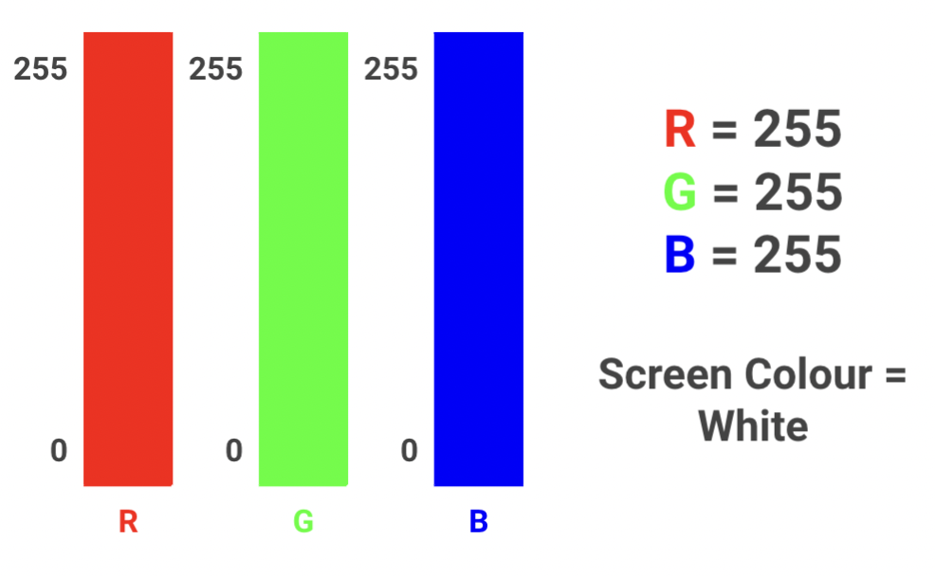



How does the combination work?
RGB for WHITE
Remember slide 6?:
WHITE is made up of R G B values each of 255
Looking at the shade WHITE, it's a bit like saying the volume is on MAX for each R G B colour
‹#›

Slide 27
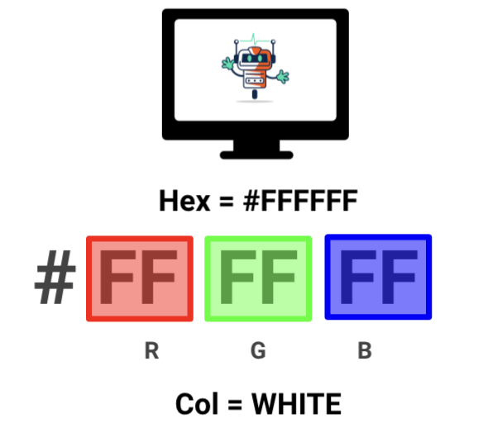
How does the combination work?
HEX for WHITE
Recall slide 14: F represents 15
The 1st F ('BIG F') → Big F has a value of 15
The 2nd F ('LITTLE F') →Little F has a value of 1
Calculate for the value of F:
RED |  |  | GREEN |  |  | BLUE
BIG F | LITTLE F |  | BIG F | LITTLE F |  | BIG F | LITTLE F
15 x 16 = 240 | 15 x 1 = 15 |  | 15 x 16 = 240 | 15 x 1 = 15 |  | 15 x 16 = 240 | 15 x 1 = 15
240 + 15 = 255 |  |  | 240 + 15 = 255 |  |  | 240 + 15 = 255
‹#›

Slide 28


VOX POP Discussion...
Let's see if we can work out the RGB combination for the following HEX Code:
# 09 a7 db
VOX POP DISCUSSION
CLOSEST COLOUR?:
Most likely to RED
Most likely to be GREEN
Most likely to be BLUE
Look at the R G B Values
Before we make some calculations, what colour do you think this combination is likely to be?
‹#›

Slide 29
Now it's your turn...
Let's see if we can work out the RGB combination for the following HEX code #09a7db:
# 09 a7 db
RED |  |  | GREEN |  |  | BLUE
0 | 9 |  | a | 7 |  | d | b
? x 16 = ? | ? x 1 = ? |  | ? x 16 = ??? | ? x 1 = ? |  | ? x 16 = ??? | ? x 1 = ??
? + ? = ? |  |  | ??? + ? = ??? |  |  | ??? + ?? = ???
‹#›

Slide 30
Now it's your turn...
Let's see if we can work out the RGB combination for the following HEX code #09a7db:
# 09 a7 db
RED |  |  | GREEN |  |  | BLUE
0 | 9 |  | a | 7 |  | d | b
0 x 16 = 0 | 9 x 1 = 9 |  | 10 x 16 = 160 | 7 x 1 = 7 |  | 13 x 16 = 208 | 11 x 1 = 11
0 + 9 = 9 |  |  | 160 + 7 = 167 |  |  | 208 + 11 = 219
‹#›

Slide 31
The solution...
So, we can see that HEX #09a7db is predominantly made up of BLUE (219), followed by GREEN (167) with a small amount of RED (009):
255 |  | 255 |  | 255
0 |  | 0 |  | 0
 | R |  | G |  | B
R = 009
G = 167
B = 219
219
167
9
‹#›

Slide 32
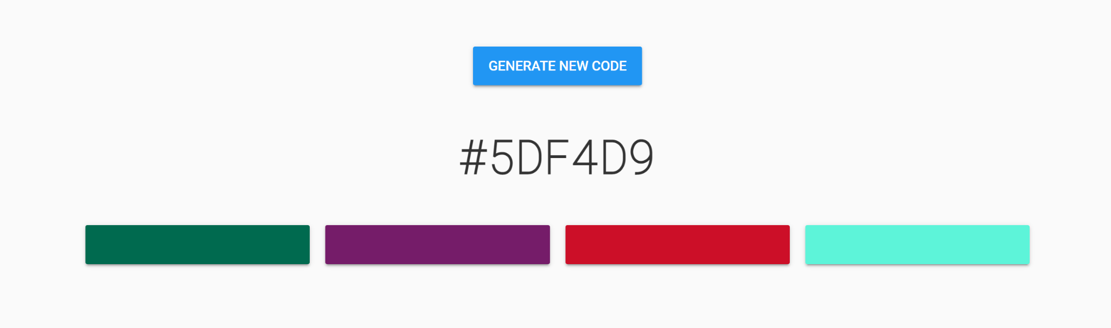
Activity: Guess the Colour!
Test out your HEX code cracking skills
‹#›

Slide 33
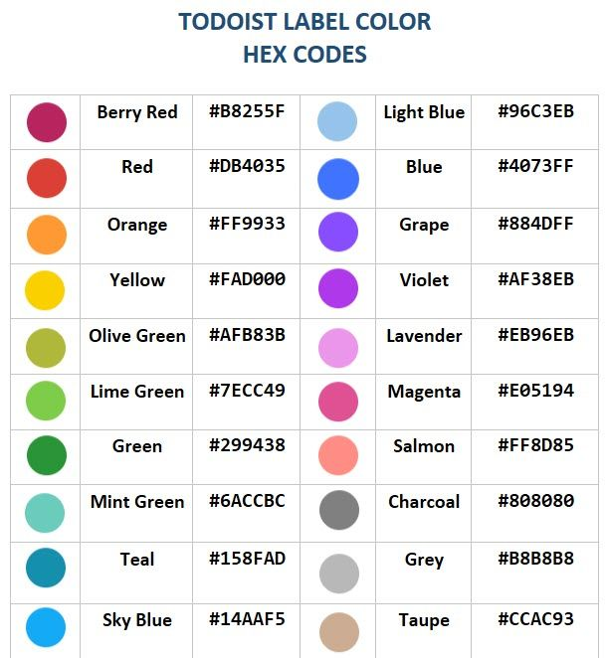
Hex triplets to represent a colour
We can use hexadecimal numbers to represent colours
These are called hexadecimal triplets
We will look more closely at these now...
‹#›

Slide 34
Specifying Colours in CSS
You can specify colours in CSS using an RGB triplet or a HEX triplet
To use an RGB triplet, you use the format rgb(value, value, value) where each value is from 0-255
To use a HEX triplet, you include a hash (#) followed by the hexadecimal triplet
(e.g. #FA13A5)
‹#›

Slide 35
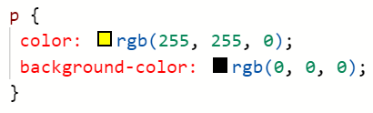
Specifying Colours in CSS
Here is an example of using an RGB triplet to create a paragraph with yellow text and a black background:
‹#›

Slide 36
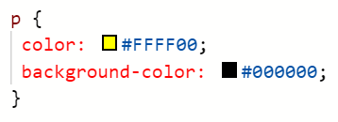
Specifying Colours in CSS
Here is the same example but with a HEX triplet instead:
‹#›

Slide 37
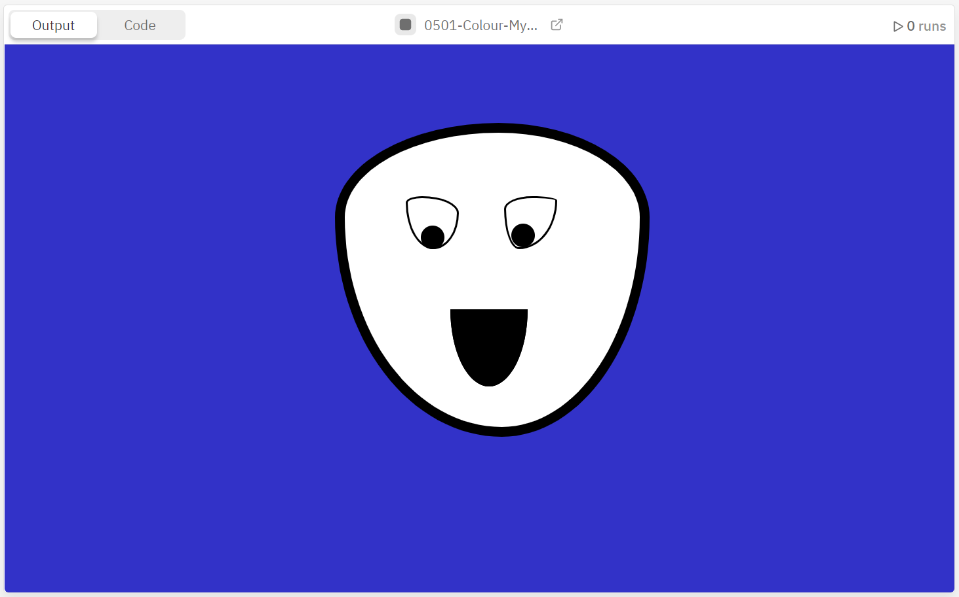
Activity 04.01 - Colour My Face
Your first task is to colour in a face that has been created using HTML and CSS.
Complete Repl.it Activity:
04.01 - Colour My Face
‹#›

Slide 38
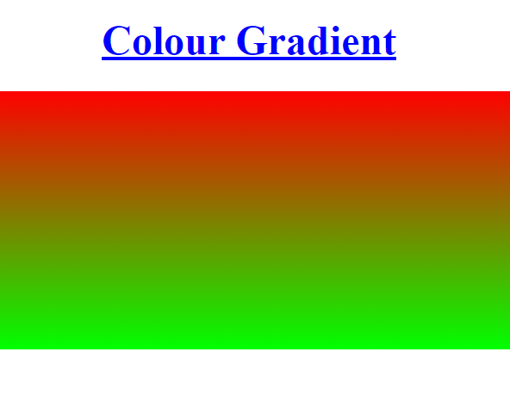

Gradient Colours
A gradient is a transition from one colour to another
In CSS we can set the background to be a gradient using the following code:
This styles an element with the ID of gradient to have a background colour that transitions from red at the top to green at the bottom.
‹#›

Slide 39
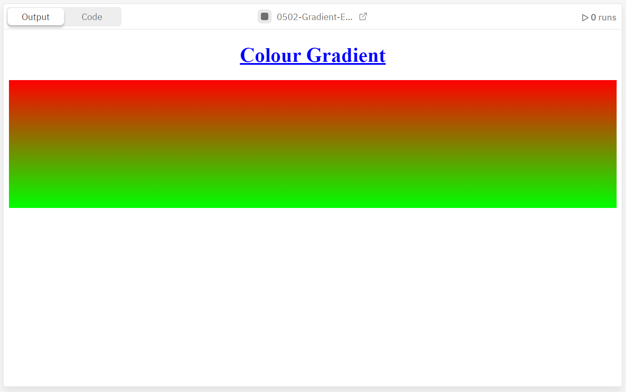
Activity 04.02 - Gradient Experiments
Using HEX triplets or RGB triplets, experiment with different colour gradients.
Complete Repl.it Activity:
04.02 - Gradient Experiment
‹#›

Slide 40
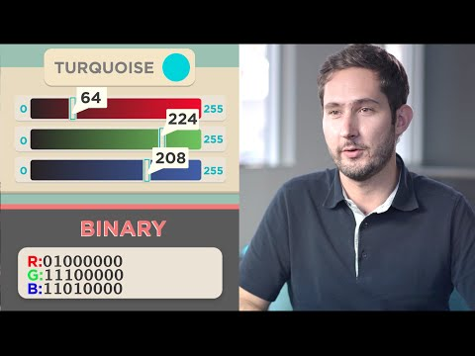
Colour and Instagram
‹#›

Slide 41
Colour Theory
With 16,777,216 colours to choose from, how do you select the right colour combination for your website?
‹#›

Slide 42

Colour Theory
The colour wheel shows the relationship between colours
Read the information about the colour wheel from the Canva website.
What is something interesting you have found out about colour wheels?
What colours do you think go well together?
‹#›

Slide 43
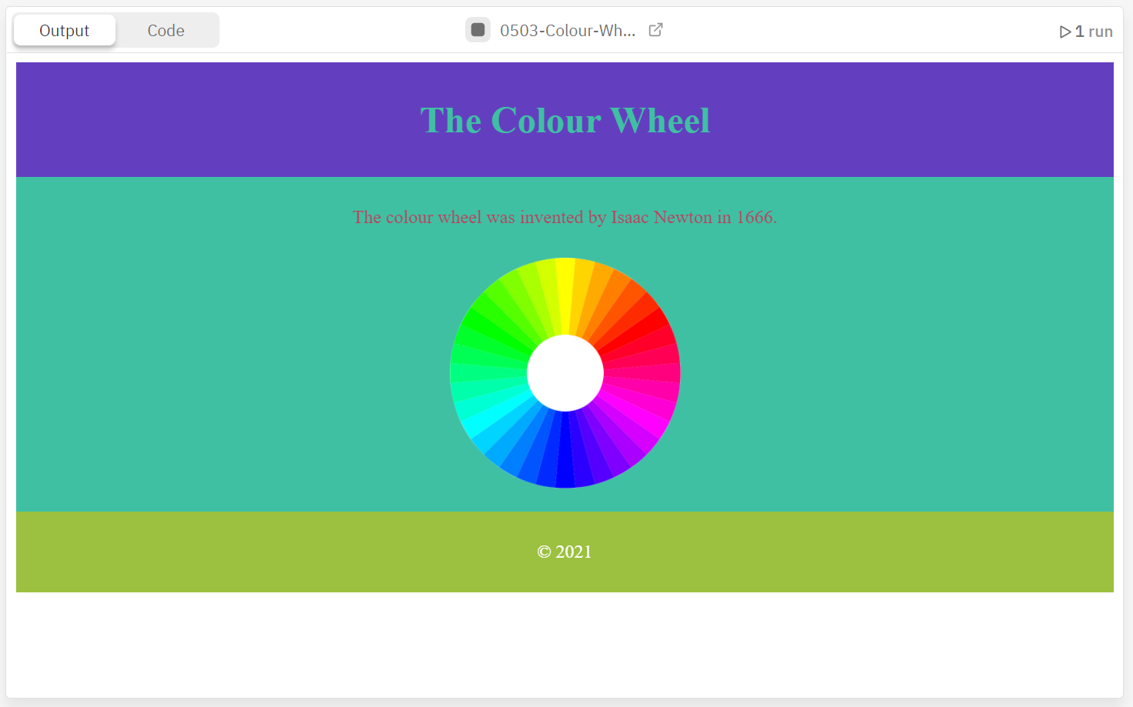
Activity 04.03 - Colour Wheel
Using the Canva Colour Wheel Tool, select a range of colours and update the website to use them.
Complete Repl.it Activity:
04.03 - Colour Wheel
‹#›

Slide 44
Summary
Colours can be represented through RGB triplets by specifying the amount of red, green, and blue to display.
Colours can be selected by using an RGB triplet or a HEX triplet.
The colour wheel is a tool used to select colour combinations.
‹#›

Slide 45
Extension - Basic Colour Filter
In the video we watched with the founder of Instagram, it was mentioned that a basic filter works by changing the colour of certain pixels.
Take a look at the this web page and play around with the buttons.
Notice how the darken button causes the RGB values to decrease;
And the lighten button causes the RGB values to increase
See if you can modify the JavaScript to cause the buttons to change the RGB values by more or less each click.
How do you think a black and white filter works?
‹#›

Slide 46
License Information
These CS in Schools lessons plans, worksheets, and other materials were created by Jeff Plumb and have been modified by the team at CS in Schools. They are licensed under a Creative Commons Attribution-ShareAlike 4.0 International License.
‹#›

