Slide 1


Lesson 3
Styling Web Pages
CSS Basics
csinschools.com

Slide 2
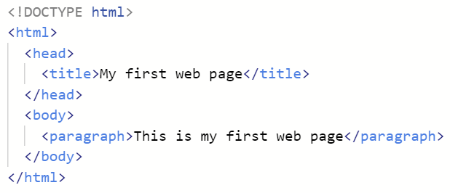
Previously, on CS in Schools...
What is wrong with the following HTML?
Hint: opening tags we are allowed to use are <html>, <head>, <title>, <body> and <p>
‹#›
Notes:
The paragraph tag is only a <p>

Slide 3
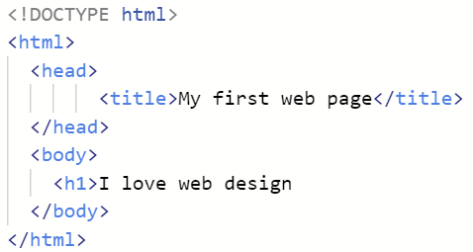
Previously, on CS in Schools...
What is wrong with the following HTML?
Hint: tags usually come in pairs, weird things happen when they don't!
‹#›
Notes:
There is no closing </h1> tag

Slide 4
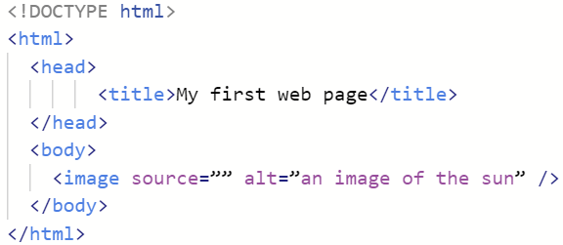
Previously, on CS in Schools...
What is wrong with the following HTML?
Hint: there are three issues, look at the image tag.
‹#›
Notes:
The image tag is img, the source attribute is src, and the filename is missing! Here is a correct version:
<img src="sun.jpg" alt="an image of the sun" />

Slide 5
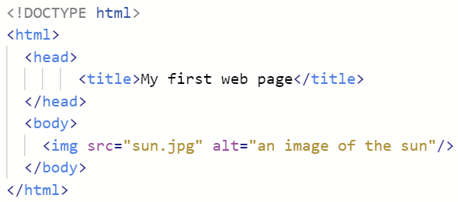
Previously, on CS in Schools...
This is the last slide with the HTML corrected:
‹#›
Notes:
The image tag is img, the source attribute is src. The filename is missing! Here is a correct version:
<img src="sun.jpg" alt="an image of the sun" />

Slide 6



Learning objectives
By the end of the lesson you will be able to:
Understand what CSS is
Style a web page using CSS
Distinguish between the 3 different types of selectors
‹#›

Slide 7

What is CSS?
CSS stands for Cascading Style Sheets
It describes how HTML elements should be styled
We will be writing our styling rules in a file
Multiple web pages can use the same styling by sharing a CSS file
‹#›

Slide 8


Why HTML and CSS?
HTML was designed to describe the content of a web page | CSS describes how elements are to be displayed
‹#›

Slide 9
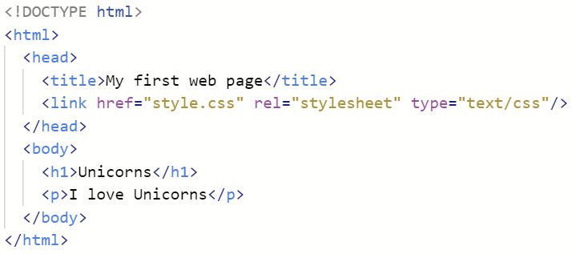
Where will we put our CSS?
Our rules will go in a file called style.css
We tell our HTML document about this file using the <link> tag which sits in between the <head> tags.
‹#›

Slide 10
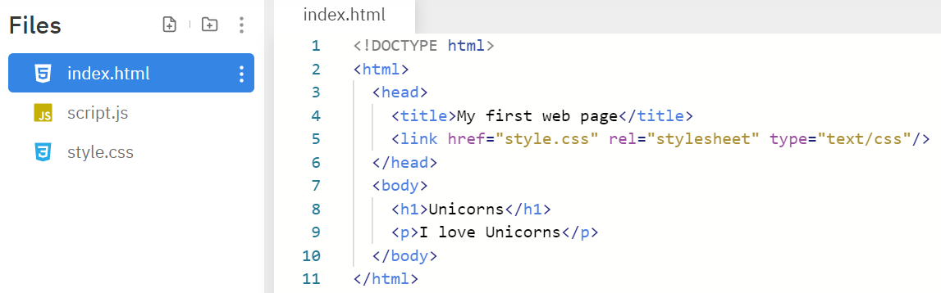
Replit creates this for us
‹#›

Slide 11
CSS Syntax
When choosing a colour, Replit inserts a preview for you
This is the green square in the code above
Note that HTML requires US spelling of words like 'color' and 'center'
‹#›

Slide 12
CSS Syntax
This is called the selector
It selects the HTML element (or elements) that the rules will affect
In this case all <h1> tags will be styled according to these rules
Notice the selector has not got these symbols: < and >
‹#›

Slide 13
CSS Syntax
The rules are specified between the curly braces { }
‹#›

Slide 14
CSS Syntax
Each individual style is specified by:
a property name (eg/ color)
a colon ':'
a value (eg/ green)
a semi-colon ';'
‹#›

Slide 15
CSS Syntax
You can specify as many rules as required in between the curly braces { }
The same rules still apply:
a property name (eg/ text-align)
a colon ':'
a value (eg/ center)
a semi-colon ';'
‹#›

Slide 16

CSS Demonstration
‹#›

Slide 17
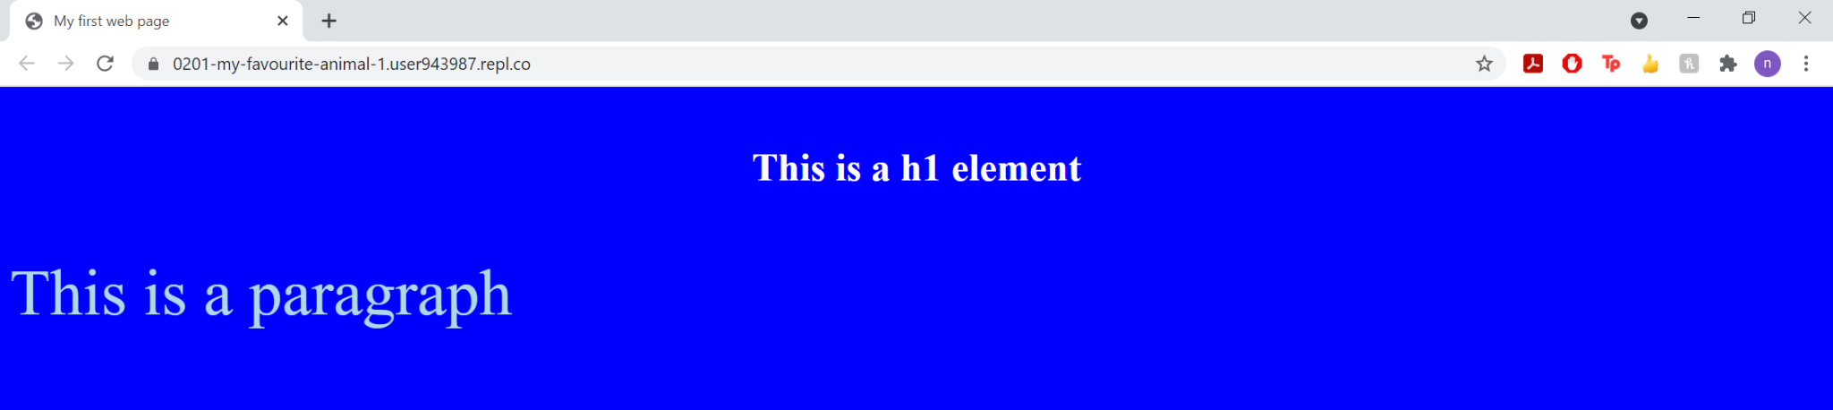
CSS Demonstration
The first CSS rule styles all content with a blue background
The second CSS rule colours the text white and center aligns the text for all h1 elements
The third CSS rule colours the text light blue and sets the font size to 54 pixels for all paragraphs
‹#›

Slide 18
Element Selector
In these examples this selector type refers to all HTML elements (e.g. body, h1, p) of that type. This is like changing the default styling on your text in Microsoft Word or Google Docs.
This is also called a simple selector.
‹#›

Slide 19
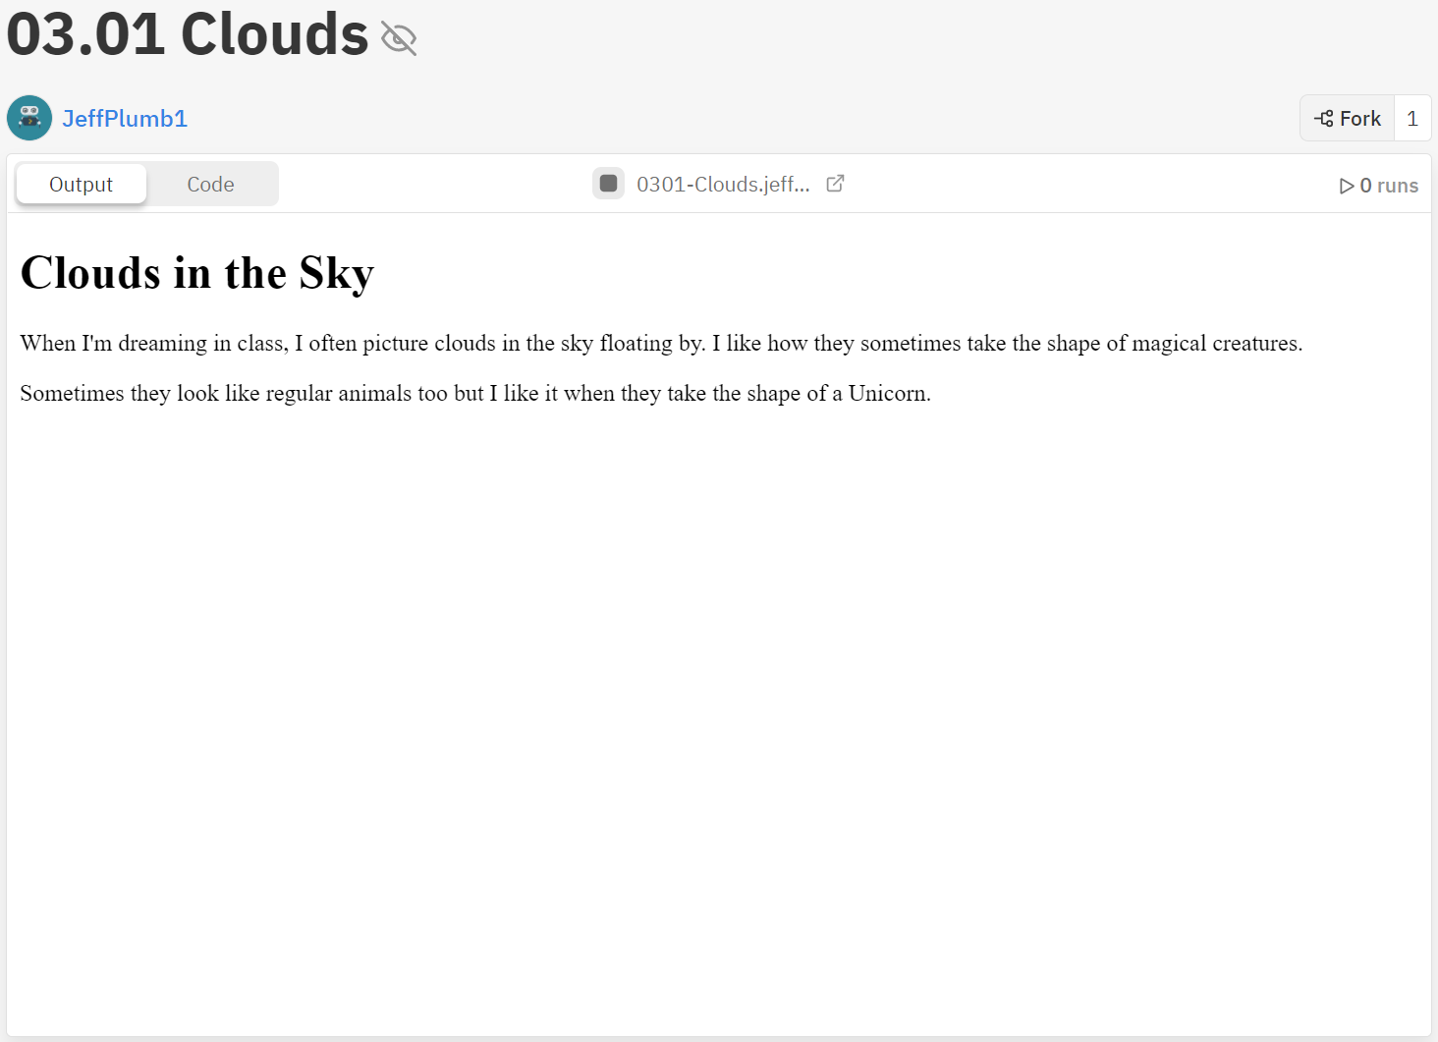


Activity 03.01 - Clouds in the Sky
Your first task is to style a web page using element selectors.
Hint
See the next slide for an example of what your page might look like!
Complete Repl.it Activity: 03.01 - Clouds in the Sky
‹#›

Slide 20
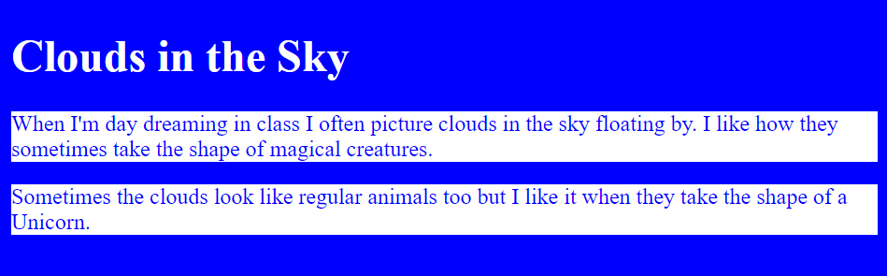

Activity 03.01 - Clouds in the Sky
Your final web page should look something like this:
Feel free to get creative with your colours and styles!
‹#›

Slide 21

Industry Connection: Thinktank Time...
Look at the following Webpages
Class Discussion:
What is good? What is bad?
‹#›
Notes:
Lesson 3 insert after slide 19

Slide 22
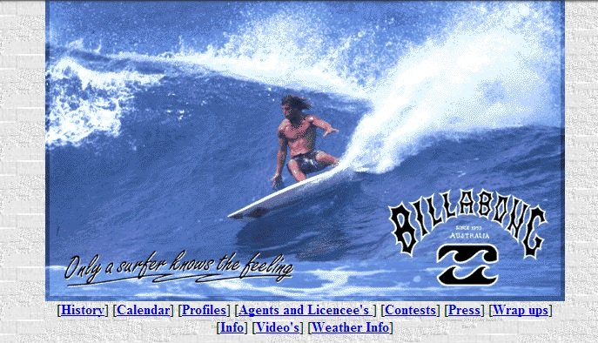

Industry Connection: Thinktank Time...
1997
2021
‹#›

Slide 23
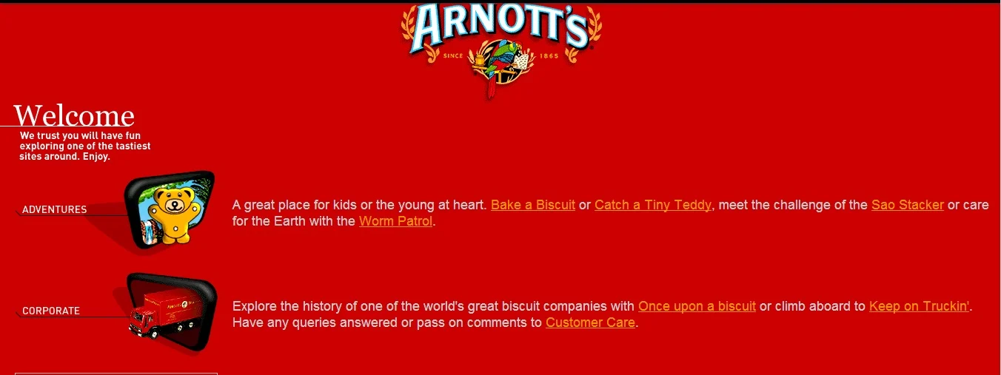

Industry Connection: Thinktank Time...
1997
2021
‹#›

Slide 24
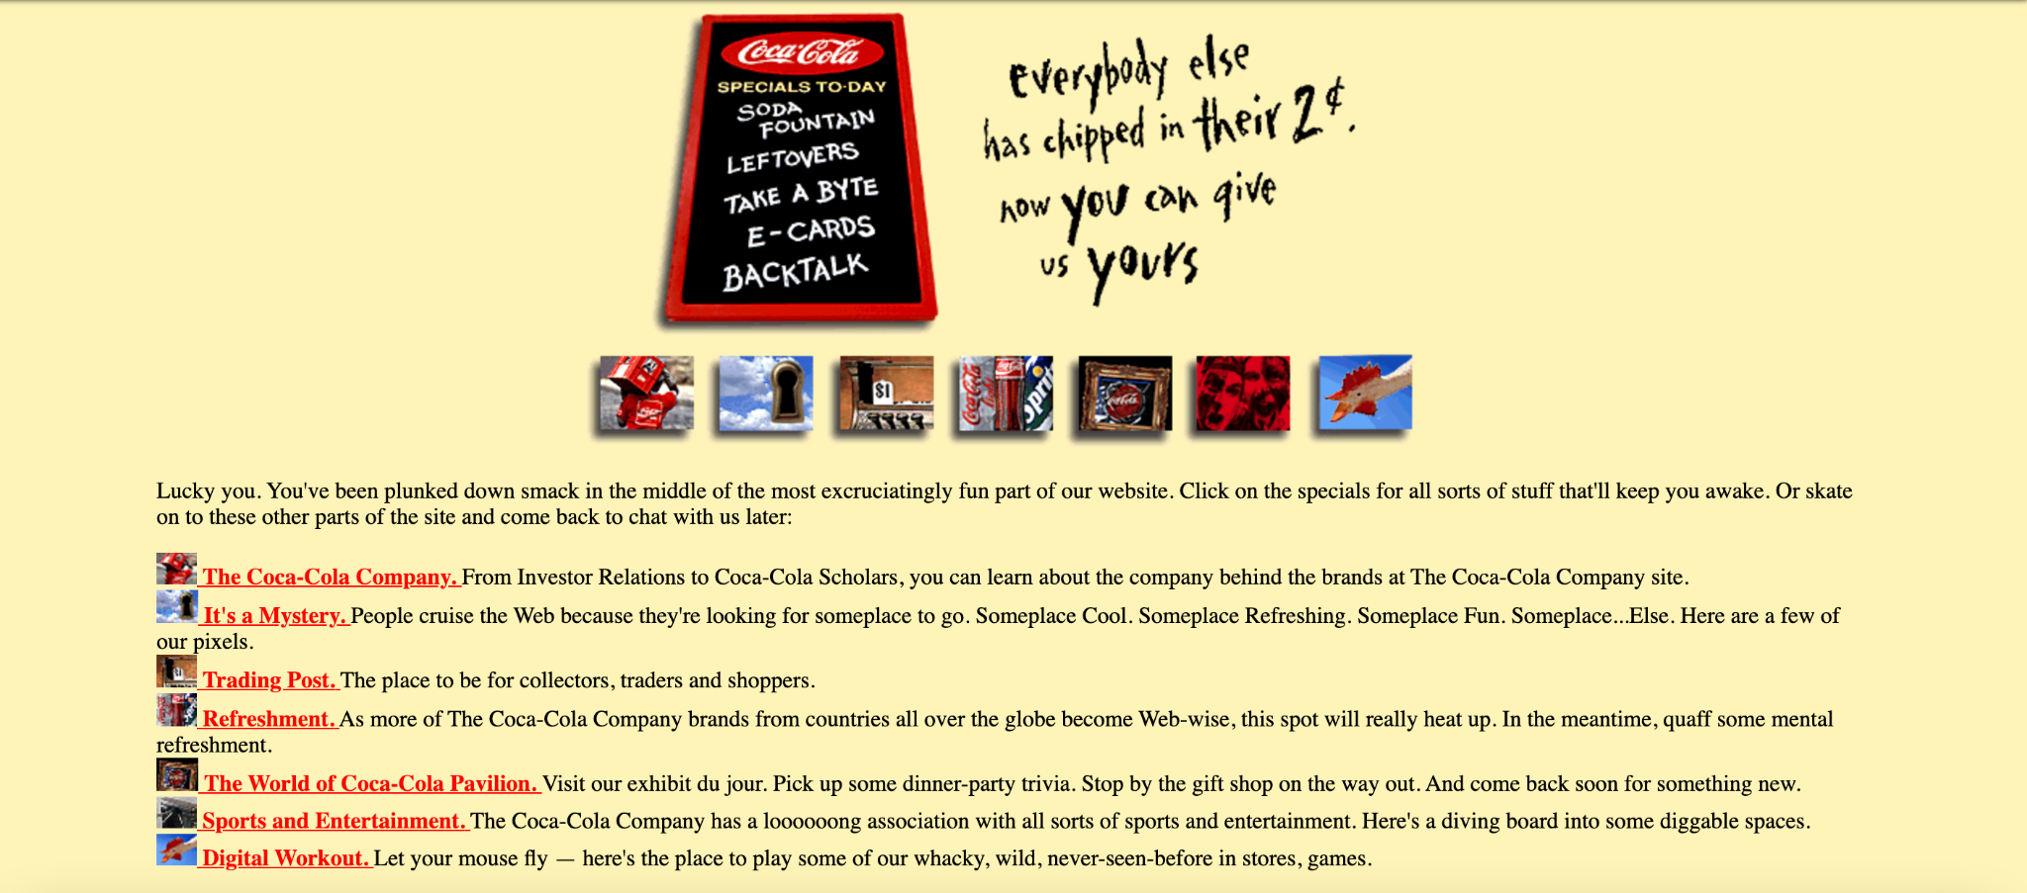

Industry Connection: Thinktank Time...
1997
2021
‹#›

Slide 25
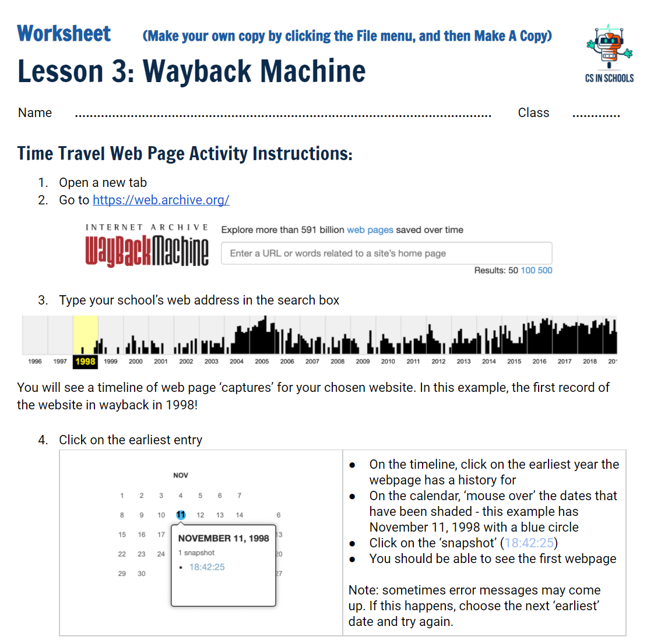
Let’s give it a go!
Open the following worksheet, and have a go comparing some other websites:
Complete the worksheet activity: Wayback Machine
‹#›

Slide 26
ID Selector
index.html
If we add an id attribute to an HTML element, we can use this id as a selector.
‹#›

Slide 27
ID Selector
index.html
If we add an id attribute to an HTML element, we can use this id as a selector.
style.css
In our CSS file, we reference the id by using a # followed by the id name (e.g. mainParagraph).
‹#›

Slide 28
ID Selector
index.html
We can use any name we want as the id. However, it should be relevant and meaningful to the page.
The id of an element is unique within a web page. This means the id selector is used to select one unique element. This is similar to your student code or your Tax File Number - it uniquely identifies you!
‹#›

Slide 29
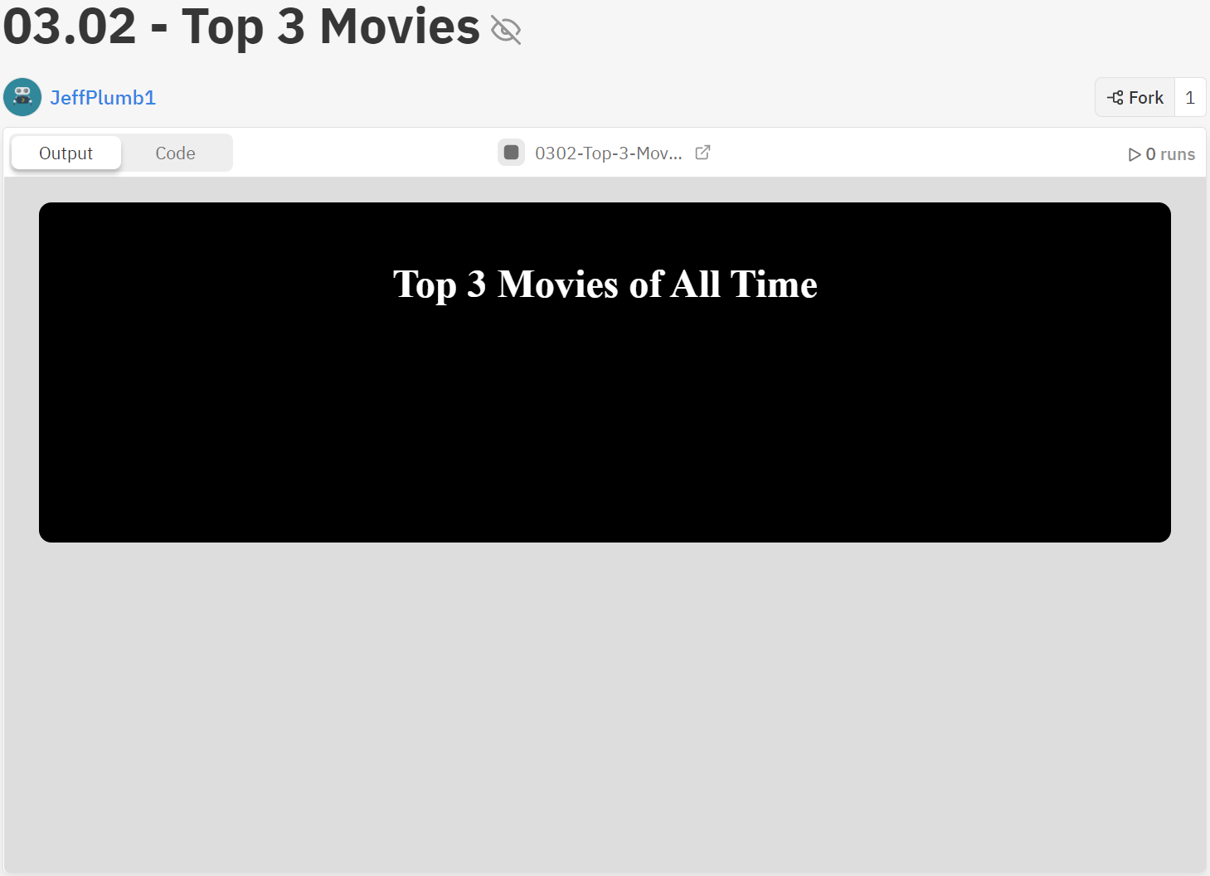
Activity 03.02 - Top 3 Movies
Your task is to style a top 3 movies page so that it colours the winners as gold, silver and bronze.
Hint
See the next slide for an example of what your page might look like!
Complete Repl.it Activity: 03.02 - Top 3 Movies
‹#›

Slide 30

Activity 03.02 - Top 3 Movies
Once you have finished the page should look similar to:
‹#›

Slide 31
Class Selector
index.html
If we add an class attribute to an HTML element, we can use this class as a selector.
‹#›

Slide 32
Class Selector
index.html
If we add an class attribute to an HTML element, we can use this class as a selector.
style.css
In our CSS file, we reference the class by using a '.' followed by the class name (e.g. centerText).
‹#›

Slide 33









Difference Between ID Selectors and Class Selectors
The id attribute can only be given to a single element on a page | The class attribute can apply to many elements on a page
‹#›

Slide 34
Common CSS Properties
Set the background colour: background-color: blue;
Set the text colour: color: red;
Style the border: border: 2px solid black;
Set the size of text: font-size: 20px;
W3Schools is a great resource for CSS information: https://www.w3schools.com/cssref/default.asp
‹#›

Slide 35
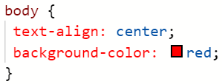
Formatting Your CSS
If you have more than one rule, as above, you should format your CSS so it is easy to check for errors.
Have the selector and opening { on the same line
Have each declaration indented on a new line
Have the closing } by itself at the end
This makes it easy to see if you have both brackets, and if there is a semicolon is after each declaration.
‹#›

Slide 36
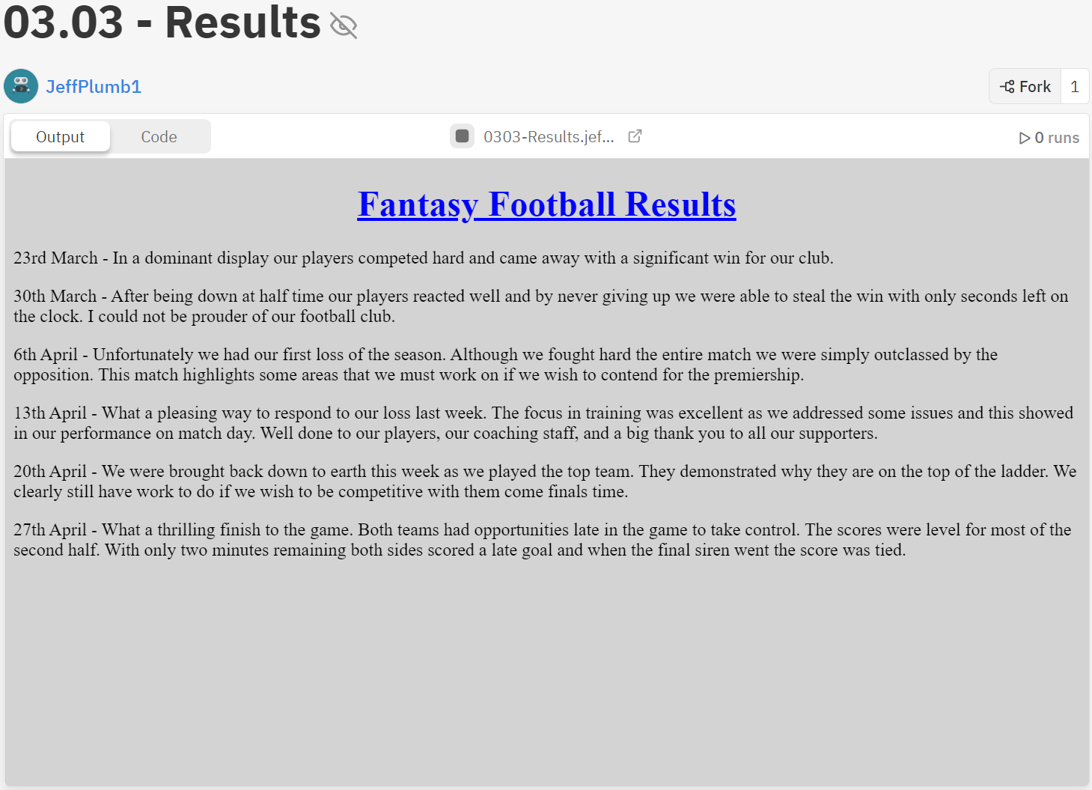
Activity 03.03 - Fantasy Football Results
Your task is to style a football results page so it is colour coded. It should display green for a win, red for a loss, and blue for a draw.
Hint
See the next slide for an example of what your page might look like!
Complete Repl.it Activity: 03.03 - Fantasy Football Results
‹#›

Slide 37
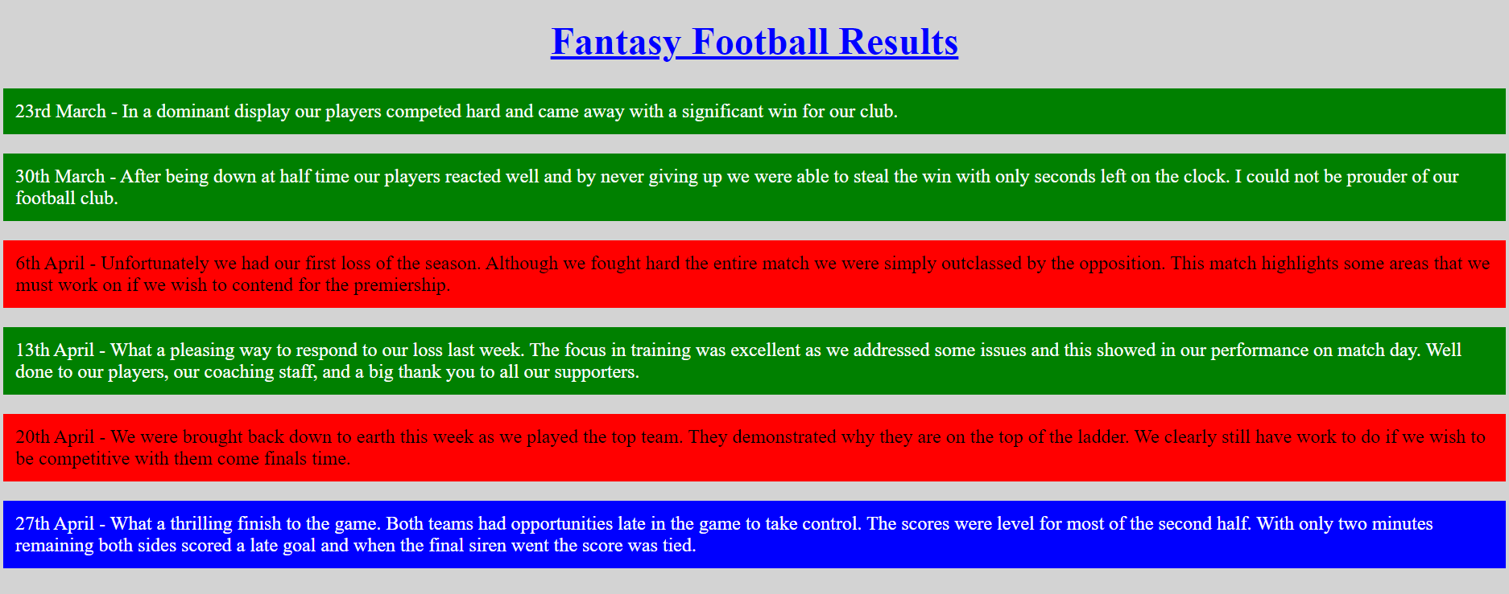
Activity 03.03 - Fantasy Football Results
Your web page could look like this:
‹#›

Slide 38
Summary
CSS is used to style your web page
Simple selectors are used to select html elements like <body>, <h1>, and <p>
id selectors are used to select a single unique element on a page with an id attribute
class selectors are used to select multiple elements with the same class attribute
‹#›

Slide 39
License Information
These CS in Schools lessons plans, worksheets, and other materials were created by Jeff Plumb and have been modified by the team at CS in Schools. They are licensed under a Creative Commons Attribution-ShareAlike 4.0 International License.
‹#›

