Slide 1


Lesson 6
Using DALL.E
csinschools.com

Slide 2
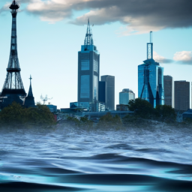
Demo 06.01: Your City In the Future…
A scary potential future for your city…

Slide 3
Learning objectives
By the end of this lesson, you should be able to:
Understand how to call the getOpenAIImage() function to generate an image based on a text prompt
Display the image returned from the getOpenAIImage() function in Python using the printImage() function
Understand the difference between the print() and printImage() function

Slide 4
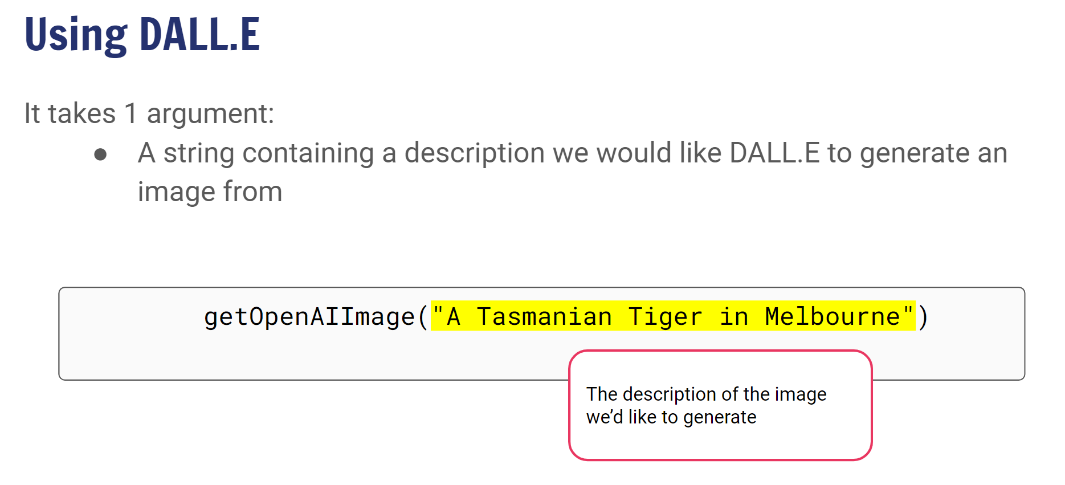

2:03 min
Link to Accompanying Slides

Slide 5

Worksheet 06.01 Activity
Complete Question 1

Slide 6
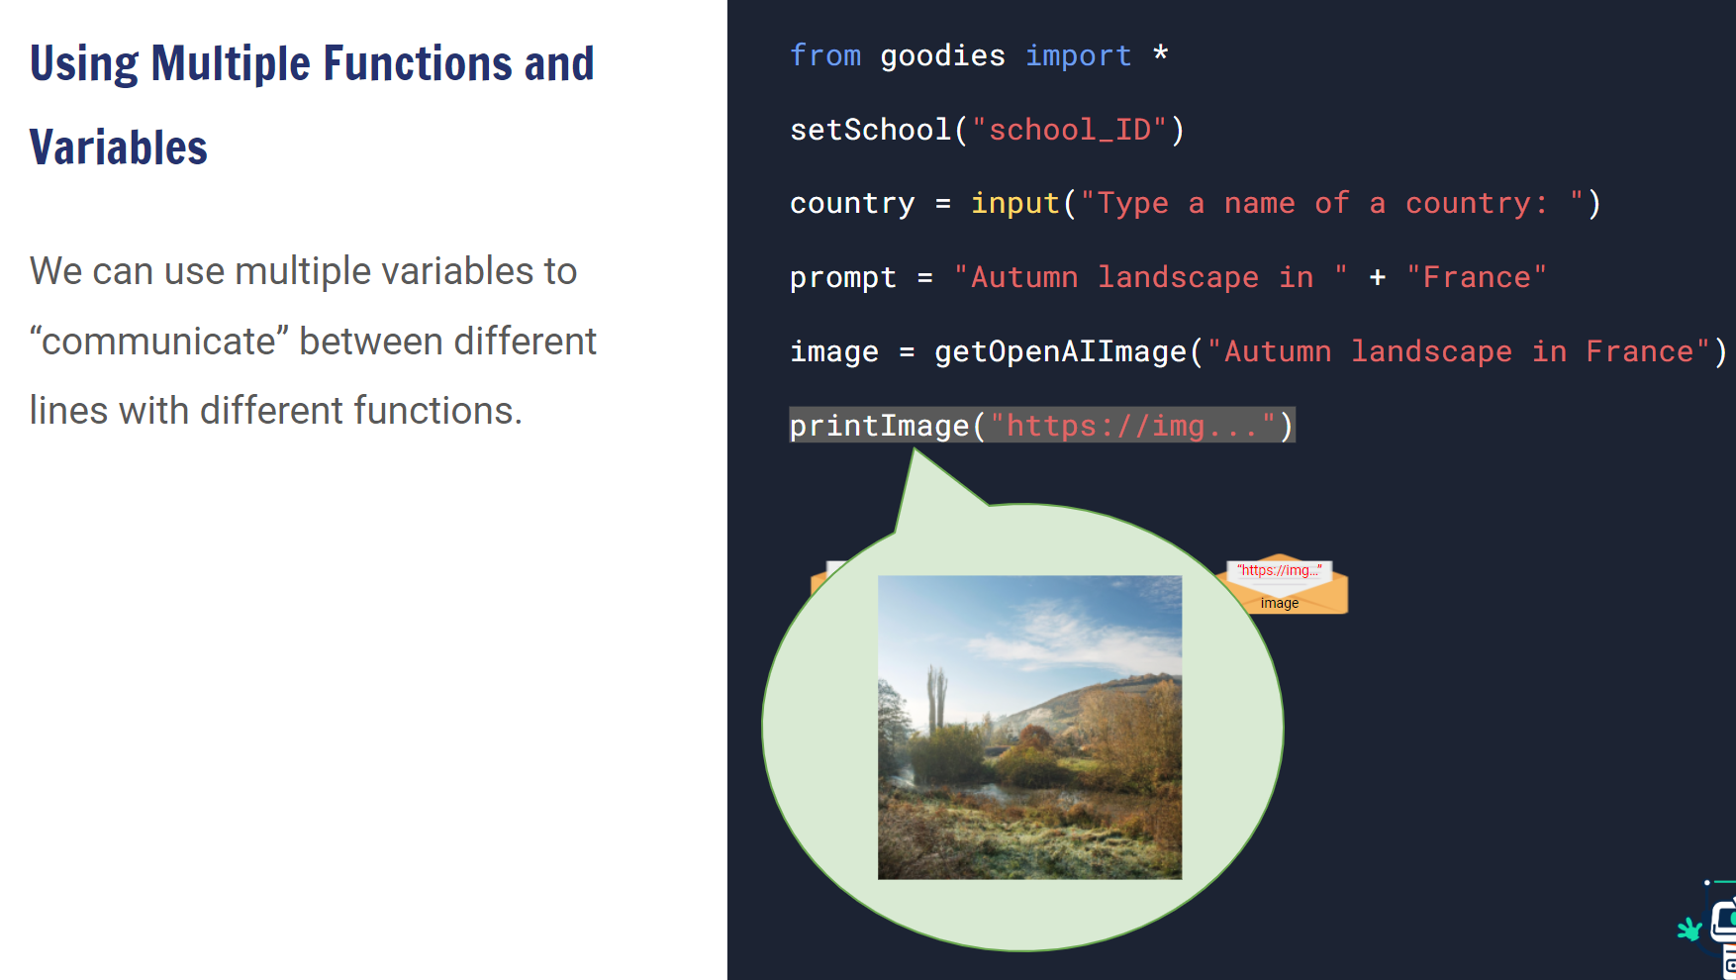
1:32 min
Link to Accompanying Slides

Slide 7
Worksheet 05.01 Activity
Complete Questions 2 - 7

Slide 8
Summary
You should now be able to:
Understand how to call the getOpenAIImage() function to generate an image based on a text prompt
Display the image returned from the getOpenAIImage() function in Python using the printImage() function
Understand the difference between the print() and printImage() function

Slide 9


Reflection: Exit pass
What is one new thing you learnt today?
Write it on a sticky note and stick it on the board before you leave the classroom
‹#›

Slide 10
License Information
These CS in Schools lessons plans, worksheets, and other materials were created by Toan Huynh and Hugh Williams. They are licensed under a Creative Commons Attribution-ShareAlike 4.0 International License.
Images, in order of appearance:
"Award" by Good Ware on flaticon.com
"Our Solar System Features Eight Planets" from NASA
"Mouse" by freepik on flaticon.com

