Slide 1


Lesson 5
Using ChatGPT
csinschools.com

Slide 2
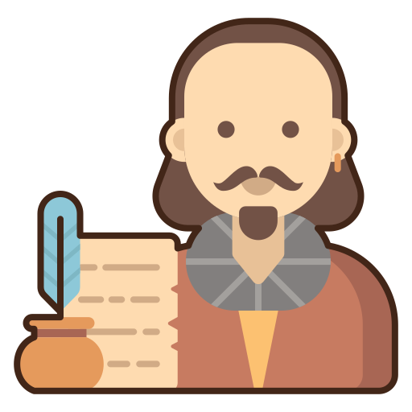


05.01 Demo: ChatGPT… the Poet
Exploratory Activity
Can you get ChatGPT to write a rap for the topic instead of a poem?
Let me be your own personal poet

Slide 3
Learning objectives
By the end of this lesson, you should be able to:
Understand how to call the getChatGPTAnswer() function to get a text “completion” from ChatGPT
Continue practicing using functions and variables

Slide 4
About Using ChatGPT
Before using the ChatGPT functions in this lesson, you’ll need to be aware of what you can and can’t do with it:
The responses are limited to about 20 words
Only use it in this subject and classes
Only use it for the activities and questions in this subject
Do not use it in other subjects
All your activities with the function are monitored and can be traced back to you and your school

Slide 5
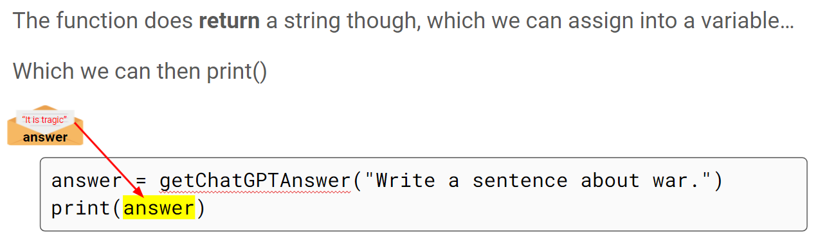

Using the getChatGPTAnswer() function
2:30 min
Link to Accompanying Slides

Slide 6

Worksheet 05.01 Activity
Complete Question 1

Slide 7
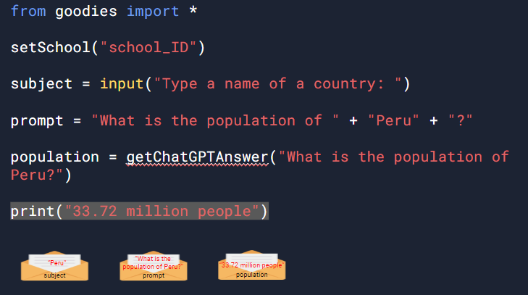
Using the getChatGPTAnswer() function
3:04 min
Link to Accompanying Slides

Slide 8
05.02 Worksheet Activity
Complete Questions 2 - 7

Slide 9
Lesson Summary
You should now be able to:
Understand how to call the getChatGPTAnswer() function to get a text “completion” from ChatGPT
Continue practicing using functions and variables

Slide 10


Reflection: Exit pass
What is one new thing you learnt today?
Write it on a sticky note and stick it on the board before you leave the classroom
‹#›

Slide 11
License Information
These CS in Schools lessons plans, worksheets, and other materials were created by Toan Huynh and Hugh Williams. They are licensed under a Creative Commons Attribution-ShareAlike 4.0 International License.
Images, in order of appearance:
"Award" by Good Ware on flaticon.com
"Our Solar System Features Eight Planets" from NASA
"Mouse" by freepik on flaticon.com

