Slide 1


Lesson 4
Speaking in Languages
csinschools.com

Slide 2



Demo 04.01: Worldly Greetings
Exploratory Activity
Can you ask the user to type in their own greeting?
Learn to Greet People wherever you are in the world!

Slide 3
Learning objectives
By the end of this lesson, you should be able to:
Understand how to call the getTranslation() function to translate a string from one language to another
Call the speak() function to speak a sentence in another language through your device’s speakers
Continue practicing using functions and variables

Slide 4
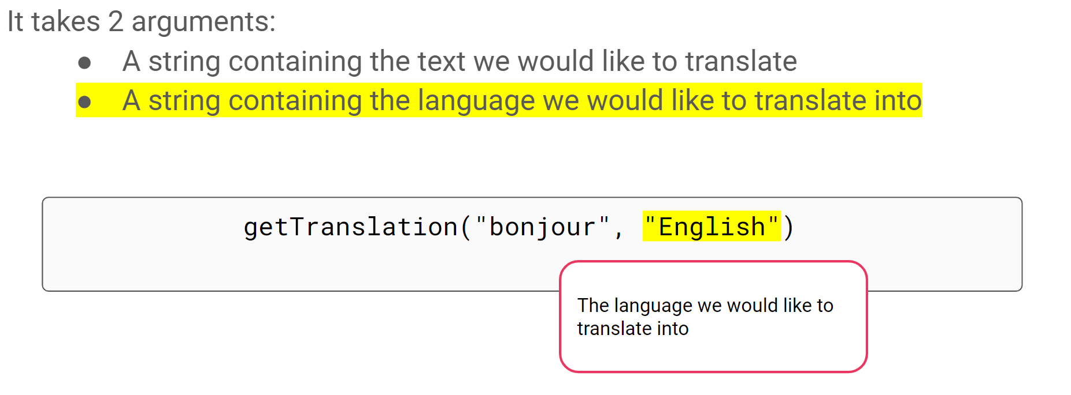

Translating Between Languages
2:21 min
Link to Accompanying Slides

Slide 5
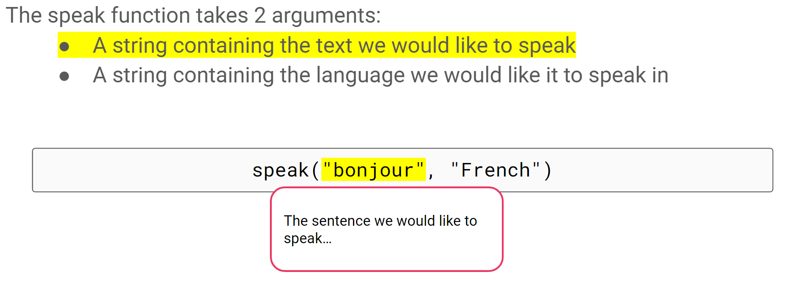
Speaking in Different Languages
0:58 min
Link to Accompanying Slides

Slide 6

Worksheet 04.01 Activity
Complete Questions 1 & 2

Slide 7
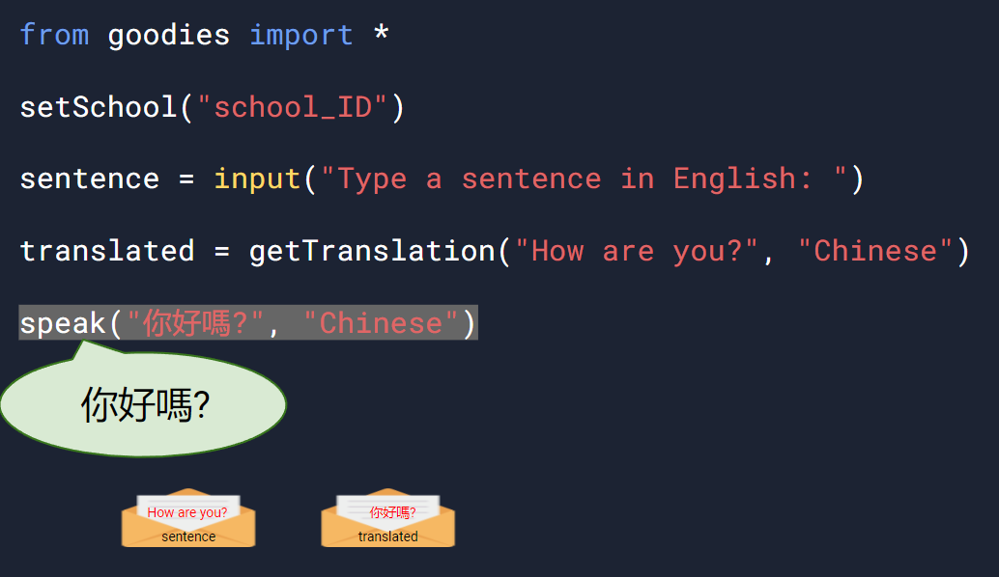
Using Multiple Functions and Variables
2:05 min
Link to Accompanying Slides

Slide 8
Worksheet 04.01 Activity
Complete Questions 3 - 5

Slide 9
Lesson Summary
You should now be able to:
Understand how to call the getTranslation() function to translate a string from one language to another
Call the speak() function to speak a sentence in another language through your device’s speakers
Continue practicing using functions and variables

Slide 10


Reflection: Exit pass
What is one new thing you learnt today?
Write it on a sticky note and stick it on the board before you leave the classroom
‹#›

Slide 11
License Information
These CS in Schools lessons plans, worksheets, and other materials were created by Toan Huynh and Hugh Williams. They are licensed under a Creative Commons Attribution-ShareAlike 4.0 International License.
Images, in order of appearance:
"Award" by Good Ware on flaticon.com
"Our Solar System Features Eight Planets" from NASA
"Mouse" by freepik on flaticon.com

