Slide 1


Lesson 3
Cloud Variables
Teachers: From this lesson onwards, you’ll need a School ID.
Please contact support@csinschools.com if you don’t yet have one.
csinschools.com

Slide 2

Learning objectives
By the end of this lesson, you should be able to:
Understand how cloud variables allow communication between devices
Make a connection between between regular and cloud variables
Continue practicing using functions and variables

Slide 3
Introduction to Cloud Variable
We’re going to learn about cloud variables and how to use them to communicate between programs on different devices
It will also illustrate why general variables are important
Note: Cloud variables are not part of the official Python language, we will be using them as a learning tool
‹#›
Notes:
Solution:
city = input("Enter your city: ")
print(city + "'s current temperature is 25c")

Slide 4
Previously on CS in Schools…
In the last episode of CS in Schools:
In the following line of code:
temperature = getTemperature("Melbourne, VIC","2001-10-23")
What is the:
  Variable name
  Function name
  Function arguments

Slide 5
Previously on CS in Schools…
In the last episode of CS in Schools:
In the following line of code:
temperature = getTemperature("Melbourne, VIC","2001-10-23")
What is the:
  Variable name: temperature
  Function name: getTemperature
  Function arguments: “Melbourne, VIC” and “2001-10-23”

Slide 6
Previously on CS in Schools…
In the last episode of CS in Schools:
Jake wants to ask the user to type in their age and store it into the age variable. However, his code below doesn’t seem to be working:
input = print("Enter your age:")
Rewrite the line of code so that it works.

Slide 7
Previously on CS in Schools…
In the last episode of CS in Schools:
Jake wants to ask the user to type in their age and store it into the age variable. However, his code below doesn’t seem to be working:
age = input("Enter your age:")
Rewrite the line of code so that it works.

Slide 8
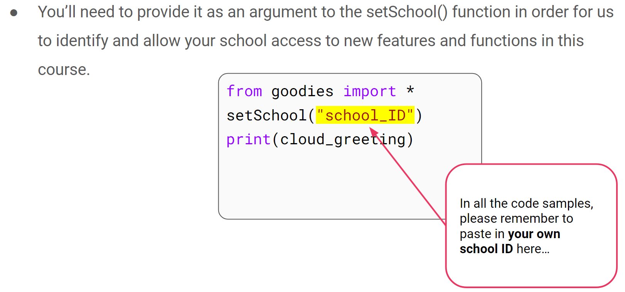

School ID
0:46 min
Link to Accompanying Slides

Slide 9

Demo: Introduction to Cloud Variables
1:00 min
Link to Accompanying Slides
Students: Follow the steps on the worksheet here!
Teachers: You have your own script sheet. To access it, login as a teacher to this page.

Slide 10
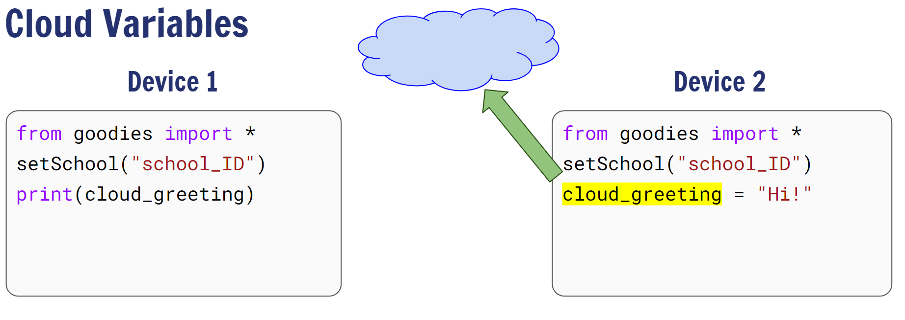
A Explanation of Cloud Variables
1:56 min
Link to Accompanying Slides

Slide 11

03.02 Worksheet Activity
Complete Questions 1 & 2

Slide 12
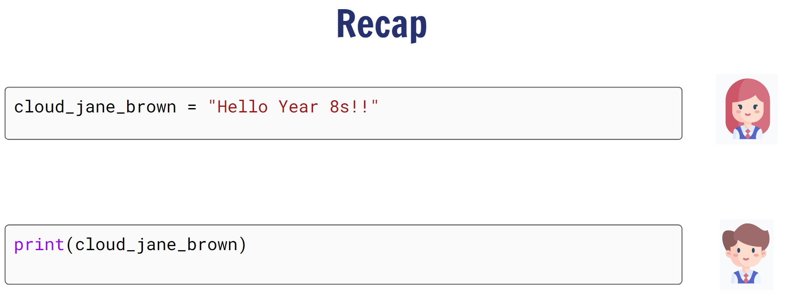
Regular Variables vs Cloud Variables
2:00 min
Link to Accompanying Slides

Slide 13
03.02 Worksheet Activity
Complete Questions 3 & 4

Slide 14
Lesson Summary
You should now be able to:
Understand how cloud variables allow communication between devices
Make a connection between between regular and cloud variables
Continue practicing using functions and variables

