Slide 1


Lesson 1
Functions
1 2 3
csinschools.com

Slide 2
Learning objectives
By the end of this lesson, you should be able to:
Revise print() and the goodies (csinsc) module
Use the say() function
Understand what function arguments are and how they are used

Slide 3

01.01 Demo: Long Time No See!
Python is very happy to see you again!

Slide 4
Previously on CS in Schools…
In last season of CS in Schools:
How would you display “Welcome back!” on the screen in Python code?

Slide 5
Previously on CS in Schools…
In last season of CS in Schools:
How would you display “Welcome back!” on the screen in Python code?
print("Welcome back!")

Slide 6
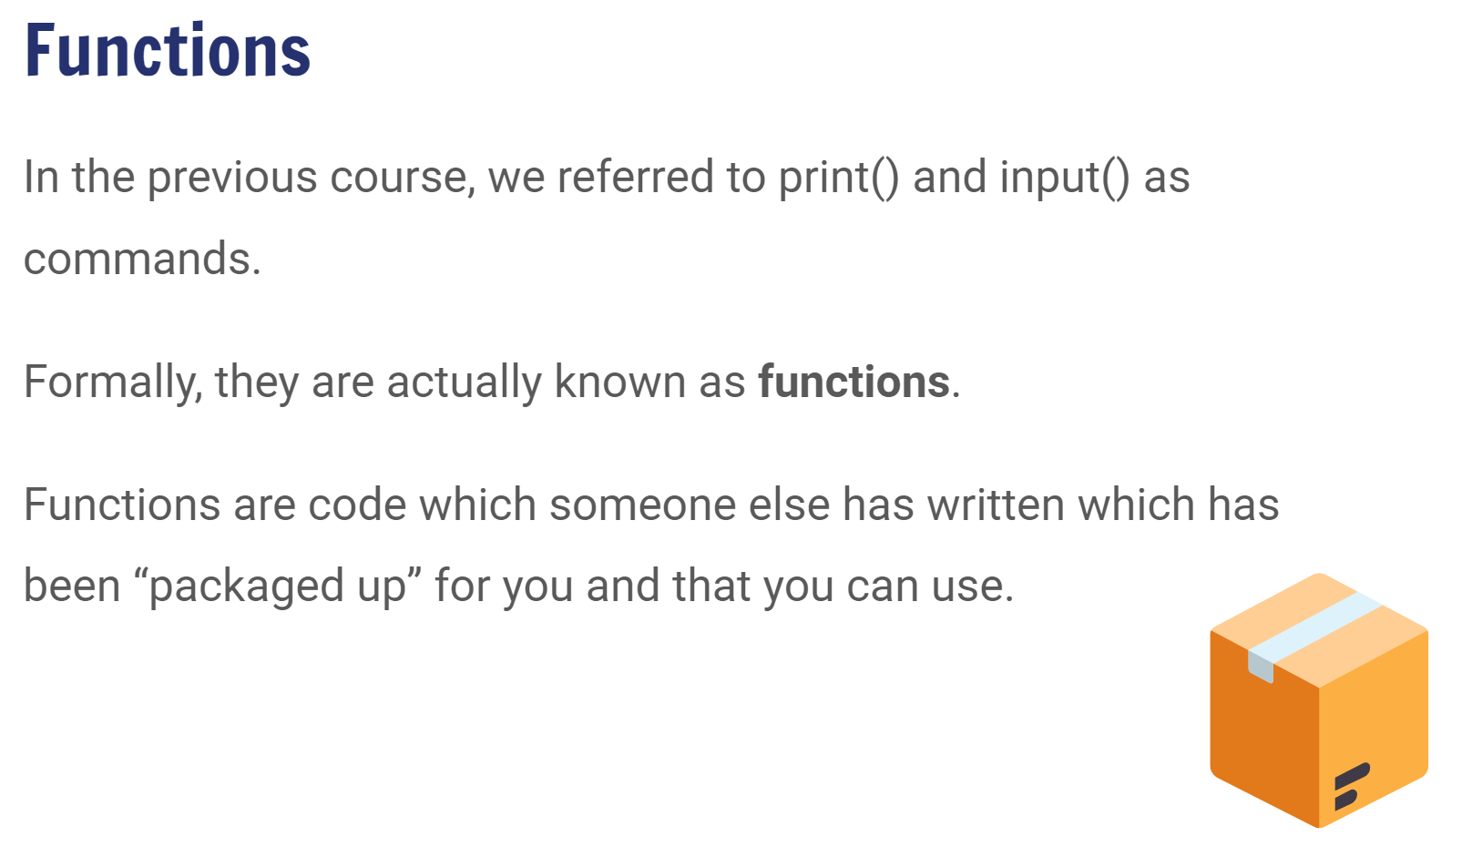

2:42 min
Link to Explanation Slides

Slide 7
Check Your Understanding
In the following code, highlight the print functions.
print("Superhero name generator")
top_colour = input("What is the colour of your top? ")
drink = input("What was the last thing you drank? ")
supehero_name = top_colour + " " + drink
print("Generating your name...")
sleep(1)
print("Your superhero name is " + supehero_name + "!")

Slide 8
Check Your Understanding
In the following code, highlight the print functions.
print("Superhero name generator")
top_colour = input("What is the colour of your top? ")
drink = input("What was the last thing you drank? ")
supehero_name = top_colour + " " + drink
print("Generating your name...")
sleep(1)
print("Your superhero name is " + supehero_name + "!")

Slide 9
Check Your Understanding
In the following code, highlight the print functions arguments.
print("Superhero name generator")
top_colour = input("What is the colour of your top? ")
drink = input("What was the last thing you drank? ")
supehero_name = top_colour + " " + drink
print("Generating your name...")
sleep(1)
print("Your superhero name is " + supehero_name + "!")

Slide 10
Check Your Understanding
In the following code, highlight the print functions arguments.
print("Superhero name generator")
top_colour = input("What is the colour of your top? ")
drink = input("What was the last thing you drank? ")
supehero_name = top_colour + " " + drink
print("Generating your name...")
sleep(1)
print("Your superhero name is " + supehero_name + "!")

Slide 11

01.02 Worksheet Activity
Complete Questions 1

Slide 12

01.03 Demo: Hello, world…. again??
Why do we have to keep saying hello?

Slide 13
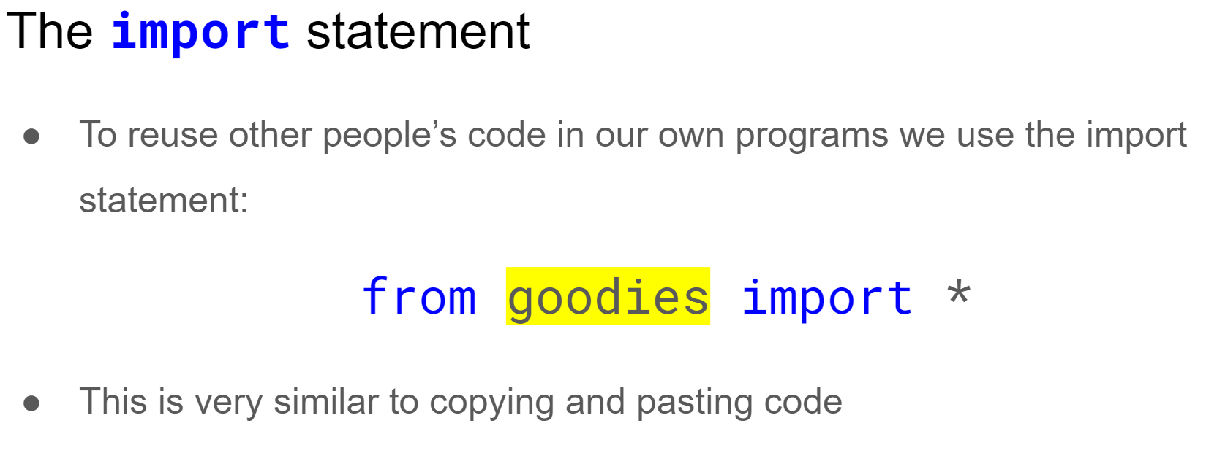
2:38 min
Link to Explanation Slides

Slide 14
01.02 Worksheet Activity
Complete Question 2

Slide 15
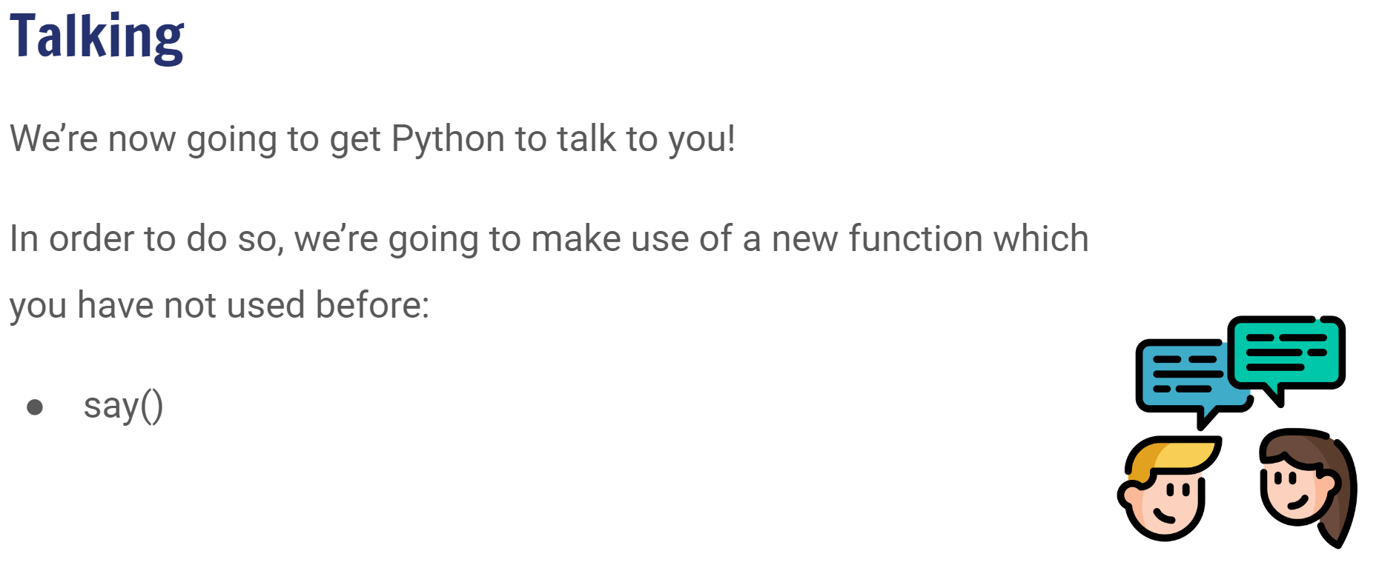
2:42 min
Link to Explanation Slides

Slide 16
01.02 Worksheet Activity
Complete Question 3

Slide 17

01.04 Coding Activity: Your first words
Your First Words

Slide 18

01.05 Coding Activity: Look who’s talking!
The Three Amigos say Hello!

Slide 19


01.06 Coding Activity: Tetris!
Change the colour of the blocks
Change the score for each line
Change the score for a Tetris (4 lines)!
(Advanced) Add this new block:
Play our Python version of Tetris, Pytris here!

Slide 20

Summary
You should now be able to:
Revise print() and the goodies (csinsc) module
Use the say() function
Understand what function arguments are and how they are used

Slide 21


Reflection: Exit pass
What is one new thing you learnt today?
Write it on a sticky note and stick it on the board before you leave the classroom
‹#›

Slide 22
License Information
These CS in Schools lessons plans, worksheets, and other materials were created by Toan Huynh and Hugh Williams. They are licensed under a Creative Commons Attribution-ShareAlike 4.0 International License.
Images, in order of appearance:
"Yeah!! text" by rawpixel on Unsplash
"Rugby Ball" by Freepik on flaticon.com
"Footprint" by Freepik on flaticon.com

