Slide 1


Lesson 7 & 8
Assignment
csinschools.com
Notes:
Teachers please note: the first two slides have a grey background and are for your reading prior to the lesson.

Slide 2


1:01 min
Link to Accompanying Slides

Slide 3
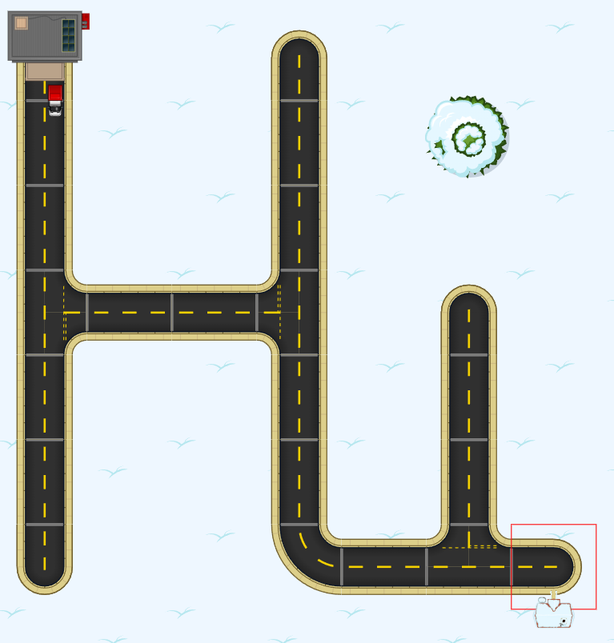
Assignment: Your Own Rapid Router Map
Assignment Marking Rubric

Slide 4
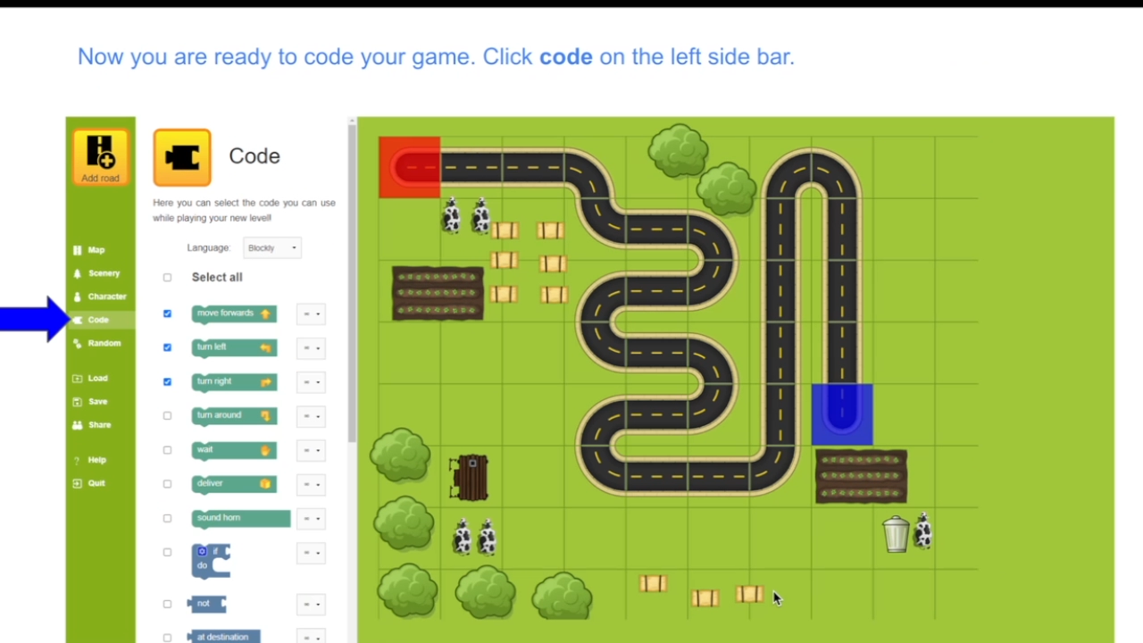
Creating your own level in Rapid Router
7:57 min
Watch the video to learn how to create your own level in Rapid Router

Slide 5
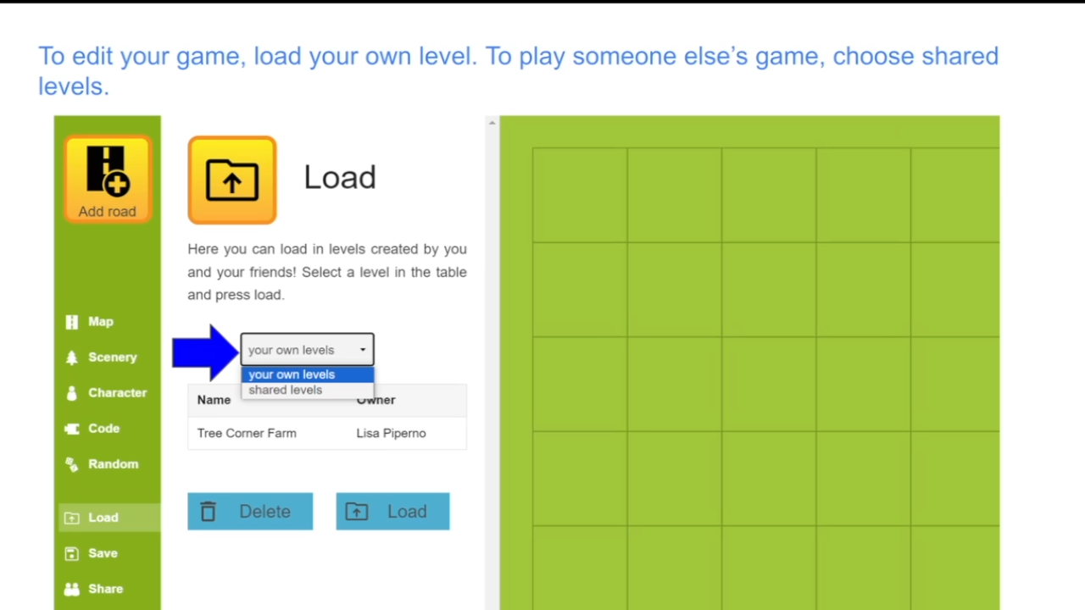
Editing and changing your level in Rapid Router
0:58 min
Need to add extra things to your level? Watch the video to learn how to edit and change your level in Rapid Router

Slide 6
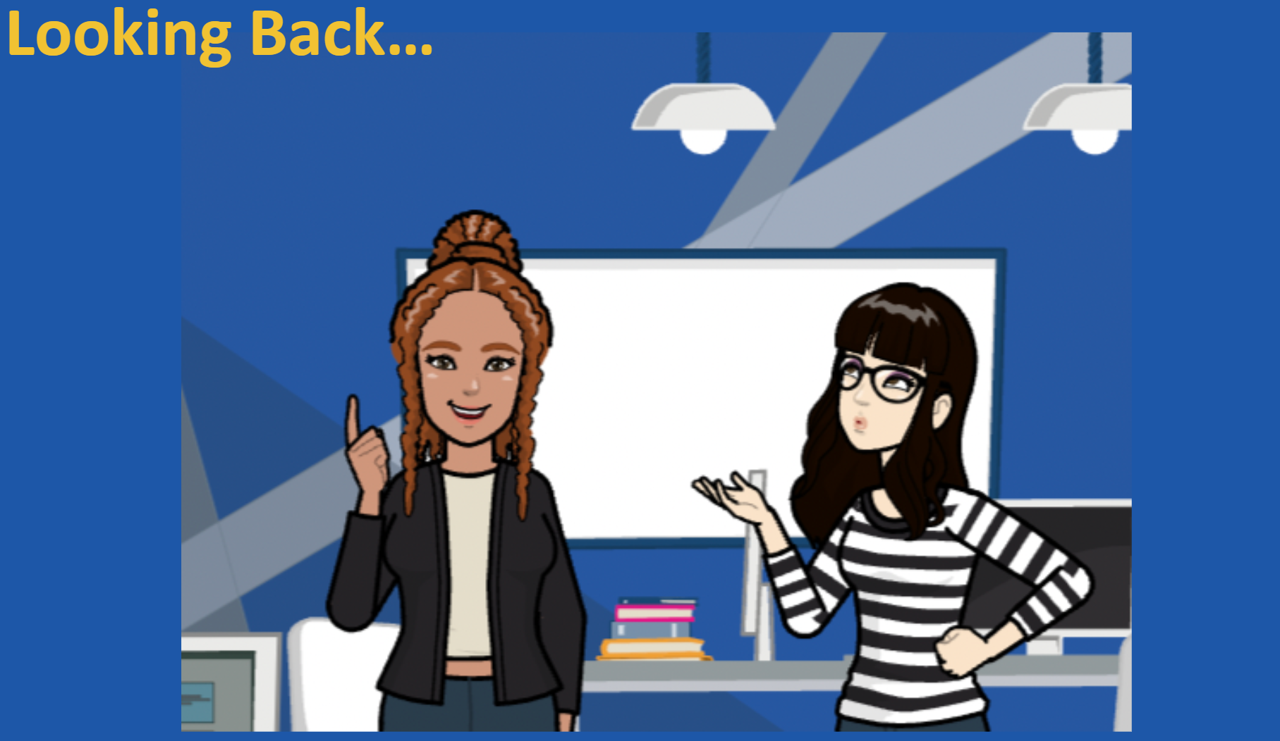
1:00 min
Link to Accompanying Slides

Slide 7

BE INSPIRED
GET CODING

