Slide 1


Lesson 6
Conditional Repeat Loops
csinschools.com
Notes:
Teachers please note: the first two slides have a grey background and are for your reading prior to the lesson.

Slide 2
Lesson Outline and Suggested Timings
Lesson 6 Conditions | Time Required | Notes/Details | Resources
Review | 5 minutes | Think, pair, share. Nesting loops | Lesson 6 slides interactive whiteboard
Introduction to conditions in repeat loops and coding practice | 10 minutes | Teacher to introduce concept via explanation slides. Students continue to explore Ocado- Code for Life Level 29 | Lesson 6 slides projector or interactive whiteboard student devices
Comparing and contrasting algorithms | 10 minutes | Teacher to facilitate a class discussion analysing 3 different types of algorithms. Prompt students to describe their positive and negative attributes. | Lesson 6 slides projector or interactive whiteboard printed copy or digital copy of slide 60
What is a condition? Draw a route | 20 minutes | Teacher to elaborate via explanation slides. Students practice and consolidate new learning by completing worksheets | Lesson 6 slides What is a condition? worksheet Draw a route worksheet *Students that need support writing can circle the correct conditions instead of writing them.
Reflection | 5 minutes | Students reflect on the learning intention and success criteria by responding to journal prompts. This is also an opportunity for the teacher to gauge student progress. | Lesson 6 student devices or workbook

Slide 3



Slide 4

Learning Intention:
We are learning to understand and use conditions in repeat loops.
Success Criteria
• I can explain conditions in repeat loops.
• I can use conditions in repeat loops to create algorithms

Slide 5
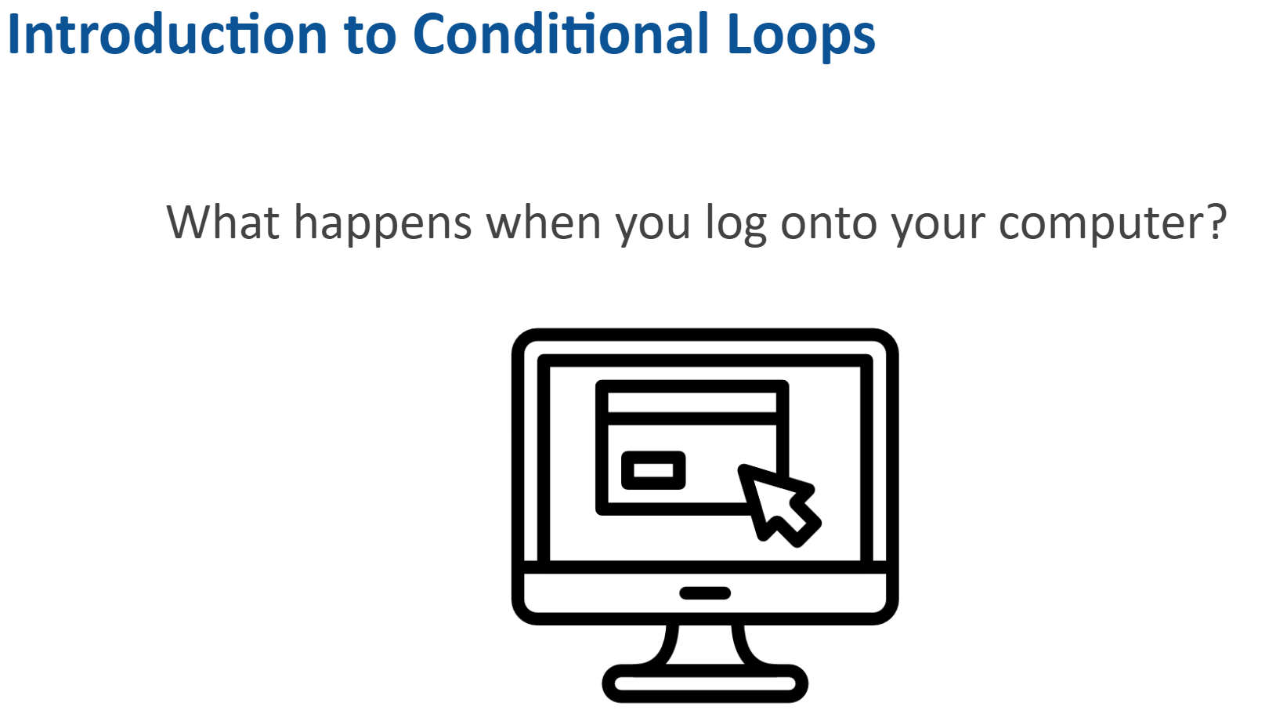
1:08 min
Link to Explanation Slides

Slide 6
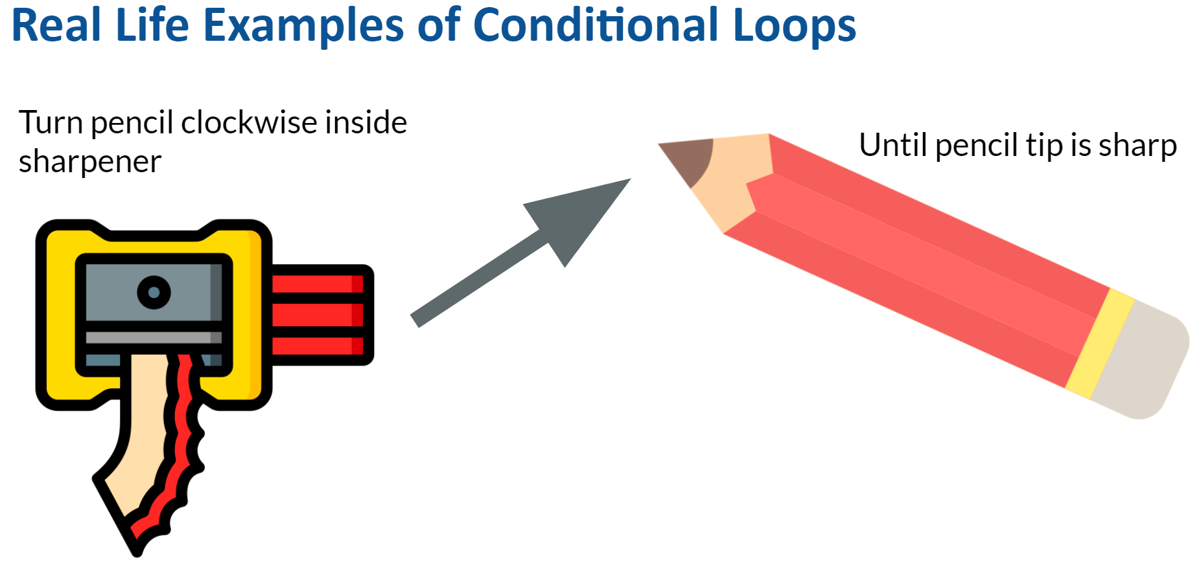
2:33 min
Link to Explanation Slides

Slide 7
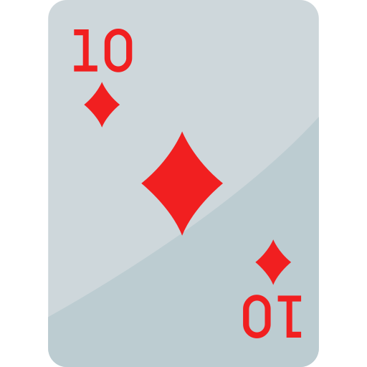

Real Life Examples of Conditional Loops
Playing a Game of SNAP
Take turns to flip cards
Until there is a match

Slide 8
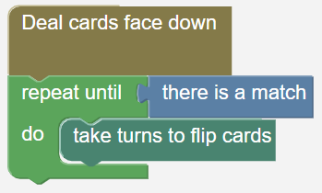


Real Life Examples of Conditional Loops
Playing a Game of SNAP

Slide 9
Real Life Examples of Conditional Loops
Playing a Game of SNAP
Why might this not work in this algorithm?

Slide 10

06.01 Worksheet: Playing a Game of SNAP
Complete the worksheet provided.

Slide 11
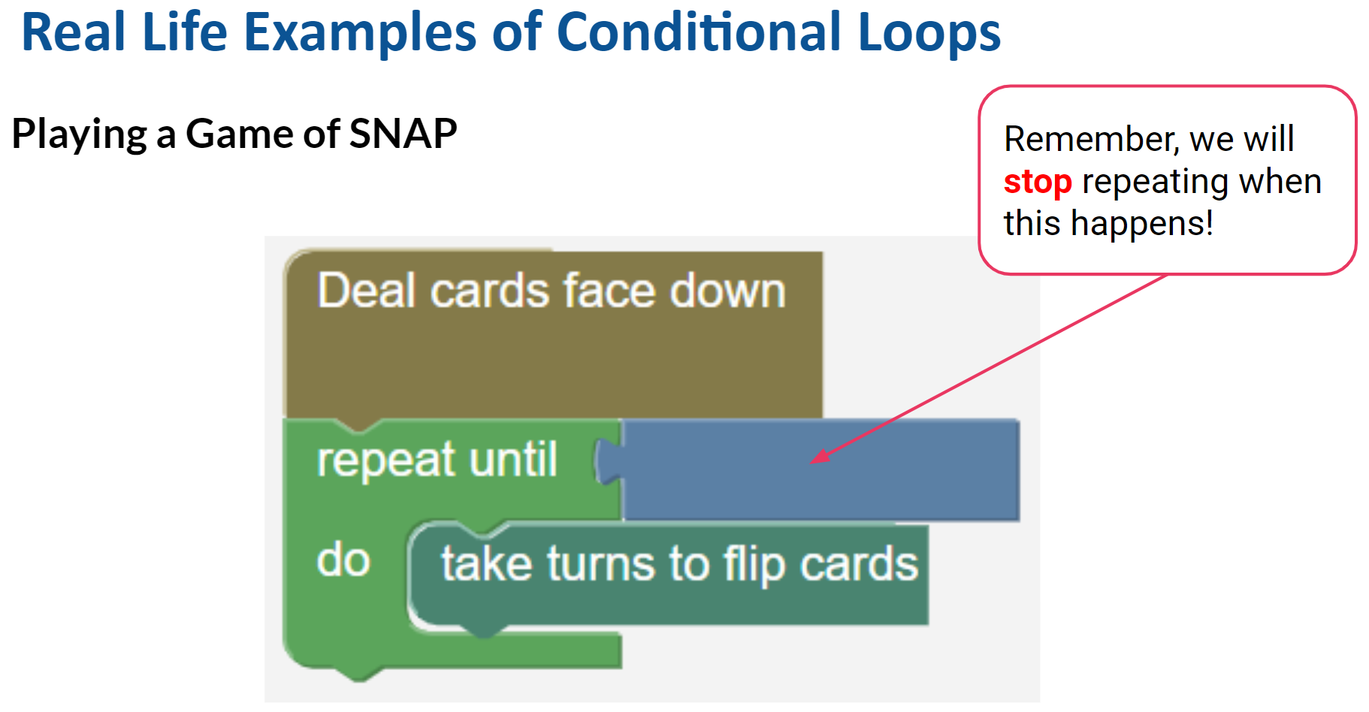
1:07 min
Link to Explanation Slides

Slide 12
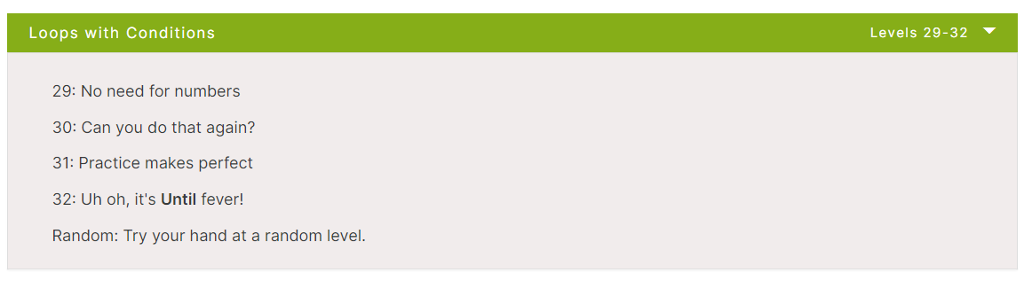
Rapid Router Time!
Have a try at Level 29
Don’t worry if you can’t get it to work, we’ll show you the answer soon!

Slide 13
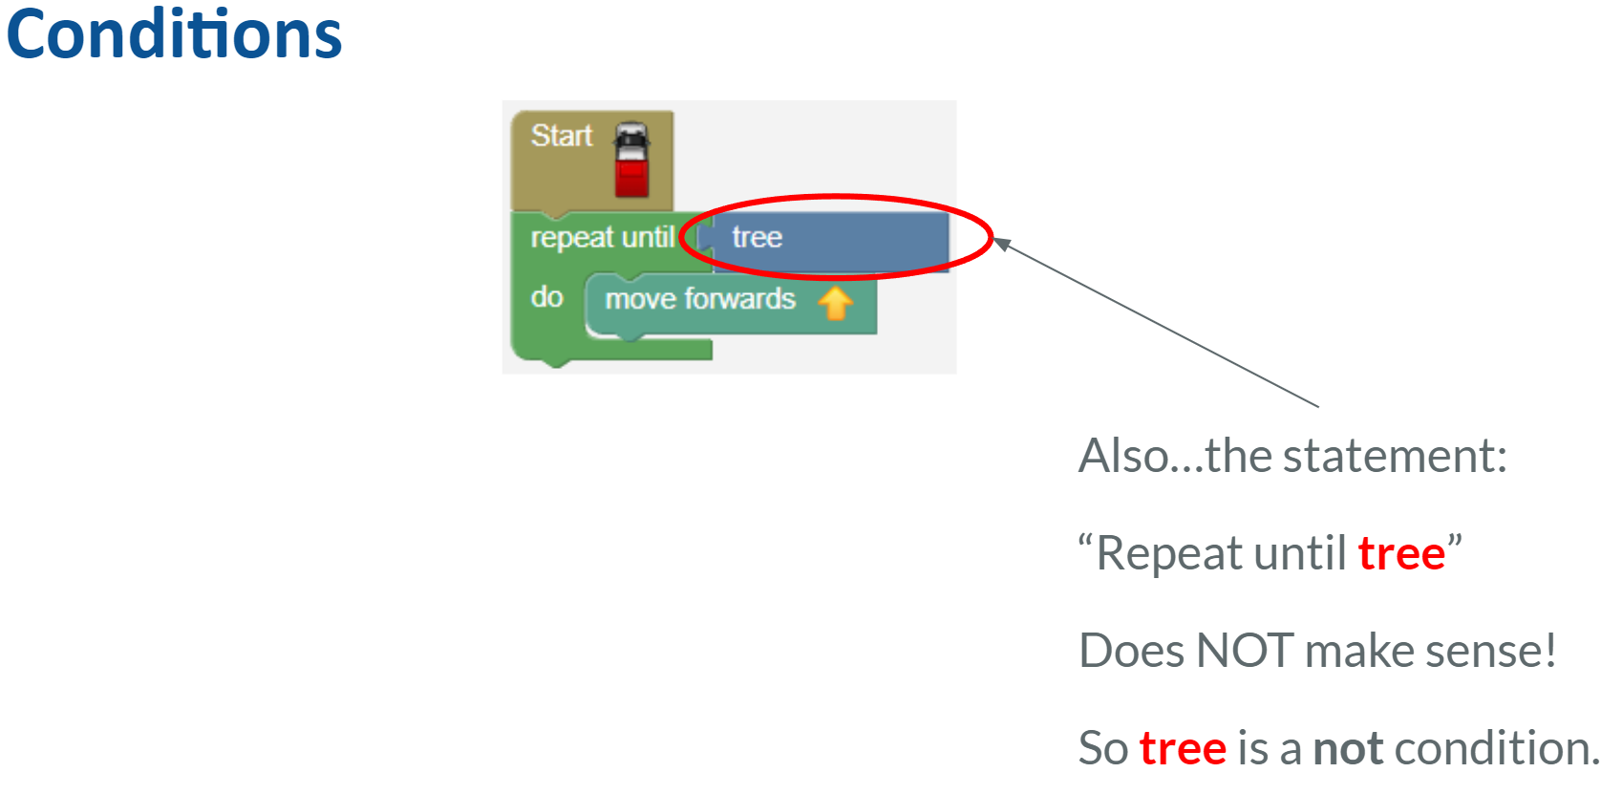
1:45 min
Link to Explanation Slides

Slide 14
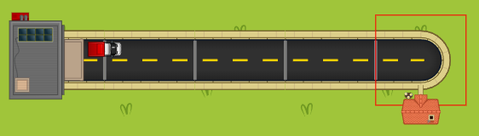
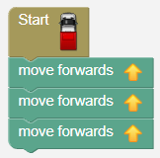
You’ve now seen 3 different ways to solve this map…
Level 1

Slide 15
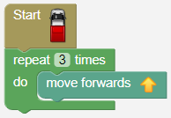
You’ve now seen 3 different ways to solve this map…
Level 1
Level 19

Slide 16
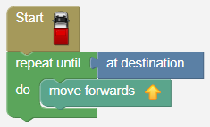
You’ve now seen 3 different ways to solve this map…
Level 1
Level 19
Level 29

Slide 17
Which algorithm do you like more? Explain the reason why.
Level 1
Level 19
Level 29

Slide 18

06.02 Worksheet: What is a Condition?
Complete the worksheet provided.
Yes or No?

Slide 19
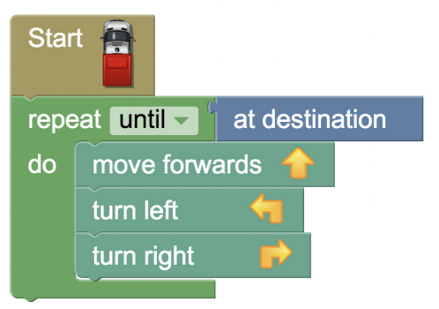

06.03 Worksheet: Drawing a Route
Complete the worksheet provided.

Slide 20
Rapid Router Time!
Now complete levels 30 - 32!

Slide 21


Slide 22

Coding Learning Journal
Write today’s date.
Write the heading: Conditional Repeats
Use all or some of the following prompts to show your learning today.
I think loops which uses conditions are useful when …..
It was challenging when……..
I got better at ………..
Notes:
Instructions for learning journal

