Slide 1


Lesson 5
Nesting Repeat Loops
csinschools.com
Notes:
Teachers please note: the first two slides have a grey background and are for your reading prior to the lesson.

Slide 2
Lesson Outline and Suggested Timings
Lesson 5 Nested Loops | Time Required | Notes/Details | Resources
Review | 5 minutes | Think, pair, share. Multiple repeat loops | Lesson 5 slides interactive whiteboard
Introduction to nested loops | 10 minutes | Students execute a dance routine - link in slides At the conclusion of the activity they are prompted to consider the repeat loops in the instructions and how the instructions can be simplified. | Lesson 5 slides projector or interactive whiteboard space for students to dance on the spot
Coloured beads activity | 10 minutes | Students practise identifying repeat loops and writing shorter code. Check answers; supplied in slides | Lesson 5 projector or interactive whiteboard student worksheet- coloured beads student devices
Coding Practice | 10 minutes | Students continue to explore Ocado- Code for Life Levels 26 & 27 | Lesson 5 student devices
Comparing and contrasting algorithms | 10 minutes | Teacher to facilitate a class discussion analysing 3 different types of algorithms. Prompt students to describe their positive and negative attributes. | Lesson 5 projector or interactive whiteboard printed copy of slide 25 student devices
Reflection | 10 minutes | Students reflect on the learning intention and success criteria by responding to journal prompts. This is also an opportunity for the teacher to gauge student progress. | Lesson 5 student devices or workbook

Slide 3



Slide 4

Learning Intention:
We are learning to understand and use repeat within repeat loops otherwise known as nested loops.
Success Criteria
I can identify nested loops in real life
I can create an algorithm that contains a nested loop
I can explain how a nested loop makes the code shorter.

Slide 5
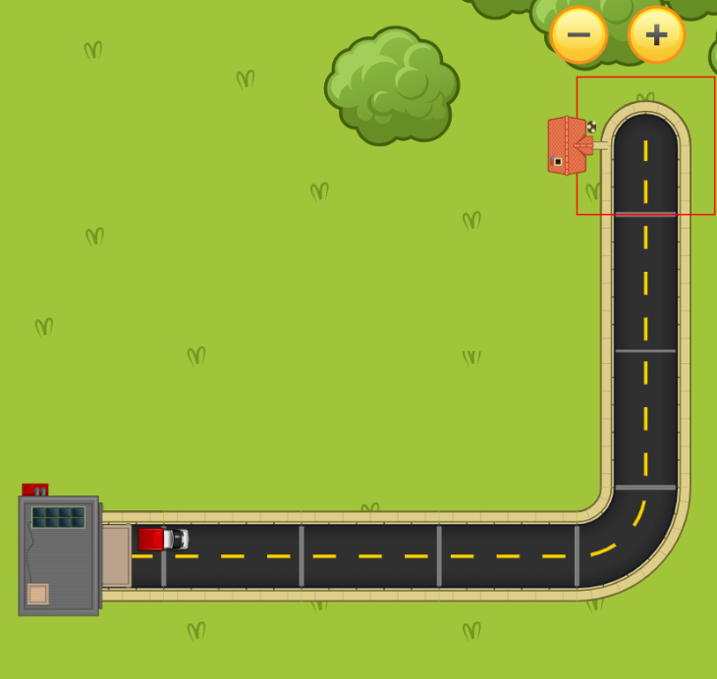
Review: Multiple repeat loops
How many repeat loops can you see in this map?

Slide 6
Review: Multiple repeat loops
Discuss your findings with a partner.

Slide 7

Review: Multiple repeat loops
Here is the first repeat loop.

Slide 8
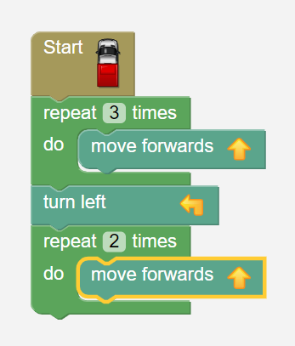
Review: Multiple repeat loops

Slide 9
Review: Multiple repeat Loops
Here is the second repeat loop.

Slide 10
Review: Multiple Repeat Loops

Slide 11
Review: Did you find the two repeat loops?

Slide 12

Let’s Dance!

Slide 13



The Dance Routine…
Here is the complete dance routine!

Slide 14
The Dance Routine…
By using the repeat function, how much shorter can you describe the routine?

Slide 15
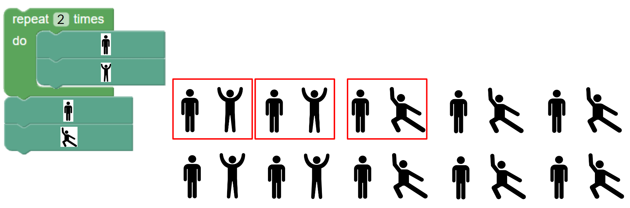
2:36 min
Link to Explanation Slides

Slide 16

05.01 Worksheet: Nested Loops in Beads
Complete the worksheet provided.

Slide 17
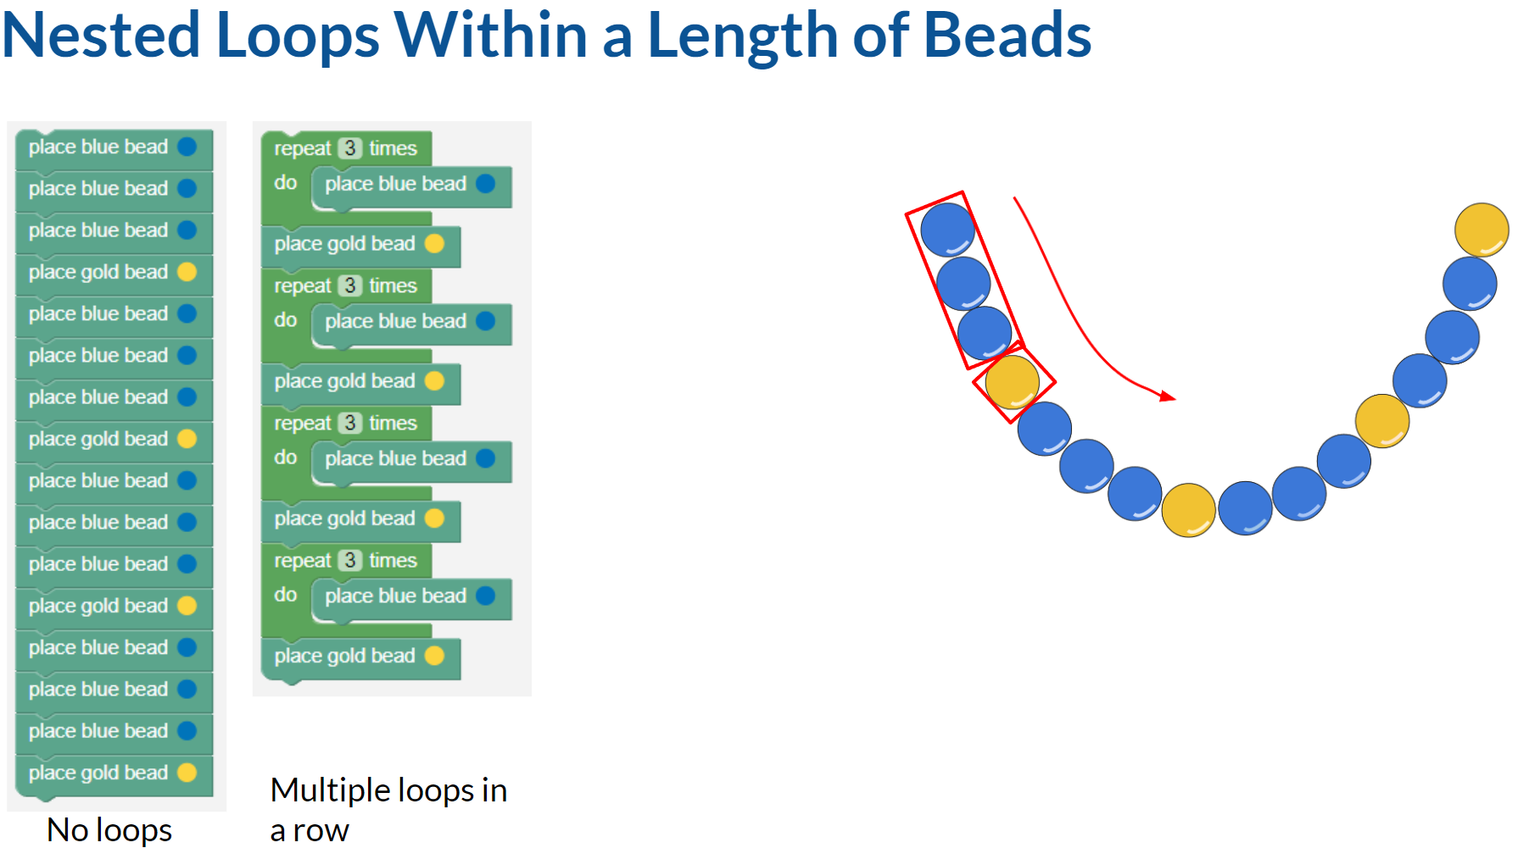
2:11 min
Link to Explanation Slides

Slide 18
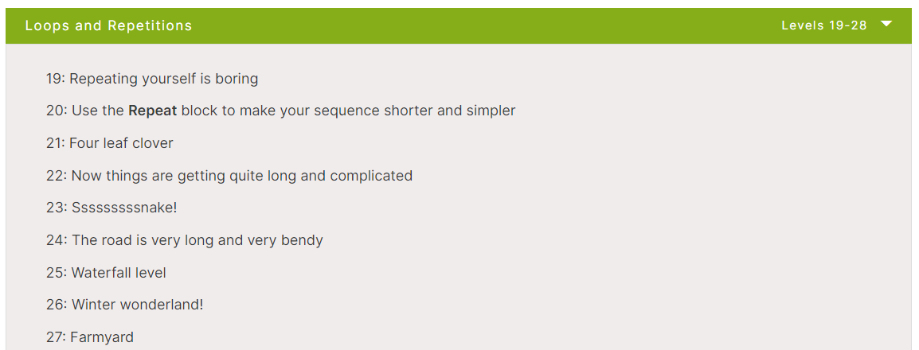
Rapid Router Time!
Now complete levels 26 - 27!

Slide 19
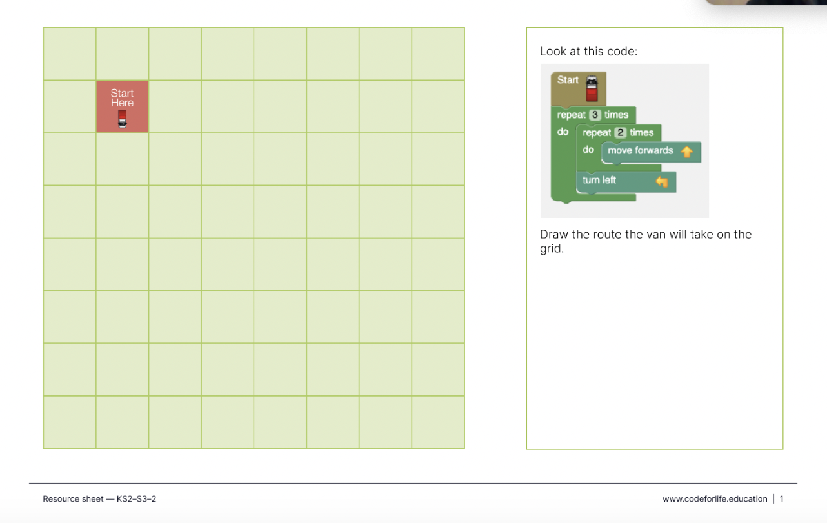
Rapid Router Time!
Now complete levels 26 - 27!
Extension Activity PDF

Slide 20
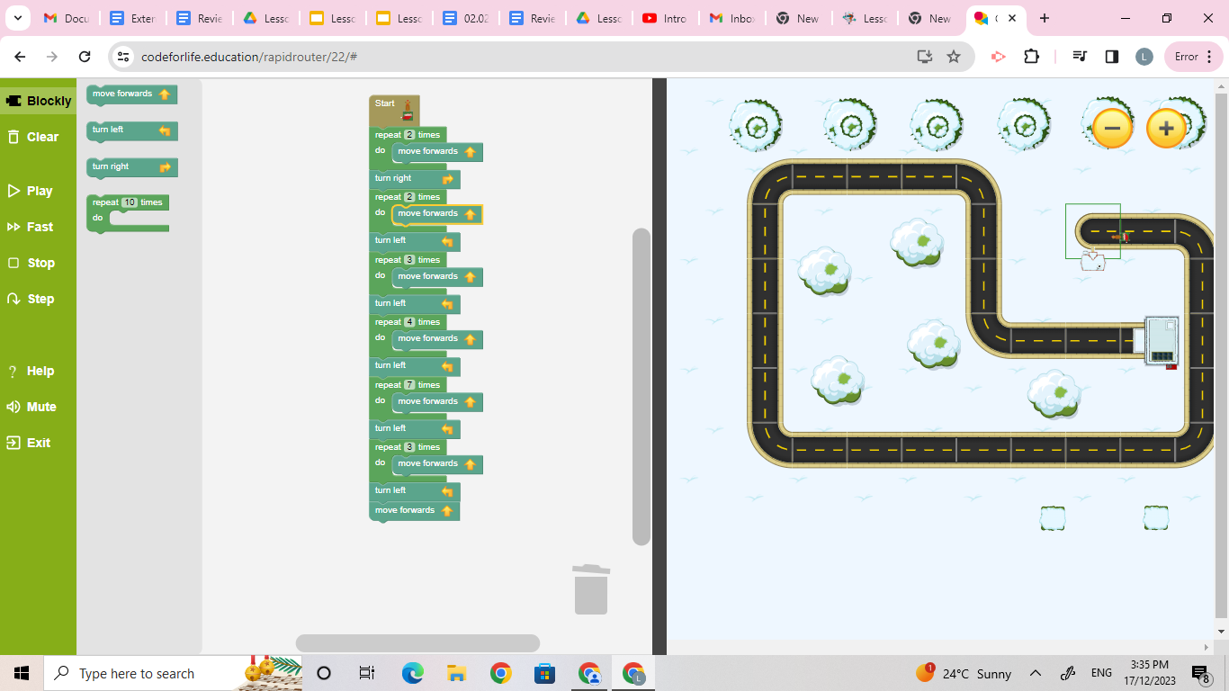
Review: Did you find the repeat loops?

Slide 21
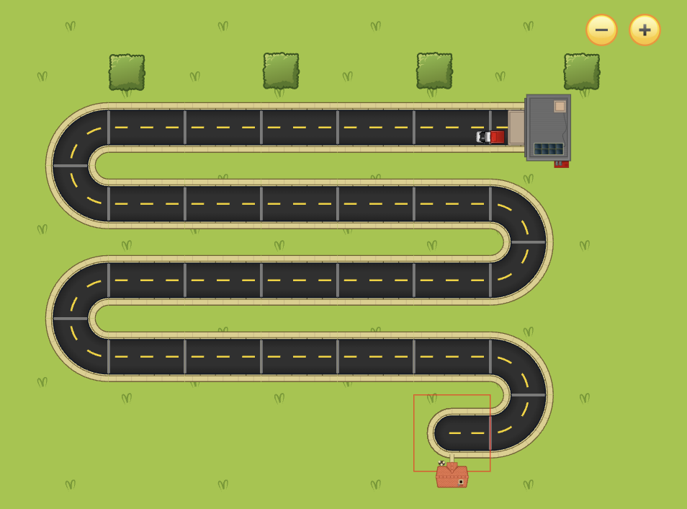
While playing Rapid Router (Level 23), how did you code the algorithm for the van?

Slide 22
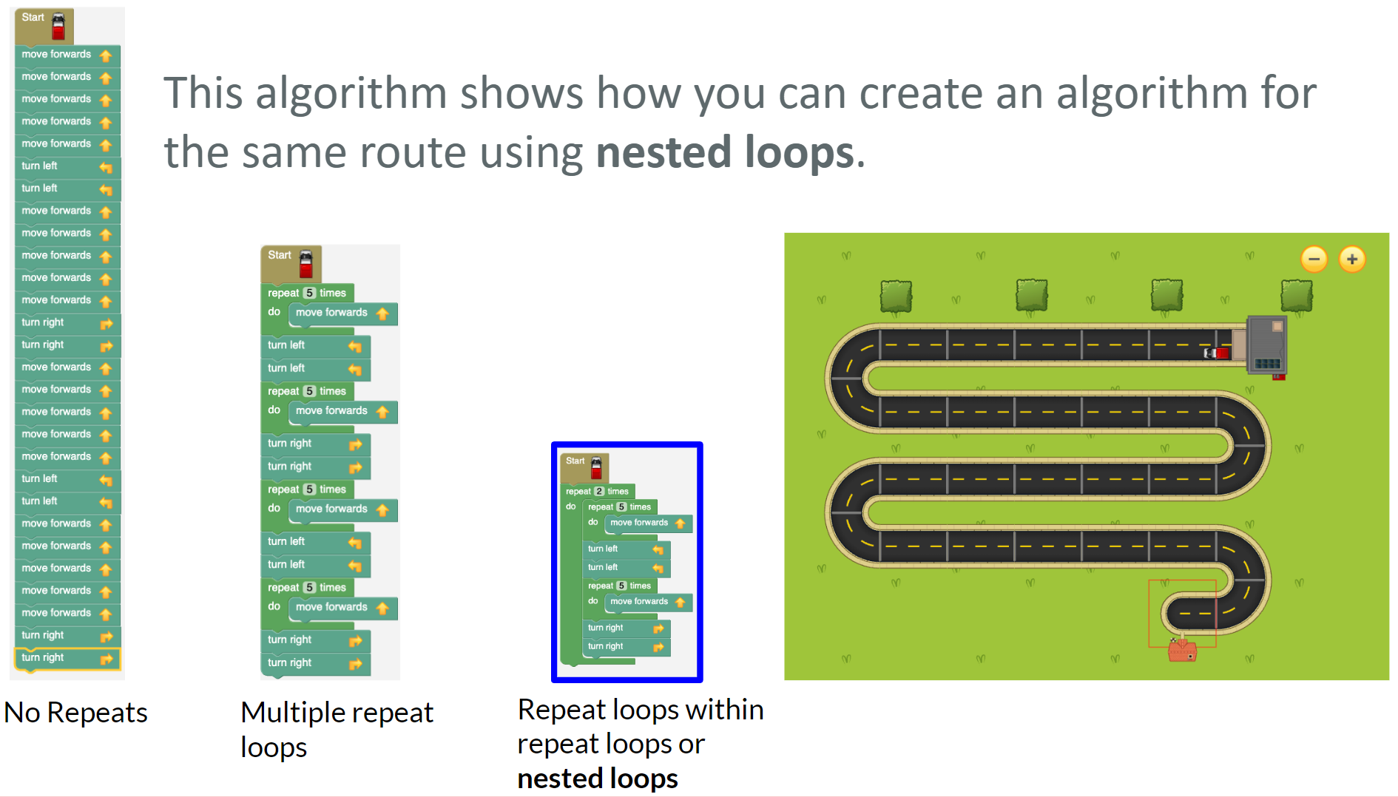
1:37 min
Link to Explanation Slides

Slide 23
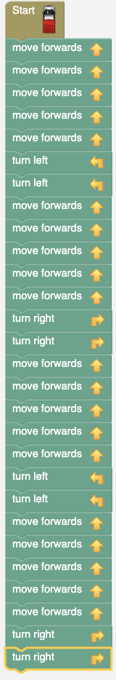
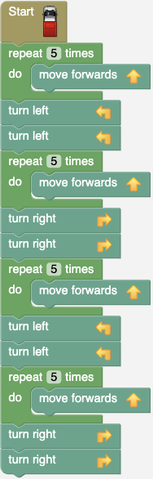
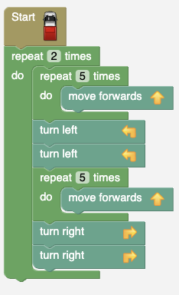
Which algorithm do you like more? Explain why.
No loops
Multiple loops
Nested loops

Slide 24
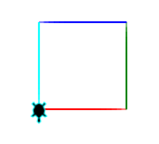
Extension Topic: Turtle Graphics
Extension Topic
1:33 min
Learn how to change the pen colour!

Slide 25

Extension Topic: Turtle Graphics
Extension Topic
2:21 min
Learn how to
colour in shapes.

Slide 26
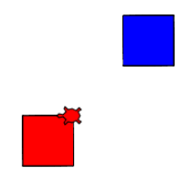
Extension Topic: Turtle Graphics
Extension Topic
3:24 min
Learn how to move the turtle …
… without leaving a trail

Slide 27


Extension Topic: Turtle Worksheet Activity
Extension Topic
Complete Worksheet Questions

Slide 28


Slide 29

Coding Learning Journal
Write today’s date.
Write the heading: Nested loops
Use one or both of the following prompts to show your learning today.
This is what I know about nested loops….
Nested loops are an efficient way to code because….
Notes:
Instructions for learning journal

