Slide 1


Lesson 4
Multiple Repeats
csinschools.com
Notes:
Teachers please note: the first two slides have a grey background and are for your reading prior to the lesson.

Slide 2
Lesson Outline and Suggested Timings
Lesson 4 Multiple repeats | Time Required | Notes/Details | Resources
Review | 5 minutes | Think, pair, share. Using the repeat block | Lesson 4 slides projector or interactive whiteboard
Introduction to multiple repeat loops | 10 minutes | Desk drumming activity | Lesson 4 slides projector or interactive whiteboard Students should be seated where they can pound their fists on a hard surface (desks are fine)
Finding repeat loops PLEASE NOTE: This activity clearly demonstrates students’ understanding of the the repeat code. It is a valuable tool for formative assessment. | 10 minutes | Students identify multiple repeating patterns in a bead string. | Lesson 4 slides projector or interactive whiteboard student workbooks or blank paper
Coding Practice | 25 minutes | Students continue to explore Ocado- Code for Life Levels 6-18 | student devices
Reflection | 10 minutes | Students reflect on the learning intention and success criteria by responding to journal prompts. | Lesson 4 slides student devices or workbook

Slide 3



Slide 4
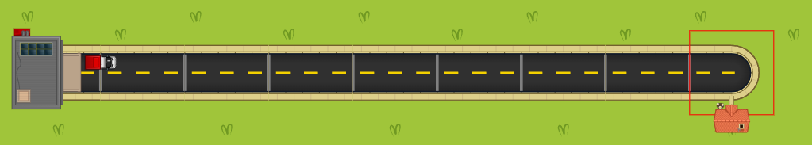


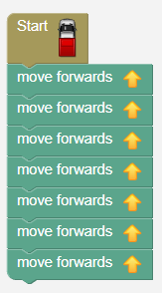
Review: Using the REPEAT Block
Brian has written this code to solve this map:
Ariel says she has found a better way!
Discuss with your partner what you think would be a better algorithm to solve this map.

Slide 5
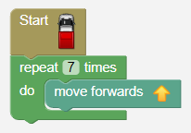
Review: Using the REPEAT Block
Brian has written this code to solve this map:
Ariel says she has found a better way!

Slide 6
Review: Using the REPEAT Block
Brian has written this code to solve this map:
Ariel says she has found a better way!
Why is this “better”?

Slide 7

Learning Intention:
We are learning to understand and use multiple repeat loops also known as sequential repeat loops.
Success Criteria
• I can understand and use simple repetition
• I can use the repeat instruction several times in a program

Slide 8
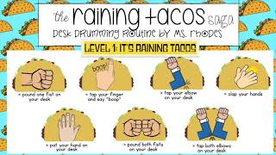
Using the multiple REPEAT loops
Watch the following video.
You may complete the desk drumming activity as you watch.

Slide 9

Using the multiple REPEAT loops
Turn to the person sitting next to you and discuss what you noticed about the actions in the video.

Slide 10

Using the multiple REPEAT loops
Did you notice the pattern?

Slide 11
Using the multiple REPEAT loops
Did you notice the pattern?
How can this pattern be written in another way?

Slide 12
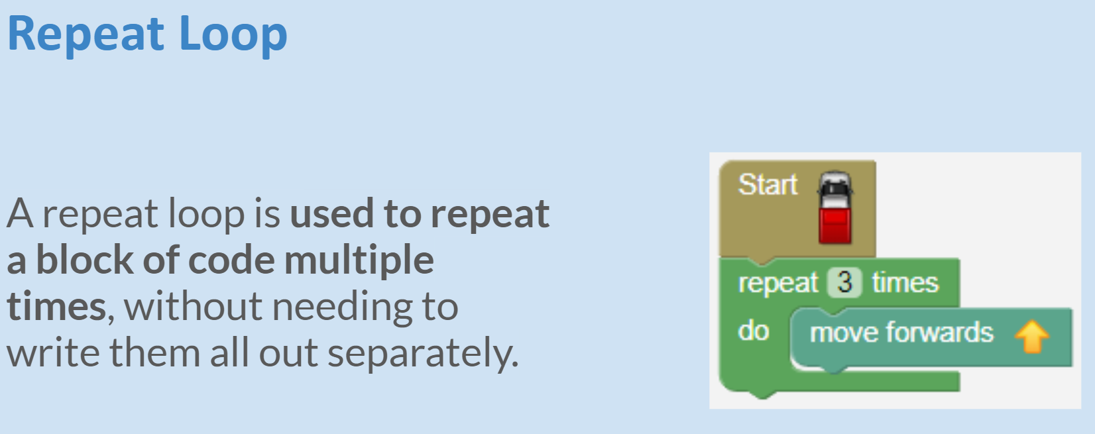
1:05 min
Link to Explanation Slides

Slide 13
Multiple repeats within a length of beads
This is a further example of multiple repeat loops.

Slide 14
Multiple repeats within a length of beads
Can you see the repeating patterns?

Slide 15

Multiple repeats within a length of beads
Working with a partner,
write an algorithm
for someone to recreate this exact pattern on a bead string.
Remember to use the “repeat” function!

Slide 16
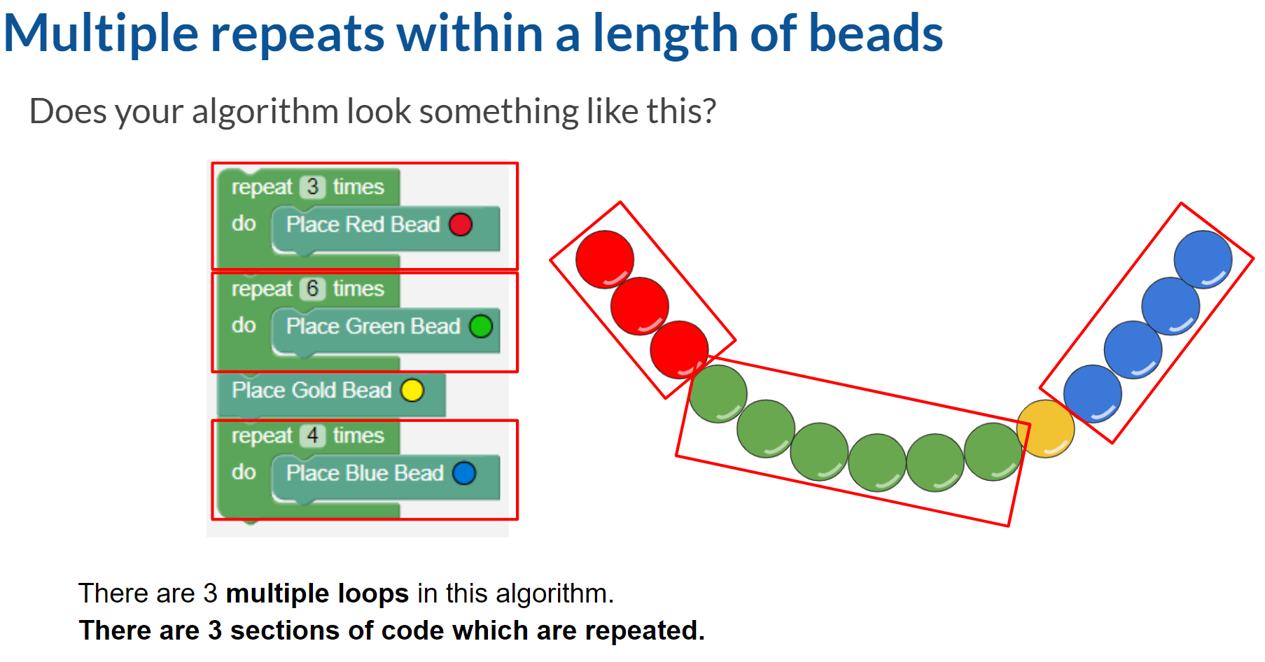
0:32 min
Link to Explanation Slides

Slide 17
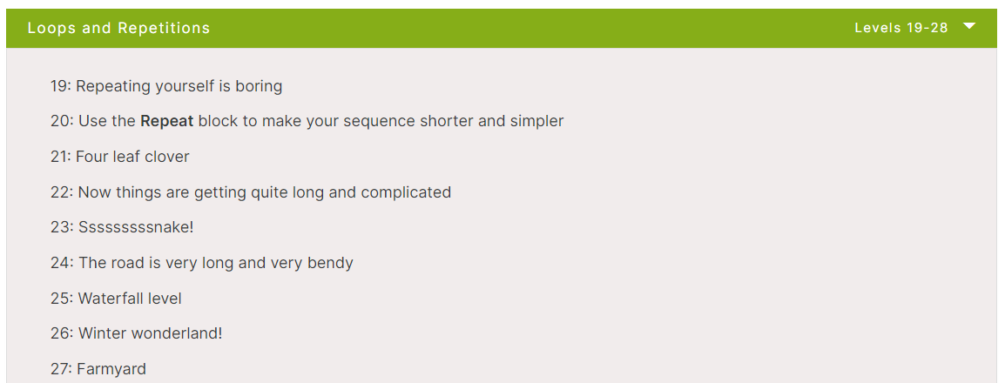
Rapid Router Time!
Have a go at Level 22!
Click here to play the levels

Slide 18
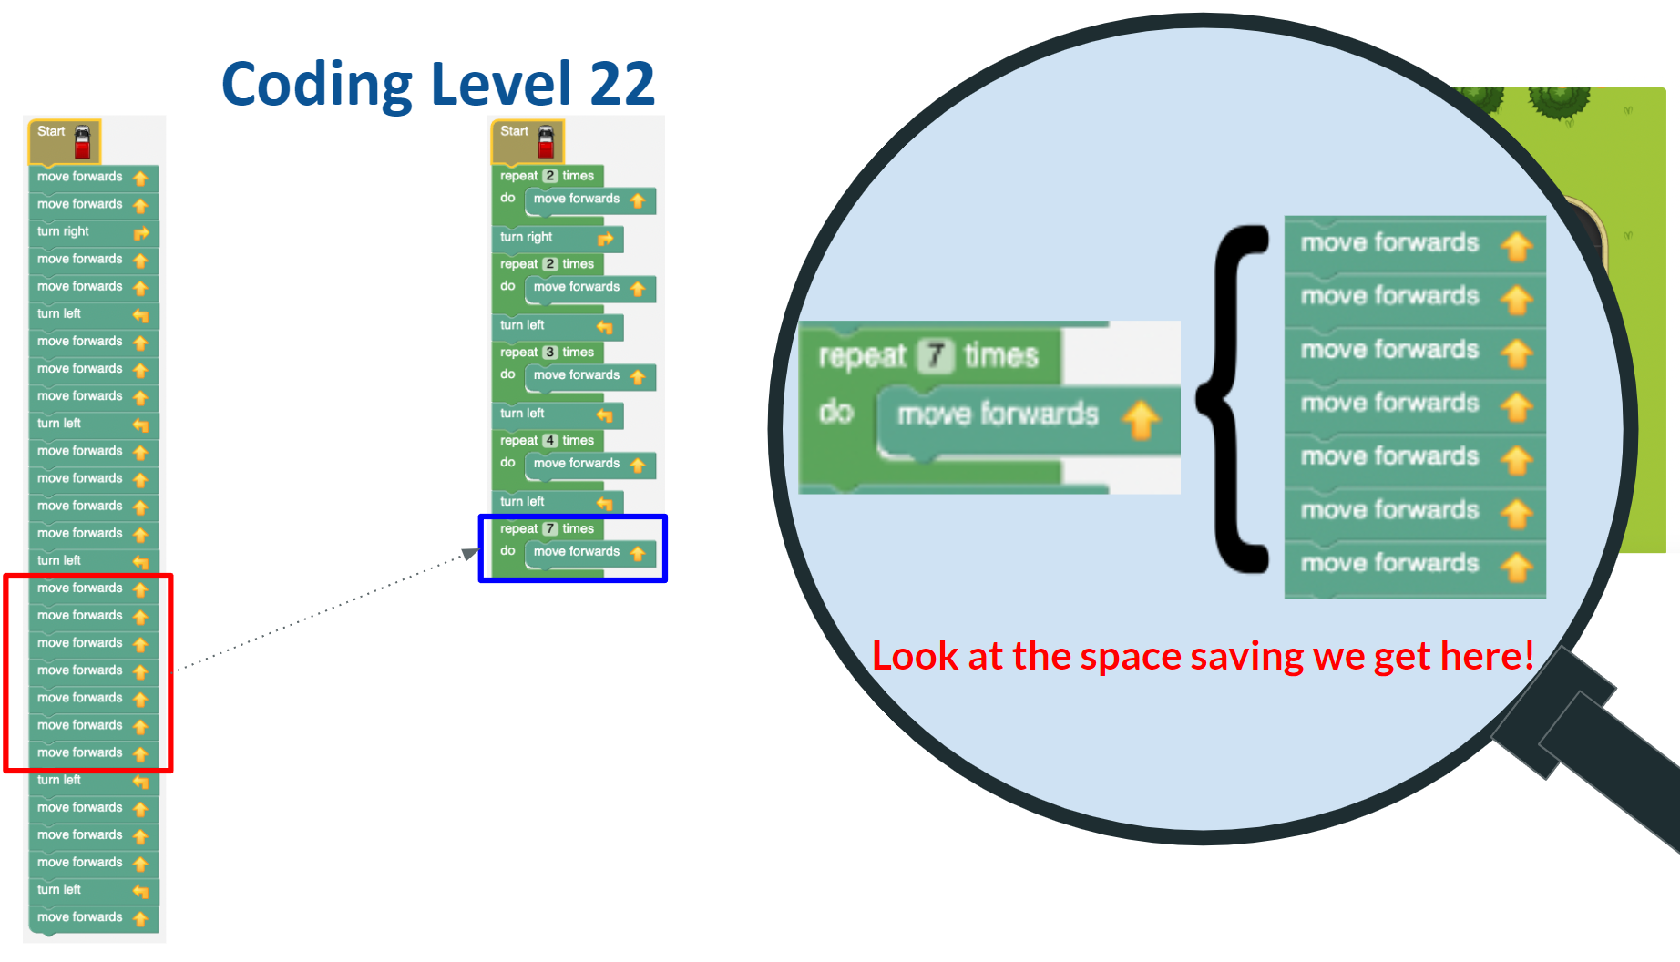
1:56 min
Link to Accompanying Slides

Slide 19
Rapid Router Time!
Now complete levels 23 - 25!
Click here to play the levels

Slide 20
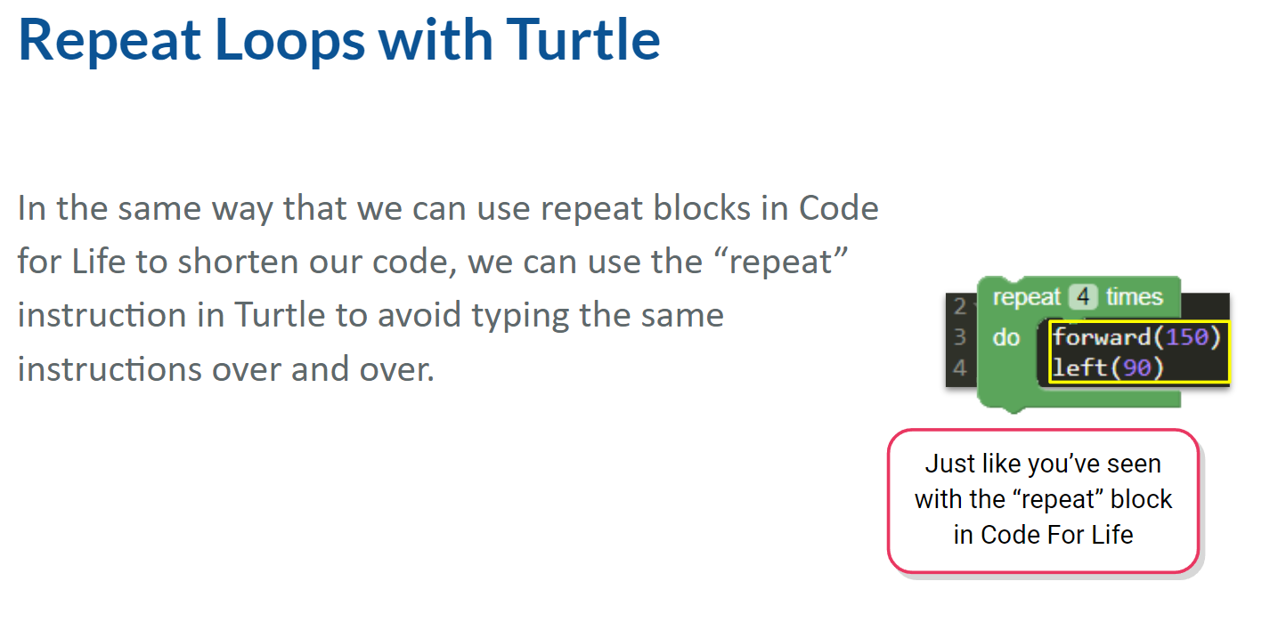
Extension Topic: Turtle Graphics
Extension Topic
2:13 min
Link to Accompanying Slides

Slide 21


Extension Topic: Turtle Worksheet Activity
Extension Topic
Complete Worksheet Questions

Slide 22
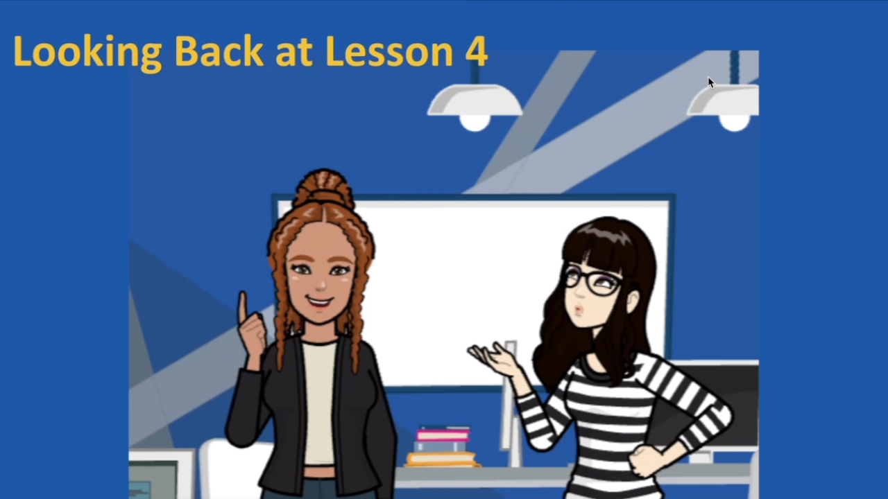

Slide 23

Coding Learning Journal
Write today’s date.
Write the heading: Multiple Repeat Blocks
Provide an example demonstrating how multiple repeat loops work.
(You may like to use an exercise sequence, a bead string, an example from Rapid Router or any other example that you can think of)
Notes:
Instructions for learning journal

