Slide 1


Lesson 3
Loops and Repetitions
csinschools.com
Notes:
https://www.inspiritscholars.com/blog/what-is-an-algorithm-for-kids/

Slide 2
Lesson Outline and Suggested Timings
Lesson 3 Loops and repetition | Time Required | Notes/Details | Resources
Review | 5 minutes | Think, pair, share. What I know about the sequence and accuracy of an algorithm | Lesson 3 slides projector or interactive whiteboard
Introduction to repeat | 10 minutes | Students think of real life applications of repetition | Lesson 3 slides projector or interactive whiteboard
Song lyric activity- find repetition | 15 minutes | Students complete worksheet looking for repetition in song and create shorter algorithm. | Lesson 3 slides projector or interactive whiteboard ‘I’m walking On Sunshine’ lyrics worksheet
Coding Practice | 20 minutes | Students continue to explore Ocado- Code for Life Levels 19-21 | student devices
Reflection | 10 minutes | Students reflect on the learning intention and success criteria by responding to journal prompts. | Lesson 3 slides student devices or workbook

Slide 3
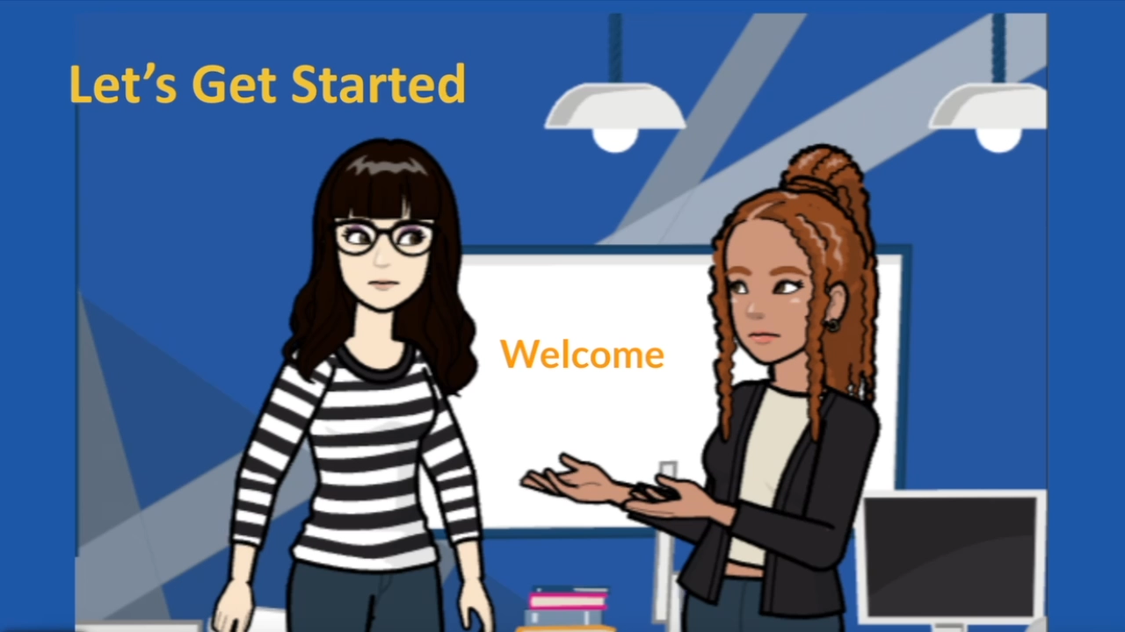


Slide 4

Learning Intention:
We are learning to understand and use simple repetition.
Success Criteria
• I can identify repetition in real life
• I can follow an algorithm using repetition
• I can create an algorithm using repetition

Slide 5

Review: Sequence and Accuracy
Turn to the person sitting next to you and give sequenced and accurate instructions for one of the following:
Making your bed.
Making breakfast
Kicking a ball
Playing a game

Slide 6

Understanding the REPEAT operation in an algorithm
Turn and talk with a partner.
Can you think of any instances in real life where actions are repeated?
Notes:
Possible answers might include: Sifting flour when making a cake, exercise reps, dance moves, multiplication in maths

Slide 7

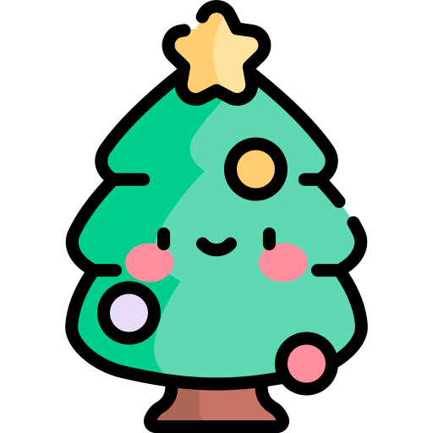

Understanding the REPEAT operation in an algorithm
Watch the each of the 3 videos below and discuss:
What is happening in each video?
What are the actions being repeated?
When do the repeated actions stop?

Slide 8
Understanding the REPEAT operation in an algorithm
Did you see…

Slide 9
Understanding the REPEAT operation in an algorithm
Did you see…
A ball bouncing

Slide 10
Understanding the REPEAT operation in an algorithm
Did you see…
A ball bouncing
Hair being combed

Slide 11
Understanding the REPEAT operation in an algorithm
Did you see…
A ball bouncing
Hair being combed
Lights blinking on and off

Slide 12

Understanding the REPEAT operation in an algorithm
Baby Shark
What do you notice about the lyrics in the song?
What do you notice about the actions in the dance?
Notes:
Prompt students to notice the repetitive nature of the song and actions.

Slide 13
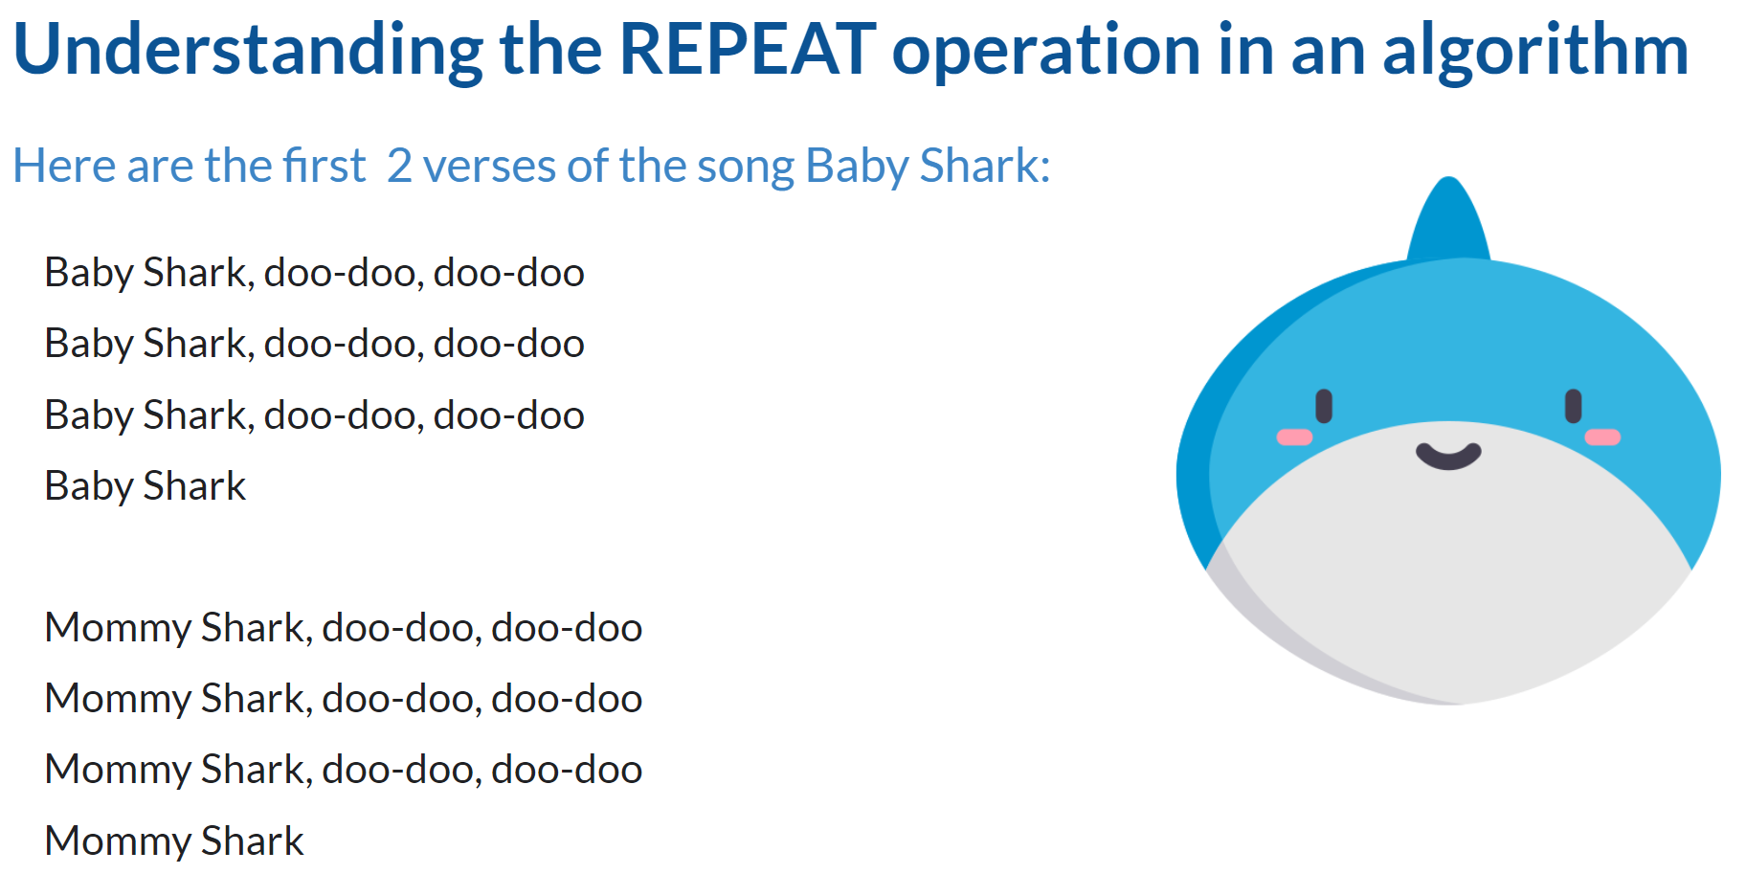
1:17 min
Link to Explanation Slides

Slide 14
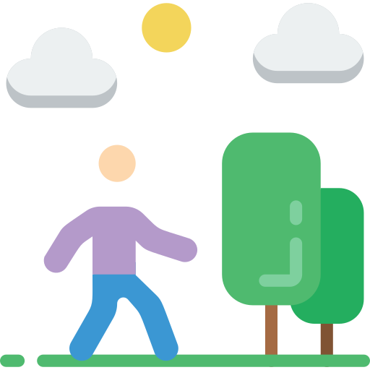
Understanding the REPEAT operation in an algorithm
Listen to the first 2 verses of the song ‘I’m walking on Sunshine’ by Katrina and the Waves.

Slide 15

Understanding the REPEAT operation in an algorithm
Can you rewrite the words to the first two verses of this song using a shorter algorithm?
Mark your changes on the worksheet provided.

Slide 16
Understanding the REPEAT operation in an algorithm
Did you notice which phrases were being repeated?
Oh!
Ohhhh, yeeeh
I used to think maybe you loved me now baby I'm sure
And I just can't wait till the day when you knock on my door
Now everytime I go for the mailbox, gotta hold myself down
'Cause I just can't wait till you write me you're coming around
I'm walking on sunshine, woooah
I'm walking on sunshine, woooah
I'm walking on sunshine, woooah
And don't it feel good!
Hey, alright now
And don't it feel good!
Hey yeah
I used to think maybe you loved me, now I know that it's true
And I don't want to spend my whole life, just waiting for you
Now I don't want you back for the weekend
Not back for a day, no no no
I said baby I just want you back and I want you to stay
Woah yeah!
I'm walking on sunshine, woooah
I'm walking on sunshine, woooah
I'm walking on sunshine, woooah
And don't it feel good!

Slide 17
Understanding the REPEAT operation in an algorithm
Did you notice which phrases were being repeated?
Oh!
Ohhhh, yeeeh
I used to think maybe you loved me now baby I'm sure
And I just can't wait till the day when you knock on my door
Now everytime I go for the mailbox, gotta hold myself down
'Cause I just can't wait till you write me you're coming around
I'm walking on sunshine, woooah
I'm walking on sunshine, woooah
I'm walking on sunshine, woooah
And don't it feel good!
Hey, alright now
And don't it feel good!
Hey yeah
I used to think maybe you loved me, now I know that it's true
And I don't want to spend my whole life, just waiting for you
Now I don't want you back for the weekend
Not back for a day, no no no
I said baby I just want you back and I want you to stay
Woah yeah!
I'm walking on sunshine, woooah
I'm walking on sunshine, woooah
I'm walking on sunshine, woooah
And don't it feel good!

Slide 18
Understanding the REPEAT operation in an algorithm
Did you write “REPEAT 3 TIMES” where the phrase was repeated?
Oh!
Ohhhh, yeeeh
I used to think maybe you loved me now baby I'm sure
And I just can't wait till the day when you knock on my door
Now everytime I go for the mailbox, gotta hold myself down
'Cause I just can't wait till you write me you're coming around
I'm walking on sunshine, woooah
I'm walking on sunshine, woooah
I'm walking on sunshine, woooah
And don't it feel good!
Hey, alright now
And don't it feel good!
Hey yeah
I used to think maybe you loved me, now I know that it's true
And I don't want to spend my whole life, just waiting for you
Now I don't want you back for the weekend
Not back for a day, no no no
I said baby I just want you back and I want you to stay
Woah yeah!
I'm walking on sunshine, woooah
I'm walking on sunshine, woooah
I'm walking on sunshine, woooah
And don't it feel good!

Slide 19
Understanding the REPEAT operation in an algorithm
Did you write “REPEAT 3 TIMES” where the phrase was repeated?
Oh!
Ohhhh, yeeeh
I used to think maybe you loved me now baby I'm sure
And I just can't wait till the day when you knock on my door
Now everytime I go for the mailbox, gotta hold myself down
'Cause I just can't wait till you write me you're coming around
I'm walking on sunshine, woooah repeat 3 times
And don't it feel good!
Hey, alright now
And don't it feel good!
Hey yeah
I used to think maybe you loved me, now I know that it's true
And I don't want to spend my whole life, just waiting for you
Now I don't want you back for the weekend
Not back for a day, no no no
I said baby I just want you back and I want you to stay
Woah yeah!
I'm walking on sunshine, woooah
I'm walking on sunshine, woooah
I'm walking on sunshine, woooah
And don't it feel good!

Slide 20
Understanding the REPEAT operation in an algorithm
Did you write “REPEAT 3 TIMES” where the phrase was repeated?
Oh!
Ohhhh, yeeeh
I used to think maybe you loved me now baby I'm sure
And I just can't wait till the day when you knock on my door
Now everytime I go for the mailbox, gotta hold myself down
'Cause I just can't wait till you write me you're coming around
I'm walking on sunshine, woooah repeat 3 times
And don't it feel good!
Hey, alright now
And don't it feel good!
Hey yeah
I used to think maybe you loved me, now I know that it's true
And I don't want to spend my whole life, just waiting for you
Now I don't want you back for the weekend
Not back for a day, no no no
I said baby I just want you back and I want you to stay
Woah yeah!
I'm walking on sunshine, woooah repeat 3 times
And don't it feel good!

Slide 21
Understanding the REPEAT operation in an algorithm
Did you write “REPEAT 3 TIMES” where the phrase was repeated?
Oh!
Ohhhh, yeeeh
I used to think maybe you loved me now baby I'm sure
And I just can't wait till the day when you knock on my door
Now everytime I go for the mailbox, gotta hold myself down
'Cause I just can't wait till you write me you're coming around
I'm walking on sunshine, woooah repeat 3 times
And don't it feel good!
Hey, alright now
And don't it feel good!
Hey yeah
I used to think maybe you loved me, now I know that it's true
And I don't want to spend my whole life, just waiting for you
Now I don't want you back for the weekend
Not back for a day, no no no
I said baby I just want you back and I want you to stay
Woah yeah!
I'm walking on sunshine, woooah repeat 3 times
And don't it feel good!
Yay… this is now shorter too!

Slide 22
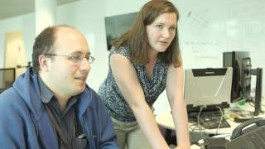
Introducing the repeat function

Slide 23
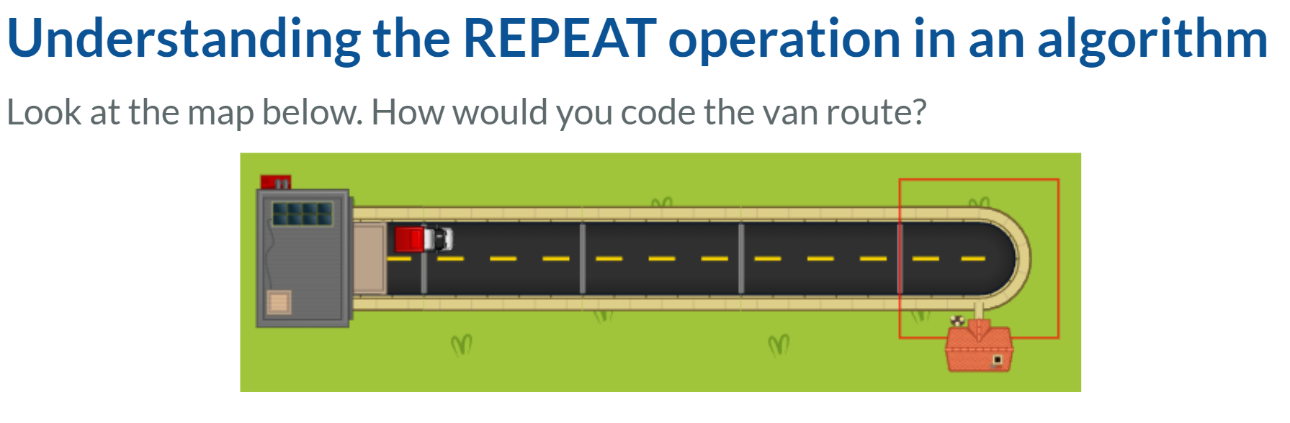
1:37 min
Link to Explanation Slides

Slide 24
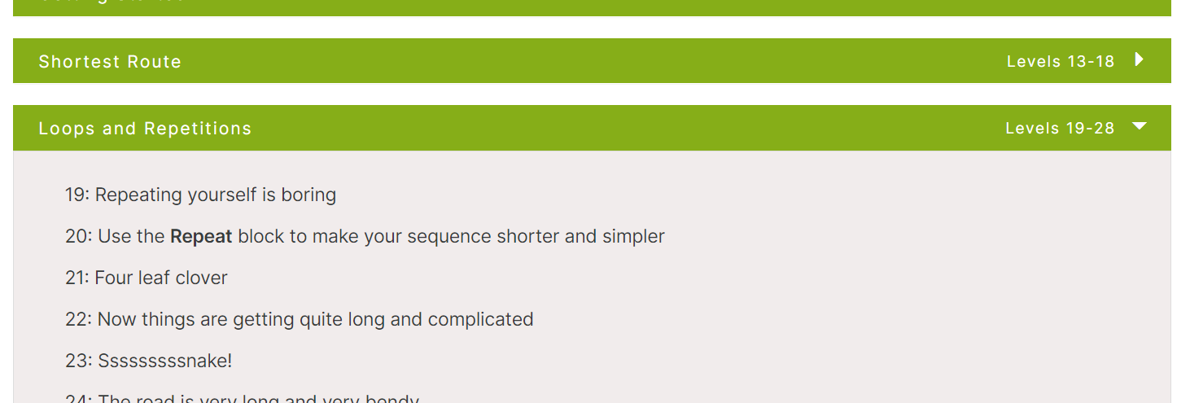
Rapid Router Time!
Now complete levels 19 - 21!
Click here to play the levels

Slide 25
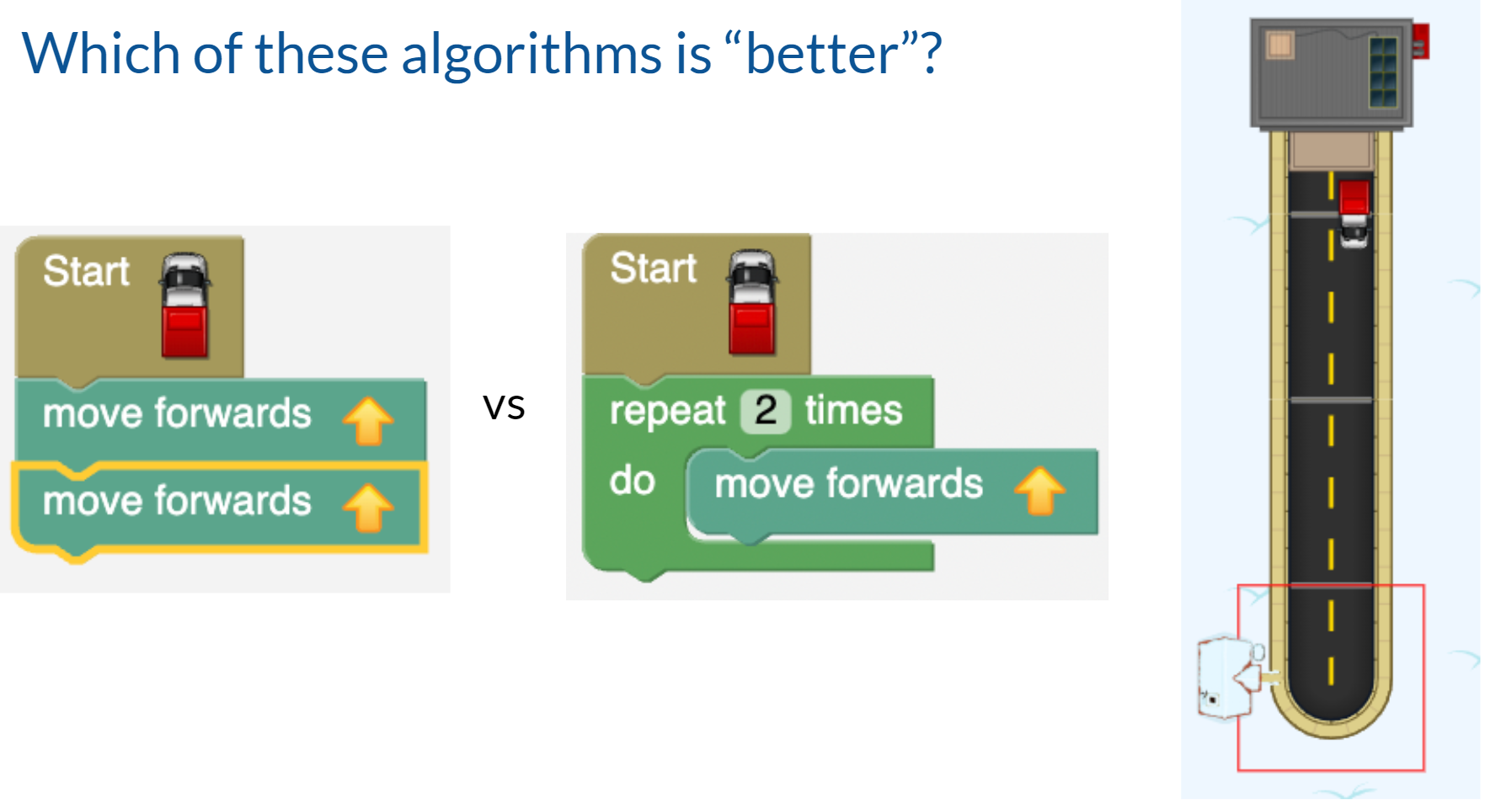
1:11 min
Link to Explanation Slides

Slide 26
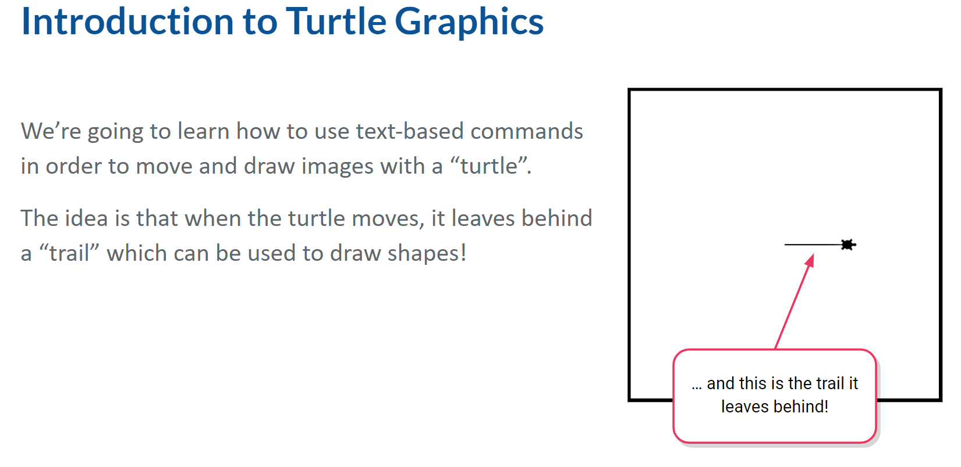
Extension Topic: Turtle Graphics
Extension Topic
1:39 min
Link to Accompanying Slides

Slide 27
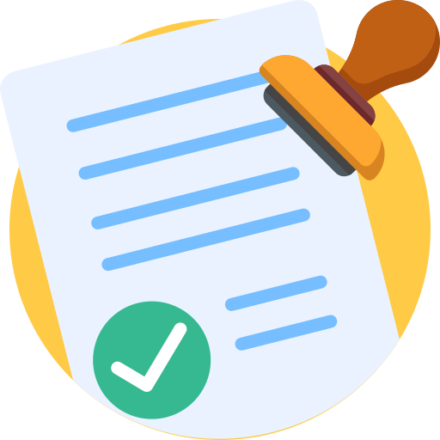
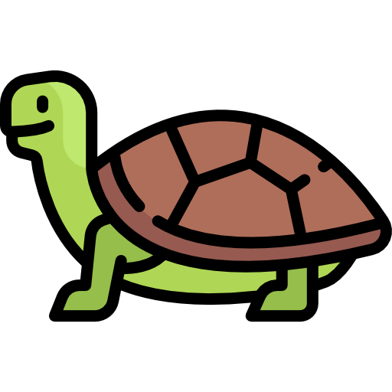
Extension Topic: Turtle Worksheet Activity
Extension Topic
Complete Worksheet Questions

Slide 28
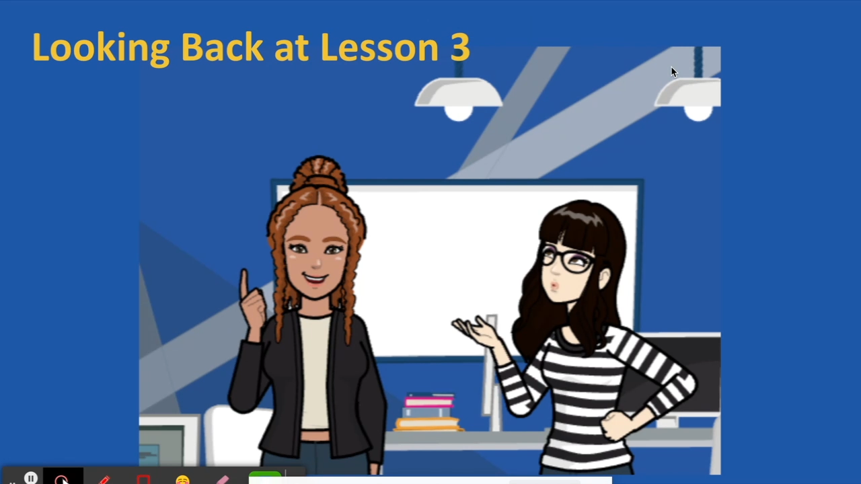

Slide 29

Coding Learning Journal
Write today’s date.
Write the heading: Repeat block
Use all or some of the following prompts to show your learning today.
It is useful to have a block for repeat because …..
It was challenging when……..
I got better at ………..
Notes:
Instructions for learning journal

