Slide 1


Lesson 2
Sequencing
csinschools.com
Notes:
https://www.inspiritscholars.com/blog/what-is-an-algorithm-for-kids/

Slide 2
Lesson Outline and Suggested Timings
Lesson 2 Sequencing and accuracy | Time Required | Notes/Details | Resources
Review | 5 minutes | Think, pair, share. What I know about algorithms | Lesson 2 slides projector or interactive whiteboard
Sequencing activity | 10 minutes | Students sequence the steps for making a cup of tea. Check answers; supplied in slides | Lesson 2 slides projector or interactive whiteboard How to Make a Cup of Tea worksheet (one each, or one between two)
Accuracy activity | 10 minutes | Teacher facilitates a discussion using slides 11-17 to focus on accuracy of instructions for ‘How to Make a Cheese Sandwich.’ . Check answers; supplied in slides | Lesson 2 slides projector or interactive whiteboard
Coding Practice | 25 minutes | Students continue to explore Ocado- Code for Life Levels 6-18 | student devices
Reflection | 10 minutes | Students reflect on the learning intention and success criteria by responding to journal prompts. This is also an opportunity for the teacher to gauge student progress. | Lesson 2 slides student devices or workbook

Slide 3



Slide 4

Learning Intention:
We are learning to sequence the instructions in an algorithm.
We are learning to create accurate algorithms
Success Criteria
• I can sequence the instructions in an algorithm.
• I can add details to instructions to create accurate algorithms.

Slide 5

Review: What is an algorithm?
Turn to the person sitting next to you and discuss what you learnt about algorithms in the previous lesson.
Can you think of 3 examples of an algorithm?

Slide 6


Sequencing: How to Make a Cup of Tea
Provide students with worksheet
How to Make a Cup of Tea
Students are asked to sequence a list of instructions.
Provide opportunities for students to compare their work with a partner.
What is the same?
What is different?
Does it matter?
Check your answers on the following slide.
Notes:
Students may work independently or in pairs. When discussing the importance of sequence be sure to iterate the point that humans can adapt to different instructions but computers can’t.

Slide 7

Sequencing: How to Make a Cup of Tea
Correct answers are given below.
Fill up the kettle with water
Boil the kettle
Place a tea bag into the mug
Pour boiling water into the mug
Brew the tea for a few moments
Remove and dispose of the teabag
Add milk and sugar to taste
Stir the tea
Enjoy the beverage
Notes:
Use this slide for students to check their own work

Slide 8
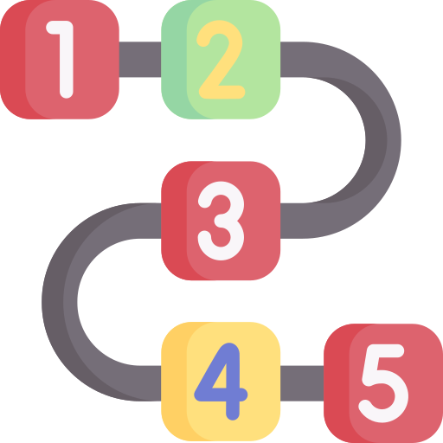
Sequence
A set of programming instructions carried out in a specific and consistent order every time.
Notes:
Revise the meaning of the word sequence and add to word wall

Slide 9
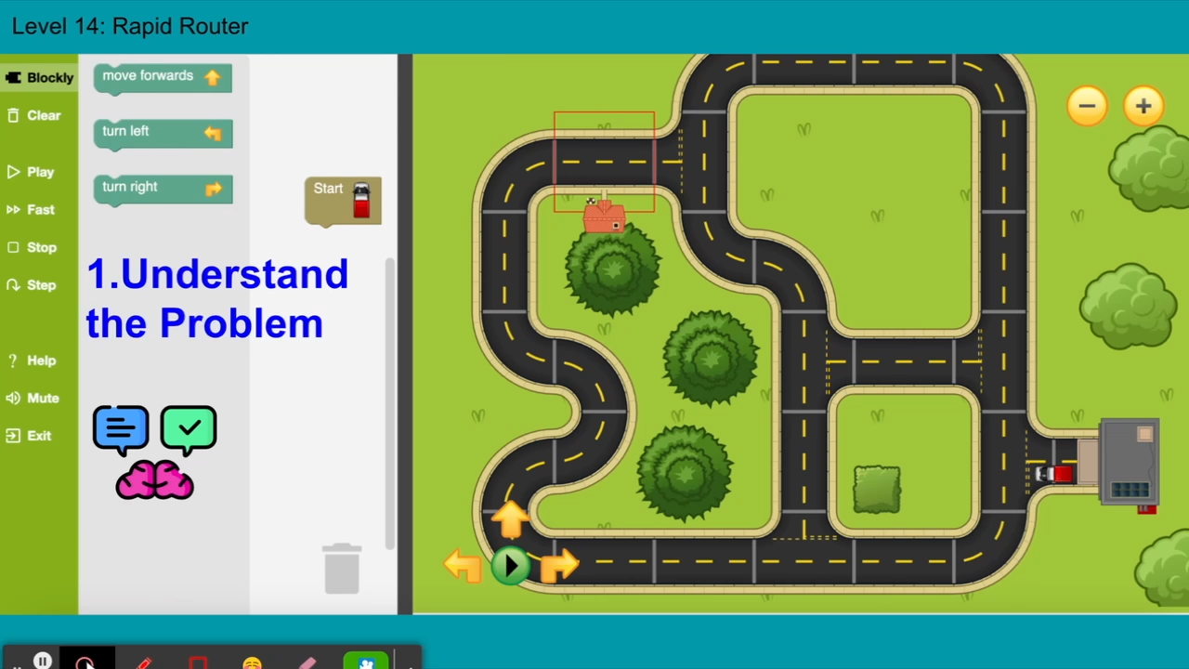

Slide 10
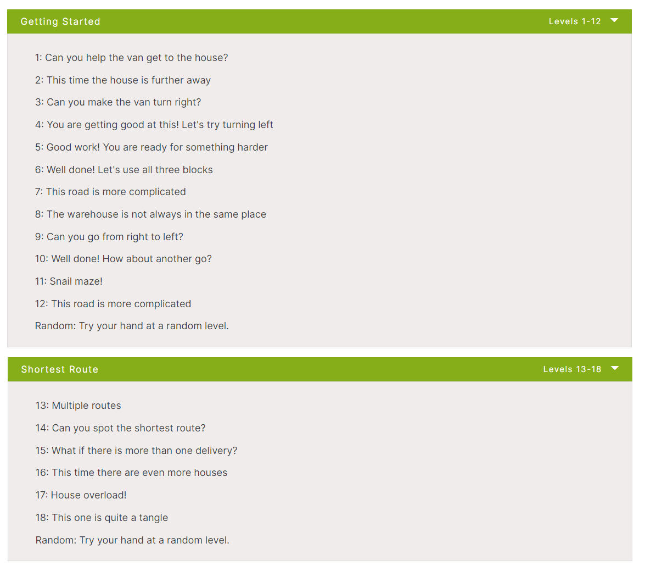
Rapid Router Time!
Click here to play the levels
Now complete levels 6 - 18!

Slide 11

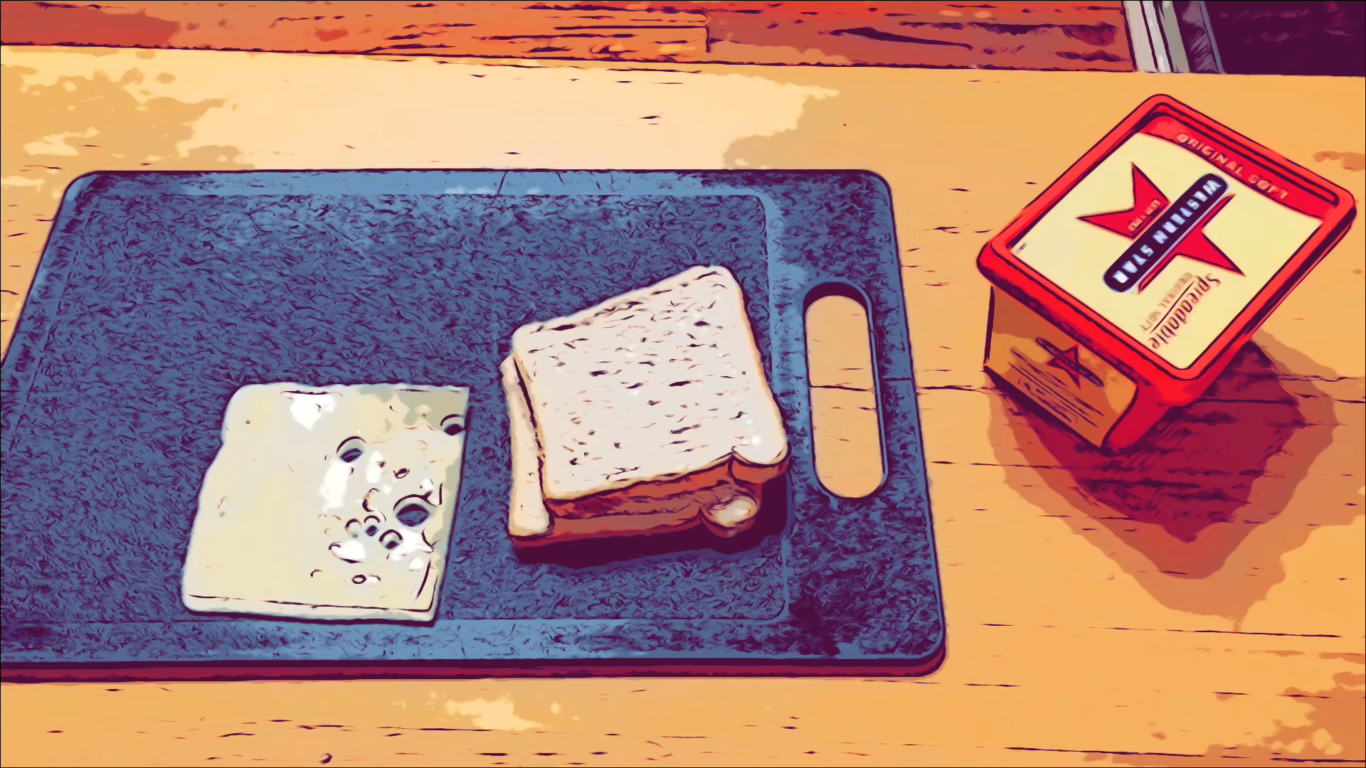
Accuracy: How to Make a Cheese Sandwich
Watch a video demonstrating how to make a cheese sandwich.
Notes:
This task will focus on the accuracy of instructions for algorithms to be successful.

Slide 12
Accuracy: How to Make a Cheese Sandwich
Here are some instructions to make a cheese sandwich.
Get some ingredients for a cheese sandwich
Put them on the bread
Use a knife
Serve on a plate and enjoy
Talk to the person sitting next to you and think of details you could add to make the instructions more accurate.
Notes:
This task will focus on the accuracy of instructions for algorithms to be successful.

Slide 13



Did you consider any of the following?
Ingredients
Quantity
Utensils
Language to describe the process
Notes:
Teacher to show students after 5 minutes.

Slide 14
Quantities?
Check the quantities:
2 slices of bread
1 tablespoon of butter
1 slice of cheese
Notes:
When students have completed worksheet 2, teacher leads discussion

Slide 15


Utensils?
Check the utensils:
A plate
A knife
Notes:
When students have completed worksheet 2, teacher leads discussion

Slide 16
Language choices?
Check the language used to describe the process:
Take 2 slices of bread
Spread the butter on one side of each slice of bread
Place the cheese on one of the bread slices over the butter
Place the other slice of bread over the cheese
Serve sandwich on a plate
Notes:
When students have completed worksheet 2, teacher leads discussion

Slide 17
Compare the two algorithms.
Which one is more effective at providing accurate instructions?
Explain your thinking.
Get some ingredients for a cheese sandwich
Put them on the bread
Use a knife
Serve on a plate and enjoy
Take 2 slices of bread
Spread the butter on one side of each slice of bread
Place the cheese on one of the bread slices over the butter
Place the other slice of bread over the cheese
Serve sandwich on a plate
Notes:
When students have completed worksheet 2, teacher leads discussion

Slide 18
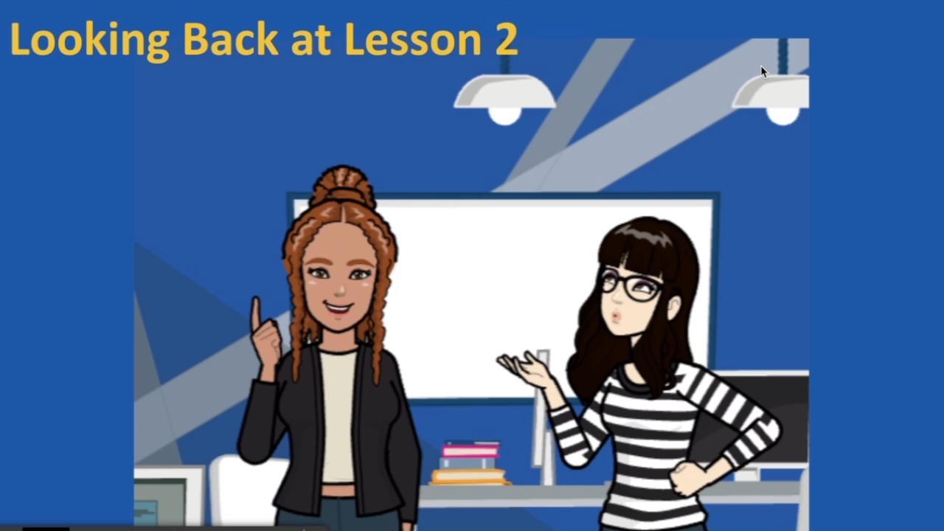

Slide 19

Coding Learning Journal
Write today’s date.
Write the heading: Sequencing and Accuracy of an Algorithm.
Use all or some of the following prompts to show your learning today.
Sequencing is important because…..
Instructions need to be accurate because….. Here is an example…
It was challenging when……..
I got better at ………..
Notes:
Instructions for learning journal

