Slide 1


Lesson 1
What are Algorithms?
csinschools.com
Notes:
Teachers please note: the first two slides have a grey background and are for your reading prior to the lesson.

Slide 2
Lesson Outline and Suggested Timings
Lesson 1 What is an Algorithm? | Time Required | Notes/Details | Resources
Introduction | 5 minutes | Video: introduction to the course and lesson 1 - What is an algorithm? | Lesson 1 slides
Giving Instructions/drawing activity | 15 minutes | Working in pairs students devise a set of instructions for each other to draw a simple picture. Opportunity for reflection. | Lesson 1 slides Projector or interactive whiteboard Blank paper for drawing and pens/ pencils
Coding Practice | 20 minutes | Students explore Ocado- Code for Life Levels 1-5 | Student devices Copy and paste the following link on Google Classroom, Seesaw or Dojo, alternatively you can email the link to the students. https://www.codeforlife.education/rapidrouter/.
BTN (Behind the News ) | 15 minutes | Watch BTN and answer questions in groups of 3-5. Share responses. | Lesson 1 slides Projector or interactive whiteboard A3 print out of BTN response (1 per group of 3-5 students)
Reflection | 10 minutes | Students reflect on the learning intention and success criteria by responding to journal prompts. This is also an opportunity for the teacher to gauge student progress. | Lesson 1 slides student devices or workbook

Slide 3


Pre-Assessment Activity
Pre-assessment Activity

Slide 4



Slide 5

Learning Intention:
We are learning to create algorithms to solve problems
Success Criteria
• I can explain what an algorithm is
• I can create an algorithm
• I can follow an algorithm

Slide 6


Creating and Following Instructions
Find a partner
Turn your seats so that you are sitting back-to-back with your partner
For two minutes:
  Both students draw a simple picture in one colour
  (such as a house, flower, or an object of some sort)
Notes:
If there is an odd number of students, have one group of three students

Slide 7

Creating and Following Instructions
Starting with the student with the longer hair:
  You have two minutes to give instructions to your partner to reproduce your image
  The person drawing the image cannot say anything or use any gestures
  No peeking or showing the original image!
  Your partner cannot show you the drawn image (don’t say “Does this look right?”)
Swap partners and repeat the previous step 4
Notes:
If there is an odd number of students, have one group of three students

Slide 8

Let’s Reflect:
Working with your partner, reflect on the task you have just completed.
What worked?
What didn’t work?
How could you have improve your drawing instructions to make your partner more successful?

Slide 9


Algorithm
A precise step-by-step set of instructions to solve a problem or complete a specific task.

Slide 10
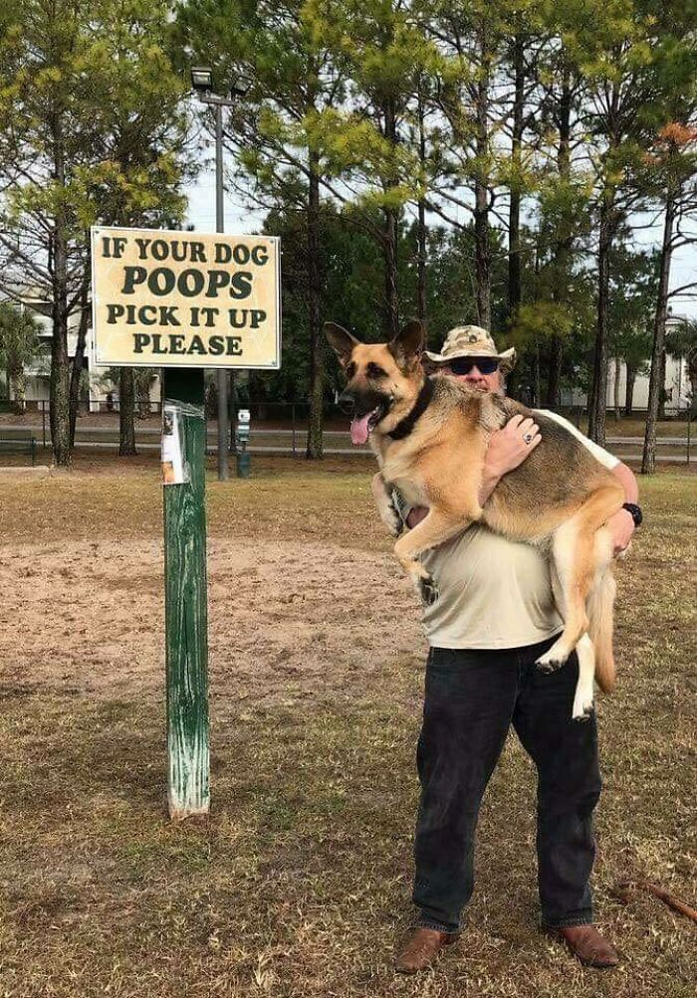
What do you think about the algorithm that was used for this sign?
Notes:
Teacher asks: Do you think the person who created this sign intended for a person to pick up their dog?
What would have been their intention?
What changes could you make to the sign to make it reflect the intention?

Slide 11


Slide 12
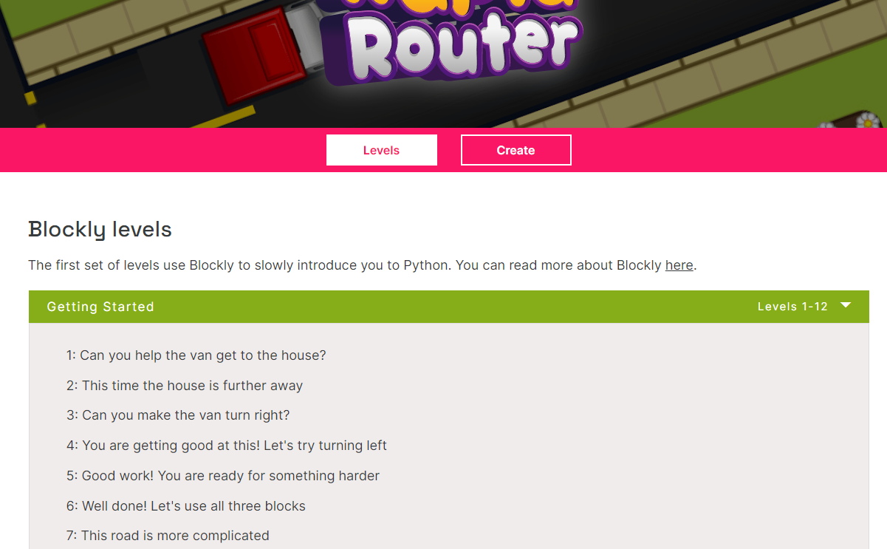
Now complete levels 1 - 5!
Click here to play the levels

Slide 13

Now complete levels 1 - 5!
Click here to play the levels

Slide 14
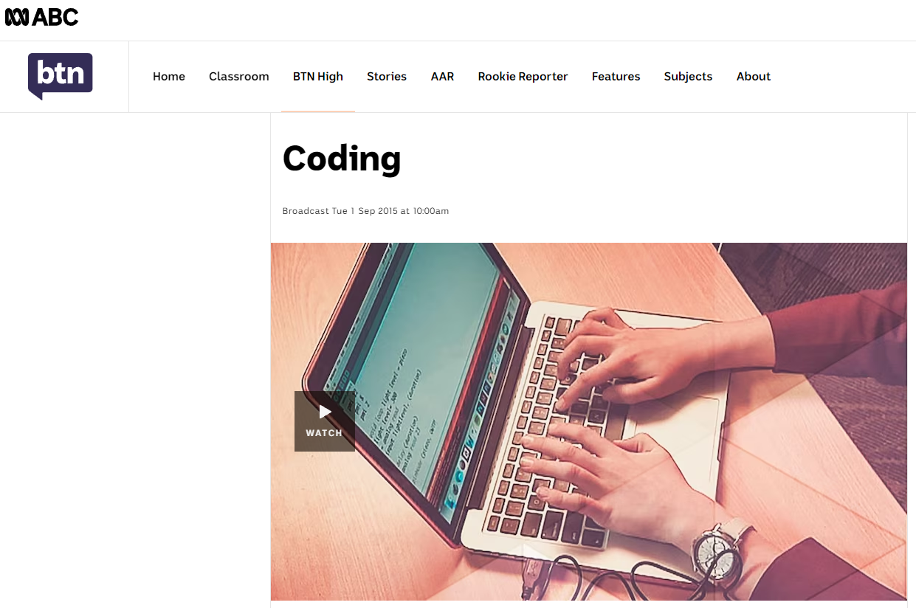

Slide 15

Students get into groups of 3 - 5.
Provide each group with the following worksheet:
A3 print out of BTN response
Notes:
Organise the students into groups of 3-5. Provide each group of students with an A3 copy of the questions in response to BTN.

Slide 16

In your groups, answer the following questions about the BTN video:
What are the kids learning about?
Think of three adjectives to describe computer coding
How has your thinking about coding changed since watching video?
Notes:
Organise the students into groups of 3-5. Provide each group of students with an A3 copy of the questions in response to BTN.

Slide 17

Now share your responses to the BTN video with the rest of the class!
Notes:
Organise the students into groups of 3-5. Provide each group of students with an A3 copy of the questions in response to BTN.

Slide 18
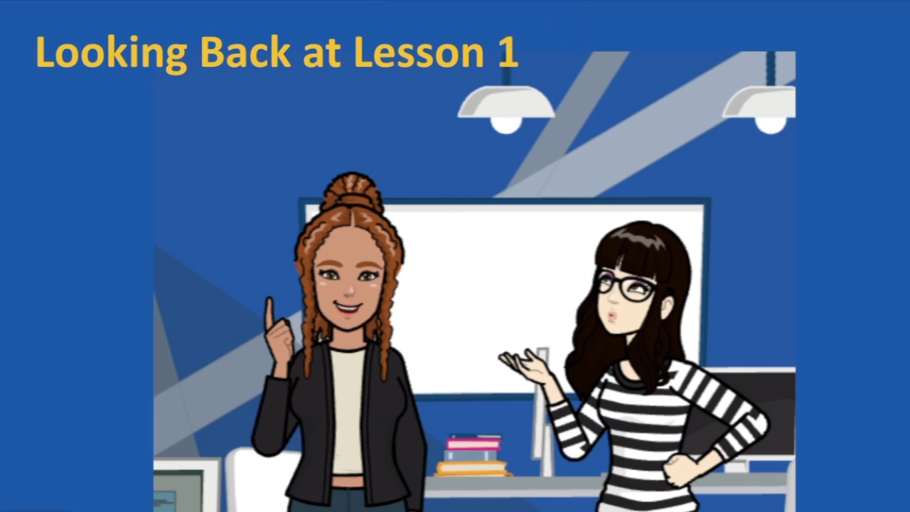

Slide 19

Set up of Coding Learning Journal
Today you will set up your Coding Learning Journal.
This may either be in your Google Drive or in a workbook.
At the end of each lesson you will be given some prompts to help you reflect on your learning.
This is so you have the opportunity to think about what you have been learning, and for your teacher to monitor your learning and provide feedback.
You will be required to make a journal entry at the end of each coding lesson.
Notes:
Instructions for learning journal

Slide 20
Coding Learning Journal
Write today’s date.
Write the heading: Algorithms.
Use all or some of the following prompts to show your learning today.
An algorithm is…
Today I learnt …
Coding is used for…
This is what I used to think about algorithms… Now I think…
The most important thing about …
It was challenging …
Notes:
Instructions for learning journal

