Slide 1



Lesson 2
Making Choices
7
csinschools.com

Slide 2



Learning objectives
By the end of this lesson, you should be able to:
Understand how decisions are made within algorithms
Draw a flowchart representing an algorithm which makes a single decision with 2 outcomes
‹#›

Slide 3
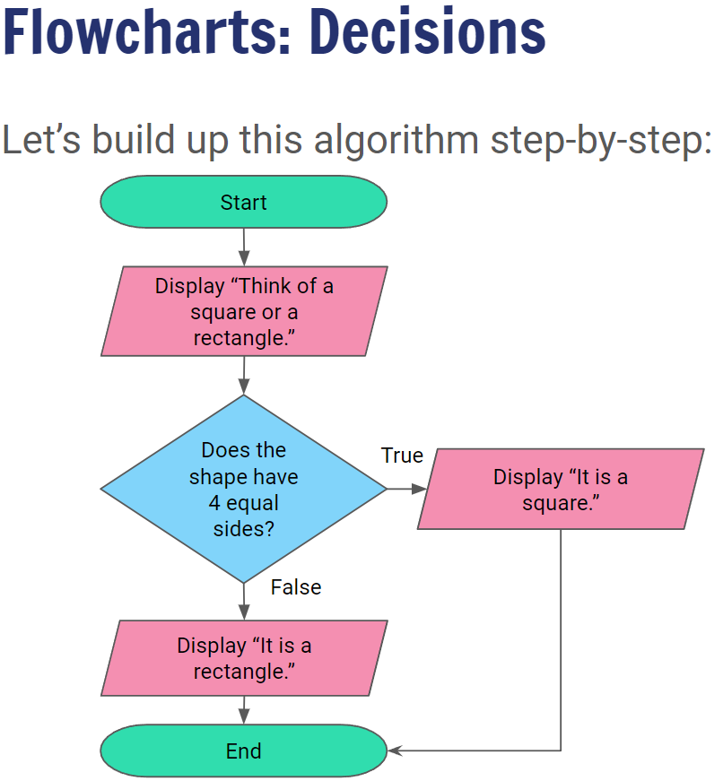


4:55 min
Vimeo video link
Link to Accompanying Slides
(PDF, powerpoint)

Slide 4

02.01 Worksheet Activity
Complete Questions 1 - 6
(PDF, MS Word)

Slide 5

Summary
You should now be able to:
Understand how decisions are made within algorithms
Draw a flowchart representing an algorithm which makes a single decision with 2 outcomes

Slide 6
License Information
These CS in Schools lessons plans, worksheets, and other materials were created by the CS in Schools team. They are licensed under a Creative Commons Attribution-ShareAlike 4.0 International License.
Images all taken from flaticon.

