Slide 1



Lesson 1
Algorithms and Flowcharts
csinschools.com

Slide 2



Learning objectives
By the end of this lesson, you should be able to:
Understand what algorithms are and how they relate to mathematics
Write a simple algorithm in English to classify shapes
Draw flowcharts with terminal and output shapes to represent simple output algorithms
‹#›

Slide 3
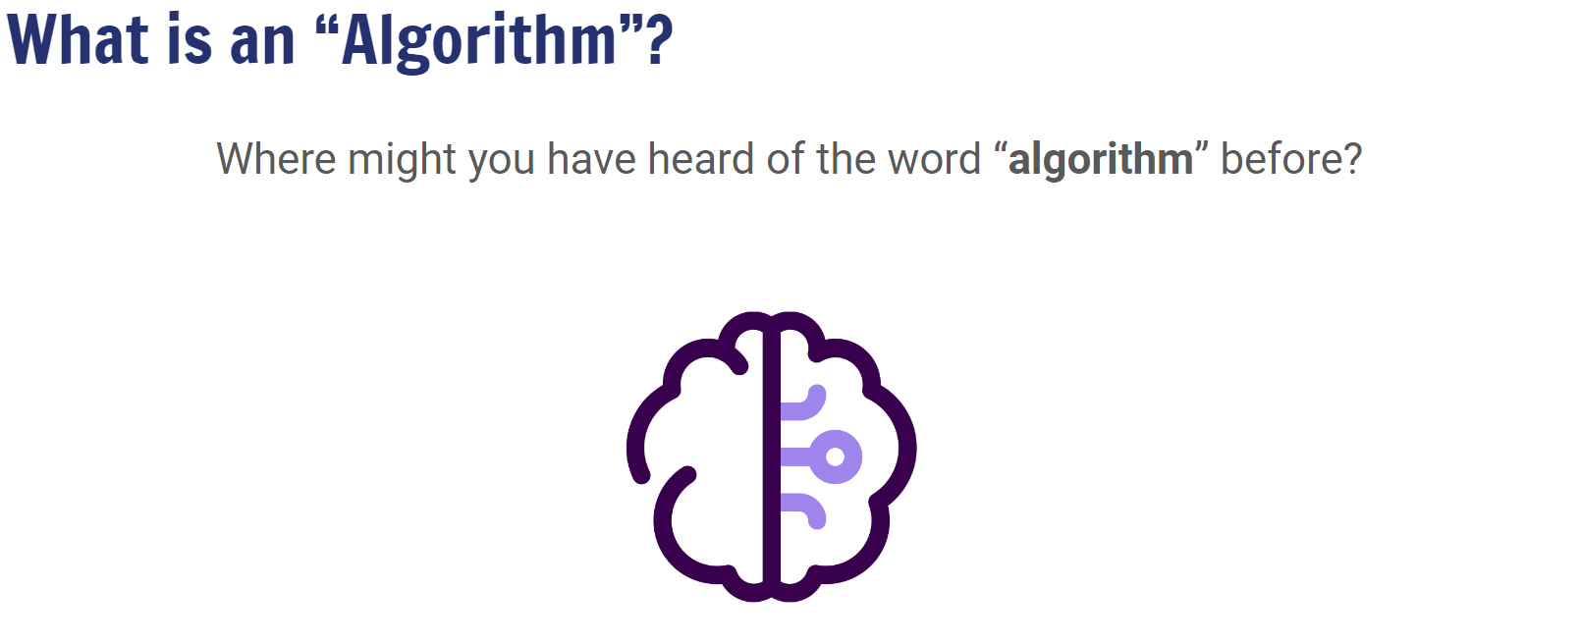


4:10 min
Vimeo video link
Link to Accompanying Slides
(PDF, powerpoint)

Slide 4
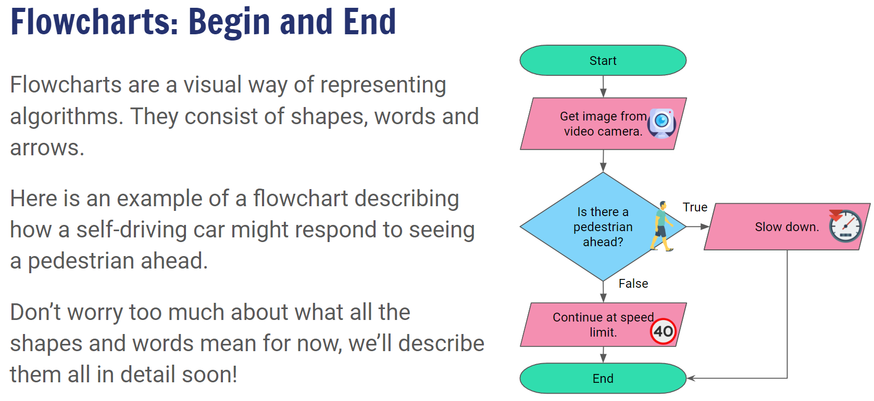
4:24 min
Vimeo video link
Link to Accompanying Slides
(PDF, powerpoint)

Slide 5

Worksheet Activity
Complete Questions 1 - 6
(PDF, MS Word)

Slide 6

Summary
You should now be able to:
Understand what algorithms are and how they relate to mathematics
Write a simple algorithm in English to classify shapes
Draw flowcharts with terminal and output shapes to represent simple output algorithms

Slide 7
License Information
These CS in Schools lessons plans, worksheets, and other materials were created by the CS in Schools team. They are licensed under a Creative Commons Attribution-ShareAlike 4.0 International License.
Images all taken from flaticon.

