Slide 1


Lesson 6
Round and Round We Go
csinschools.com

Slide 2



Previously, on CS in Schools...
In a flow chart, what does this symbol mean?
‹#›
Notes:
Answer:
Start or end of the program

Slide 3
Previously, on CS in Schools...
In a flow chart, what does this symbol mean?
‹#›
Notes:
Answer:
Receiving input and displaying output

Slide 4
Previously, on CS in Schools...
In a flow chart, what does this symbol mean?
‹#›
Notes:
Answer:
A true/false decision is being made

Slide 5
Previously, on CS in Schools...
In a flow chart, what does this symbol mean?
‹#›
Notes:
Answer:
An operation is being performed

Slide 6
Previously, on CS in Schools...
What are two things wrong with this section of code?
colour = "Green"
if colour = "green":
print("Green is my favourite colour too!")
‹#›
Notes:
Answer:
= instead of ==
Casing of "green"

Slide 7

Learning objectives
By the end of this lesson, you should be able to:
understand how to have parts of the code repeat over again until something happens
‹#›

Slide 8

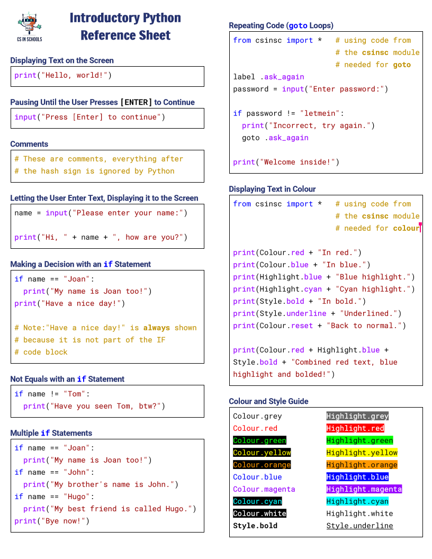

Python Reference Sheet
Python Reference Sheet
Print it out and use it!
Get it online. (Microsoft)
‹#›

Slide 9




Can you crack the secret PIN number?
Play Video
2:10 min
Slide 9 - 10
Click here to try
‹#›

Slide 10
Can you crack the secret PIN number?
Click here to try
Notice how the system is willing to ask you again and again if you get it wrong? We’ll learn about how to get your code to repeat itself in this lesson
‹#›

Slide 11
Let’s work through a flow chart together for the secret PIN program...
Play Video
4:26 min
Slide 11 - 62
‹#›

Slide 12
Flowchart
Start
‹#›

Slide 13
Flowchart
Start
Ask user for PIN
‹#›

Slide 14
Flowchart
Start
Ask user for PIN
Is the PIN not equal to "65"?
‹#›

Slide 15
Flowchart
Start
Ask user for PIN
Is the PIN not equal to "65"?
True
Display "Incorrect PIN…"
‹#›

Slide 16
Flowchart
Start
Ask user for PIN
Is the PIN not equal to "65"?
True
Display "Incorrect PIN…"
‹#›

Slide 17
Flowchart
Start
Ask user for PIN
Is the PIN not equal to "65"?
True
Display "Incorrect PIN…"
‹#›

Slide 18
Flowchart
Start
Ask user for PIN
Is the PIN not equal to "65"?
True
Display "Incorrect PIN…"
‹#›

Slide 19
Flowchart
Start
Ask user for PIN
Is the PIN not equal to "65"?
True
Display "Incorrect PIN…"
‹#›

Slide 20
Flowchart
Start
Ask user for PIN
Is the PIN not equal to "65"?
True
Display "Incorrect PIN…"
‹#›

Slide 21
Flowchart
Start
Ask user for PIN
Is the PIN not equal to "65"?
True
Display "Incorrect PIN…"
‹#›

Slide 22
Flowchart
Start
Ask user for PIN
Is the PIN not equal to "65"?
True
Display "Incorrect PIN…"
‹#›

Slide 23
Flowchart
Start
Ask user for PIN
Is the PIN not equal to "65"?
True
Display "Incorrect PIN…"
‹#›

Slide 24
Flowchart
Start
Ask user for PIN
Is the PIN not equal to "65"?
True
Display "Incorrect PIN…"
‹#›

Slide 25
Flowchart
Start
Ask user for PIN
Is the PIN not equal to "65"?
True
Display "Incorrect PIN…"
‹#›

Slide 26
Flowchart
Start
Ask user for PIN
Is the PIN not equal to "65"?
True
Display "Incorrect PIN…"
‹#›

Slide 27
Flowchart
Start
Ask user for PIN
Is the PIN not equal to "65"?
True
Display "Incorrect PIN…"
‹#›

Slide 28
Flowchart
Start
Ask user for PIN
Is the PIN not equal to "65"?
True
Display "Incorrect PIN…"
‹#›

Slide 29
Flowchart
Start
Ask user for PIN
Is the PIN not equal to "65"?
True
Display "Incorrect PIN…"
False
Display welcome message
‹#›

Slide 30
Flowchart
Start
Ask user for PIN
Is the PIN not equal to "65"?
True
Display "Incorrect PIN…"
False
Display welcome message
End
‹#›

Slide 31
Flowchart
Start
Ask user for PIN
Is the PIN not equal to "65"?
True
Display "Incorrect PIN…"
False
Display welcome message
End
‹#›

Slide 32
Flowchart
Start
Ask user for PIN
Is the PIN not equal to "65"?
True
Display "Incorrect PIN…"
False
Display welcome message
End
‹#›

Slide 33
Flowchart
Start
Ask user for PIN
Is the PIN not equal to "65"?
True
Display "Incorrect PIN…"
False
Display welcome message
End
‹#›

Slide 34
Flowchart
Start
Ask user for PIN
Is the PIN not equal to "65"?
True
Display "Incorrect PIN…"
False
Display welcome message
End
‹#›

Slide 35
Flowchart
Start
Ask user for PIN
This forms a loop
Is the PIN not equal to "65"?
True
Display "Incorrect PIN…"
False
Display welcome message
End
‹#›

Slide 36
Flowchart
Start
Ask user for PIN
Is the PIN not equal to "65"?
True
Display "Incorrect PIN…"
False
Display welcome message
End
‹#›

Slide 37
Flowchart
We need to be able to "jump" back to an earlier part of our code.
Start
Ask user for PIN
Is the PIN not equal to "65"?
True
Display "Incorrect PIN…"
False
Display welcome message
End
‹#›

Slide 38
Flowchart & code
Start
Ask user for PIN
pin = input("Enter your pin:")
if pin != "65":
print("Incorrect pin…")
print("Welcome to your account!")
Is the PIN not equal to "65"?
True
Display "Incorrect PIN…"
False
Display welcome message
End
‹#›

Slide 39
Flowchart & code
Start
Ask user for PIN
pin = input("Enter your pin:")
if pin != "65":
print("Incorrect pin…")
print("Welcome to your account!")
Is the PIN not equal to "65"?
True
Display "Incorrect PIN…"
False
Display welcome message
End
‹#›

Slide 40
Flowchart & code
Start
Ask user for PIN
pin = input("Enter your pin:")
if pin != "65":
print("Incorrect pin…")
print("Welcome to your account!")
Is the PIN not equal to "65"?
True
Display "Incorrect PIN…"
False
Display welcome message
End
‹#›

Slide 41
Flowchart & code
Start
Ask user for PIN
pin = input("Enter your pin:")
if pin != "65":
print("Incorrect pin…")
print("Welcome to your account!")
Is the PIN not equal to "65"?
True
Display "Incorrect PIN…"
False
Display welcome message
The != means "NOT equal to"
End
‹#›

Slide 42
Flowchart & code
Start
Ask user for PIN
pin = input("Enter your pin:")
if pin != "65":
print("Incorrect pin…")
print("Welcome to your account!")
Is the PIN not equal to "65"?
True
Display "Incorrect PIN…"
False
Display welcome message
!= is the opposite of ==
== means "is equal to"
End
‹#›

Slide 43
Flowchart & code
Start
Ask user for PIN
pin = input("Enter your pin:")
if pin != "65":
print("Incorrect pin…")
print("Welcome to your account!")
Is the PIN not equal to "65"?
True
Display "Incorrect PIN…"
False
Display welcome message
End
‹#›

Slide 44
Flowchart & code
Start
Ask user for PIN
pin = input("Enter your pin:")
if pin != "65":
print("Incorrect pin…")
print("Welcome to your account!")
Is the PIN not equal to "65"?
True
Display "Incorrect PIN…"
False
Display welcome message
End
‹#›

Slide 45
Flowchart & code
Start
Ask user for PIN
pin = input("Enter your pin:")
if pin != "65":
print("Incorrect pin…")
print("Welcome to your account!")
Is the PIN not equal to "65"?
True
Display "Incorrect PIN…"
False
Display welcome message
End
‹#›

Slide 46
Flowchart & code
Start
Ask user for PIN
pin = input("Enter your pin:")
if pin != "65":
print("Incorrect pin…")
print("Welcome to your account!")
Is the PIN not equal to "65"?
True
Display "Incorrect PIN…"
False
Display welcome message
End
‹#›

Slide 47
Flowchart & code
Start
Ask user for PIN
pin = input("Enter your pin:")
if pin != "65":
print("Incorrect pin…")
print("Welcome to your account!")
Is the PIN not equal to "65"?
True
Display "Incorrect PIN…"
False
Display welcome message
End
‹#›

Slide 48
Flowchart & code
Start
Ask user for PIN
pin = input("Enter your pin:")
if pin != "65":
print("Incorrect pin…")
print("Welcome to your account!")
Is the PIN not equal to "65"?
True
Display "Incorrect PIN…"
False
At this point, we want to go back to here. How?
Display welcome message
End
‹#›

Slide 49

Flowchart & code
Start
Imagine we had a bookmark here
Ask user for PIN
pin = input("Enter your pin:")
if pin != "65":
print("Incorrect pin…")
print("Welcome to your account!")
Is the PIN not equal to "65"?
True
Display "Incorrect PIN…"
False
Display welcome message
End
‹#›

Slide 50
Flowchart & code
Start
Imagine we had a bookmark here
Ask user for PIN
pin = input("Enter your pin:")
if pin != "65":
print("Incorrect pin…")
print("Welcome to your account!")
Is the PIN not equal to "65"?
True
Display "Incorrect PIN…"
False
Display welcome message
... and that we can go to that bookmark from here
End
‹#›

Slide 51
Flowchart & code
Start
Imagine we had a bookmark here
Ask user for PIN
pin = input("Enter your pin:")
if pin != "65":
print("Incorrect pin…")
print("Welcome to your account!")
Is the PIN not equal to "65"?
True
Display "Incorrect PIN…"
False
Display welcome message
... and that we can go to that bookmark from here
End
‹#›

Slide 52
Flowchart & code
Start
Imagine we had a bookmark here
Ask user for PIN
pin = input("Enter your pin:")
if pin != "65":
print("Incorrect pin…")
goto ...
print("Welcome to your account!")
Is the PIN not equal to "65"?
True
Display "Incorrect PIN…"
False
Display welcome message
... and that we can go to that bookmark from here
End
‹#›

Slide 53
Flowchart & code
Start
Imagine we had a bookmark here
Ask user for PIN
pin = input("Enter your pin:")
if pin != "65":
print("Incorrect pin…")
goto .
print("Welcome to your account!")
Is the PIN not equal to "65"?
True
Display "Incorrect PIN…"
False
Display welcome message
... and that we can go to that bookmark from here
End
‹#›

Slide 54
Flowchart & code
Start
Ask user for PIN
pin = input("Enter your pin:")
if pin != "65":
print("Incorrect pin…")
goto
print("Welcome to your account!")
Is the PIN not equal to "65"?
True
Display "Incorrect PIN…"
False
Display welcome message
End
‹#›

Slide 55
Flowchart & code
Start
Ask user for PIN
pin = input("Enter your pin:")
if pin != "65":
print("Incorrect pin…")
goto
print("Welcome to your account!")
Is the PIN not equal to "65"?
True
Display "Incorrect PIN…"
False
Display welcome message
End
‹#›

Slide 56
Flowchart & code
Start
Ask user for PIN
label .again
pin = input("Enter your pin:")
if pin != "65":
print("Incorrect pin…")
goto
print("Welcome to your account!")
Is the PIN not equal to "65"?
True
Display "Incorrect PIN…"
False
Display welcome message
End
‹#›

Slide 57
Flowchart & code
Start
Ask user for PIN
label .again
pin = input("Enter your pin:")
if pin != "65":
print("Incorrect pin…")
goto
print("Welcome to your account!")
Is the PIN not equal to "65"?
True
Display "Incorrect PIN…"
False
Display welcome message
End
‹#›

Slide 58
Flowchart & code
Start
All labels MUST start
with a full stop .
Ask user for PIN
label .again
pin = input("Enter your pin:")
if pin != "65":
print("Incorrect pin…")
goto
print("Welcome to your account!")
Is the PIN not equal to "65"?
True
Display "Incorrect PIN…"
False
Display welcome message
End
‹#›

Slide 59
Flowchart & code
Start
Ask user for PIN
label .again
pin = input("Enter your pin:")
if pin != "65":
print("Incorrect pin…")
goto
print("Welcome to your account!")
Is the PIN not equal to "65"?
True
Display "Incorrect PIN…"
False
Display welcome message
End
‹#›

Slide 60
Flowchart & code
Start
Ask user for PIN
label .again
pin = input("Enter your pin:")
if pin != "65":
print("Incorrect pin…")
goto .again
print("Welcome to your account!")
Is the PIN not equal to "65"?
True
Display "Incorrect PIN…"
False
Display welcome message
End
‹#›

Slide 61
Flowchart & code
Start
Ask user for PIN
label .again
pin = input("Enter your pin:")
if pin != "65":
print("Incorrect pin…")
goto .again
print("Welcome to your account!")
Is the PIN not equal to "65"?
True
Display "Incorrect PIN…"
False
Display welcome message
End
‹#›

Slide 62
Flowchart & code
Start
Ask user for PIN
label .again
pin = input("Enter your pin:")
if pin != "65":
print("Incorrect pin…")
goto .again
print("Welcome to your account!")
Is the PIN not equal to "65"?
True
Display "Incorrect PIN…"
False
Display welcome message
End
‹#›

Slide 63

Why did the programmer get stuck in the shower?
‹#›

Slide 64
Why did the programmer get stuck in the shower?
The instructions said: lather, rinse, repeat!
‹#›

Slide 65


Activity: Easiest Game in the World!
Start
Ask user to type "w" to win
Is input equal to "w"?
True
Display "You win!"
False
Display "Game over!"
Activity 06.01
Easiest Game in the World!
End
‹#›

Slide 66
Let’s work through a flowchart and code for a simple menu program...
Play Video
4:11 min
Slide 66 - 87
‹#›

Slide 67
Simple menu program
Start
Display options:
1. Hello, world!
2. Quit
Ask user for option
Is option equal to 1?
True
Display "Hello, world!"
False
Is option equal to 2?
False
Display "Invalid option!"
True
‹#›
End

Slide 68
Simple menu program
Start
Display options:
1. Hello, world!
2. Quit
Ask user for option
Is option equal to 1?
True
Display "Hello, world!"
False
Is option equal to 2?
False
Display "Invalid option!"
True
‹#›
End

Slide 69
Simple menu program
Start
Display options:
1. Hello, world!
2. Quit
Ask user for option
Is option equal to 1?
True
Display "Hello, world!"
False
Is option equal to 2?
False
Display "Invalid option!"
True
‹#›
End

Slide 70
Simple menu program
print("1. Hello, world!")
print("2. Quit")
Start
Display options:
1. Hello, world!
2. Quit
Ask user for option
Is option equal to 1?
True
Display "Hello, world!"
False
Is option equal to 2?
False
Display "Invalid option!"
True
‹#›
End

Slide 71
Simple menu program
print("1. Hello, world!")
print("2. Quit")
Start
Display options:
1. Hello, world!
2. Quit
Ask user for option
Is option equal to 1?
True
Display "Hello, world!"
False
Is option equal to 2?
False
Display "Invalid option!"
True
‹#›
End

Slide 72
Simple menu program
print("1. Hello, world!")
print("2. Quit")
option = input("Enter your choice:")
Start
Display options:
1. Hello, world!
2. Quit
Ask user for option
Is option equal to 1?
True
Display "Hello, world!"
False
Is option equal to 2?
False
Display "Invalid option!"
True
‹#›
End

Slide 73
Simple menu program
print("1. Hello, world!")
print("2. Quit")
option = input("Enter your choice:")
Start
Display options:
1. Hello, world!
2. Quit
Ask user for option
Is option equal to 1?
True
Display "Hello, world!"
False
Is option equal to 2?
False
Display "Invalid option!"
True
‹#›
End

Slide 74
Simple menu program
print("1. Hello, world!")
print("2. Quit")
option = input("Enter your choice:")
if option == "1":
Start
Display options:
1. Hello, world!
2. Quit
Ask user for option
Is option equal to 1?
True
Display "Hello, world!"
False
Is option equal to 2?
False
Display "Invalid option!"
True
‹#›
End

Slide 75
Simple menu program
print("1. Hello, world!")
print("2. Quit")
option = input("Enter your choice:")
if option == "1":
Start
Display options:
1. Hello, world!
2. Quit
Ask user for option
Is option equal to 1?
True
Display "Hello, world!"
False
Is option equal to 2?
False
Display "Invalid option!"
True
‹#›
End

Slide 76
Simple menu program
print("1. Hello, world!")
print("2. Quit")
option = input("Enter your choice:")
if option == "1":
print("Hello, world!")
Start
Display options:
1. Hello, world!
2. Quit
Ask user for option
Is option equal to 1?
True
Display "Hello, world!"
False
Is option equal to 2?
False
Display "Invalid option!"
True
‹#›
End

Slide 77
Simple menu program
print("1. Hello, world!")
print("2. Quit")
option = input("Enter your choice:")
if option == "1":
print("Hello, world!")
Start
Display options:
1. Hello, world!
2. Quit
Ask user for option
Is option equal to 1?
True
Display "Hello, world!"
False
Is option equal to 2?
False
Display "Invalid option!"
True
‹#›
End

Slide 78
Simple menu program
label .menu
print("1. Hello, world!")
print("2. Quit")
option = input("Enter your choice:")
if option == "1":
print("Hello, world!")
goto .menu
Start
Display options:
1. Hello, world!
2. Quit
Ask user for option
Is option equal to 1?
True
Display "Hello, world!"
False
Is option equal to 2?
False
Display "Invalid option!"
True
‹#›
End

Slide 79
Simple menu program
label .menu
print("1. Hello, world!")
print("2. Quit")
option = input("Enter your choice:")
if option == "1":
print("Hello, world!")
goto .menu
Start
Display options:
1. Hello, world!
2. Quit
Ask user for option
Is option equal to 1?
True
Display "Hello, world!"
False
Is option equal to 2?
False
Display "Invalid option!"
True
‹#›
End

Slide 80
Simple menu program
label .menu
print("1. Hello, world!")
print("2. Quit")
option = input("Enter your choice:")
if option == "1":
print("Hello, world!")
goto .menu
if option == "2":
Start
Display options:
1. Hello, world!
2. Quit
Ask user for option
Is option equal to 1?
True
Display "Hello, world!"
False
Is option equal to 2?
False
Display "Invalid option!"
True
‹#›
End

Slide 81
Simple menu program
label .menu
print("1. Hello, world!")
print("2. Quit")
option = input("Enter your choice:")
if option == "1":
print("Hello, world!")
goto .menu
if option == "2":
Start
Display options:
1. Hello, world!
2. Quit
Ask user for option
Is option equal to 1?
True
Display "Hello, world!"
False
Is option equal to 2?
False
Display "Invalid option!"
True
‹#›
End

Slide 82
Simple menu program
label .menu
print("1. Hello, world!")
print("2. Quit")
option = input("Enter your choice:")
if option == "1":
print("Hello, world!")
goto .menu
if option == "2":
goto .end
label .end
Start
Display options:
1. Hello, world!
2. Quit
Ask user for option
Is option equal to 1?
True
Display "Hello, world!"
False
Is option equal to 2?
False
Display "Invalid option!"
True
‹#›
End

Slide 83
Simple menu program
label .menu
print("1. Hello, world!")
print("2. Quit")
option = input("Enter your choice:")
if option == "1":
print("Hello, world!")
goto .menu
if option == "2":
goto .end
label .end
Start
Display options:
1. Hello, world!
2. Quit
Ask user for option
Is option equal to 1?
True
Display "Hello, world!"
False
Is option equal to 2?
False
Display "Invalid option!"
True
‹#›
End

Slide 84
Simple menu program
label .menu
print("1. Hello, world!")
print("2. Quit")
option = input("Enter your choice:")
if option == "1":
print("Hello, world!")
goto .menu
if option == "2":
goto .end
print("Invalid option!")
label .end
Start
Display options:
1. Hello, world!
2. Quit
Ask user for option
Is option equal to 1?
True
Display "Hello, world!"
False
Is option equal to 2?
False
Display "Invalid option!"
True
‹#›
End

Slide 85
Simple menu program
label .menu
print("1. Hello, world!")
print("2. Quit")
option = input("Enter your choice:")
if option == "1":
print("Hello, world!")
goto .menu
if option == "2":
goto .end
print("Invalid option!")
label .end
Start
Display options:
1. Hello, world!
2. Quit
Ask user for option
Is option equal to 1?
True
Display "Hello, world!"
False
Is option equal to 2?
False
Display "Invalid option!"
True
‹#›
End

Slide 86
Simple menu program
label .menu
print("1. Hello, world!")
print("2. Quit")
option = input("Enter your choice:")
if option == "1":
print("Hello, world!")
goto .menu
if option == "2":
goto .end
print("Invalid option!")
goto .menu
label .end
Start
Display options:
1. Hello, world!
2. Quit
Ask user for option
Is option equal to 1?
True
Display "Hello, world!"
False
Is option equal to 2?
False
Display "Invalid option!"
True
‹#›
End

Slide 87
Simple menu program
label .menu
print("1. Hello, world!")
print("2. Quit")
option = input("Enter your choice:")
if option == "1":
print("Hello, world!")
goto .menu
if option == "2":
goto .end
print("Invalid option!")
goto .menu
label .end
Start
Display options:
1. Hello, world!
2. Quit
Ask user for option
Is option equal to 1?
True
Display "Hello, world!"
False
Is option equal to 2?
False
Display "Invalid option!"
True
‹#›
End

Slide 88
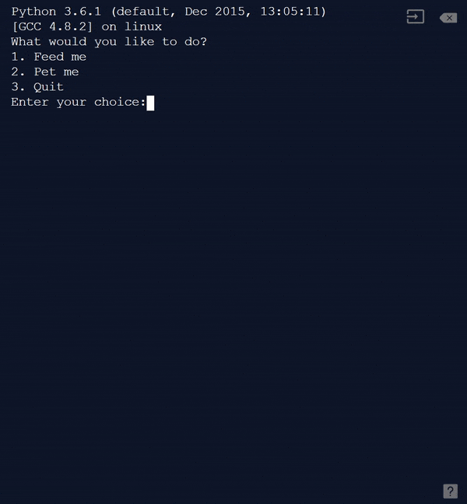

Activity: Virtual Pet Menu!
Activity 06.02
Virtual Pet Menu
‹#›

Slide 89

Activity: Your Solar System!
Helpful Hints
Watch the tutorial video.
Check the cheat sheet for the code you might need!
Activity 06.03
Your Solar System
‹#›

Slide 90
Summary
A loop makes it possible to have parts of the code repeat over again until something happens
We’ve learnt how to build a simple menu system that uses a loop and an if statement
We can write a loop in our code using goto
‹#›

Slide 91


Reflection: Exit pass
What is one new thing you learnt today?
Write it on a sticky note and stick it on the board before you leave the classroom
‹#›

Slide 92
License Information
These CS in Schools lessons plans, worksheets, and other materials were created by Toan Huynh and Hugh Williams. They are licensed under a Creative Commons Attribution-ShareAlike 4.0 International License.
Images, in order of appearance:
"CIA Secret Weapon, after Otto Messmer" by Mike Licht via Flickr
"Shower Douche Spray Cleaning" by OpenIcons via pixabay.com
"Girly tux" from Free SVG
"Our Solar System Features Eight Planets" from NASA
‹#›

