Slide 1
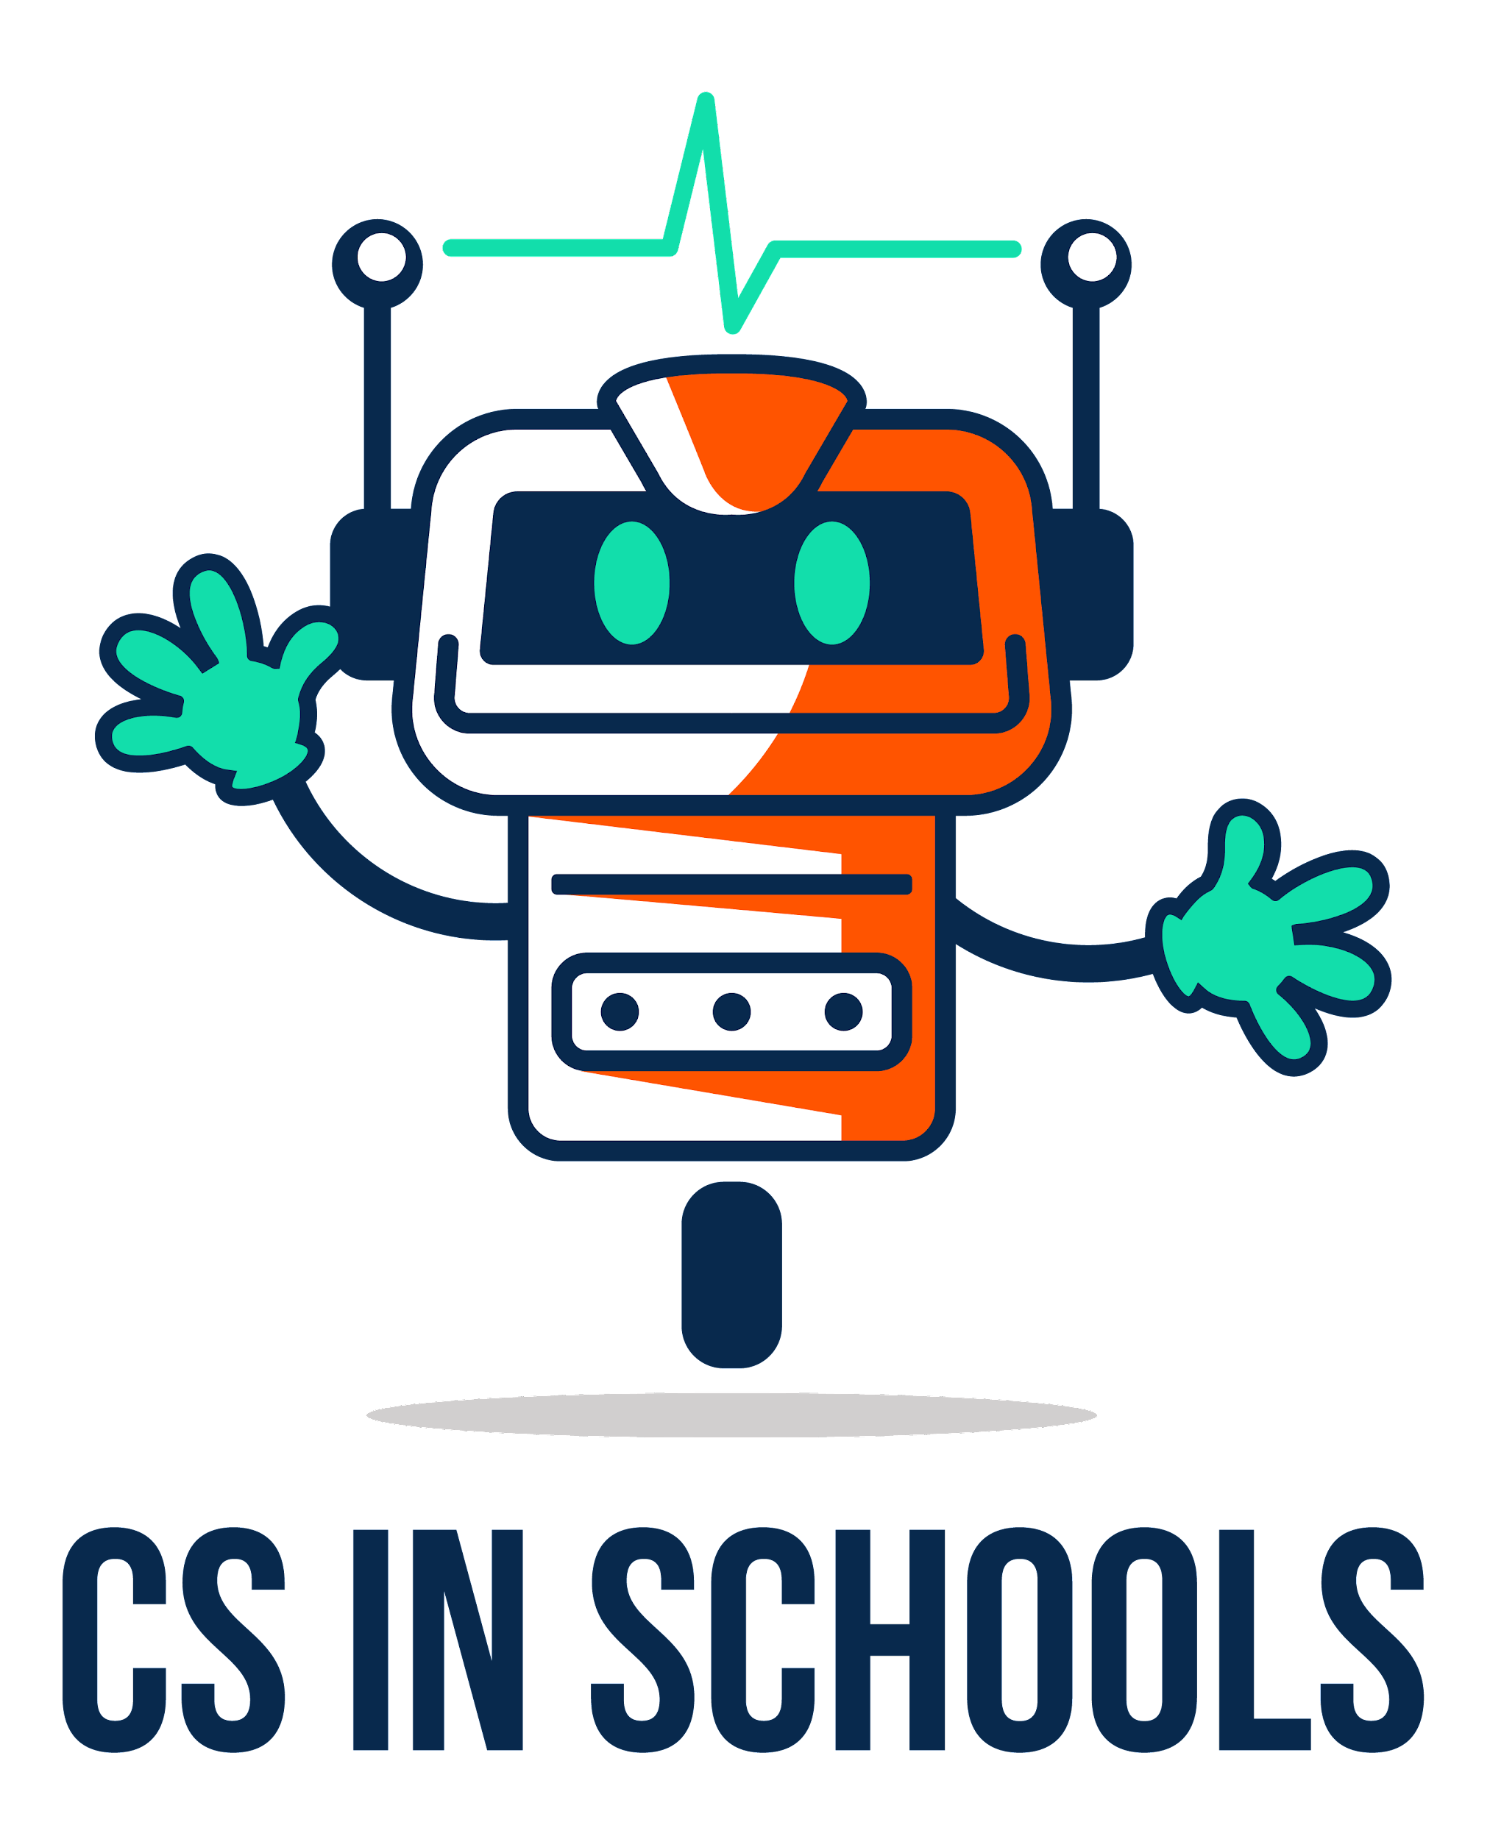
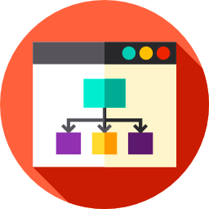
Lesson 5
Programs That Make Decisions
csinschools.com

Slide 2

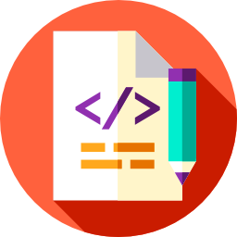
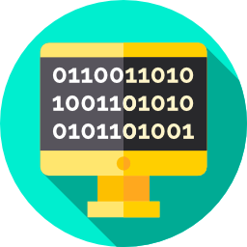
Previously, on CS in Schools...
Will the following code run?
name = input("Enter your first name:")
‹#›
Notes:
Answer:
Yes

Slide 3
Previously, on CS in Schools...
If the user types in John when asked for their name, what will be displayed on the screen after the following code is run:
name = input("Enter your first name:")
print("Hello, " + name)
‹#›
Notes:
Answer:
Hello, John

Slide 4
Previously, on CS in Schools...
If the user types in Jane when asked for their name, and 21 when asked for their age, what will be displayed on the screen after the following code is run:
name = input("Enter your first name:")
age = input("Enter your age:")
print("Hello, " + name + ", " + age)
‹#›
Notes:
Answer:
Hello, Jane, 21

Slide 5
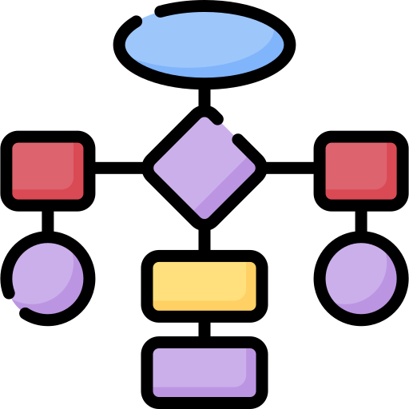
Learning objectives
By the end of this lesson, you should be able to:
understand control flow and how we can use it in our programs to make decisions
use a flowchart to represent program flow
understand boolean expressions and how they are either True or False
use if statements to make choices in a program so that it can behave differently depending on what a user types
‹#›

Slide 6
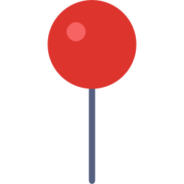
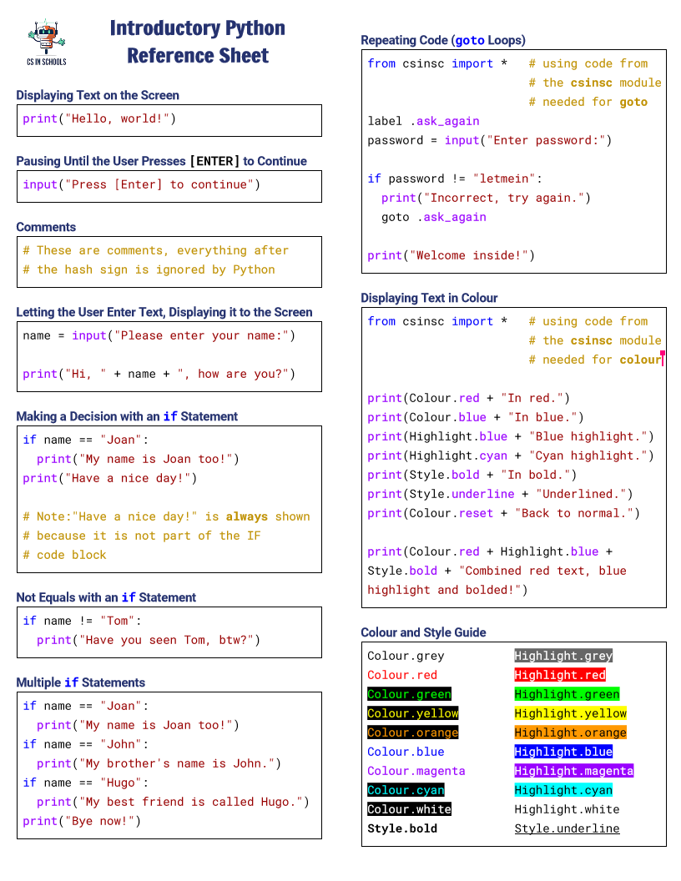

Python Reference Sheet
Python Reference Sheet
Print it out and use it!
Get it online. (Microsoft)
‹#›

Slide 7

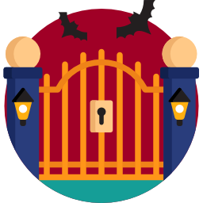
Can you pass through the Gates of Doom?
Play Video
1:13 min
Slide 7 - 10
Click here and see if you can "guess" the password
Hint: Look through the code and see if you can figure out what’s going on
‹#›

Slide 8
How did you go?
print("Who dares approach the gates of doom! ")
password = input("Speak the password:")
if password == "0p3nSe5@m3":
print("You are correct!")
print("You may enter, friend.")
if password != "0p3nSe5@m3":
print(" ****** ")
print(" * ** ")
‹#›

Slide 9
How did you go?
print("Who dares approach the gates of doom! ")
password = input("Speak the password:")
if password == "0p3nSe5@m3":
print("You are correct!")
print("You may enter, friend.")
if password != "0p3nSe5@m3":
print(" ****** ")
print(" * ** ")
‹#›

Slide 10
How did you go?
print("Who dares approach the gates of doom! ")
password = input("Speak the password:")
if password == "0p3nSe5@m3":
print("You are correct!")
print("You may enter, friend.")
if password != "0p3nSe5@m3":
print(" ****** ")
print(" * ** ")
Here are the key lines.
We’ll learn more about what this means in this lesson.
‹#›

Slide 11
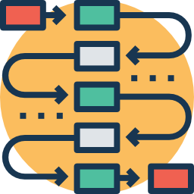
Control flow
Play Video
4:57 min
Slide 11 - 53
Up until now, our programs never had to make a choice about anything
Sometimes, we might want to display something different when the user enters a certain word or string of characters
When and why would doing this be useful?
‹#›

Slide 12
Control flow
Here are some examples of when changing the flow might be useful:
  Being able to recognise a user (for example, so we can show them the purchases they’ve made online)
  Recall and continue past interactions (for example, to continue a game at Level 5)
  Bring up customised displays and preferences (for example, show you a link to submit an assignment in your school management system)
  Apply specific rules and permissions (for example, only let teachers mark assignments)
There are many different examples and situations where control flow is important
‹#›

Slide 13
Flowcharts
A flowchart is a special type of diagram that is used by programmers to help them lay out their step-by-step design for their programs
Flowcharts help us better understand the way computers make "decisions" and how they act differently based on different choices
Flowcharts are written in English, and they often don’t use the same keywords as a programming language
‹#›

Slide 14
Program example
from time import sleep
name = input("Please enter your name:")
sleep(5)
print("See ya later" + name)
Suppose we have this program...
‹#›

Slide 15
Program example
Start
from time import sleep
name = input("Please enter your name:")
sleep(5)
print("See ya later" + name)
‹#›

Slide 16
Program example
Start
from time import sleep
name = input("Please enter your name:")
sleep(5)
print("See ya later" + name)
‹#›

Slide 17
Program example
Start
from time import sleep
name = input("Please enter your name:")
sleep(5)
print("See ya later" + name)
Ask user for name
‹#›

Slide 18
Program example
Start
from time import sleep
name = input("Please enter your name:")
sleep(5)
print("See ya later" + name)
Ask user for name
‹#›

Slide 19
Program example
Start
from time import sleep
name = input("Please enter your name:")
sleep(5)
print("See ya later" + name)
Ask user for name
Wait 5 seconds
‹#›

Slide 20
Program example
Start
from time import sleep
name = input("Please enter your name:")
sleep(5)
print("See ya later" + name)
Ask user for name
Wait 5 seconds
‹#›

Slide 21
Program example
Start
from time import sleep
name = input("Please enter your name:")
sleep(5)
print("See ya later" + name)
Ask user for name
Wait 5 seconds
Display "See ya later ", name
‹#›

Slide 22
Program example
Start
from time import sleep
name = input("Please enter your name:")
sleep(5)
print("See ya later" + name)
Ask user for name
Wait 5 seconds
Display "See ya later ", name
End
‹#›

Slide 23
Program example
Start
Ask user for name
This symbol represents the start and end points of the program.
Wait 5 seconds
Display "See ya later ", name
End
‹#›

Slide 24
Program example
Start
Ask user for name
This symbol represents getting input or producing output
Examples include:
• the user typing something in
• retrieving data from the internet
• displaying text on the screen
Wait 5 seconds
Display "See ya later ", name
End
‹#›

Slide 25
Program example
Start
Ask user for name
This symbol represents steps where the program actually needs to do something with the information.
You can see that it’s normal in flowcharts to use English words like "Wait" rather than Python code words like sleep()
Wait 5 seconds
Display "See ya later ", name
End
‹#›

Slide 26
Look at this flowchart
Start
Ask user for name
Let’s take a look at what this flowchart describes.
Wait 5 seconds
Is the name "John"?
True
Display "Hey! I’m called John, too!"
False
Display "See ya later!"
End
‹#›

Slide 27
Look at this flowchart
Start
Ask user for name
Wait 5 seconds
Is the name "John"?
True
Display "Hey! I’m called John, too!"
False
Display "See ya later!"
End
‹#›

Slide 28
Look at this flowchart
Start
Ask user for name
Wait 5 seconds
Is the name "John"?
True
Display "Hey! I’m called John, too!"
False
Display "See ya later!"
End
‹#›

Slide 29
Look at this flowchart
Start
Ask user for name
Please enter your name:
Wait 5 seconds
Is the name "John"?
True
Display "Hey! I’m called John, too!"
False
Display "See ya later!"
End
‹#›

Slide 30
Look at this flowchart
Start
Ask user for name
Please enter your name: Carla
Wait 5 seconds
Is the name "John"?
True
Display "Hey! I’m called John, too!"
False
Display "See ya later!"
End
‹#›

Slide 31
Look at this flowchart
Start
Ask user for name
Please enter your name: Carla
Wait 5 seconds
Is the name "John"?
True
Display "Hey! I’m called John, too!"
False
Display "See ya later!"
End
‹#›

Slide 32
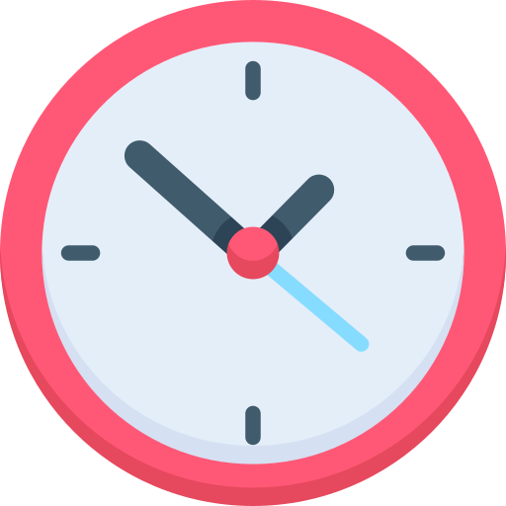
Look at this flowchart
Start
Ask user for name
Please enter your name: Carla
Wait 5 seconds
Is the name "John"?
True
Display "Hey! I’m called John, too!"
False
Wait 5 seconds...
Display "See ya later!"
End
‹#›

Slide 33
Look at this flowchart
Start
Ask user for name
Please enter your name: Carla
Wait 5 seconds
Is the name "John"?
True
Display "Hey! I’m called John, too!"
False
Display "See ya later!"
End
‹#›

Slide 34
Look at this flowchart
Start
Ask user for name
Please enter your name: Carla
Wait 5 seconds
Is the name "John"?
True
Display "Hey! I’m called John, too!"
False
Display "See ya later!"
End
‹#›

Slide 35
Look at this flowchart
Start
Ask user for name
Please enter your name: Carla
Wait 5 seconds
Is the name "John"?
True
Display "Hey! I’m called John, too!"
False
Display "See ya later!"
End
‹#›

Slide 36
Look at this flowchart
Start
Ask user for name
Please enter your name: Carla
See ya later!
Wait 5 seconds
Is the name "John"?
True
Display "Hey! I’m called John, too!"
False
Display "See ya later!"
End
‹#›

Slide 37
Look at this flowchart
Start
Ask user for name
Please enter your name: Carla
See ya later!
Wait 5 seconds
Is the name "John"?
True
Display "Hey! I’m called John, too!"
False
Display "See ya later!"
End
‹#›

Slide 38
Look at this flowchart
Start
Ask user for name
Now, let’s try again with a different response.
Wait 5 seconds
Is the name "John"?
True
Display "Hey! I’m called John, too!"
False
Display "See ya later!"
End
‹#›

Slide 39
Look at this flowchart
Start
Ask user for name
Wait 5 seconds
Is the name "John"?
True
Display "Hey! I’m called John, too!"
False
Display "See ya later!"
End
‹#›

Slide 40
Look at this flowchart
Start
Ask user for name
Wait 5 seconds
Is the name "John"?
True
Display "Hey! I’m called John, too!"
False
Display "See ya later!"
End
‹#›

Slide 41
Look at this flowchart
Start
Ask user for name
Please enter your name:
Wait 5 seconds
Is the name "John"?
True
Display "Hey! I’m called John, too!"
False
Display "See ya later!"
End
‹#›

Slide 42
Look at this flowchart
Start
Ask user for name
Please enter your name: John
Wait 5 seconds
Is the name "John"?
True
Display "Hey! I’m called John, too!"
False
Display "See ya later!"
End
‹#›

Slide 43
Look at this flowchart
Start
Ask user for name
Please enter your name: John
Wait 5 seconds
Is the name "John"?
True
Display "Hey! I’m called John, too!"
False
Display "See ya later!"
End
‹#›

Slide 44
Look at this flowchart
Start
Ask user for name
Please enter your name: John
Wait 5 seconds
Is the name "John"?
True
Display "Hey! I’m called John, too!"
False
Wait 5 seconds...
Display "See ya later!"
End
‹#›

Slide 45
Look at this flowchart
Start
Ask user for name
Please enter your name: John
Wait 5 seconds
Is the name "John"?
True
Display "Hey! I’m called John, too!"
False
Display "See ya later!"
End
‹#›

Slide 46
Look at this flowchart
Start
Ask user for name
Please enter your name: John
Wait 5 seconds
Is the name "John"?
True
Display "Hey! I’m called John, too!"
False
Display "See ya later!"
End
‹#›

Slide 47
Look at this flowchart
Start
Ask user for name
Please enter your name: John
Wait 5 seconds
Is the name "John"?
True
Display "Hey! I’m called John, too!"
False
Display "See ya later!"
End
‹#›

Slide 48
Look at this flowchart
Start
Ask user for name
Please enter your name: John
Hey! I’m called John, too!
Wait 5 seconds
Is the name "John"?
True
Display "Hey! I’m called John, too!"
False
Display "See ya later!"
End
‹#›

Slide 49
Look at this flowchart
Start
Ask user for name
Please enter your name: John
Hey! I’m called John, too!
See ya later!
Wait 5 seconds
Is the name "John"?
True
Display "Hey! I’m called John, too!"
False
Display "See ya later!"
End
‹#›

Slide 50
Look at this flowchart
Start
Ask user for name
Please enter your name: John
Hey! I’m called John, too!
See ya later!
Wait 5 seconds
Is the name "John"?
True
Display "Hey! I’m called John, too!"
False
Display "See ya later!"
End
‹#›

Slide 51
Look at this flowchart
Start
Ask user for name
This is the part in the program where a choice needs to be made.
In programming, this comes in the form of a question that is asked
Wait 5 seconds
Is the name "John"?
True
Display "Hey! I’m called John, too!"
False
Display "See ya later!"
End
‹#›

Slide 52
Look at this flowchart
Start
Ask user for name
Notice that the question can only have two answers: True or False (yes or no)
Wait 5 seconds
Is the name "John"?
True
Display "Hey! I’m called John, too!"
False
Display "See ya later!"
End
‹#›

Slide 53
Summary of flowchart symbols
Start
Ask user for name
The start and end points of the program.
Wait 5 seconds
The program needs to input information (eg. from the user typing something in) or output something (eg. display text on the screen)
Is the name "John"?
True
Display "Hey! I’m called John, too!"
The program performs an operation or calculation.
False
Display "See ya later!"
The program is making a True/False decision.
End
‹#›

Slide 54
Activity: Flowcharts!
Draw a flowchart for this program.
User types: green
User types: red
‹#›

Slide 55
Activity: Flowcharts!
Draw a flowchart for this program.
Hi there!
Hi there!
User types: green
User types: red
‹#›

Slide 56
Activity: Flowcharts!
Draw a flowchart for this program.
Hi there!
Enter a colour:
Hi there!
Enter a colour:
User types: green
User types: red
‹#›

Slide 57
Activity: Flowcharts!
Draw a flowchart for this program.
Hi there!
Enter a colour: green
Hi there!
Enter a colour: red
User types: green
User types: red
‹#›

Slide 58
Activity: Flowcharts!
Draw a flowchart for this program.
Hi there!
Enter a colour: green
That’s my favourite colour!
Hi there!
Enter a colour: red
User types: green
User types: red
‹#›

Slide 59
Activity: Flowcharts!
Draw a flowchart for this program.
Hi there!
Enter a colour: green
That’s my favourite colour!
See ya later!
Hi there!
Enter a colour: red
See ya later!
User types: green
User types: red
‹#›

Slide 60
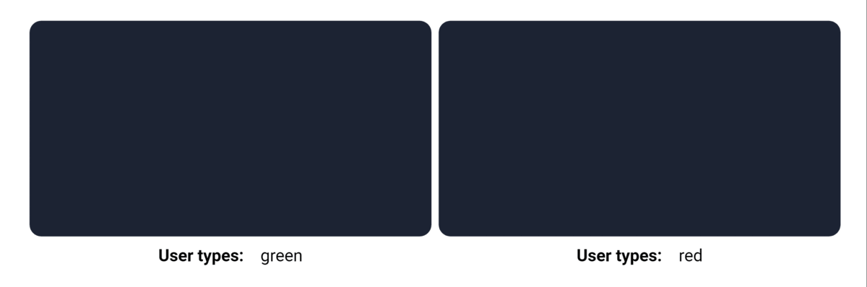
Activity: Flowcharts!
Draw a flowchart for this program.
Draw a flowchart for this program.
Make a copy of the worksheet and draw the flowchart (Microsoft Version)
‹#›

Slide 61
Look at this flowchart
Play Video
Start
3:46 min
Ask user for name
Slide 61 - 98
Wait 5 seconds
In Python, this choice is represented by an if statement
Is the name "John"?
True
Display "Hey! I’m called John, too!"
False
Display "See ya later!"
End
‹#›

Slide 62
Look at this flowchart
Start
Ask user for name
In Python, this choice is represented by an if statement
In this case:
if name == "John":
Wait 5 seconds
Is the name "John"?
True
Display "Hey! I’m called John, too!"
False
Display "See ya later!"
End
‹#›

Slide 63
Look at this flowchart
Start
Ask user for name
In Python, this choice is represented by an if statement
In this case:
if name == "John":
Wait 5 seconds
Is the name "John"?
True
Display "Hey! I’m called John, too!"
False
Display "See ya later!"
The if keyword. Notice that it is all lowercase.
End
‹#›

Slide 64
Look at this flowchart
Start
Ask user for name
In Python, this choice is represented by an if statement
In this case:
if name == "John":
Wait 5 seconds
Is the name "John"?
True
Display "Hey! I’m called John, too!"
False
Display "See ya later!"
This is the question that we are asking.
End
‹#›

Slide 65
Look at this flowchart
Start
Ask user for name
In Python, this choice is represented by an if statement
In this case:
if name == "John":
Wait 5 seconds
Is the name "John"?
True
Display "Hey! I’m called John, too!"
False
Display "See ya later!"
In this case, it is asking whether name is the same as "John".
End
‹#›

Slide 66
Look at this flowchart
Start
Ask user for name
In Python, this choice is represented by an if statement
In this case:
if name == "John":
Wait 5 seconds
Is the name "John"?
True
Display "Hey! I’m called John, too!"
False
Display "See ya later!"
In this case, it is asking whether name is the same as "John".
End
‹#›

Slide 67
Look at this flowchart
Start
Ask user for name
In Python, this choice is represented by an if statement
In this case:
if name == "John":
Wait 5 seconds
Is the name "John"?
True
Display "Hey! I’m called John, too!"
False
Display "See ya later!"
In this case, it is asking whether name is the same as "John".
End
‹#›

Slide 68
Look at this flowchart
Start
Ask user for name
In Python, this choice is represented by an if statement
In this case:
if name == "John":
Wait 5 seconds
Is the name "John"?
True
Display "Hey! I’m called John, too!"
False
Display "See ya later!"
In this case, it is asking whether name is the same as "John".
End
‹#›

Slide 69
Look at this flowchart
Start
Ask user for name
In Python, this choice is represented by an if statement
In this case:
if name == "John":
Wait 5 seconds
Is the name "John"?
True
Display "Hey! I’m called John, too!"
False
Display "See ya later!"
In this case, it is asking whether name is the same as "John".
End
‹#›

Slide 70
Look at this flowchart
Start
Ask user for name
In Python, this choice is represented by an if statement
In this case:
if name == "John":
Wait 5 seconds
Is the name "John"?
True
Display "Hey! I’m called John, too!"
False
Display "See ya later!"
Notice the double ==
If we just use a single = sign, it won’t work. Instead, == is used to compare if one
thing is equal to another.
End
‹#›

Slide 71
Look at this flowchart
Start
Ask user for name
In Python, this choice is represented by an if statement
In this case:
if name == "John":
Wait 5 seconds
Is the name "John"?
True
Display "Hey! I’m called John, too!"
False
Display "See ya later!"
We always end the if statement with a colon character :
End
‹#›

Slide 72
Look at this flowchart
Start
Ask user for name
In Python, this choice is represented by an if statement
In this case:
if name == "John":
print("Hey! I’m called
John, too!")
Wait 5 seconds
Is the name "John"?
True
Display "Hey! I’m called John, too!"
False
Display "See ya later!"
Now, if the answer to the question is True, Python will run any code that is underneath and indented below the if statement.
End
‹#›

Slide 73
Look at this flowchart
Start
Ask user for name
In Python, this choice is represented by an if statement
In this case:
if name == "John":
print("Hey! I’m called
John, too!")
Wait 5 seconds
Is the name "John"?
True
Display "Hey! I’m called John, too!"
False
Display "See ya later!"
Now, if the answer to the question is True, Python will run any code that is underneath and indented below the if statement.
End
‹#›

Slide 74
Look at this flowchart
Start
Ask user for name
In Python, this choice is represented by an if statement
In this case:
if name == "John":
print("Hey! I’m called
John, too!")
Wait 5 seconds
Is the name "John"?
True
Display "Hey! I’m called John, too!"
False
Display "See ya later!"
Now, if the answer to the question is True, Python will run any code that is underneath and indented below the if statement.
End
‹#›

Slide 75
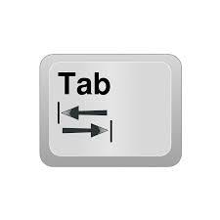
Look at this flowchart
Start
Ask user for name
In Python, this choice is represented by an if statement
In this case:
if name == "John":
print("Hey! I’m called
John, too!")
Wait 5 seconds
Is the name "John"?
True
Display "Hey! I’m called John, too!"
False
Display "See ya later!"
To indent, press the [TAB] key ( ).
End
‹#›

Slide 76
Look at this flowchart
Start
Ask user for name
In Python, this choice is represented by an if statement
In this case:
if name == "John":
print("Hey! I’m called
John, too!")
print("Let’s be twins!")
Wait 5 seconds
Is the name "John"?
True
Display "Hey! I’m called John, too!"
False
Display "See ya later!"
Now, if the answer to the question is True, Python will run any code that is underneath and indented below the if statement.
End
‹#›

Slide 77
Look at this flowchart
Start
Ask user for name
In Python, this choice is represented by an if statement
In this case:
if name == "John":
print("Hey! I’m called
John, too!")
print("See ya later!")
Wait 5 seconds
Is the name "John"?
True
Display "Hey! I’m called John, too!"
False
Display "See ya later!"
But if the answer was False, Python will skip all the code that was indented, and run the next line of code that was not indented.
End
‹#›

Slide 78
Look at this flowchart
Start
Ask user for name
In Python, this choice is represented by an if statement
In this case:
if name == "John":
print("Hey! I’m called
John, too!")
print("See ya later!")
Wait 5 seconds
Is the name "John"?
True
Display "Hey! I’m called John, too!"
False
Display "See ya later!"
But if the answer was False, Python will skip all the code that was indented, and run the next line of code that was not indented.
End
‹#›

Slide 79
Look at this flowchart
Start
Ask user for name
In Python, this choice is represented by an if statement
In this case:
if name == "John":
print("Hey! I’m called
John, too!")
print("See ya later!")
Wait 5 seconds
Is the name "John"?
True
Display "Hey! I’m called John, too!"
False
Display "See ya later!"
This line of code also gets run when Python finishes running all the code above that was for the True answer.
End
‹#›

Slide 80
Look at this flowchart
Start
Ask user for name
In Python, this choice is represented by an if statement
In this case:
if name == "John":
print("Hey! I’m called
John, too!")
print("See ya later!")
Wait 5 seconds
Is the name "John"?
True
Display "Hey! I’m called John, too!"
False
Display "See ya later!"
This line of code also gets run when Python finishes running all the code above that was for the True answer.
End
‹#›

Slide 81
Let’s go through the code
Start
Ask user for name
from time import sleep
Wait 5 seconds
Is the name "John"?
True
Display "Hey! I’m called John, too!"
False
Display "See ya later!"
End
‹#›

Slide 82
Let’s go through the code
Start
Ask user for name
from time import sleep
Importing the sleep() command from the time module.
Wait 5 seconds
Is the name "John"?
True
Display "Hey! I’m called John, too!"
False
Display "See ya later!"
End
‹#›

Slide 83
Let’s go through the code
Start
Ask user for name
from time import sleep
This line has to go at the top, or we won’t be able to use sleep() later on
Wait 5 seconds
Is the name "John"?
True
Display "Hey! I’m called John, too!"
False
Display "See ya later!"
End
‹#›

Slide 84
Let’s go through the code
Start
Ask user for name
from time import sleep
Wait 5 seconds
Is the name "John"?
True
Display "Hey! I’m called John, too!"
False
Display "See ya later!"
End
‹#›

Slide 85
Let’s go through the code
Start
Ask user for name
from time import sleep
Wait 5 seconds
Is the name "John"?
True
Display "Hey! I’m called John, too!"
False
Display "See ya later!"
End
‹#›

Slide 86
Let’s go through the code
Start
Ask user for name
from time import sleep
name=input("Enter your name:")
Wait 5 seconds
Is the name "John"?
True
Display "Hey! I’m called John, too!"
False
Display "See ya later!"
End
‹#›

Slide 87
Let’s go through the code
Start
Ask user for name
from time import sleep
name=input("Enter your name:")
Wait 5 seconds
Is the name "John"?
True
Display "Hey! I’m called John, too!"
False
Display "See ya later!"
End
‹#›

Slide 88
Let’s go through the code
Start
Ask user for name
from time import sleep
name=input("Enter your name:")
sleep(5)
Wait 5 seconds
Is the name "John"?
True
Display "Hey! I’m called John, too!"
False
Display "See ya later!"
End
‹#›

Slide 89
Let’s go through the code
Start
Ask user for name
from time import sleep
name=input("Enter your name:")
sleep(5)
Wait 5 seconds
Is the name "John"?
True
Display "Hey! I’m called John, too!"
False
Display "See ya later!"
End
‹#›

Slide 90
Let’s go through the code
Start
Ask user for name
from time import sleep
name=input("Enter your name:")
sleep(5)
if name == "John":
Wait 5 seconds
Is the name "John"?
True
Display "Hey! I’m called John, too!"
False
Display "See ya later!"
End
‹#›

Slide 91
Let’s go through the code
Start
Ask user for name
from time import sleep
name=input("Enter your name:")
sleep(5)
if name == "John":
Wait 5 seconds
Is the name "John"?
True
Display "Hey! I’m called John, too!"
False
Display "See ya later!"
End
‹#›

Slide 92
Let’s go through the code
Start
Ask user for name
from time import sleep
name=input("Enter your name:")
sleep(5)
if name == "John":
Wait 5 seconds
Is the name "John"?
True
Display "Hey! I’m called John, too!"
False
Display "See ya later!"
End
‹#›

Slide 93
Let’s go through the code
Start
Ask user for name
from time import sleep
name=input("Enter your name:")
sleep(5)
if name == "John":
print("Hey! I’m called John,
too!")
Wait 5 seconds
Is the name "John"?
True
Display "Hey! I’m called John, too!"
False
Display "See ya later!"
End
‹#›

Slide 94
Let’s go through the code
Start
Ask user for name
from time import sleep
name=input("Enter your name:")
sleep(5)
if name == "John":
print("Hey! I’m called John,
too!")
Wait 5 seconds
Is the name "John"?
True
Display "Hey! I’m called John, too!"
False
Display "See ya later!"
End
‹#›

Slide 95
Let’s go through the code
Start
Ask user for name
from time import sleep
name=input("Enter your name:")
sleep(5)
if name == "John":
print("Hey! I’m called John,
too!")
Wait 5 seconds
Is the name "John"?
True
Display "Hey! I’m called John, too!"
False
Display "See ya later!"
End
‹#›

Slide 96
Let’s go through the code
Start
Ask user for name
from time import sleep
name=input("Enter your name:")
sleep(5)
if name == "John":
print("Hey! I’m called John,
too!")
print("See ya later!")
Wait 5 seconds
Is the name "John"?
True
Display "Hey! I’m called John, too!"
False
Display "See ya later!"
End
‹#›

Slide 97
Let’s go through the code
Start
Ask user for name
from time import sleep
name=input("Enter your name:")
sleep(5)
if name == "John":
print("Hey! I’m called John,
too!")
print("See ya later!")
Wait 5 seconds
Is the name "John"?
True
Display "Hey! I’m called John, too!"
False
Display "See ya later!"
End
‹#›

Slide 98
Let’s go through the code
Start
Ask user for name
from time import sleep
name=input("Enter your name:")
sleep(5)
if name == "John":
print("Hey! I’m called John,
too!")
print("See ya later!")
Wait 5 seconds
Is the name "John"?
True
Display "Hey! I’m called John, too!"
False
Display "See ya later!"
End
‹#›

Slide 99

Activity: Favourite Subject!
Start
Ask user for favourite school subject
Is the subject "coding"?
True
Display "Hey, fellow programmer!!"
False
Display "Art is my favourite subject!"
Activity 05.01
Favourite Subject!
End
‹#›

Slide 100

Activity: Are we Twins?
Helpful Hints
You might need to draw a flowchart to help you with the flow!
Check the cheat sheet for the code you need!
Activity 05.02
Are We Twins
‹#›

Slide 101

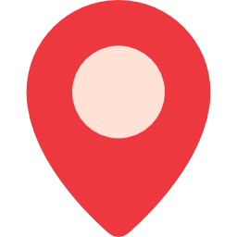
Activity: A Quiz!
Helpful Hints
Watch the tutorial video.
Check the cheat sheet for the code you need!
Activity 05.03
A Quiz
‹#›

Slide 102
Summary
Flowcharts can be used to represent how a program flows
if statements are used to make choices in a program so that it can behave differently based on what the user entered
‹#›

Slide 103


Reflection: Exit pass
What is one new thing you learnt today?
Write it on a sticky note and stick it on the board before you leave the classroom
‹#›

Slide 104
License Information
These CS in Schools lessons plans, worksheets, and other materials were created by Toan Huynh and Hugh Williams. They are licensed under a Creative Commons Attribution-ShareAlike 4.0 International License.
"Clock" by Freepik on flaticon.com
‹#›

