Slide 1


Lesson 3
Colour Your World!
csinschools.com

Slide 2



Previously, on CS in Schools...
True or False?
Extra blank lines between Python code lines will change how the program runs.
‹#›
Notes:
Answer:
False

Slide 3
Previously, on CS in Schools...
True or False?
These two lines of code do exactly the same thing.
print("Hello, world!")
print(" Hello, world!")
‹#›
Notes:
Answer:
False

Slide 4
Previously, on CS in Schools...
True or False?
These two lines of code do exactly the same thing.
print("Press [ENTER] to continue.")
input("Press [ENTER] to continue.")
‹#›
Notes:
Answer:
False
The first line will just display the text and move on
The second line will display the text and wait for the user to press [enter] before moving on

Slide 5

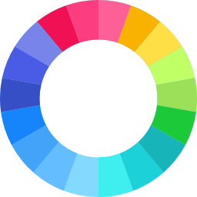
Learning objectives
By the end of this lesson, you should be able to:
understand how to reuse other people’s code in Python
understand how to change the text colour, highlighting, and styles!
‹#›

Slide 6

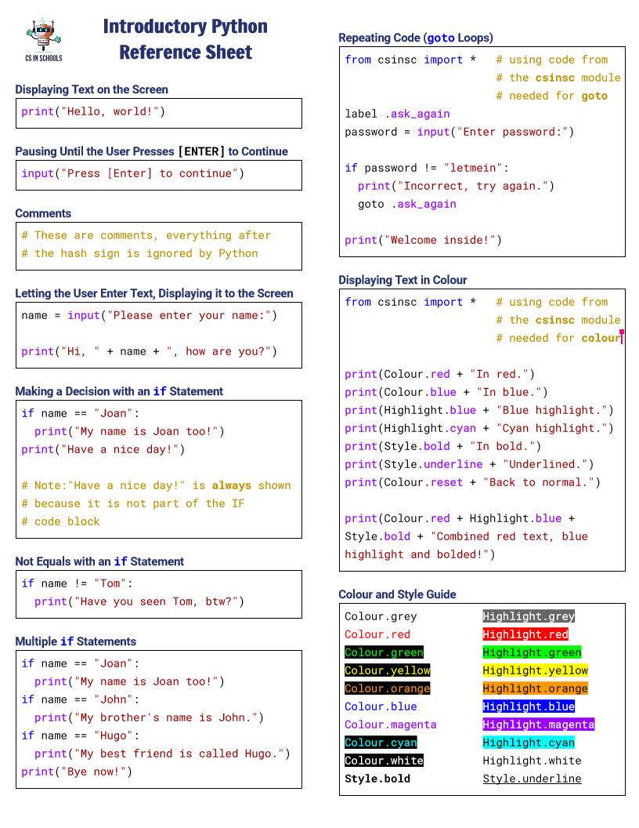

Python Reference Sheet
Python Reference Sheet
Print it out and use it!
Get it online. (Microsoft)
‹#›

Slide 7


Look Who’s Talking
Can you identify the mystery cartoon character?
‹#›

Slide 8
Look Who’s Talking
What is the new feature that you haven’t seen before in this program?
‹#›

Slide 9
Look Who’s Talking
What is the new feature that you haven’t seen before in this program?
Colours!
‹#›

Slide 10
Look Who’s Talking
What is the new feature that you haven’t seen before in this program?
Colours!
We will learn how to use code that other people have written to help us colour our text
‹#›

Slide 11


Using other people’s code!
In Python, as in many other programming languages, we do not have to reinvent the wheel by writing everything from scratch
We have the ability to reuse code that other people have written
Are there examples of code that you wish someone else had written and that you could just use? Chat with the person next to you!
‹#›

Slide 12
The import statement
To reuse other people’s code in our own programs we use the import statement:
from csinsc import *
This is very similar to copying and pasting code
‹#›

Slide 13
The import statement
from csinsc import *
‹#›

Slide 14
The import statement
from csinsc import *
‹#›

Slide 15
The import statement
from csinsc import *
In this code, csinsc is the name of a module
A module is a collection of code that is contained in a separate file
In this case, the module we are using is called csinsc (short for CS in Schools) and it was developed by the CS in Schools team
Importing this module means you don’t have to copy and paste the code, and you always get the latest version from the original creator
‹#›

Slide 16
The import statement
from csinsc import *
‹#›

Slide 17
The import statement
from csinsc import *
The asterisk * means that everything should be imported from the module
Sometimes, you might only import what you need from the module (rather than telling Python to use everything)
‹#›

Slide 18

Changing colours
To change colours and styles, we will use code from the csinsc module
‹#›

Slide 19


Changing colours
After we have imported csinsc, we can add the following text to our print statement to display text in colour:
print(Colour.green + "This is green.")
‹#›

Slide 20
Changing colours
After we have imported csinsc, we can add the following text to our print statement to display text in colour:
print(Colour.green + "This is green.")
‹#›

Slide 21
Changing colours
After we have imported csinsc, we can add the following text to our print statement to display text in colour:
print(Colour.green + "This is green.")
We can change the colour name here to use different colours
‹#›

Slide 22
Changing colours
After we have imported csinsc, we can add the following text to our print statement to display text in colour:
print(Colour.green + "This is green.")
‹#›

Slide 23
Changing colours
After we have imported csinsc, we can add the following text to our print statement to display text in colour:
print(Colour.green + "This is green.")
We use the plus ‘+’ sign to ‘join’ the text to the colour.
‹#›

Slide 24
Changing colours
There are many different colours, highlights, and styles that you combine together to achieve many effects. We’ll see some code examples on the next slides.
Colour names
Highlight names
Style names
Colour.red
Colour.orange
Colour.yellow
Colour.green
Colour.cyan
Colour.blue
Colour.purple
Colour.magenta
Colour.white
Colour.grey
Colour.reset
Highlight.red
Highlight.orange
Highlight.yellow
Highlight.green
Highlight.cyan
Highlight.blue
Highlight.purple
Highlight.magenta
Highlight.white
Highlight.grey
Style.bold
Style.underline
‹#›

Slide 25


Activity: Colour a Rainbow!
Helpful Hints
Remember, Colour needs a capital 'C'
Check the cheat sheet for the colours you can use!
Activity 03.01 Colour a Rainbow
‹#›

Slide 26

Code example
from csinsc import *
print(Colour.red + "In red.")
print(Colour.blue + "In blue.")
print(Highlight.cyan + Colour.red + "=)")
print(Style.bold + Colour.grey + "xD")
print(Colour.reset + "Back to normal!")
print(Colour.green + "*" + Colour.red + "*")
‹#›

Slide 27
Code example
from csinsc import *
print(Colour.red + "In red.")
print(Colour.blue + "In blue.")
print(Highlight.cyan + Colour.red + "=)")
print(Style.bold + Colour.grey + "xD")
print(Colour.reset + "Back to normal!")
print(Colour.green + "*" + Colour.red + "*")
‹#›

Slide 28
Code example
Reusing all the code in the csinsc module.
from csinsc import *
print(Colour.red + "In red.")
print(Colour.blue + "In blue.")
print(Highlight.cyan + Colour.red + "=)")
print(Style.bold + Colour.grey + "xD")
print(Colour.reset + "Back to normal!")
print(Colour.green + "*" + Colour.red + "*")
‹#›

Slide 29
Code example
Without this, none of the Colour. and Highlight. code below will work.
from csinsc import *
print(Colour.red + "In red.")
print(Colour.blue + "In blue.")
print(Highlight.cyan + Colour.red + "=)")
print(Style.bold + Colour.grey + "xD")
print(Colour.reset + "Back to normal!")
print(Colour.green + "*" + Colour.red + "*")
‹#›

Slide 30
Code example
from csinsc import *
print(Colour.red + "In red.")
print(Colour.blue + "In blue.")
print(Highlight.cyan + Colour.red + "=)")
print(Style.bold + Colour.grey + "xD")
print(Colour.reset + "Back to normal!")
print(Colour.green + "*" + Colour.red + "*")
‹#›

Slide 31
Code example
In red.
from csinsc import *
print(Colour.red + "In red.")
print(Colour.blue + "In blue.")
print(Highlight.cyan + Colour.red + "=)")
print(Style.bold + Colour.grey + "xD")
print(Colour.reset + "Back to normal!")
print(Colour.green + "*" + Colour.red + "*")
‹#›

Slide 32
Code example
In red.
from csinsc import *
print(Colour.red + "In red.")
print(Colour.blue + "In blue.")
print(Highlight.cyan + Colour.red + "=)")
print(Style.bold + Colour.grey + "xD")
print(Colour.reset + "Back to normal!")
print(Colour.green + "*" + Colour.red + "*")
‹#›

Slide 33
Code example
In red.
In blue.
from csinsc import *
print(Colour.red + "In red.")
print(Colour.blue + "In blue.")
print(Highlight.cyan + Colour.red + "=)")
print(Style.bold + Colour.grey + "xD")
print(Colour.reset + "Back to normal!")
print(Colour.green + "*" + Colour.red + "*")
‹#›

Slide 34
Code example
In red.
In blue.
from csinsc import *
print(Colour.red + "In red.")
print(Colour.blue + "In blue.")
print(Highlight.cyan + Colour.red + "=)")
print(Style.bold + Colour.grey + "xD")
print(Colour.reset + "Back to normal!")
print(Colour.green + "*" + Colour.red + "*")
‹#›

Slide 35
Code example
In red.
In blue.
=)
from csinsc import *
print(Colour.red + "In red.")
print(Colour.blue + "In blue.")
print(Highlight.cyan + Colour.red + "=)")
print(Style.bold + Colour.grey + "xD")
print(Colour.reset + "Back to normal!")
print(Colour.green + "*" + Colour.red + "*")
‹#›

Slide 36
Code example
In red.
In blue.
=)
from csinsc import *
print(Colour.red + "In red.")
print(Colour.blue + "In blue.")
print(Highlight.cyan + Colour.red + "=)")
print(Style.bold + Colour.grey + "xD")
print(Colour.reset + "Back to normal!")
print(Colour.green + "*" + Colour.red + "*")
We can combine styles together with the ‘+’ sign!
‹#›

Slide 37
Code example
In red.
In blue.
=)
from csinsc import *
print(Colour.red + "In red.")
print(Colour.blue + "In blue.")
print(Highlight.cyan + Colour.red + "=)")
print(Style.bold + Colour.grey + "xD")
print(Colour.reset + "Back to normal!")
print(Colour.green + "*" + Colour.red + "*")
‹#›

Slide 38
Code example
In red.
In blue.
=)
xD
from csinsc import *
print(Colour.red + "In red.")
print(Colour.blue + "In blue.")
print(Highlight.cyan + Colour.red + "=)")
print(Style.bold + Colour.grey + "xD")
print(Colour.reset + "Back to normal!")
print(Colour.green + "*" + Colour.red + "*")
‹#›

Slide 39
Code example
In red.
In blue.
=)
xD
from csinsc import *
print(Colour.red + "In red.")
print(Colour.blue + "In blue.")
print(Highlight.cyan + Colour.red + "=)")
print(Style.bold + Colour.grey + "xD")
print(Colour.reset + "Back to normal!")
print(Colour.green + "*" + Colour.red + "*")
If we don’t change the colour, highlight or style, it will "remember" the last one that was used.
‹#›

Slide 40
Code example
In red.
In blue.
=)
xD
from csinsc import *
print(Colour.red + "In red.")
print(Colour.blue + "In blue.")
print(Highlight.cyan + Colour.red + "=)")
print(Style.bold + Colour.grey + "xD")
print(Colour.reset + "Back to normal!")
print(Colour.green + "*" + Colour.red + "*")
In this case, we didn’t change the highlight, so it will "remember" the last highlight setting and use that.
‹#›

Slide 41
Code example
In red.
In blue.
=)
xD
from csinsc import *
print(Colour.red + "In red.")
print(Colour.blue + "In blue.")
print(Highlight.cyan + Colour.red + "=)")
print(Style.bold + Colour.grey + "xD")
print(Colour.reset + "Back to normal!")
print(Colour.green + "*" + Colour.red + "*")
In this case, we didn’t change the highlight, so it will "remember" the last highlight setting and use that.
‹#›

Slide 42
Code example
In red.
In blue.
=)
xD
from csinsc import *
print(Colour.red + "In red.")
print(Colour.blue + "In blue.")
print(Highlight.cyan + Colour.red + "=)")
print(Style.bold + Colour.grey + "xD")
print(Colour.reset + "Back to normal!")
print(Colour.green + "*" + Colour.red + "*")
‹#›

Slide 43
Code example
In red.
In blue.
=)
xD
from csinsc import *
print(Colour.red + "In red.")
print(Colour.blue + "In blue.")
print(Highlight.cyan + Colour.red + "=)")
print(Style.bold + Colour.grey + "xD")
print(Colour.reset + "Back to normal!")
print(Colour.green + "*" + Colour.red + "*")
Colour.reset will reset all the colours, highlights and styles to their default values.
‹#›

Slide 44
Code example
In red.
In blue.
=)
xD
Back to normal!
from csinsc import *
print(Colour.red + "In red.")
print(Colour.blue + "In blue.")
print(Highlight.cyan + Colour.red + "=)")
print(Style.bold + Colour.grey + "xD")
print(Colour.reset + "Back to normal!")
print(Colour.green + "*" + Colour.red + "*")
‹#›

Slide 45
Code example
In red.
In blue.
=)
xD
Back to normal!
from csinsc import *
print(Colour.red + "In red.")
print(Colour.blue + "In blue.")
print(Highlight.cyan + Colour.red + "=)")
print(Style.bold + Colour.grey + "xD")
print(Colour.reset + "Back to normal!")
print(Colour.green + "*" + Colour.red + "*")
‹#›

Slide 46
Code example
In red.
In blue.
=)
xD
Back to normal!
**
from csinsc import *
print(Colour.red + "In red.")
print(Colour.blue + "In blue.")
print(Highlight.cyan + Colour.red + "=)")
print(Style.bold + Colour.grey + "xD")
print(Colour.reset + "Back to normal!")
print(Colour.green + "*" + Colour.red + "*")
‹#›

Slide 47
Code example
In red.
In blue.
=)
xD
Back to normal!
**
from csinsc import *
print(Colour.red + "In red.")
print(Colour.blue + "In blue.")
print(Highlight.cyan + Colour.red + "=)")
print(Style.bold + Colour.grey + "xD")
print(Colour.reset + "Back to normal!")
print(Colour.green + "*" + Colour.red + "*")
We can change colours and styles in the same line by using the ‘+’ between bits of text.
‹#›

Slide 48
Code example
In red.
In blue.
=)
xD
Back to normal!
**
from csinsc import *
print(Colour.red + "In red.")
print(Colour.blue + "In blue.")
print(Highlight.cyan + Colour.red + "=)")
print(Style.bold + Colour.grey + "xD")
print(Colour.reset + "Back to normal!")
print(Colour.green + "*" + Colour.red + "*")
We can change colours and styles in the same line by using the ‘+’ between bits of text.
‹#›

Slide 49
Code example
In red.
In blue.
=)
xD
Back to normal!
**
from csinsc import *
print(Colour.red + "In red.")
print(Colour.blue + "In blue.")
print(Highlight.cyan + Colour.red + "=)")
print(Style.bold + Colour.grey + "xD")
print(Colour.reset + "Back to normal!")
print(Colour.green + "*" + Colour.red + "*")
We can change colours and styles in the same line by using the ‘+’ between bits of text.
‹#›

Slide 50
Code example
In red.
In blue.
=)
xD
Back to normal!
**
from csinsc import *
print(Colour.red + "In red.")
print(Colour.blue + "In blue.")
print(Highlight.cyan + Colour.red + "=)")
print(Style.bold + Colour.grey + "xD")
print(Colour.reset + "Back to normal!")
print(Colour.green + "*" + Colour.red + "*")
We can change colours and styles in the same line by using the ‘+’ between bits of text.
‹#›

Slide 51
Code example
In red.
In blue.
=)
xD
Back to normal!
**
from csinsc import *
print(Colour.red + "In red.")
print(Colour.blue + "In blue.")
print(Highlight.cyan + Colour.red + "=)")
print(Style.bold + Colour.grey + "xD")
print(Colour.reset + "Back to normal!")
print(Colour.green + "*" + Colour.red + "*")
All done!
‹#›

Slide 52

Activity: No Signal!
Helpful Hints
You should change colours multiple times in one print statement
Check the cheat sheet for the colours you can use!
Activity 03.02 No Signal!
‹#›

Slide 53

The import statement
We don’t always import everything (using the asterisk *)
Some modules are quite big, and it would slow down our program if we imported everything in those modules
There’s no point importing things we don’t need and won’t use!
‹#›

Slide 54
Making our program wait
from time import sleep
‹#›

Slide 55
Making our program wait
from time import sleep
Here’s another example of using import with a different module
The time module is quite big, and includes lots of helpful commands that involve time, dates and more
sleep is a very useful command that makes the program wait for a certain amount of seconds
‹#›

Slide 56
Code example
from time import sleep
print("Hello, world!")
print("Give me a sec...")
sleep(5)
print("Okay, good to go!")
‹#›

Slide 57
Code example
from time import sleep
print("Hello, world!")
print("Give me a sec...")
sleep(5)
print("Okay, good to go!")
‹#›

Slide 58
Code example
Importing the sleep command from the time module.
from time import sleep
print("Hello, world!")
print("Give me a sec...")
sleep(5)
print("Okay, good to go!")
‹#›

Slide 59
Code example
Without this, we can’t use sleep()
from time import sleep
print("Hello, world!")
print("Give me a sec...")
sleep(5)
print("Okay, good to go!")
‹#›

Slide 60
Code example
from time import sleep
print("Hello, world!")
print("Give me a sec...")
sleep(5)
print("Okay, good to go!")
‹#›

Slide 61
Code example
Hello, world!
from time import sleep
print("Hello, world!")
print("Give me a sec...")
sleep(5)
print("Okay, good to go!")
‹#›

Slide 62
Code example
Hello, world!
from time import sleep
print("Hello, world!")
print("Give me a sec...")
sleep(5)
print("Okay, good to go!")
‹#›

Slide 63
Code example
Hello, world!
Give me a sec...
from time import sleep
print("Hello, world!")
print("Give me a sec...")
sleep(5)
print("Okay, good to go!")
‹#›

Slide 64
Code example
Hello, world!
Give me a sec...
from time import sleep
print("Hello, world!")
print("Give me a sec...")
sleep(5)
print("Okay, good to go!")
‹#›

Slide 65
Code example
Hello, world!
Give me a sec...
from time import sleep
print("Hello, world!")
print("Give me a sec...")
sleep(5)
print("Okay, good to go!")
Note that 5 is NOT inside quotation marks!
‹#›

Slide 66
Code example
Hello, world!
Give me a sec...
from time import sleep
print("Hello, world!")
print("Give me a sec...")
sleep(5)
print("Okay, good to go!")
This means it is a number and not text
‹#›

Slide 67
Code example
Hello, world!
Give me a sec...
from time import sleep
print("Hello, world!")
print("Give me a sec...")
sleep(5)
print("Okay, good to go!")
‹#›

Slide 68

Code example
Hello, world!
Give me a sec...
from time import sleep
print("Hello, world!")
print("Give me a sec...")
sleep(5)
print("Okay, good to go!")
Wait 5 seconds...
‹#›

Slide 69
Code example
Hello, world!
Give me a sec...
from time import sleep
print("Hello, world!")
print("Give me a sec...")
sleep(5)
print("Okay, good to go!")
‹#›

Slide 70
Code example
Hello, world!
Give me a sec...
Okay, good to go!
from time import sleep
print("Hello, world!")
print("Give me a sec...")
sleep(5)
print("Okay, good to go!")
‹#›

Slide 71
Code example
Hello, world!
Give me a sec...
Okay, good to go!
from time import sleep
print("Hello, world!")
print("Give me a sec...")
sleep(5)
print("Okay, good to go!")
All done!
‹#›

Slide 72
Changing colours
There are many different colours, highlights, and styles that you combine together to achieve many effects. We’ll see some code examples on the next slides.
Colour names
Highlight names
Style names
Colour.red
Colour.orange
Colour.yellow
Colour.green
Colour.cyan
Colour.blue
Colour.purple
Colour.magenta
Colour.white
Colour.grey
Colour.reset
Highlight.red
Highlight.orange
Highlight.yellow
Highlight.green
Highlight.cyan
Highlight.blue
Highlight.purple
Highlight.magenta
Highlight.white
Highlight.grey
Style.bold
Style.underline
‹#›

Slide 73

Activity: Rubber Ducky!
Helpful Hints
Copy the duck ASCII art from the markdown tab
Check the cheat sheet for the colours you can use!
Activity 03.03 Rubber Ducky!
‹#›

Slide 74

Summary
We can reuse other people’s code in Python by importing modules
We use the Colour. Highlight. and Style. settings in the csinsc module to display text in different colours and styles
We use the sleep() command from the time module to make the computer sleep for a certain number of seconds
‹#›

Slide 75


Reflection: Exit pass
What is one new thing you learnt today?
Write it on a sticky note and stick it on the board before you leave the classroom
‹#›

Slide 76
License Information
These CS in Schools lessons plans, worksheets, and other materials were created by Toan Huynh and Hugh Williams. They are licensed under a Creative Commons Attribution-ShareAlike 4.0 International License.
"Clock" by Freepik on flaticon.com
‹#›

