Slide 1


Lesson 2
Animation
csinschools.com

Slide 2



Previously, on CS in Schools...
What are the coordinates of the bottom left position of the canvas?
What command is used to set the size of the canvas?
Which direction is specified by the x-axis?
Which direction is specified by the y-axis?
‹#›
Notes:
Answers: (0, 0), setCanvasSize(x, y), x-axis is horizontal, y-axis is vertical

Slide 3
Learning objectives
By the end of this lesson, you should be able to:
understand what a variable is
understand what a data type is
create a basic animation using code
‹#›

Slide 4

What is Animation?
As a class, discuss “What is animation?”

Slide 5

What is Animation?
Animation is the technique of showing many images successively to give the illusion of movement
Basically, animation is the art of making still images come alive and move!
This can be done with computers or by hand
It is used in games, movies, GIFs, and many other forms of media

Slide 6
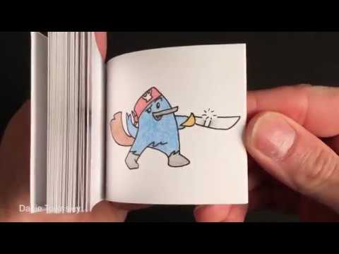
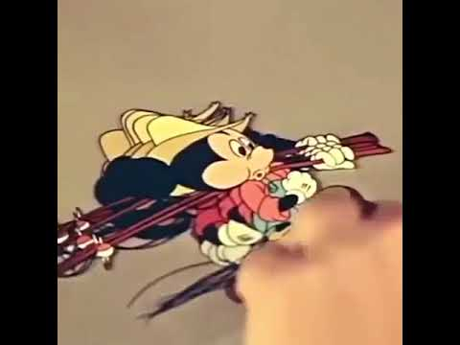
Take a look at some forms of animation…

Slide 7
Animation before computers
As a class, discuss “How was animation created before computers?”

Slide 8

Animation before computers
Animation before computers could be created by:
  Drawing images and taking photos of them (Mickey Mouse)
  Making clay models and taking photos of them (Wallace and Gromit)
  Flipping through multiple drawings in a book (Like the video we just saw)
‹#›

Slide 9
A Short Animation
‹#›

Slide 10
A Short Animation
‹#›

Slide 11
A Short Animation
‹#›

Slide 12
A Short Animation
‹#›

Slide 13
A Short Animation
‹#›

Slide 14
A Short Animation
‹#›

Slide 15
A Short Animation
‹#›

Slide 16
A Short Animation
‹#›

Slide 17
A Short Animation
‹#›

Slide 18
A Short Animation
‹#›

Slide 19
A Short Animation
‹#›

Slide 20
A Short Animation
BYE!
‹#›

Slide 21
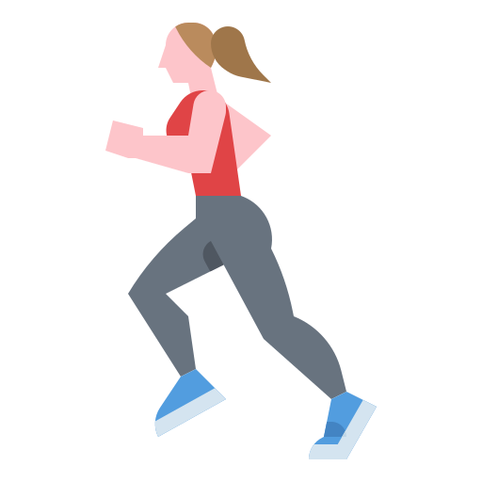
Activity 02.01 - Run, run, run!
Create your own animation by copying, pasting, and modifying the still image in the slide deck below. If you prefer, you can make a flipbook animation by drawing in a notepad.
Activity:
02.01 - Run, run, run
‹#›

Slide 22
Animating a Circle with Code
To draw a circle we use the circle() function:
circle(100, 200, 50)
‹#›

Slide 23
Animating a Circle with Code
To draw a circle we use the circle() function:
circle(100, 200, 50)
Reminder, this will:
  Draw a circle at location (100, 200) with a radius of 50
  NOTE: (100, 200) is the center of the circle
‹#›

Slide 24

Animating a Circle with Code
To draw a circle we use the circle() function:
circle(100, 200, 50)
‹#›

Slide 25
Animating a Circle with Code
To draw a circle we use the circle() function:
circle(100, 200, 50)
To animate the circle, we need to:
Draw the circle
Clear the circle
Draw the circle in a different place
Repeat steps 2 and 3
‹#›

Slide 26
Animating a Circle with Code
To draw a circle we use the circle() function:
circle(100, 200, 50)
To animate the circle, we need to:
Draw the circle
Clear the circle
Draw the circle in a different place
Repeat steps 2 and 3
How can this be done with code?
‹#›

Slide 27
setCanvasSize(300, 300)
fill(255, 255, 255)
background(48, 221, 174)
circle(100, 200, 50)
background(48, 221, 174)
circle(150, 245, 50)
background(48, 221, 174)
circle(200, 250, 50)
background(48, 221, 174)

Slide 28

setCanvasSize(300, 300)
fill(255, 255, 255)
background(48, 221, 174)
circle(100, 200, 50)
background(48, 221, 174)
circle(150, 245, 50)
background(48, 221, 174)
circle(200, 250, 50)
background(48, 221, 174)
Sets the canvas size

Slide 29


setCanvasSize(300, 300)
fill(255, 255, 255)
background(48, 221, 174)
circle(100, 200, 50)
background(48, 221, 174)
circle(150, 245, 50)
background(48, 221, 174)
circle(200, 250, 50)
background(48, 221, 174)
Sets the colour for the next drawing

Slide 30
setCanvasSize(300, 300)
fill(255, 255, 255)
background(48, 221, 174)
circle(100, 200, 50)
background(48, 221, 174)
circle(150, 245, 50)
background(48, 221, 174)
circle(200, 250, 50)
background(48, 221, 174)
Sets the background

Slide 31
setCanvasSize(300, 300)
fill(255, 255, 255)
background(48, 221, 174)
circle(100, 200, 50)
background(48, 221, 174)
circle(150, 245, 50)
background(48, 221, 174)
circle(200, 250, 50)
background(48, 221, 174)
Draws the first circle

Slide 32
setCanvasSize(300, 300)
fill(255, 255, 255)
background(48, 221, 174)
circle(100, 200, 50)
background(48, 221, 174)
circle(150, 245, 50)
background(48, 221, 174)
circle(200, 250, 50)
background(48, 221, 174)
Resets the background to blank

Slide 33
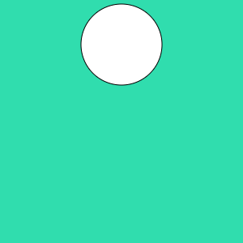
setCanvasSize(300, 300)
fill(255, 255, 255)
background(48, 221, 174)
circle(100, 200, 50)
background(48, 221, 174)
circle(150, 245, 50)
background(48, 221, 174)
circle(200, 250, 50)
background(48, 221, 174)
Draws the second circle

Slide 34
setCanvasSize(300, 300)
fill(255, 255, 255)
background(48, 221, 174)
circle(100, 200, 50)
background(48, 221, 174)
circle(150, 245, 50)
background(48, 221, 174)
circle(200, 250, 50)
background(48, 221, 174)
Resets the background to blank

Slide 35
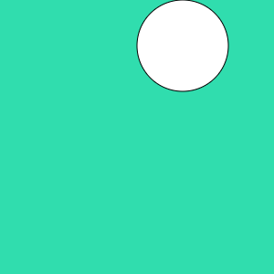
setCanvasSize(300, 300)
fill(255, 255, 255)
background(48, 221, 174)
circle(100, 200, 50)
background(48, 221, 174)
circle(150, 245, 50)
background(48, 221, 174)
circle(200, 250, 50)
background(48, 221, 174)
Draws the third circle

Slide 36
setCanvasSize(300, 300)
fill(255, 255, 255)
background(48, 221, 174)
circle(100, 200, 50)
background(48, 221, 174)
circle(150, 245, 50)
background(48, 221, 174)
circle(200, 250, 50)
background(48, 221, 174)
Resets the background to blank

Slide 37
setCanvasSize(300, 300)
fill(255, 255, 255)
background(48, 221, 174)
circle(100, 200, 50)
background(48, 221, 174)
circle(150, 245, 50)
background(48, 221, 174)
circle(200, 250, 50)
background(48, 221, 174)
When you skip through these slides quickly, you get an animated circle!

Slide 38
setCanvasSize(300, 300)
fill(255, 255, 255)
background(48, 221, 174)
circle(100, 200, 50)
background(48, 221, 174)
circle(150, 245, 50)
background(48, 221, 174)
circle(200, 250, 50)
background(48, 221, 174)
As a programmer, you should always look for repetition!
Can you see any?

Slide 39
setCanvasSize(300, 300)
fill(255, 255, 255)
background(48, 221, 174)
circle(100, 200, 50)
background(48, 221, 174)
circle(150, 245, 50)
background(48, 221, 174)
circle(200, 250, 50)
background(48, 221, 174)
Here we can see there are 3 repeating blocks

Slide 40
setCanvasSize(300, 300)
fill(255, 255, 255)
background(48, 221, 174)
circle(100, 200, 50)
background(48, 221, 174)
circle(150, 245, 50)
background(48, 221, 174)
circle(200, 250, 50)
background(48, 221, 174)
What is the only thing that changes between these 3 blocks?

Slide 41
setCanvasSize(300, 300)
fill(255, 255, 255)
background(48, 221, 174)
circle(100, 200, 50)
background(48, 221, 174)
circle(150, 245, 50)
background(48, 221, 174)
circle(200, 250, 50)
background(48, 221, 174)
What is the only thing that changes between these 3 blocks?

Slide 42
setCanvasSize(300, 300)
fill(255, 255, 255)
background(48, 221, 174)
circle(100, 200, 50)
background(48, 221, 174)
circle(150, 245, 50)
background(48, 221, 174)
circle(200, 250, 50)
background(48, 221, 174)
The position of the circle!

Slide 43

Let’s rewrite this code so that each block is identical…

Slide 44
setCanvasSize(300, 300)
fill(255, 255, 255)
x = 100
y = 100
background(48, 221, 174)
circle(x, y, 50)
x = x + 50
y = y + 50
sleep(0.5)
background(48, 221, 174)
circle(x, y, 50)
x = x + 50
y = y + 50
sleep(0.5)
background(48, 221, 174)
circle(x, y, 50)
x = x + 50
y = y + 50
sleep(0.5)
Run this program, what does it do?
Circle Animation

Slide 45
setCanvasSize(300, 300)
fill(255, 255, 255)
x = 100
y = 100
background(48, 221, 174)
circle(x, y, 50)
x = x + 50
y = y + 50
sleep(0.5)
background(48, 221, 174)
circle(x, y, 50)
x = x + 50
y = y + 50
sleep(0.5)
background(48, 221, 174)
circle(x, y, 50)
x = x + 50
y = y + 50
sleep(0.5)
It animated our circle!
Circle Animation

Slide 46
setCanvasSize(300, 300)
fill(255, 255, 255)
x = 100
y = 100
background(48, 221, 174)
circle(x, y, 50)
x = x + 50
y = y + 50
sleep(0.5)
background(48, 221, 174)
circle(x, y, 50)
x = x + 50
y = y + 50
sleep(0.5)
background(48, 221, 174)
circle(x, y, 50)
x = x + 50
y = y + 50
sleep(0.5)
REMEMBER - computers are very fast!
Circle Animation

Slide 47
setCanvasSize(300, 300)
fill(255, 255, 255)
x = 100
y = 100
background(48, 221, 174)
circle(x, y, 50)
x = x + 50
y = y + 50
sleep(0.5)
background(48, 221, 174)
circle(x, y, 50)
x = x + 50
y = y + 50
sleep(0.5)
background(48, 221, 174)
circle(x, y, 50)
x = x + 50
y = y + 50
sleep(0.5)
This sleep() will ensure the computer slows enough for us to see what is happening
Circle Animation

Slide 48
setCanvasSize(300, 300)
fill(255, 255, 255)
x = 100
y = 100
background(48, 221, 174)
circle(x, y, 50)
x = x + 50
y = y + 50
sleep(0.5)
background(48, 221, 174)
circle(x, y, 50)
x = x + 50
y = y + 50
sleep(0.5)
background(48, 221, 174)
circle(x, y, 50)
x = x + 50
y = y + 50
sleep(0.5)
And now each block is the exact same!
Circle Animation

Slide 49
Let’s rewrite this code so that we have a while loop…

Slide 50

setCanvasSize(300, 300)
fill(255, 255, 255)
x = 100
y = 100
while y <= 200
background(48, 221, 174)
circle(x, y, 50)
x = x + 50
y = y + 50
sleep(0.5)
And here we have it, much more efficient code - give it a run!
While Circle Animation
Try changing the values, what happens?

Slide 51

setCanvasSize(300, 300)
fill(255, 255, 255)
x = 100
y = 100
while y <= 200
background(48, 221, 174)
circle(x, y, 50)
x = x + 50
y = y + 50
sleep(0.5)
while loops will continue running the code indented and underneath, so long as the condition is True
While Circle Animation

Slide 52

Activity 02.02 - My First Coded Animation!
Create your very first coded animation by editing the code below. Feel free to change the colours and shapes involved!
Activity:
02.02 - My First Coded Animation
‹#›

Slide 53

Activity 02.03 - Bye Bye Sunshine!
Now you have the skills to code a sunset! Finish off the code so that the sun sets below the horizon.
Activity:
02.03 - Bye Bye Sunshine
‹#›

Slide 54

Recap: Variables
A variable is used to store values, including:
  “Hi there”
  14
  True
  16.45
A data type tells us what type of data is stored by the variable, these include:
  Strings: “16”
  Integers: 267
  Boolean: True
  Float: 1.45
‹#›

Slide 55
Variables - mouseX and mouseY
Our programming environment includes built in variables
  This means you don’t have to assign them - they’re ready to be used!
Built in variables generally tell us information about a program that can be tricky to obtain
Variables that PyAngelo gives us that can be useful include:
  mouseX - represents the x location of the mouse
  mouseY - represents the y location of the mouse
The mouseX and mouseY variables have a data type of int, which means they store whole numbers

Slide 56
Variables - mouseX and mouseY
setCanvasSize(400, 400)
while True:
background(255, 255, 255)
circle(mouseX, mouseY, 10)
This program will draw a circle that tracks your mouse.

Slide 57
Variables - mouseX and mouseY
setCanvasSize(400, 400)
while True:
background(255, 255, 255)
circle(mouseX, mouseY, 10)
Notice the True condition?
This will ensure the while loop never ends

Slide 58
Variables - mouseX and mouseY
setCanvasSize(400, 400)
while True:
background(255, 255, 255)
circle(mouseX, mouseY, 10)
Notice our mouseX and mouseY variables?
This tells the circle() function to draw the circle where the mouse is!

Slide 59

Activity 02.04 - Scurry Mr Mouse!
Use the program we just took a look through to write a program that tracks your mouse! There is some code already written below for your to use.
Activity:
02.04 - Scurry Mr Mouse
‹#›

Slide 60
Summary
Animation is achieved by clearing the screen and redrawing the appropriate images
A while loop can be used to help achieve this
Variables are named locations in memory that store a value
Variables hold values of a certain type
The inbuilt mouseX and mouseY variables hold integer (whole number) values that represent where the mouse is currently positioned on the canvas
‹#›

Slide 61
Extension: Light to Dark
Can you extend “Bye Bye Sunshine” so that the sky becomes darker as the sun moves across the screen?
‹#›

Slide 62
License Information
These CS in Schools lessons plans, worksheets, and other materials were created by the CS in Schools Team. They are licensed under a Creative Commons Attribution-ShareAlike 4.0 International License.
‹#›

