Slide 1



Lesson 3
Compound Boolean Conditions
8
csinschools.com

Slide 2



Learning objectives
By the end of this lesson, you will be able to:
Understand how algorithms make more complex decisions by using compound boolean conditions involving the AND, OR operators
Design and draw flowcharts representing algorithms which makes multiple decisions with multiple outcomes
Design and draw flowcharts representing algorithms identifying congruent and similar triangles
‹#›

Slide 3
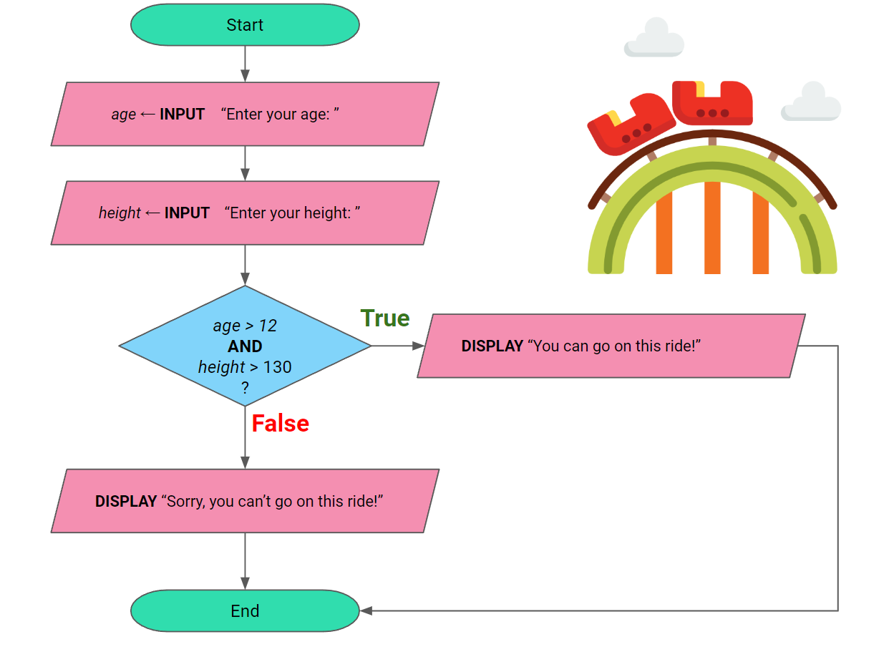


Python Demo
4:38 min
Vimeo video link
Link to Accompanying Slides
(PDF, powerpoint)

Slide 4

Worksheet Activity
Complete Questions 1 - 7
(PDF, MS Word)

Slide 5
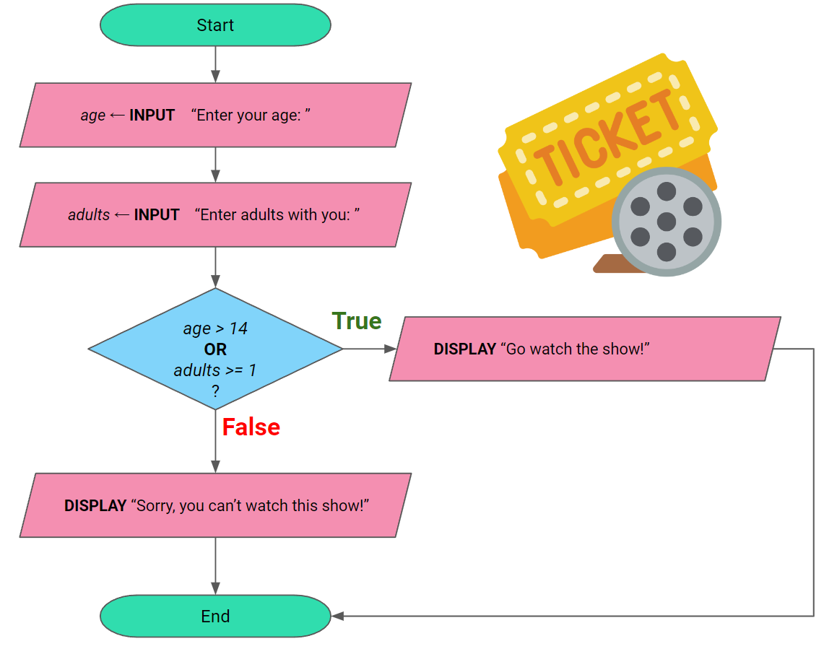
3:25 min
Vimeo video link
Link to Accompanying Slides
(PDF, powerpoint)

Slide 6
Worksheet Activity
Complete Questions 8 - 14
(PDF, MS Word)

Slide 7
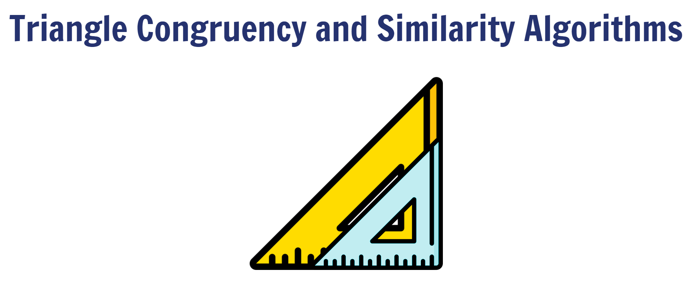
9:40 min
Vimeo video link
Link to Accompanying Slides
(PDF, powerpoint)

Slide 8
Worksheet Activity
Complete Questions 15 - 17
(PDF, MS Word)

Slide 9

Summary
You are now be able to:
Understand how algorithms make more complex decisions by using compound boolean conditions involving the AND, OR operators
Design and draw flowcharts representing algorithms which makes multiple decisions with multiple outcomes
Design and draw flowcharts representing algorithms identifying congruent and similar triangles

Slide 10
License Information
These CS in Schools lessons plans, worksheets, and other materials were created by the CS in Schools team. They are licensed under a Creative Commons Attribution-ShareAlike 4.0 International License.
Images all taken from flaticon.

