Slide 1



Lesson 2
Making Choices with Variables
8
csinschools.com

Slide 2



Learning objectives
By the end of this lesson, you will be able to:
Understand how decisions are made using variables within algorithms
Draw a flowchart representing an algorithm which makes decisions using variables
‹#›

Slide 3
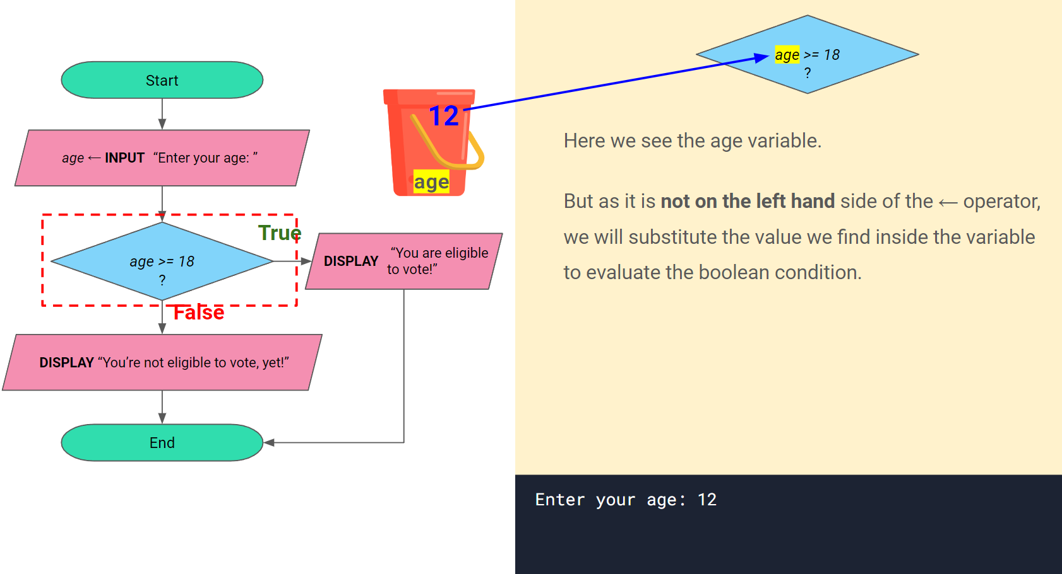


2:38 min
Vimeo video link
Link to Accompanying Slides
(PDF, powerpoint)

Slide 4

02.01 Worksheet Activity
Complete Questions 1- 6
(PDF, MS Word)

Slide 5
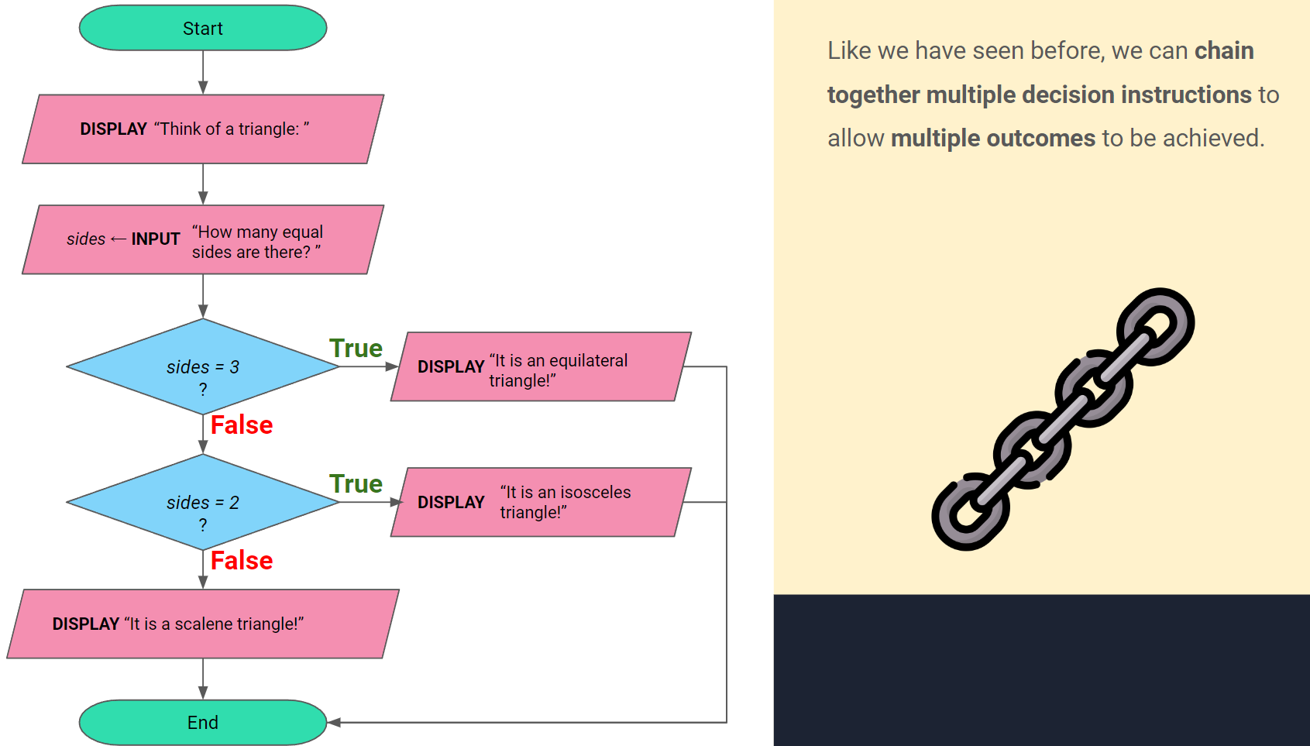
2:41 min
Vimeo video link
Link to Accompanying Slides
(PDF, powerpoint)

Slide 6
02.01 Worksheet Activity
Complete Questions 7 - 14
(PDF, MS Word)

Slide 7

Summary
You are now be able to:
Understand how decisions are made using variables within algorithms
Draw a flowchart representing an algorithm which makes decisions using variables

Slide 8
License Information
These CS in Schools lessons plans, worksheets, and other materials were created by the CS in Schools team. They are licensed under a Creative Commons Attribution-ShareAlike 4.0 International License.
Images all taken from flaticon.

