Slide 1



Lesson 1
Algorithms and Flowcharts
8
csinschools.com

Slide 2



Learning objectives
By the end of this lesson, you will be able to:
Understand how variables work within algorithms and how they are used
Draw flowcharts for algorithms involving variables and calculates
‹#›

Slide 3
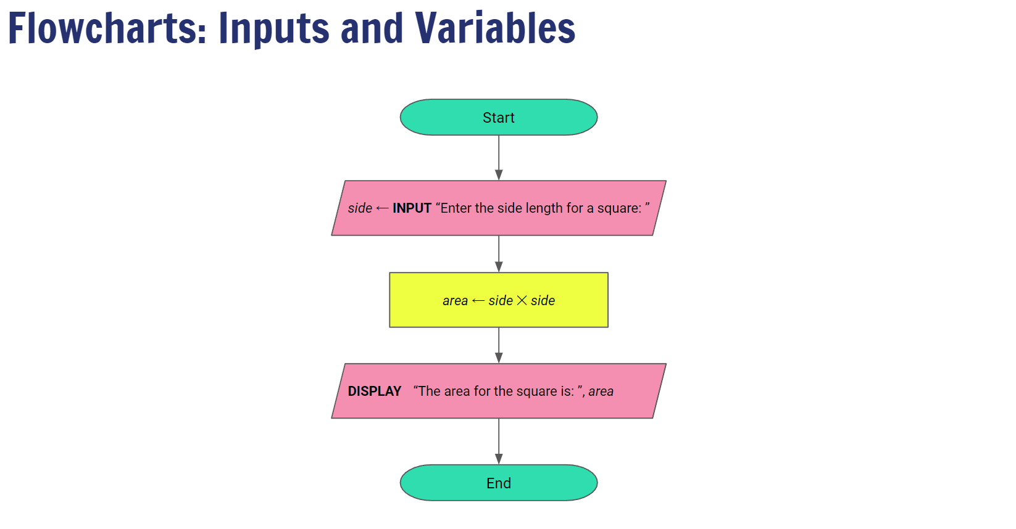


8:55 min
Vimeo video link
Link to Accompanying Slides
(PDF, powerpoint)

Slide 4

Worksheet Activity
Complete Questions 1 - 11
(PDF, MS Word)

Slide 5

Summary
You are now be able to:
Understand how variables work within algorithms and how they are used
Draw flowcharts for algorithms involving variables and calculates

Slide 6
License Information
These CS in Schools lessons plans, worksheets, and other materials were created by the CS in Schools team. They are licensed under a Creative Commons Attribution-ShareAlike 4.0 International License.
Images all taken from flaticon.

