Slide 1
Lesson 7
A Simple Text Adventure Game

Slide 2

Learning objectives
By then end of this lesson, you should be able to:
understand the assignment and how you will be marked
understand how this assignment allows you to demonstrate all you have learned about Python coding so far
start working on your assignment!

Slide 3
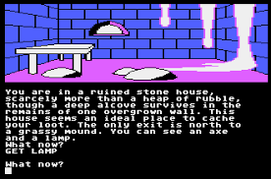
Assignment rubric
Text adventure games were popular in the 1980s and were sometimes referred to as “interactive novels”. Some of them also featured graphics to enhance the playing experience!
Check out the marking rubric here
(PDF, MS Word)
Keen for a competition? Play this game and see who is the first to successfully retrieve the package!

Slide 4

Some other examples to get you thinking...
City of Gold Example Warehouse Quest
Your Spirit Animal Example

Slide 5


Getting Starting - A simple 4 location “game”
Step 1: Drawing the Location Diagram
Instructions:
Watch the video above (3:47 min)
On paper, draw 2 large circles (make space for a 3rd circle later)
Fill them in with the details of the 2 locations in your sample game.
3:47 min
Vimeo video link

Slide 6
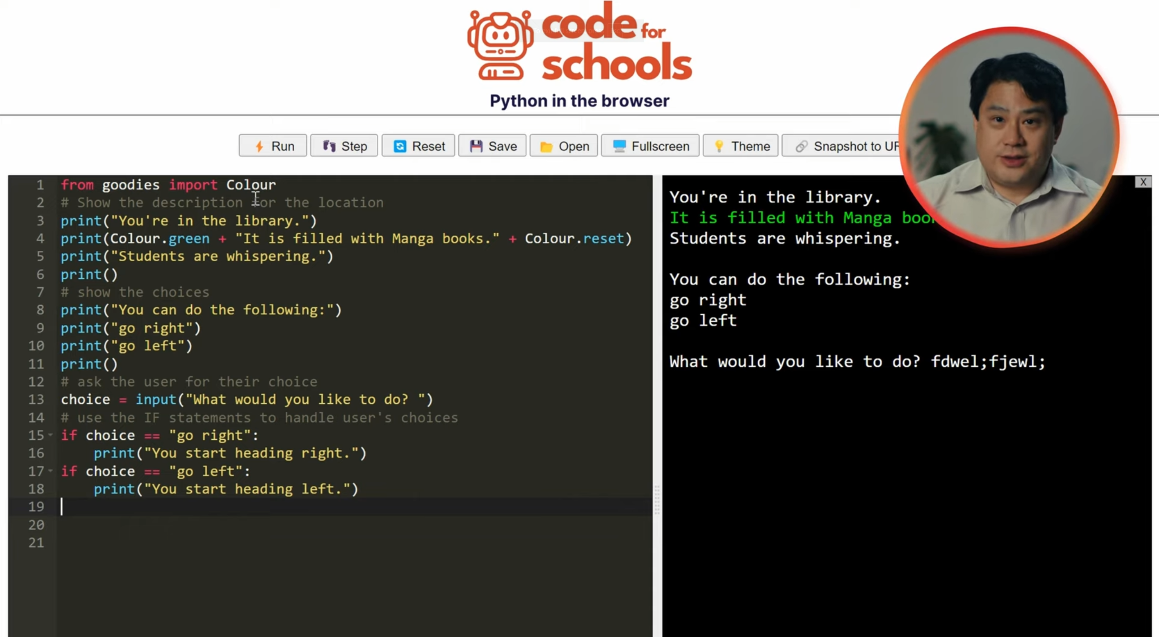
Getting Starting - A simple 4 location “game”
Step 2: Coding up the first location
Instructions:
Watch the video above (7:21 min)
While you are watching the video, code up your first location by adapting the code in the video
7:21 min
Vimeo video link

Slide 7
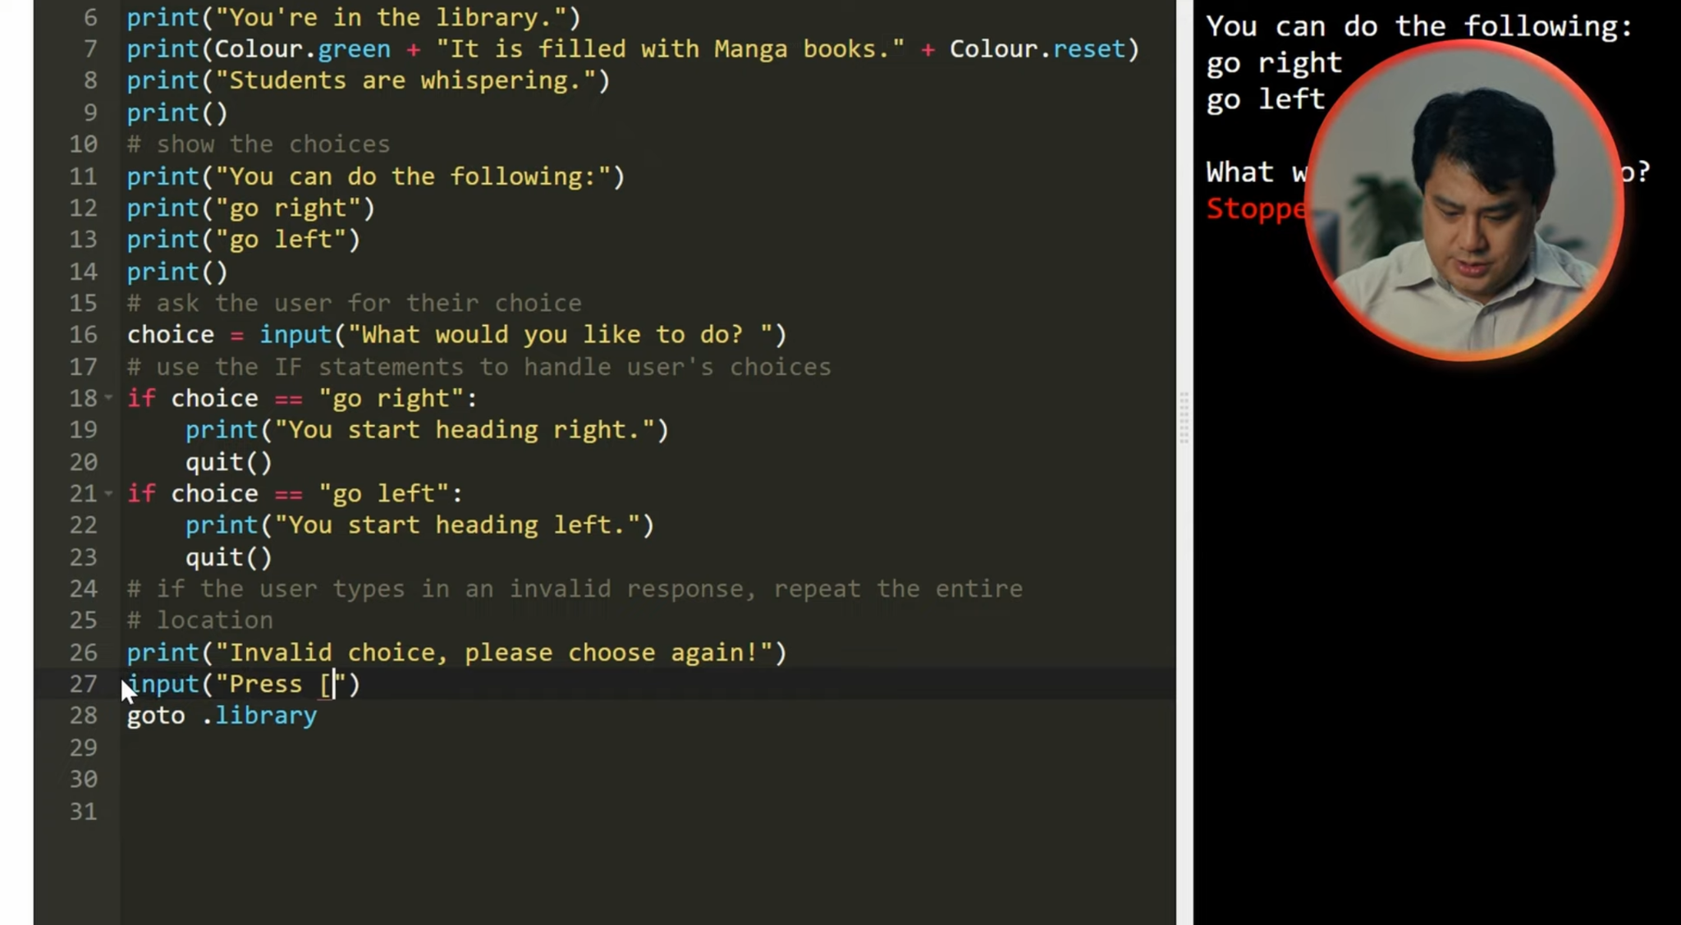
Getting Starting - A simple 4 location “game”
Step 3: Finishing the first location
Instructions:
Watch the video above(4:11 min)
Finish coding up your first location by adapting the code in the video.
4:11 min
Vimeo video link

Slide 8
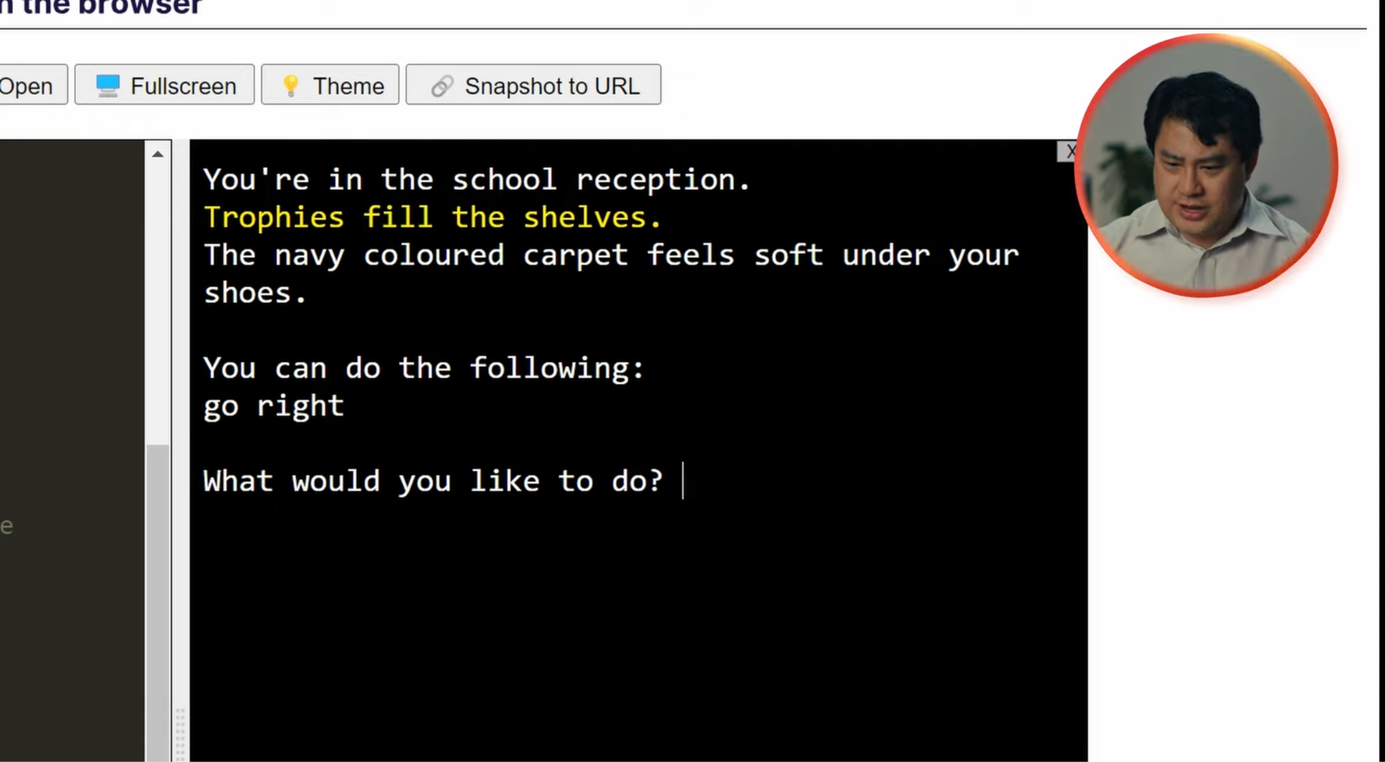
Getting Starting - A simple 4 location “game”
Step 4: Coding the second location
Instructions:
Watch the video above(5:02 min)
Code up your second location by adapting the code in the video.
Playtest your game and check that it works!
5:02 min
Vimeo video link

Slide 9
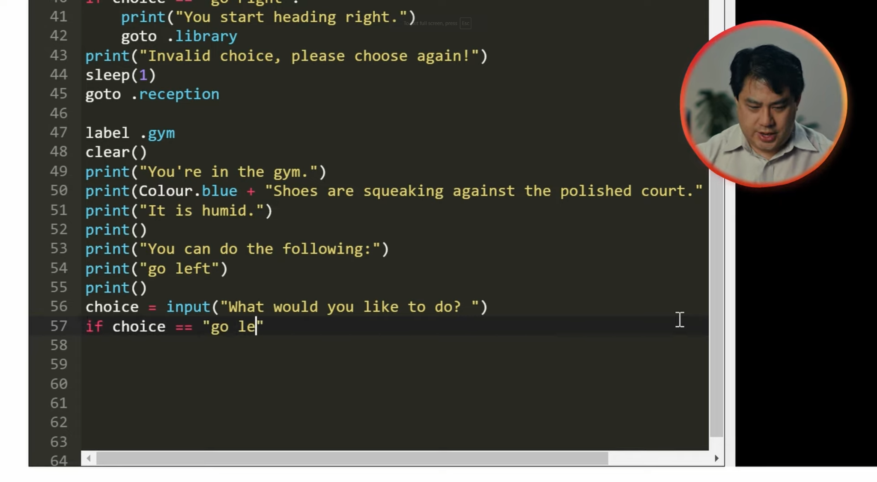
Getting Starting - A simple 4 location “game”
Step 5: Coding the third location
Instructions:
Watch the video above (2:55 min)
Code up your third location by adapting the code in the video.
Playtest your game and check that it works!
2:55 min
Vimeo video link

Slide 10

Getting Starting - A simple 4 location “game”
Step 6: Adding a fourth and final location to our state diagram
Instructions:
Watch the video above (1:20 min)
Update your state diagram by adding a fourth location and make sure there are links and choices leading to it
1:20 min
Vimeo video link

Slide 11
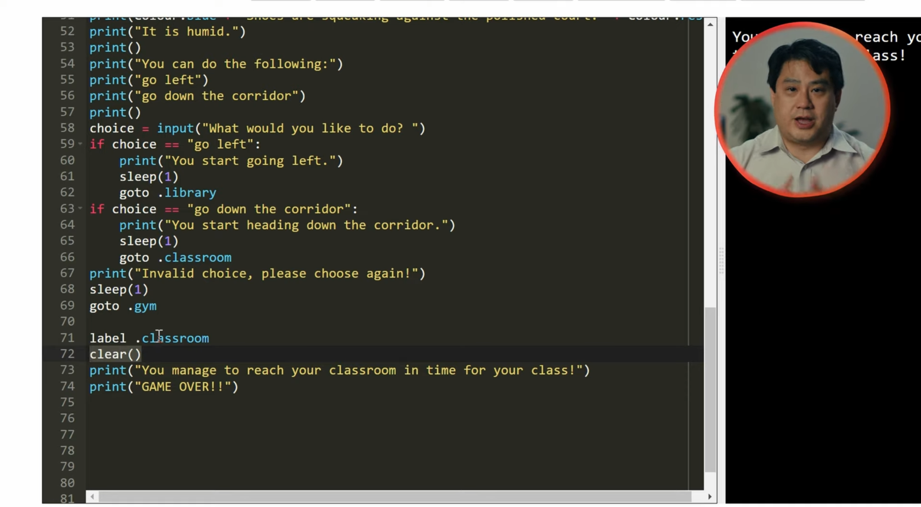
Getting Starting - A simple 4 location “game”
Step 7: Coding the fourth location and finishing the game
Instructions:
Watch the video above (3:01 min)
Code up your fourth and final location by adapting the code in the video
Playtest your game and check that it works!
3:01 min
Vimeo video link

Slide 12

Sample Code to get you started
Sample Code to help you start
You can delete the code from the editor if you don’t need it!

Slide 13
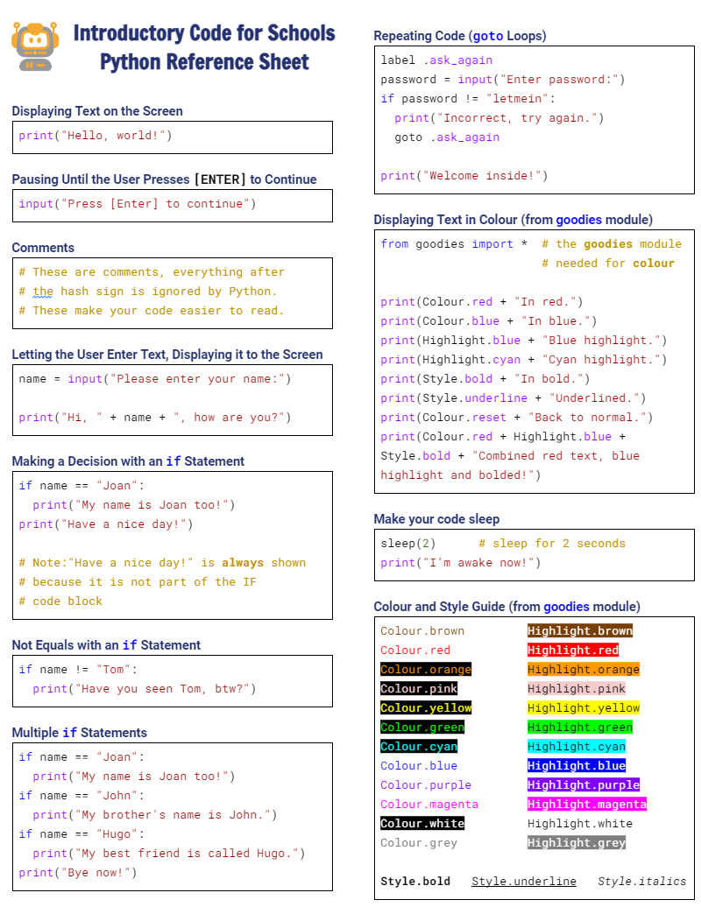

Python Reference Sheet
Python Reference Sheet
  Print it out, keep it handy and use it!
  Get it here

Slide 14
License Information
These lessons plans, worksheets, and other materials were created by Code for Schools. They are licensed under a Creative Commons Attribution-ShareAlike 4.0 International License.

