Slide 1
Lesson 6
Round and Round We Go

Slide 2
Previously, on Code For Schools...
In a flow chart, what does this symbol mean?
Notes:
Answer:
Start or end of the program

Slide 3
Previously, on Code For Schools...
In a flow chart, what does this symbol mean?
Notes:
Answer:
Receiving input and displaying output

Slide 4
Previously, on Code For Schools...
In a flow chart, what does this symbol mean?
Notes:
Answer:
A true/false decision is being made

Slide 5
Previously, on Code For Schools...
In a flow chart, what does this symbol mean?
Notes:
Answer:
An operation is being performed

Slide 6
Previously, on Code For Schools...
What are two things wrong with this section of code?
colour = "Green"
if colour = "green":
print("Green is my favourite colour too!")
Notes:
Answer:
= instead of ==
Casing of "green"

Slide 7

Learning objectives
By the end of this lesson:
I can repeat parts of my code over and over again until something happens

Slide 8
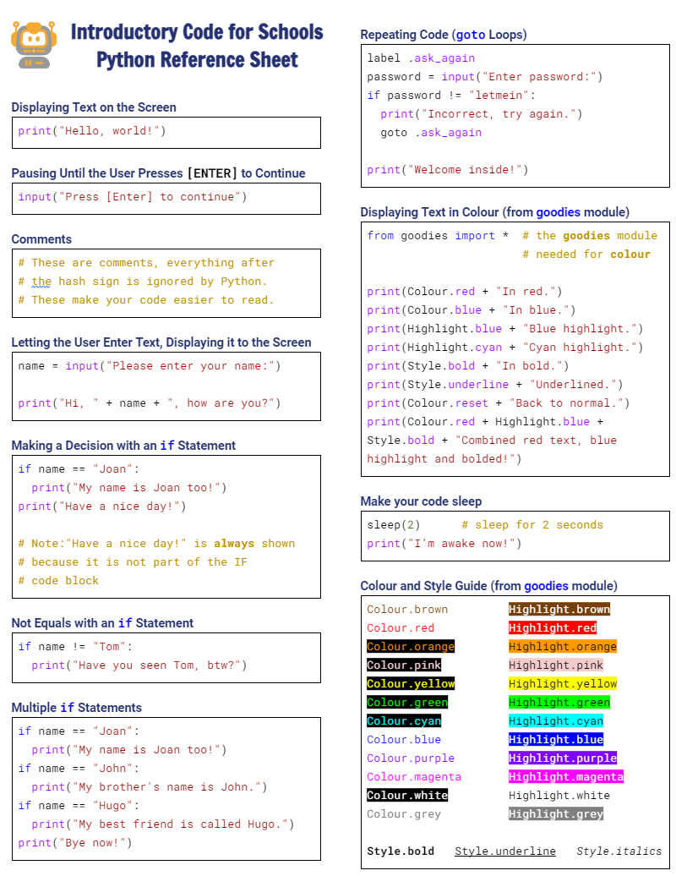

Python Reference Sheet
Python Reference Sheet
  Print it out, keep it handy and use it!
  Get it here

Slide 9


Demo 06.01: Can you crack the secret PIN number?
Notice how the program asks you again and again if you get it wrong?
We’ll learn about how to get your code to repeat itself in this lesson
Click here to try to break in!

Slide 10

Demo 06.01: Can you crack the secret PIN number?
Notice how the program asks you again and again if you get it wrong?
We’ll learn about how to get your code to repeat itself in this lesson
Hint 1: Did you know that computers represent everything as a number?
Even the letter “A” is a number!
Click here to try to break in!

Slide 11
Demo 06.01: Can you crack the secret PIN number?
Notice how the program asks you again and again if you get it wrong?
We’ll learn about how to get your code to repeat itself in this lesson
Hint 2: What is the ASCII code for the capital letter “A”?
Click here to try to break in!

Slide 12
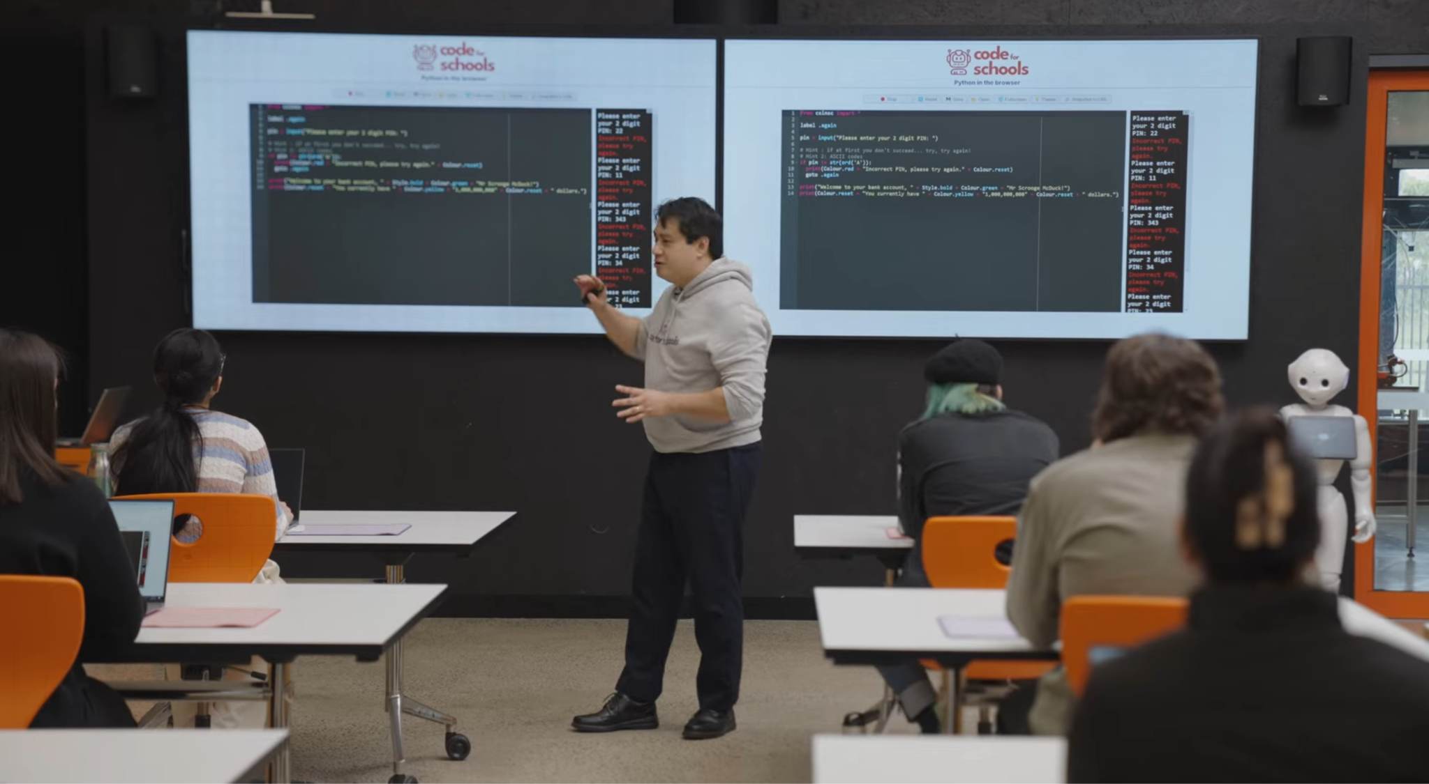


Cracking the Password!
2:11 min
Vimeo video link
Link to Accompanying Slides
(PDF, powerpoint)

Slide 13
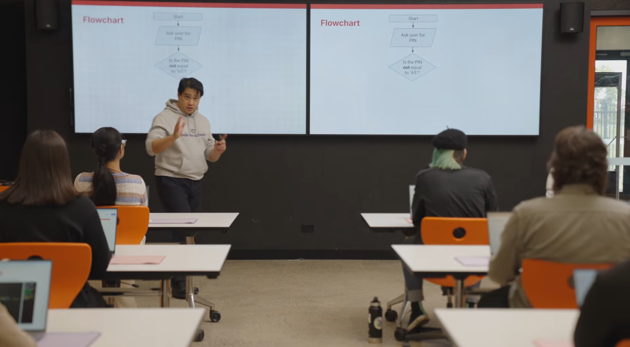
Repeating Code Using Flowcharts
1:38 min
Vimeo video link
Link to Accompanying Slides
(PDF, powerpoint)

Slide 14

Why did the programmer get stuck in the shower?

Slide 15
Why did the programmer get stuck in the shower?
The instructions said: lather, rinse, repeat!

Slide 16
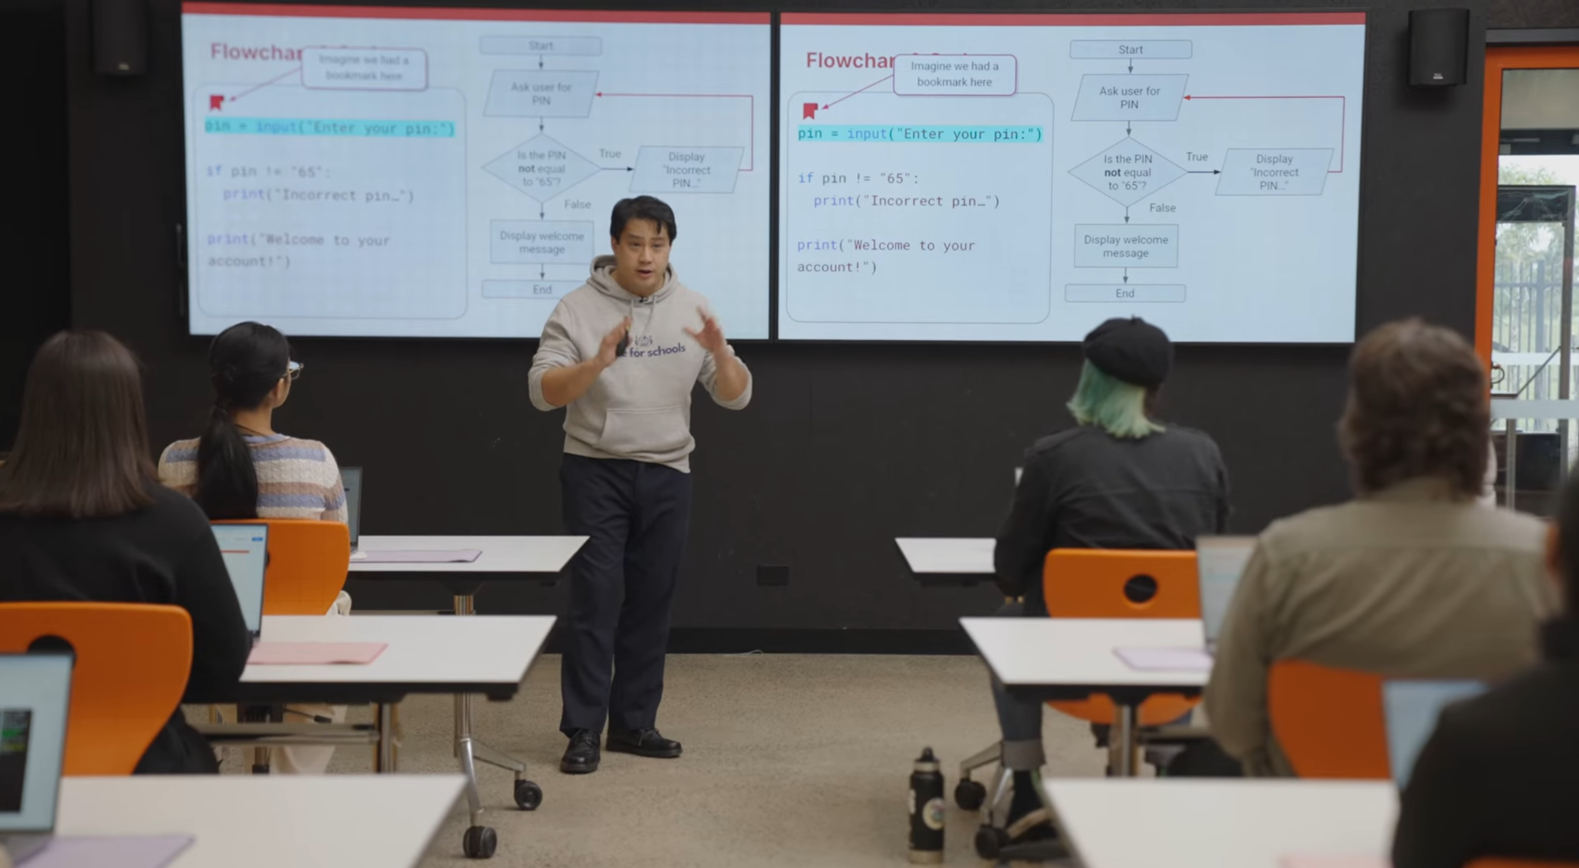
Using Loops in Your Code
2:58 min
Vimeo video link
Link to Accompanying Slides
(PDF, powerpoint)

Slide 17



Coding Activity: Easiest Game in the World!
Complete Question 1
(PDF, MS Word)
Activity 06.01
Easiest Game in the World

Slide 18

Coding Activity: A Chemistry Quiz
Complete Question 2
(PDF, MS Word)
Activity 06.02
A Chemistry Quiz

Slide 19

Demo 06.02: Virtual Pet Dog
Can you find the secret option to get your dog to bark?
Play with your Virtual Pet Dog here!

Slide 20
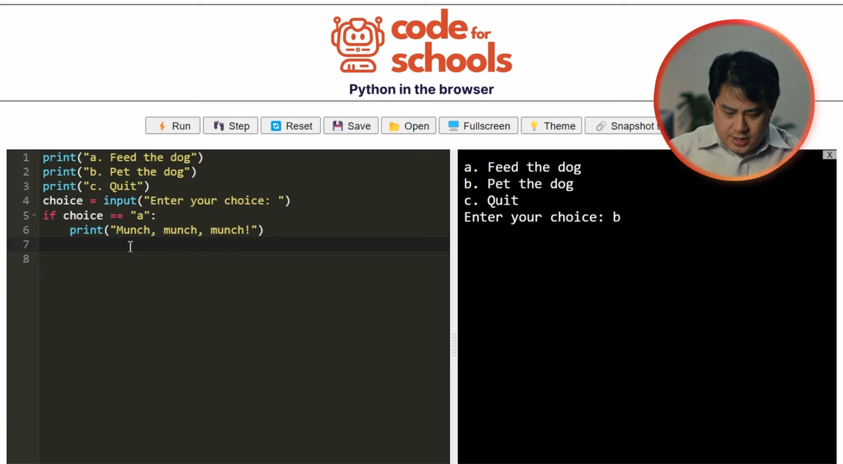
Writing a Complete Program with a Menu of Options
4:42 min
Vimeo video link
Link to Accompanying Slides
(PDF, powerpoint)

Slide 21
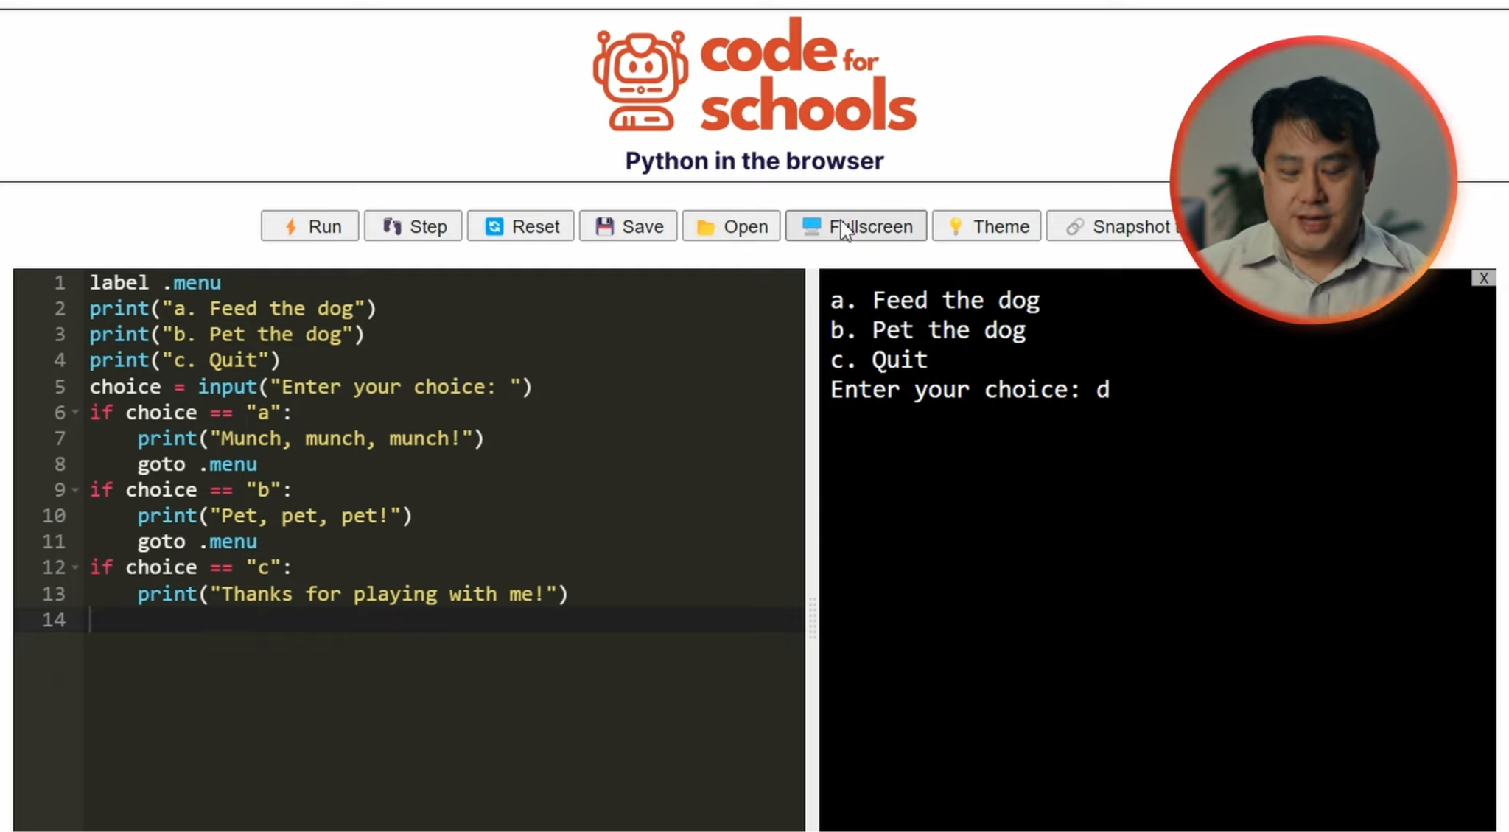
Writing a Complete Program with a Menu of Options
8:06 min
Vimeo video link
Link to Accompanying Slides
(PDF, powerpoint)

Slide 22

Coding Activity: Your Weather Report
Complete Question 3
(PDF, MS Word)
Activity 06.03
Your Weather Report

Slide 23

Coding Activity: Hi in Different Languages
Complete Question 4
(PDF, MS Word)
Activity 06.04
Hi in Different Languages

Slide 24

Coding Activity: Your Solar System!
Activity 06.05
Your Solar System

Slide 25

Coding Activity: Making Waves! (Extension)
Activity 06.06
Making Waves!

Slide 26
Review of Learning Objectives
I can repeat parts of my code over and over again until something happens

Slide 27


Reflection: Exit pass
What is one new thing you learnt today?
Write it on a sticky note and stick it on the board before you leave the classroom

Slide 28
License Information
These lessons plans, worksheets, and other materials were created by Code for Schools. They are licensed under a Creative Commons Attribution-ShareAlike 4.0 International License.

