Slide 1
Lesson 5
Programs That Make Decisions

Slide 2
Previously, on Code For Schools...
What are the variables in the following code?
a_number = input("Enter a value for y:")
height = input("How tall are you?")
Notes:
Answer:
x, age

Slide 3
Previously, on Code For Schools...
If the user types in Alex when asked for their name, what will be displayed on the screen after the following code is run:
user = input("Enter your username:")
print(user + "'s bonus points: 1000")
Notes:
Answer:
Hello, Guts

Slide 4
Previously, on Code For Schools...
If the user types in Jane when asked for their name, and 21 when asked for their age, what will be displayed on the screen after the following code is run:
name = input("Enter your first name:")
age = input("Enter your age:")
print("Hello, " + name + ", " + age)
Notes:
Answer:
Hello, Jane, 21

Slide 5
Learning objectives
By the end of this lesson:
I can understand control flow and how I can use it in my programs to make decisions
I can draw a flowchart to represent program flow
I can understand boolean expressions and how they are either True or False
I can use if statements to make choices in a program so that it can behave differently depending on what a user types

Slide 6
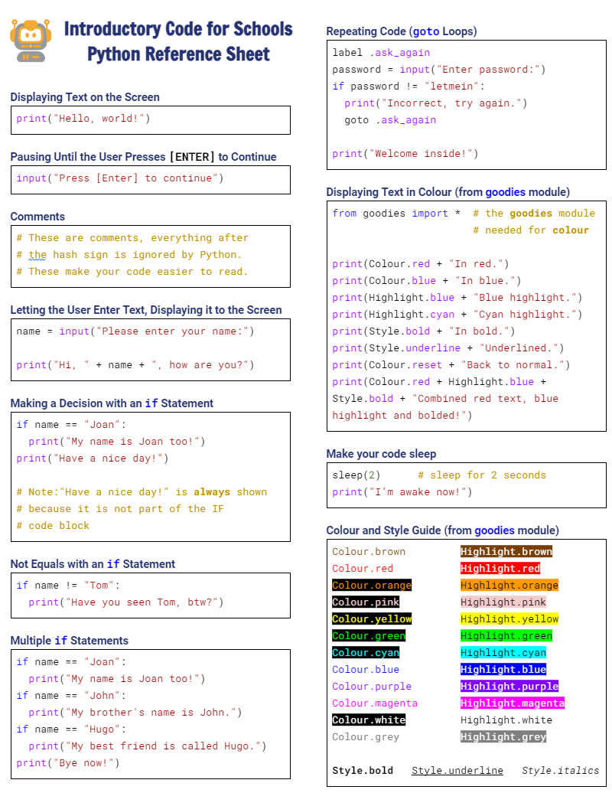

Python Reference Sheet
Python Reference Sheet
  Print it out, keep it handy and use it!
  Get it here

Slide 7


Demo 05.01 - Can you pass through the Gates of Doom?
Look through the code and see if you can figure out what’s going on
Click here and see if you can "guess" the password

Slide 8
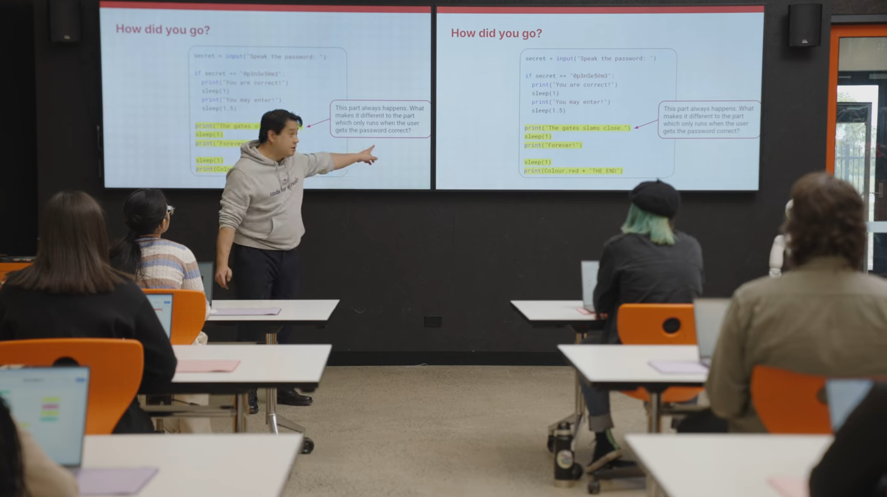


IF Statements and Flowcharts
1:24 min
Vimeo video link
Link to Accompanying Slides
(PDF, powerpoint)

Slide 9
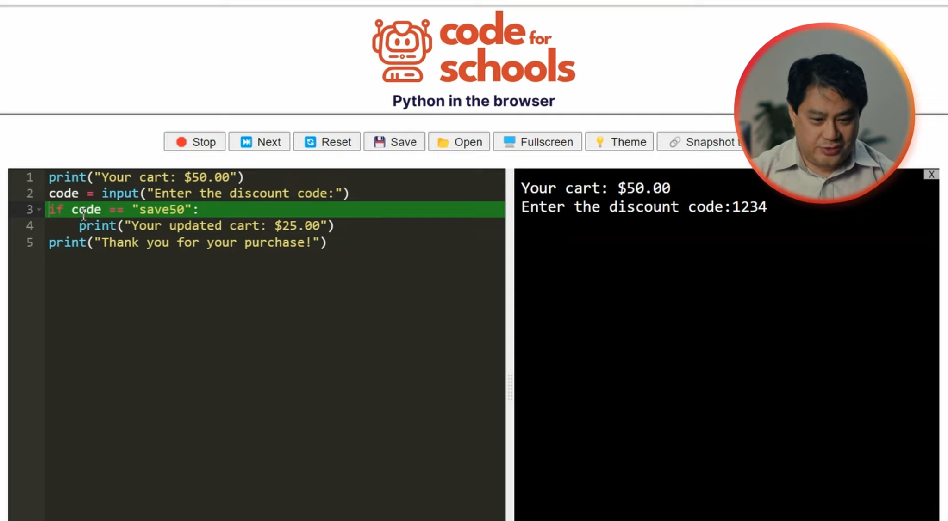
IF Statements and Flowcharts
7:25 min
Vimeo video link
Link to Accompanying Slides
(PDF, powerpoint)

Slide 10



Coding Activity: Colours in the Flag Quiz
Complete Question 1
(PDF, MS Word)
Activity 05.01
Colours in the Flag Quiz

Slide 11

Coding Activity: World War Quiz
Complete Question 2
(PDF, MS Word)
Activity 05.02
World War Quiz

Slide 12


Coding Activity: Your Own Quiz
Activity 05.03
Your Own Quiz

Slide 13

Coding Activity: Playing Dress Up! (Extension)
Activity 05.04
Playing Dress Up!

Slide 14
Review of Learning Objectives
I can understand control flow and how I can use it in my programs to make decisions
I can draw a flowchart to represent program flow
I can understand boolean expressions and how they are either True or False
I can use if statements to make choices in a program so that it can behave differently depending on what a user types

Slide 15


Reflection: Exit pass
What is one new thing you learnt today?
Write it on a sticky note and stick it on the board before you leave the classroom

Slide 16
License Information
These lessons plans, worksheets, and other materials were created by Code for Schools. They are licensed under a Creative Commons Attribution-ShareAlike 4.0 International License.

