Slide 1
Lesson 4
Variables and Remembering What the User Typed

Slide 2
Previously, on Code for Schools...
What is the name of the module we need to import in order to display colours on the screen?
Notes:
Answer:
csinsc

Slide 3
Previously, on Code for Schools...
What would:
print(Style.bold + Colour.blue + "Red")
display on the screen?
A) Red B) Red
C) Blue D) Red
Notes:
Answer:
Red (B)

Slide 4
Previously, on Code for Schools...
How would we display AB on the screen?
A) print(red + "A" + blue + "B")
B) print("A" + Colour.red + "B" + Colour.blue + Highlight.cyan)
C) print("redAblueB")
D) print(Colour.red + "A" + Colour.blue + Highlight.cyan + "B")
Notes:
Answer:
(C) print(Colour.red + "A" + Colour.blue + Highlight.cyan + "B")

Slide 5

Learning objectives
By the end of this lesson:
I can understand how variables are used to remember input() from the user
I can use and display information that the user gives to my program
name = "Jane"
country = "Australia"
Hello, Jane!

Slide 6
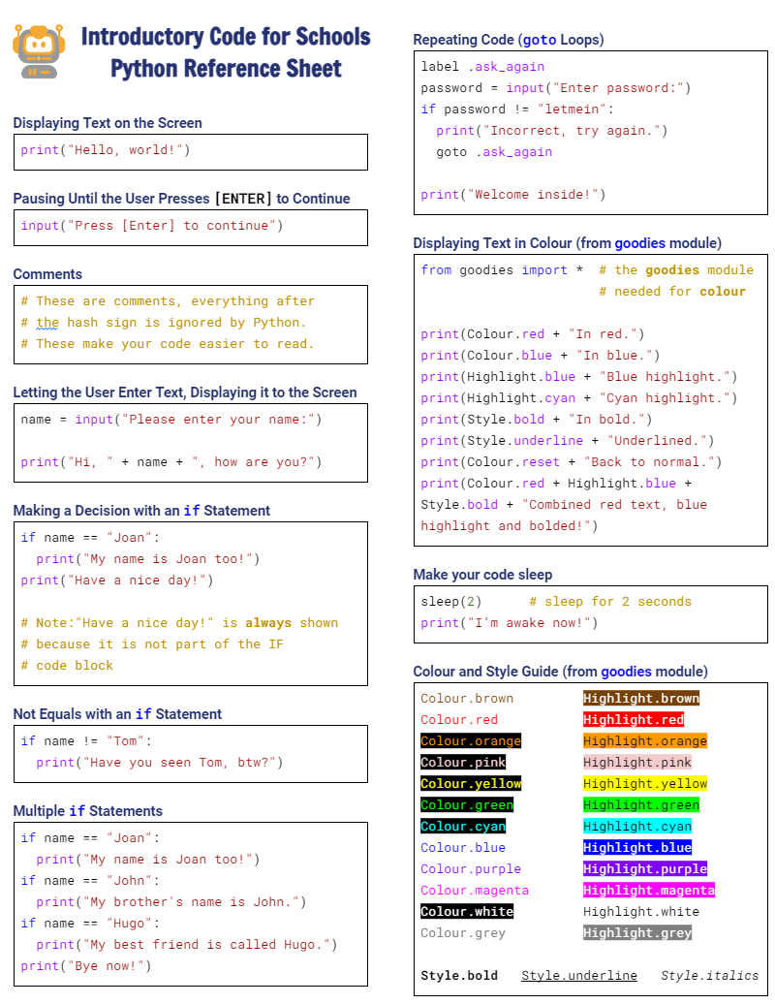

Python Reference Sheet
Python Reference Sheet
  Print it out, keep it handy and use it!
  Get it here

Slide 7




Demo 04.01: Story Time!
Can you add another sentence to the story?
Click here to create your fantastic short story!

Slide 8
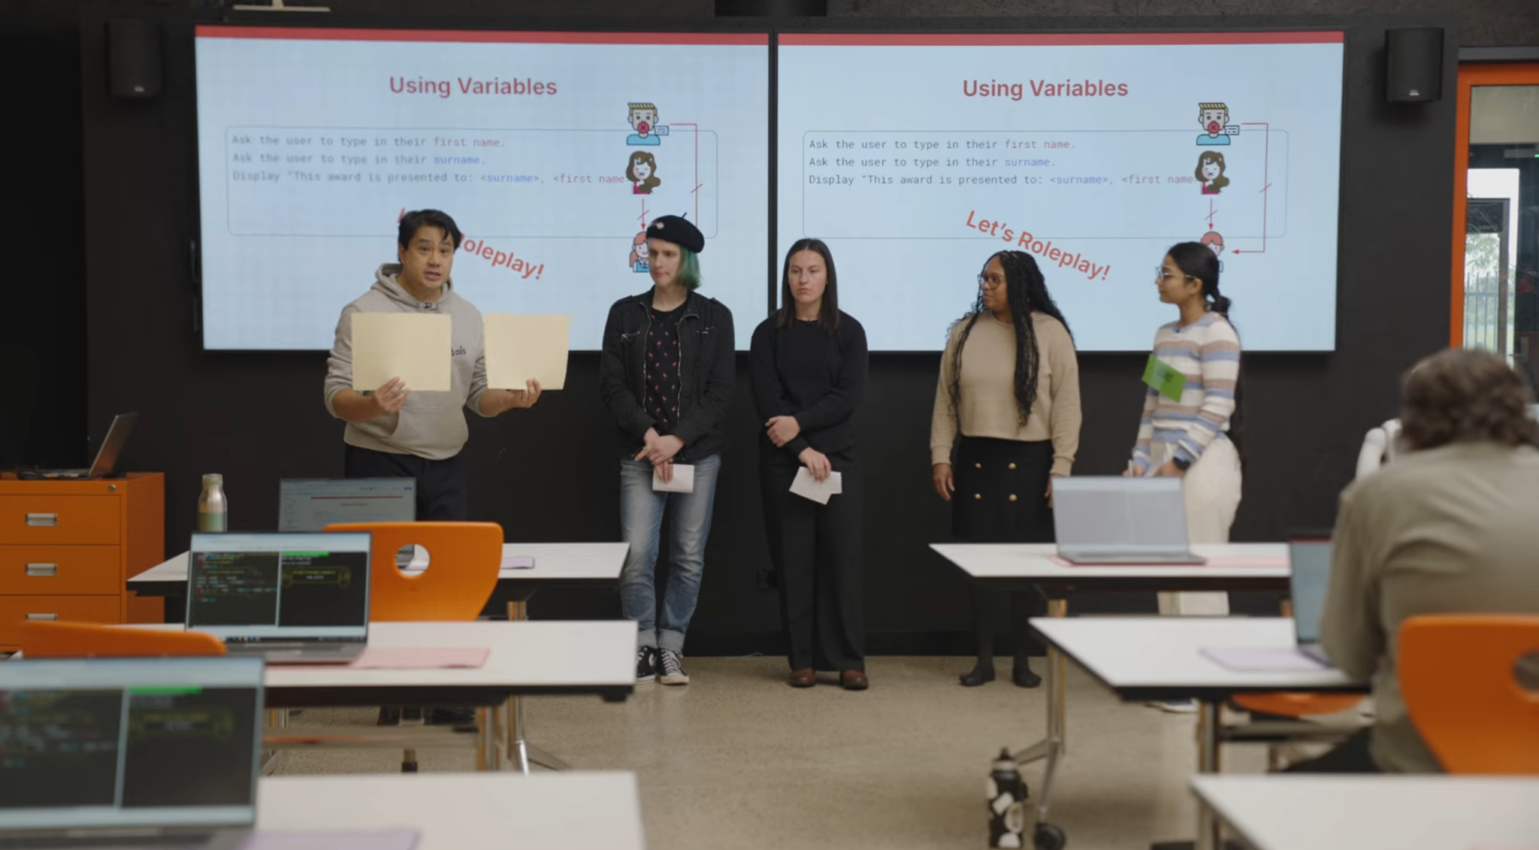


Understanding Variables (Part 1)
7:01 min
Vimeo video link
Link to Accompanying Slides
(PDF, powerpoint)

Slide 9
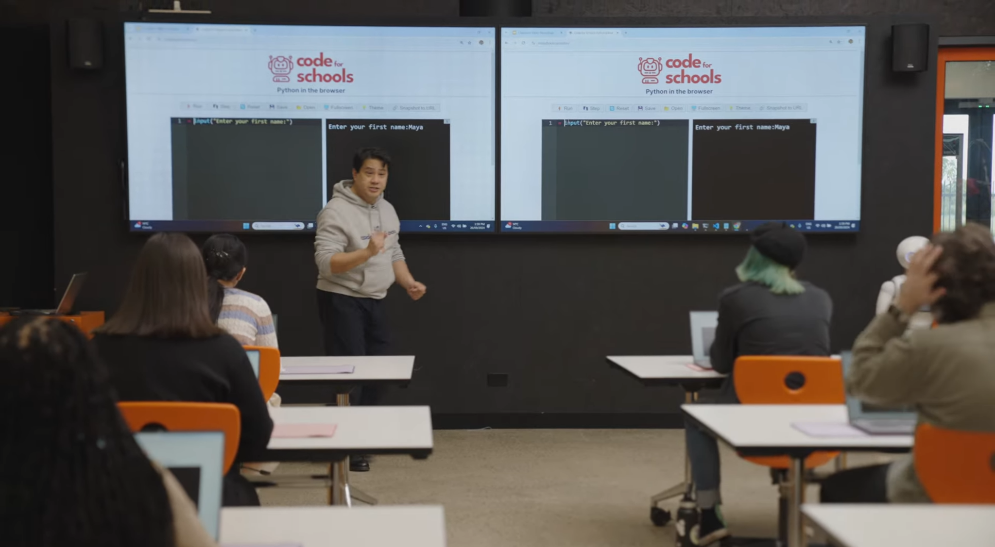
Understanding Variables (Part 2)
6:07 min
Vimeo video link
Link to Accompanying Slides
(PDF, powerpoint)

Slide 10

Worksheet Activity - Question 1 & 2
Complete Questions 1 - 3
(PDF, MS Word)

Slide 11


Coding Activity: NetFlicks
Complete Question 4
(PDF, MS Word)
Activity 04.01
NetFlicks

Slide 12
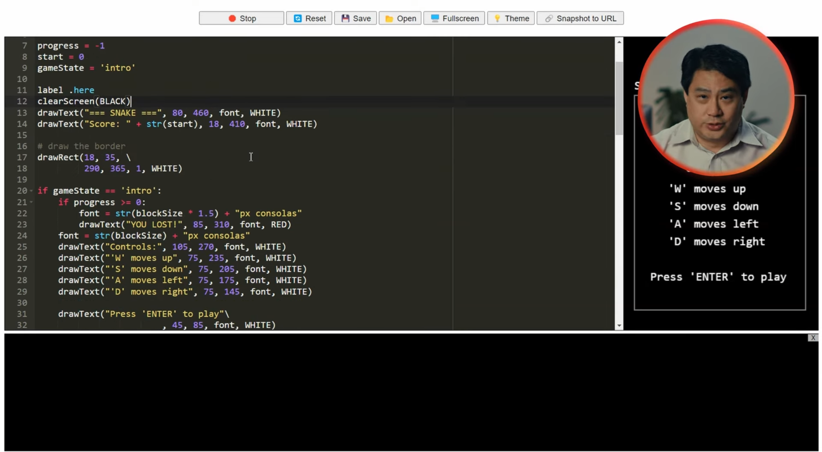
Comments
3:09 min
Vimeo video link
Link to Accompanying Slides
(PDF, powerpoint)

Slide 13
Worksheet Activity - Question 5 & 6
Complete Question 5 - 6
(PDF, MS Word)

Slide 14

Coding Activity: My Top Fashion Shop
Complete Question 7
(PDF, MS Word)
Activity 04.02
My Top Fashion Shop

Slide 15

Coding Activity: My Amazing Story
Activity 04.03
My Amazing Story

Slide 16

Coding Activity: Bouncy Text! (Extension)
Activity 04.04
Bouncy Text

Slide 17
Review of Learning Objectives
I can understand how variables are used to remember input() from the user
I can use and display information that the user gives to my program

Slide 18


Reflection: Exit pass
What is one new thing you learnt today?
Write it on a sticky note and stick it on the board before you leave the classroom

Slide 19
License Information
These lessons plans, worksheets, and other materials were created by Code for Schools. They are licensed under a Creative Commons Attribution-ShareAlike 4.0 International License.

