Slide 1
Lesson 3
Colour Your World!

Slide 2
Previously, on Code for Schools...
True or False?
Extra blank lines between Python code lines will change how the program runs.
Notes:
Answer:
False

Slide 3
Previously, on Code for Schools...
True or False?
These two lines of code do exactly the same thing.
print("Hello, world!")
print(" Hello, world!")
Notes:
Answer:
False

Slide 4
Previously, on Code for Schools...
True or False?
These two lines of code do exactly the same thing.
print("Press [ENTER] to continue.")
input("Press [ENTER] to continue.")
Notes:
Answer:
False
The first line will just display the text and move on
The second line will display the text and wait for the user to press [enter] before moving on

Slide 5
Learning objectives
By the end of this lesson:
I can reuse other people’s code in Python
I can change the text colour, highlighting, and styles!

Slide 6
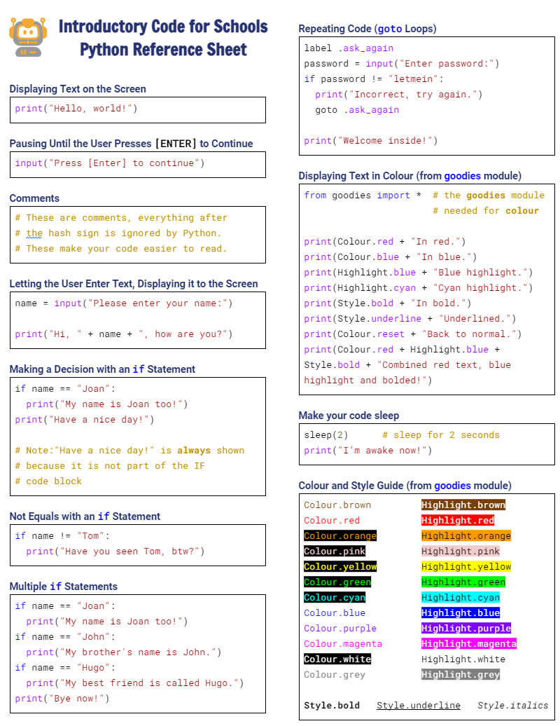

Python Reference Sheet
Python Reference Sheet
  Print it out, keep it handy and use it!
  Get it here

Slide 7

Demo 03.01: Look Who’s Talking
Can you identify the mystery cartoon character?

Slide 8
Look Who’s Talking
What is the new feature that you haven’t seen before in this program?

Slide 9
Look Who’s Talking
What is the new feature that you haven’t seen before in this program?
Colours!

Slide 10
Look Who’s Talking
What is the new feature that you haven’t seen before in this program?
Colours!
We will learn how to use code that other people have written to help us colour our text

Slide 11
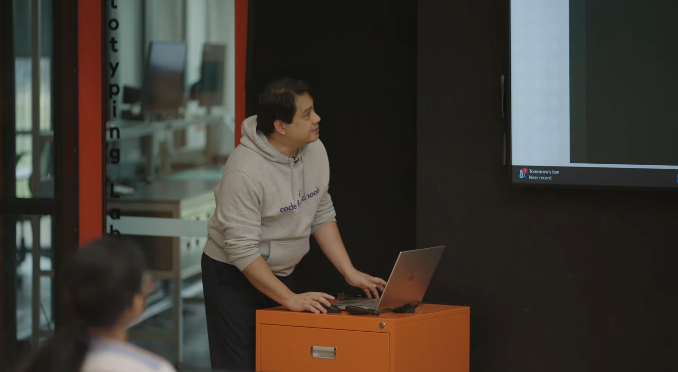


Using Colours (Part 1)
3:23 min
Link to Accompanying Slides
(PDF, powerpoint)
Vimeo video link

Slide 12
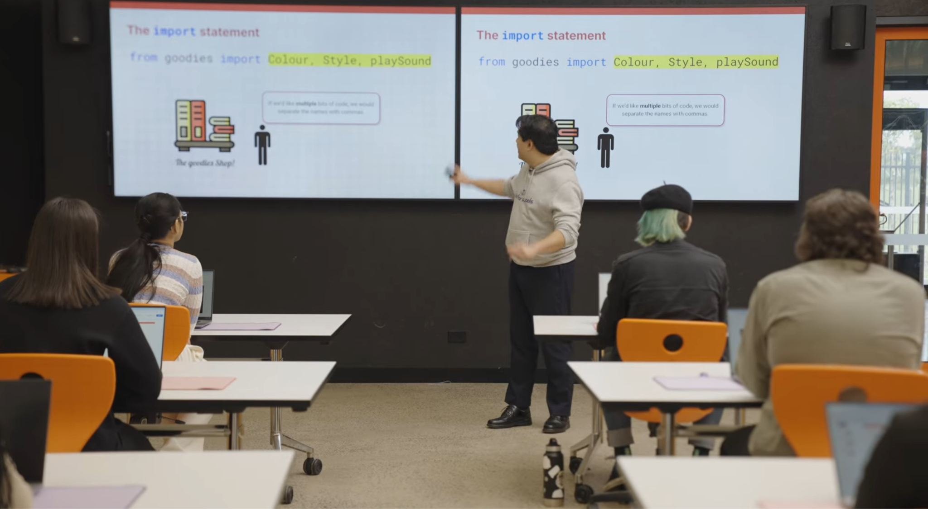
Using Colours (Part 2)
3:24 min
Vimeo video link
Link to Accompanying Slides
(PDF, powerpoint)

Slide 13

Worksheet Activity
Complete Questions 1 & 2
(PDF, MS Word)

Slide 14

Changing colours
You can combine different colours, highlights, and styles to achieve many effects.
Colour names
Highlight names
Style names
Colour.brown
Colour.red
Colour.orange
Colour.yellow
Colour.green
Colour.cyan
Colour.blue
Colour.purple
Colour.magenta
Colour.pink
Colour.white
Colour.grey
Colour.reset
Highlight.brown
Highlight.red
Highlight.orange
Highlight.yellow
Highlight.green
Highlight.cyan
Highlight.blue
Highlight.purple
Highlight.magenta
Highlight.pink
Highlight.white
Highlight.grey
Style.bold
Style.underline
Style.italics

Slide 15


Activity: Colour a Rainbow!
Helpful Hints
  Remember, Colour needs a capital ‘C’
  Check the cheat sheet for the colours you can use!
Activity 03.01
Colour a Rainbow

Slide 16
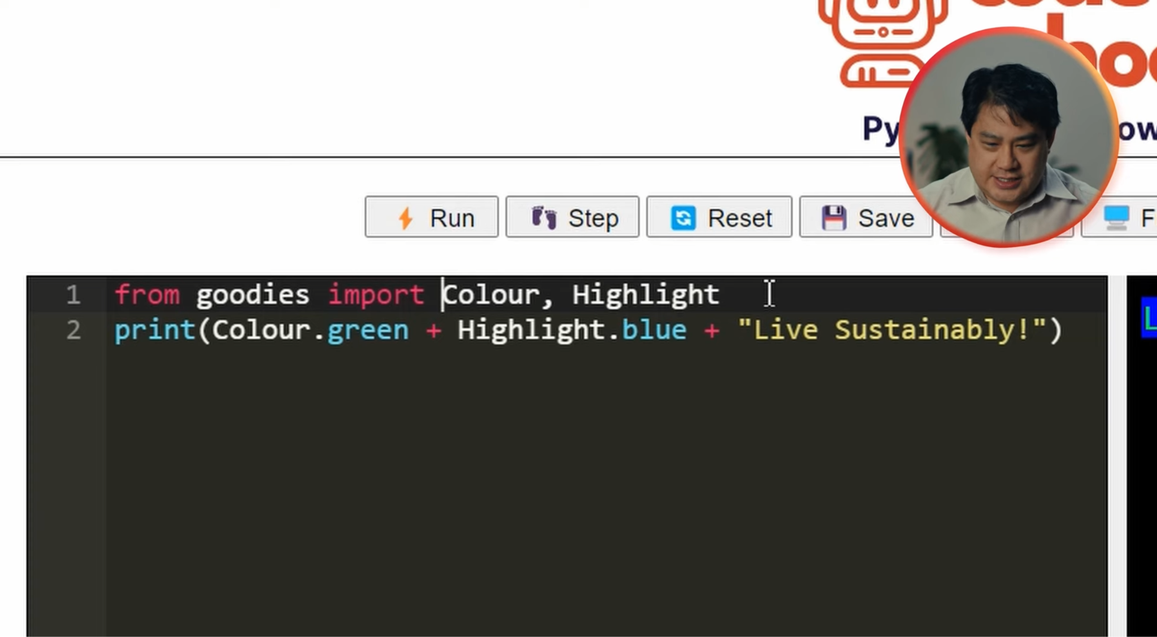
Using Highlights
2:05 min
Vimeo video link
Link to Accompanying Slides
(PDF, powerpoint)

Slide 17
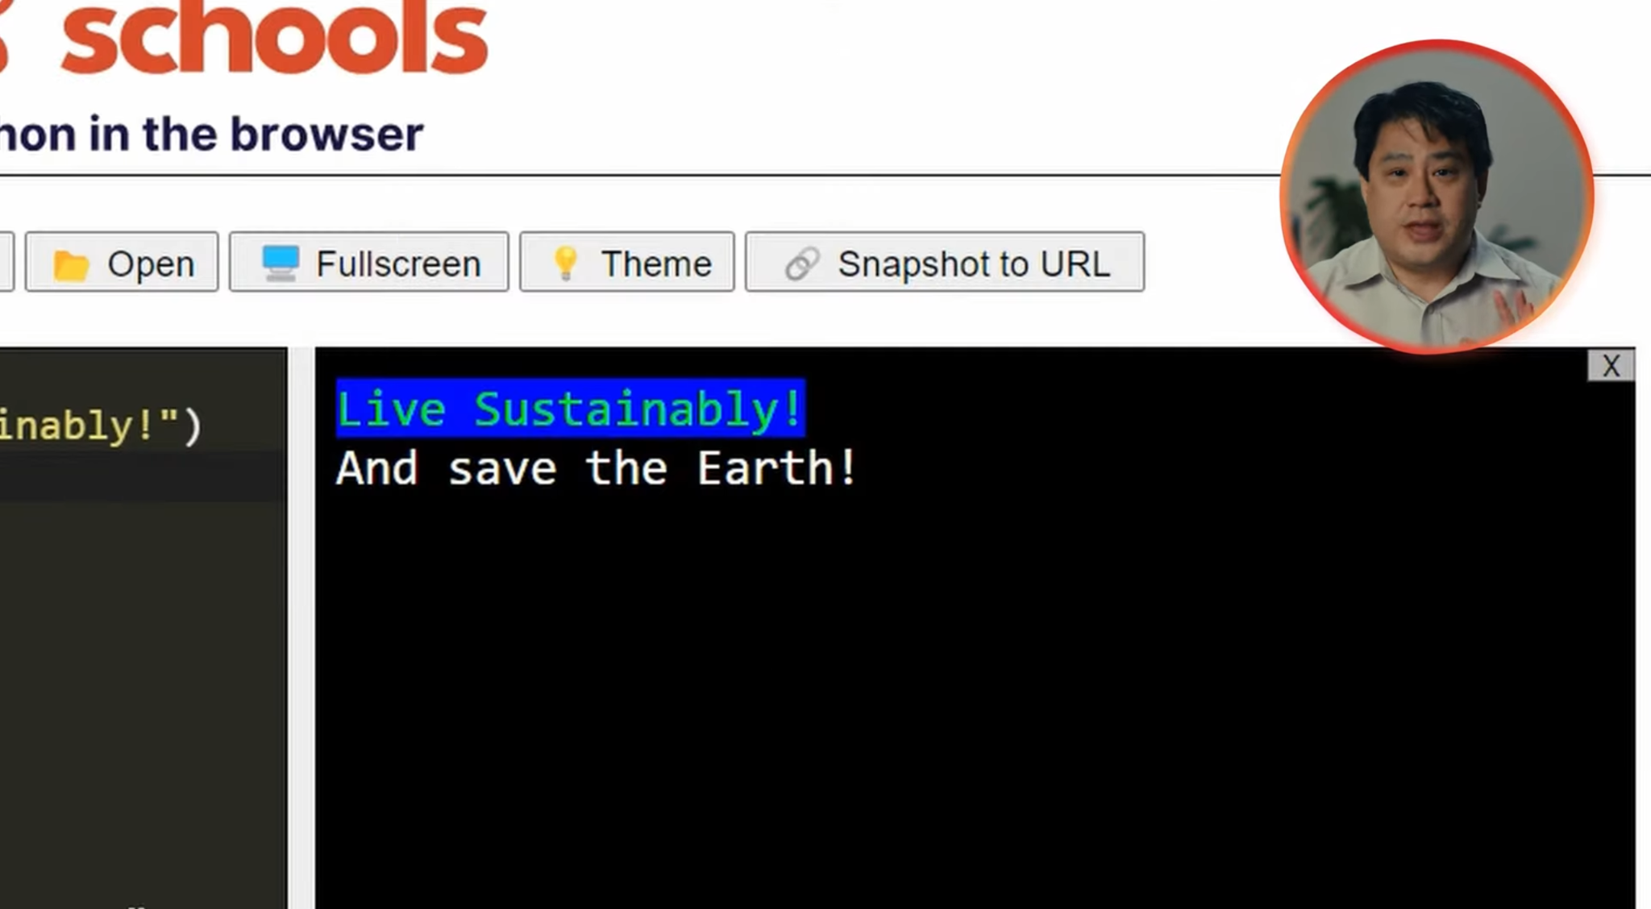
Switching Colours in your Programs
1:46 min
Vimeo video link
Link to Accompanying Slides
(PDF, powerpoint)

Slide 18
Worksheet Activity
Complete Questions 4, 5 & 6
(PDF, MS Word)

Slide 19

Coding Activity: Flags of the World!
Helpful Hints
  You’ll need to change colours multiple times in one print function
  Check the cheat sheet for the colours you can use!
Activity 03.02
Flags of the World!

Slide 20
Changing colours
You can combine different colours, highlights, and styles to achieve many effects.
Colour names
Highlight names
Style names
Colour.brown
Colour.red
Colour.orange
Colour.yellow
Colour.green
Colour.cyan
Colour.blue
Colour.purple
Colour.magenta
Colour.pink
Colour.white
Colour.grey
Colour.reset
Highlight.brown
Highlight.red
Highlight.orange
Highlight.yellow
Highlight.green
Highlight.cyan
Highlight.blue
Highlight.purple
Highlight.magenta
Highlight.pink
Highlight.white
Highlight.grey
Style.bold
Style.underline
Style.italics

Slide 21

Activity: Rubber Ducky!
Helpful Hints
  You’ll need to change colours multiple times in one print function
  Check the cheat sheet for the colours you can use!
Activity 03.03
Rubber Ducky!

Slide 22

Coding Activity: Hey Mickey! (Extension)
Activity 03.04
Hey Mickey!

Slide 23
Review of Learning Objectives
I can reuse other people’s code in Python
I can change the text colour, highlighting, and styles!

Slide 24


Reflection: Exit pass
What is one new thing you learnt today?
Write it on a sticky note and stick it on the board before you leave the classroom

Slide 25
License Information
These lessons plans, worksheets, and other materials were created by Code for Schools. They are licensed under a Creative Commons Attribution-ShareAlike 4.0 International License.

