Slide 1
Alternative Assignment
A Simple Text Animation

Slide 2
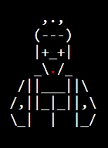

Learning objectives
By then end of this lesson, you should be able to:
understand the assignment and how you will be marked
understand how this assignment allows you to demonstrate all you have learned about Python coding so far
start working on your assignment!
‹#›

Slide 3
Simple Text Animation
You assignment is to design and code up a simple text-based animation!
Assignment Details and Marking Rubric here
It’ll be your chance to demonstrate the Python skills you’ve learned so far, including:
Printing text and symbols
Colour
ASCII art! (see below links for some handy ASCII art resources, feel free to look for more!)
  ASCII Art Archive
  Text to ASCII
‹#›

Slide 4
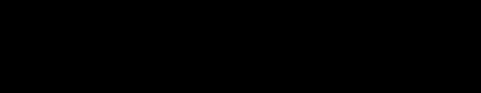
Simple Text Animation
Below is a sample animation done in the style of a movie trailer!
You can check out the code for it here!
‹#›

Slide 5
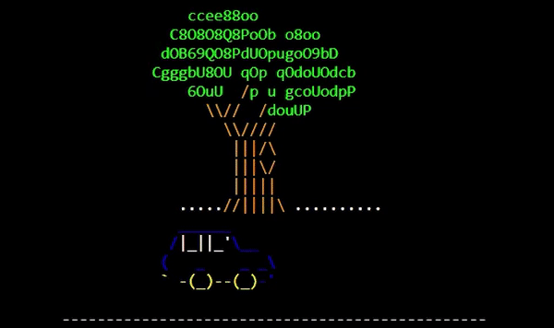
Sample Animation - (From past student work!)
Here is another example of a more storyline driven animation. It was based on a previous student’s assignment!
You can check out the code for it here!
‹#›

Slide 6
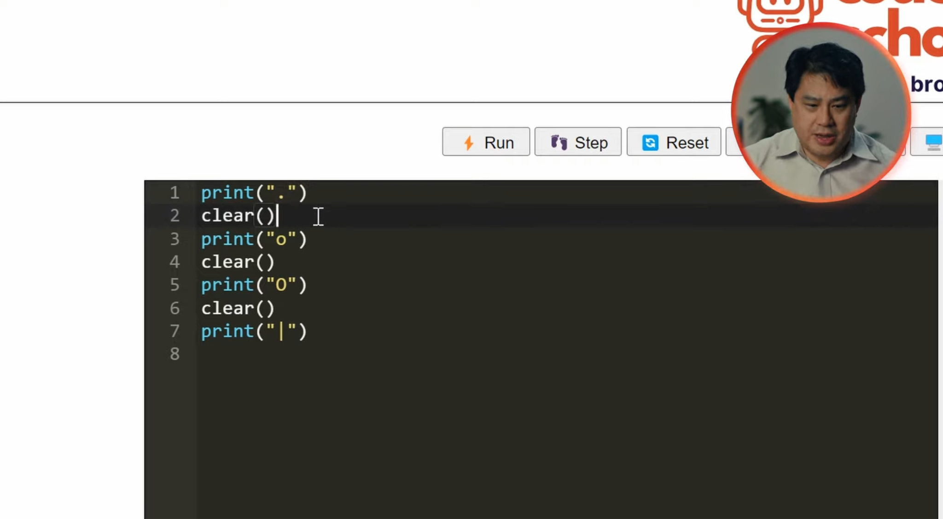

How To Code a Simple Text Animation
4:33 min
Vimeo video link
The starting code is here

Slide 7
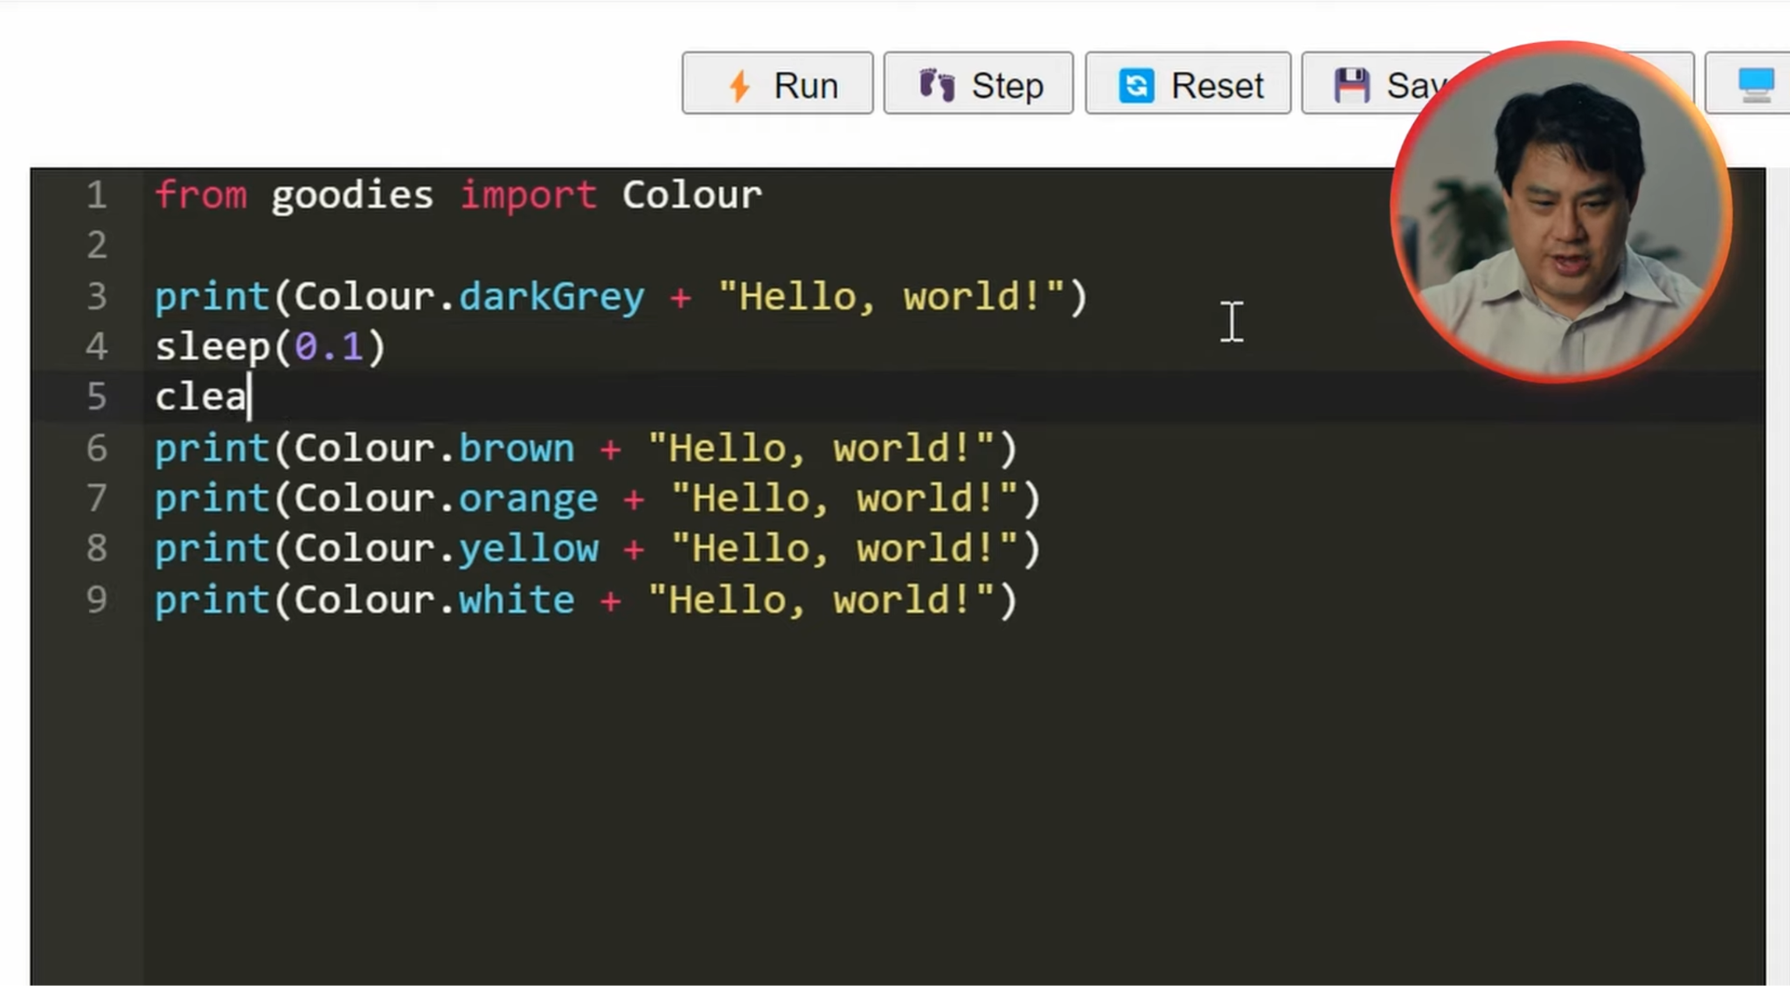
How To Code a Colour Animation
1:23 min
Vimeo video link
The starting code is here

Slide 8
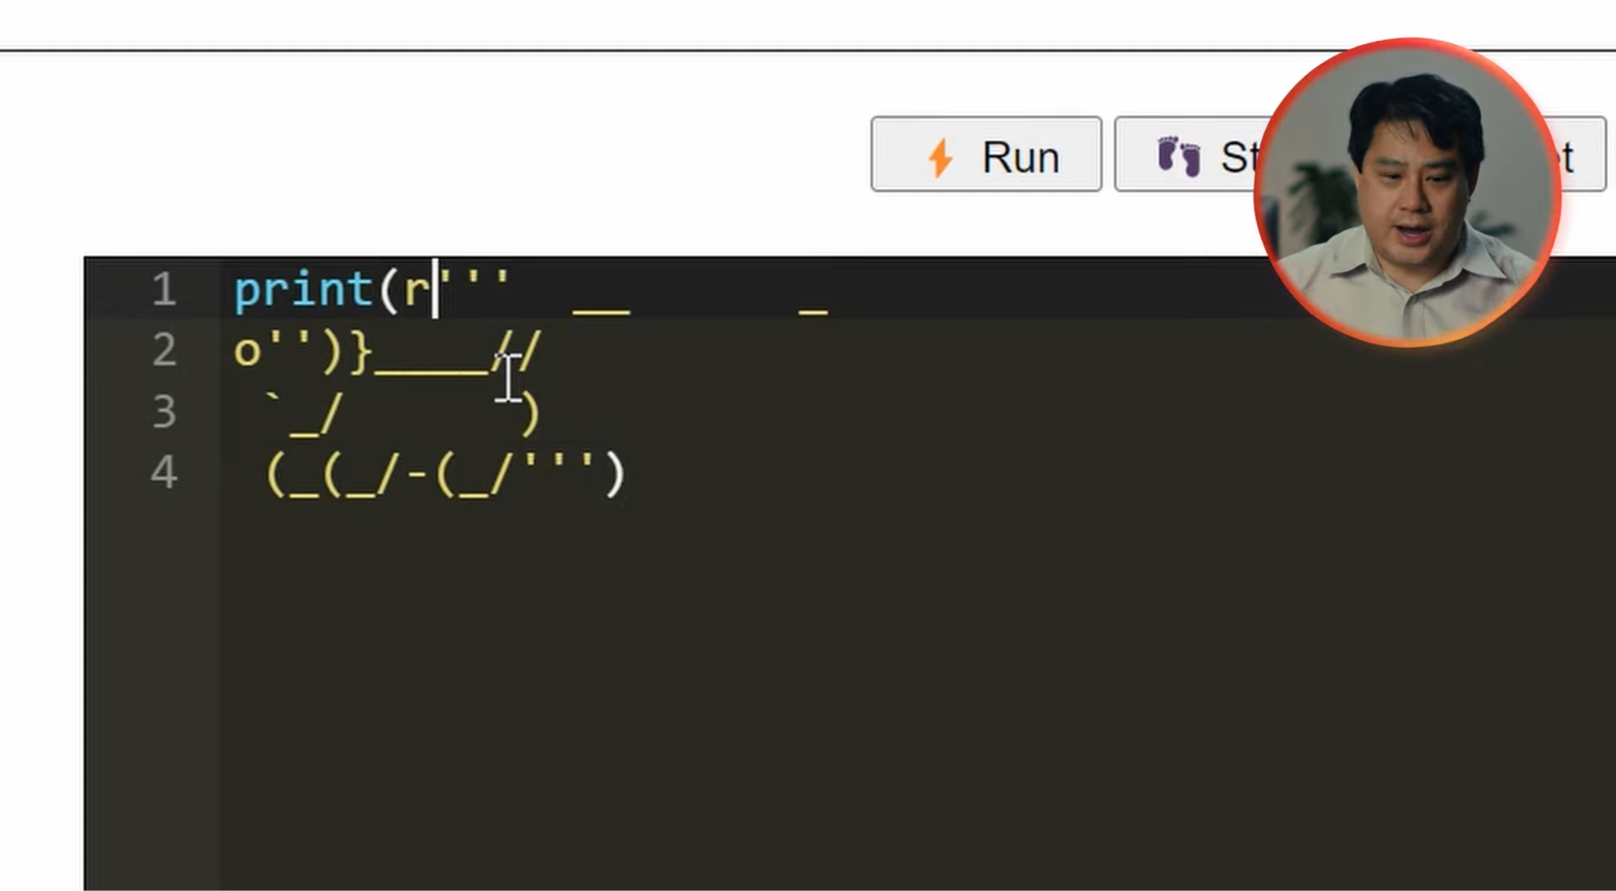
Animating ASCII Art
7:25 min
Vimeo video link
Link to ASCII Art Archive

Slide 9

Sample Code to get you started
Sample Code to help you start
You can delete the code from the editor if you don’t need it!
‹#›

Slide 10
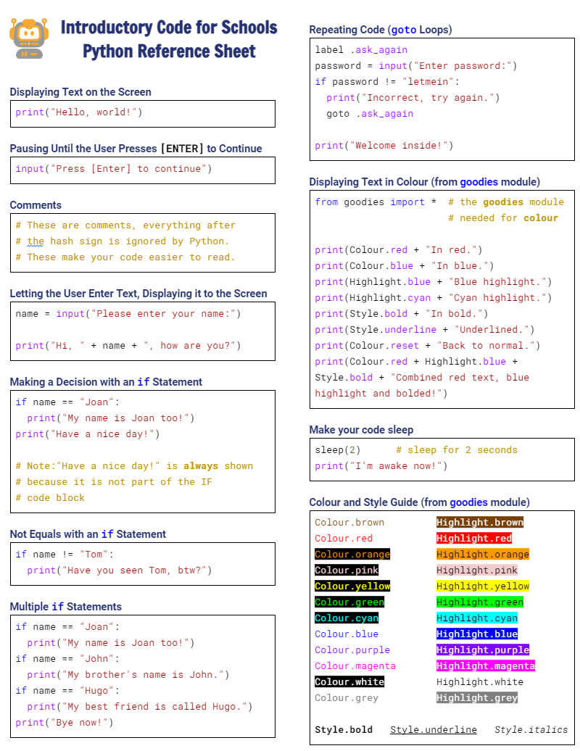

Python Reference Sheet
Python Reference Sheet
  Print it out, keep it handy and use it!
  Get it here

Slide 11
License Information
These CS in Schools lessons plans, worksheets, and other materials were created by Toan Huynh and Hugh Williams. They are licensed under a Creative Commons Attribution-ShareAlike 4.0 International License.
‹#›

