Slide 1
Lesson 2
Blank Spaces and Pauses

Slide 2
Previously, on Code for Schools...
What is the function you use to display text onto the screen?
What would you type to display
Code for Schools
on the screen?
Notes:
Answer:
print()
print("Code for Schools")

Slide 3
Learning objectives
By the end of this lesson:
I can understand how spaces and lines are used in Python
I can write Python programs with multiple lines of code
I can use input() in my programs to pause, and wait for the [ENTER] key to be pressed before continuing

Slide 4
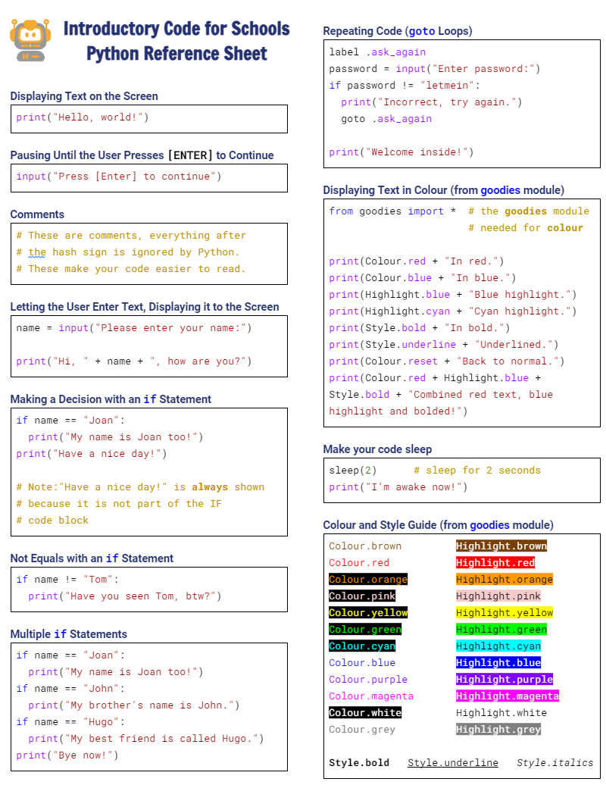

Python Reference Sheet
Python Reference Sheet
  Print it out, keep it handy and use it!
  Get it here

Slide 5


Demo 02.01: Would you like to see a magic trick?
Click here and run the program

Slide 6

Demo 02.01: Would you like to see a magic trick?
Did you figure it out?
Click here and run the program

Slide 7
Take a look at the code...
Notice all the blank lines?
print("I am going to do a magic trick")
input("[Press enter to continue]")
print("Secretly pick one of the cards below..")
print("K\u2664 J\u2667 Q\u2661 J\u2662")
print("\nYou got it? Don't tell anyone!")
input("[Press enter to continue]")
print("\nNow... Your card will disappear!")
print("Continue focusing on your card!")
input("[Press enter to continue]")
print("Can you now find your card below?")
print("J\u2664 K\u2667 Q\u2662 J\u2661 ")
input("[Press enter to continue]")
print("\nIt's magic.....!")
input("[Press enter to end]")

Slide 8
Take a look at the code...
Notice all the blank lines?
print("I am going to do a magic trick")
input("[Press enter to continue]")
print("Secretly pick one of the cards below..")
print("K\u2664 J\u2667 Q\u2661 J\u2662")
print("\nYou got it? Don't tell anyone!")
input("[Press enter to continue]")
print("\nNow... Your card will disappear!")
print("Continue focusing on your card!")
input("[Press enter to continue]")
print("Can you now find your card below?")
print("J\u2664 K\u2667 Q\u2662 J\u2661 ")
input("[Press enter to continue]")
print("\nIt's magic.....!")
input("[Press enter to end]")

Slide 9
Take a look at the code...
Notice all the blank lines?
How important do you think they are?
print("I am going to do a magic trick")
input("[Press enter to continue]")
print("Secretly pick one of the cards below..")
print("K\u2664 J\u2667 Q\u2661 J\u2662")
print("\nYou got it? Don't tell anyone!")
input("[Press enter to continue]")
print("\nNow... Your card will disappear!")
print("Continue focusing on your card!")
input("[Press enter to continue]")
print("Can you now find your card below?")
print("J\u2664 K\u2667 Q\u2662 J\u2661 ")
input("[Press enter to continue]")
print("\nIt's magic.....!")
input("[Press enter to end]")

Slide 10
Take a look at the code...
Notice all the blank lines?
How important do you think they are?
If we took them all out…
print("I am going to do a magic trick")
input("[Press enter to continue]")
print("Secretly pick one of the cards below..")
print("K\u2664 J\u2667 Q\u2661 J\u2662")
print("\nYou got it? Don't tell anyone!")
input("[Press enter to continue]")
print("\nNow... Your card will disappear!")
print("Continue focusing on your card!")
input("[Press enter to continue]")
print("Can you now find your card below?")
print("J\u2664 K\u2667 Q\u2662 J\u2661 ")
input("[Press enter to continue]")
print("\nIt's magic.....!")
input("[Press enter to end]")

Slide 11
Take a look at the code...
Notice all the blank lines?
How important do you think they are?
If we took them all out…
print("I am going to do a magic trick")
input("[Press enter to continue]")
print("Secretly pick one of the cards below..")
print("K\u2664 J\u2667 Q\u2661 J\u2662")
print("\nYou got it? Don't tell anyone!")
input("[Press enter to continue]")
print("\nNow... Your card will disappear!")
print("Continue focusing on your card!")
input("[Press enter to continue]")
print("Can you now find your card below?")
print("J\u2664 K\u2667 Q\u2662 J\u2661 ")
input("[Press enter to continue]")
print("\nIt's magic.....!")
input("[Press enter to end]")

Slide 12
Take a look at the code...
Notice all the blank lines?
How important do you think they are?
If we took them all out…
Would the program still work??
print("I am going to do a magic trick")
input("[Press enter to continue]")
print("Secretly pick one of the cards below..")
print("K\u2664 J\u2667 Q\u2661 J\u2662")
print("\nYou got it? Don't tell anyone!")
input("[Press enter to continue]")
print("\nNow... Your card will disappear!")
print("Continue focusing on your card!")
input("[Press enter to continue]")
print("Can you now find your card below?")
print("J\u2664 K\u2667 Q\u2662 J\u2661 ")
input("[Press enter to continue]")
print("\nIt's magic.....!")
input("[Press enter to end]")

Slide 13

Take a look at the code...
Notice all the blank lines?
How important do you think they are?
If we took them all out…
Would the program still work??
print("I am going to do a magic trick")
input("[Press enter to continue]")
print("Secretly pick one of the cards below..")
print("K\u2664 J\u2667 Q\u2661 J\u2662")
print("\nYou got it? Don't tell anyone!")
input("[Press enter to continue]")
print("\nNow... Your card will disappear!")
print("Continue focusing on your card!")
input("[Press enter to continue]")
print("Can you now find your card below?")
print("J\u2664 K\u2667 Q\u2662 J\u2661 ")
input("[Press enter to continue]")
print("\nIt's magic.....!")
input("[Press enter to end]")

Slide 14
Spaces in Python code
In some cases, Python ignores spaces and blank lines in your code
In code, we refer to spaces and blank lines as whitespace
Why would you add whitespace to your code?

Slide 15
Spaces in Python code
Why would you add whitespace to your code?
  It makes it easier for you to read your own code
  You may forget what your own program does over time, and good layout helps you figure it out again
  It also helps other people read your code. Companies such as Amazon, Google and Microsoft have rules about how their code should look
  Your teacher will appreciate you making your code readable!

Slide 16
These programs are the same
print("I am going to do a magic trick")
input("[Press enter to continue]")
print("Secretly pick one of the cards below..")
print("K\u2664 J\u2667 Q\u2661 J\u2662")
print("\nYou got it? Don't tell anyone!")
input("[Press enter to continue]")
print("\nNow... Your card will disappear!")
print("Continue focusing on your card!")
input("[Press enter to continue]")
print("Can you now find your card below?")
print("J\u2664 K\u2667 Q\u2662 J\u2661 ")
input("[Press enter to continue]")
print("\nIt's magic.....!")
input("[Press enter to end]")
print("I am going to do a magic trick")
input("[Press enter to continue]")
print("Secretly pick one of the cards below..")
print("K\u2664 J\u2667 Q\u2661 J\u2662")
print("\nYou got it? Don't tell anyone!")
input("[Press enter to continue]")
print("\nNow... Your card will disappear!")
print("Continue focusing on your card!")
input("[Press enter to continue]")
print("Can you now find your card below?")
print("J\u2664 K\u2667 Q\u2662 J\u2661 ")
input("[Press enter to continue]")
print("\nIt's magic.....!")
input("[Press enter to end]")

Slide 17
These programs are the same
print("I am going to do a magic trick")
input("[Press enter to continue]")
print("Secretly pick one of the cards below..")
print("K\u2664 J\u2667 Q\u2661 J\u2662")
print("\nYou got it? Don't tell anyone!")
input("[Press enter to continue]")
print("\nNow... Your card will disappear!")
print("Continue focusing on your card!")
input("[Press enter to continue]")
print("Can you now find your card below?")
print("J\u2664 K\u2667 Q\u2662 J\u2661 ")
input("[Press enter to continue]")
print("\nIt's magic.....!")
input("[Press enter to end]")
print("I am going to do a magic trick")
input("[Press enter to continue]")
print("Secretly pick one of the cards below..")
print("K\u2664 J\u2667 Q\u2661 J\u2662")
print("\nYou got it? Don't tell anyone!")
input("[Press enter to continue]")
print("\nNow... Your card will disappear!")
print("Continue focusing on your card!")
input("[Press enter to continue]")
print("Can you now find your card below?")
print("J\u2664 K\u2667 Q\u2662 J\u2661 ")
input("[Press enter to continue]")
print("\nIt's magic.....!")
input("[Press enter to end]")

Slide 18
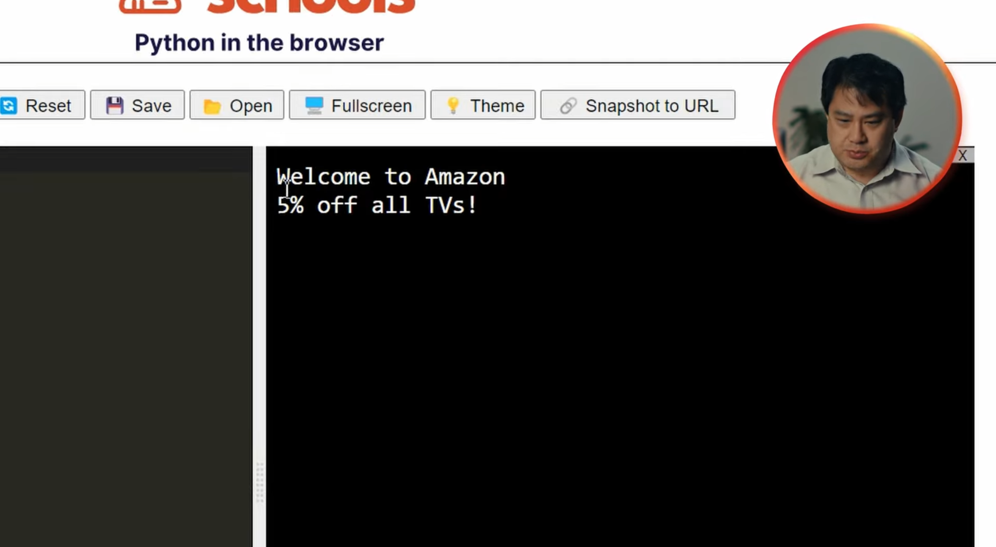


When Spaces in Python Code Matter!
1:24 min
Vimeo video link
Link to Accompanying Slides
(PDF, powerpoint)

Slide 19

Activity: Error messages
Believe it or not, your programs usually won’t work when you write them!
  It doesn’t matter how experienced you are, this always happens
A bug is something that goes wrong in your program
Sometimes, when something goes wrong, Python can detect it and tell you about it through error messages
In this exercise, we are going to get used to reading Python error messages by deliberately making mistakes!

Slide 20
Activity: Buggy Code!
Copy this code line into the editor | What error message did you see displayed on the screen when you ran it? (Some of the code may actually work!) | What did you type in to fix the code? (If the code works, you won’t need to type anything)
prit("Hello, world!") | NameError: name 'prit' is not defined | print("Hello, world!")
Complete the coding task: 02.01 - Buggy Code!
You will also need to make a copy of this worksheet (Microsoft Version)

Slide 21

Worksheet Activity
Complete Question 1 & 2
(PDF, MS Word)

Slide 22
Displaying Blank Lines
1:24 min
Vimeo video link
Link to Accompanying Slides
(PDF, powerpoint)

Slide 23
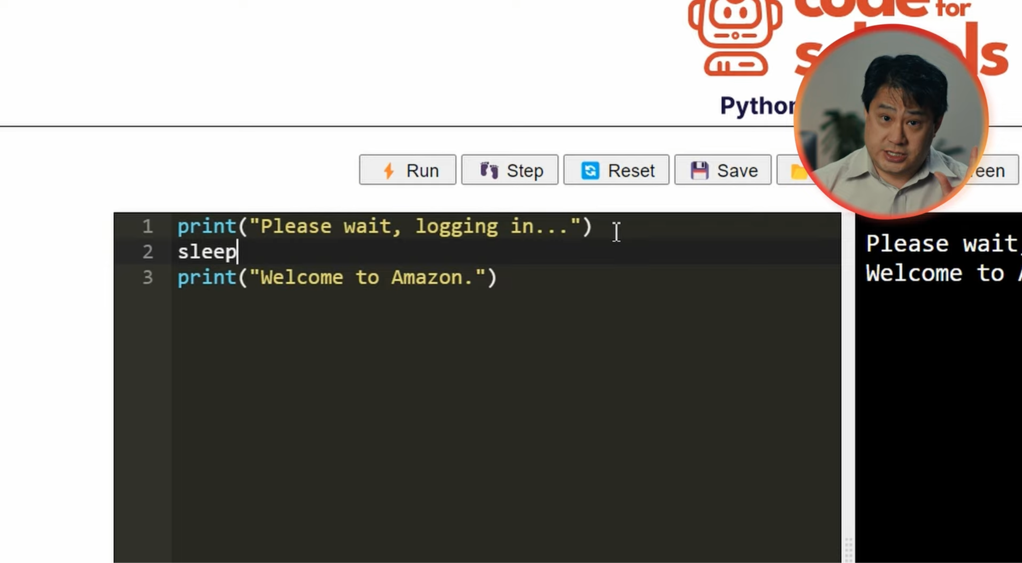
Pausing Between Lines of Code
1:49 min
Vimeo video link
Link to Accompanying Slides
(PDF, powerpoint)

Slide 24


Coding Activity: A Dramatic Poem Display
Activity 02.02
A Dramatic Poem Display

Slide 25
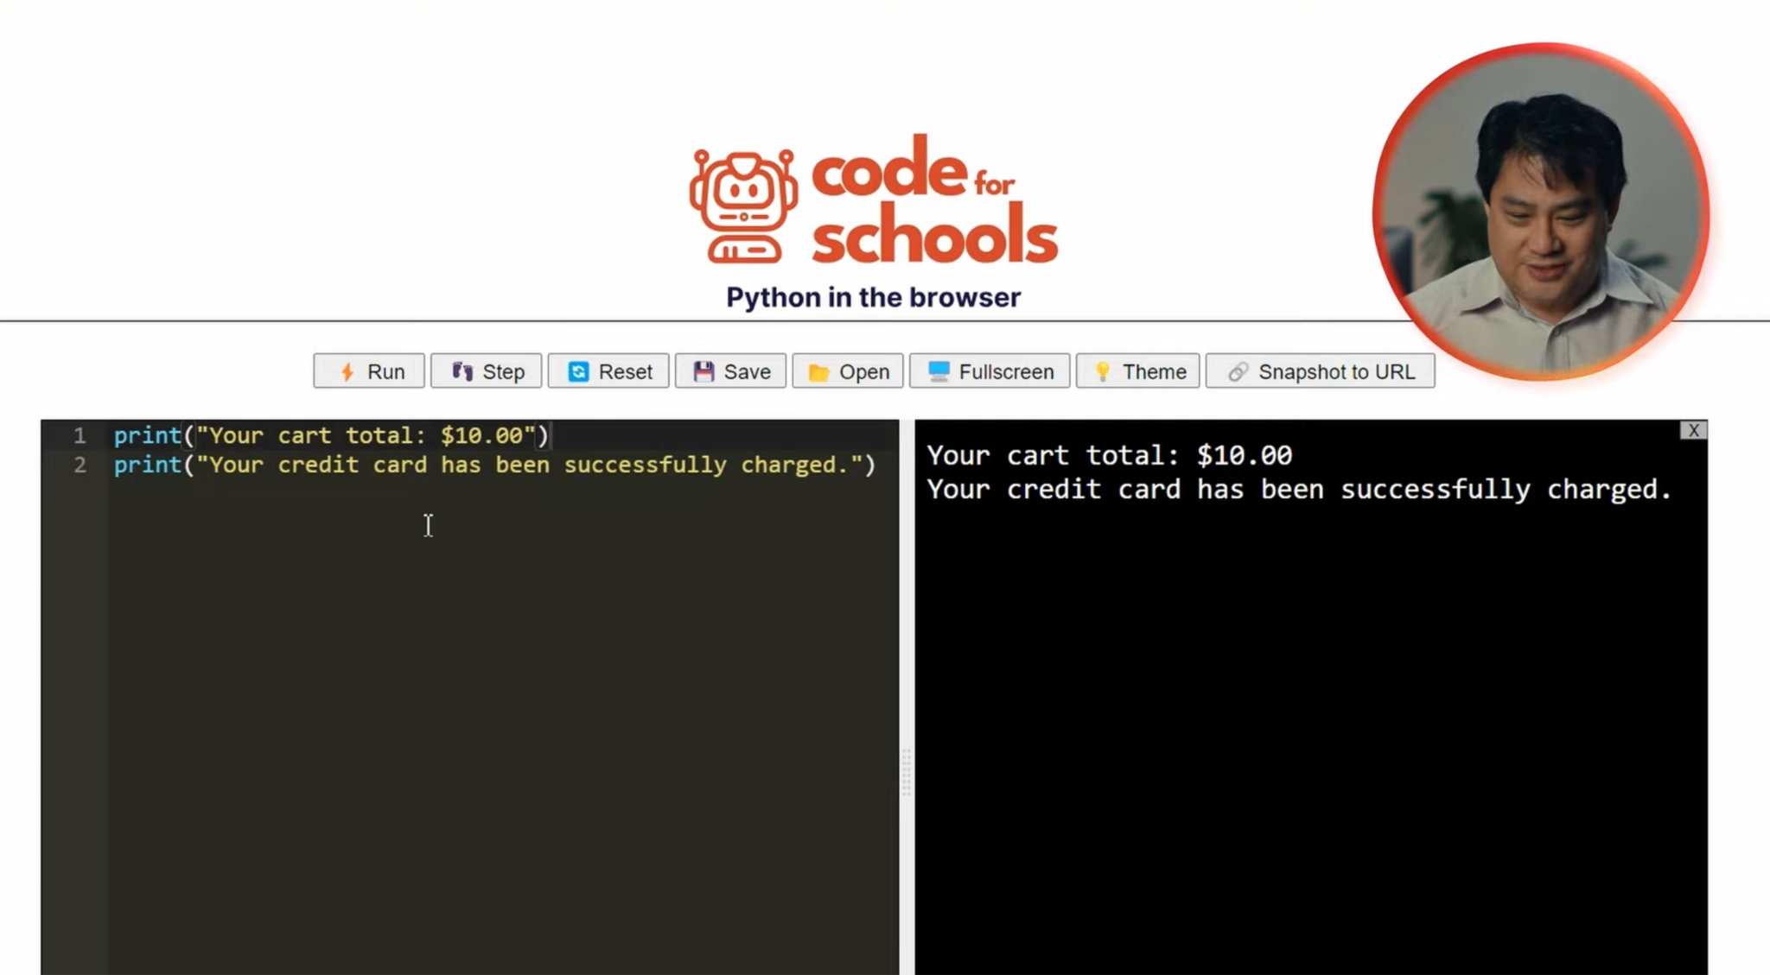
Using input() to Pause Until Enter is Pressed
2:02 min
Vimeo video link
Link to Accompanying Slides
(PDF, powerpoint)

Slide 26
Worksheet Activity
Complete Question 3 & 4
(PDF, MS Word)

Slide 27


Coding Activity: Shopping Cart Confirmation
Activity 02.01
Shopping Cart Confirmation
Complete Question 5
(PDF, MS Word)

Slide 28
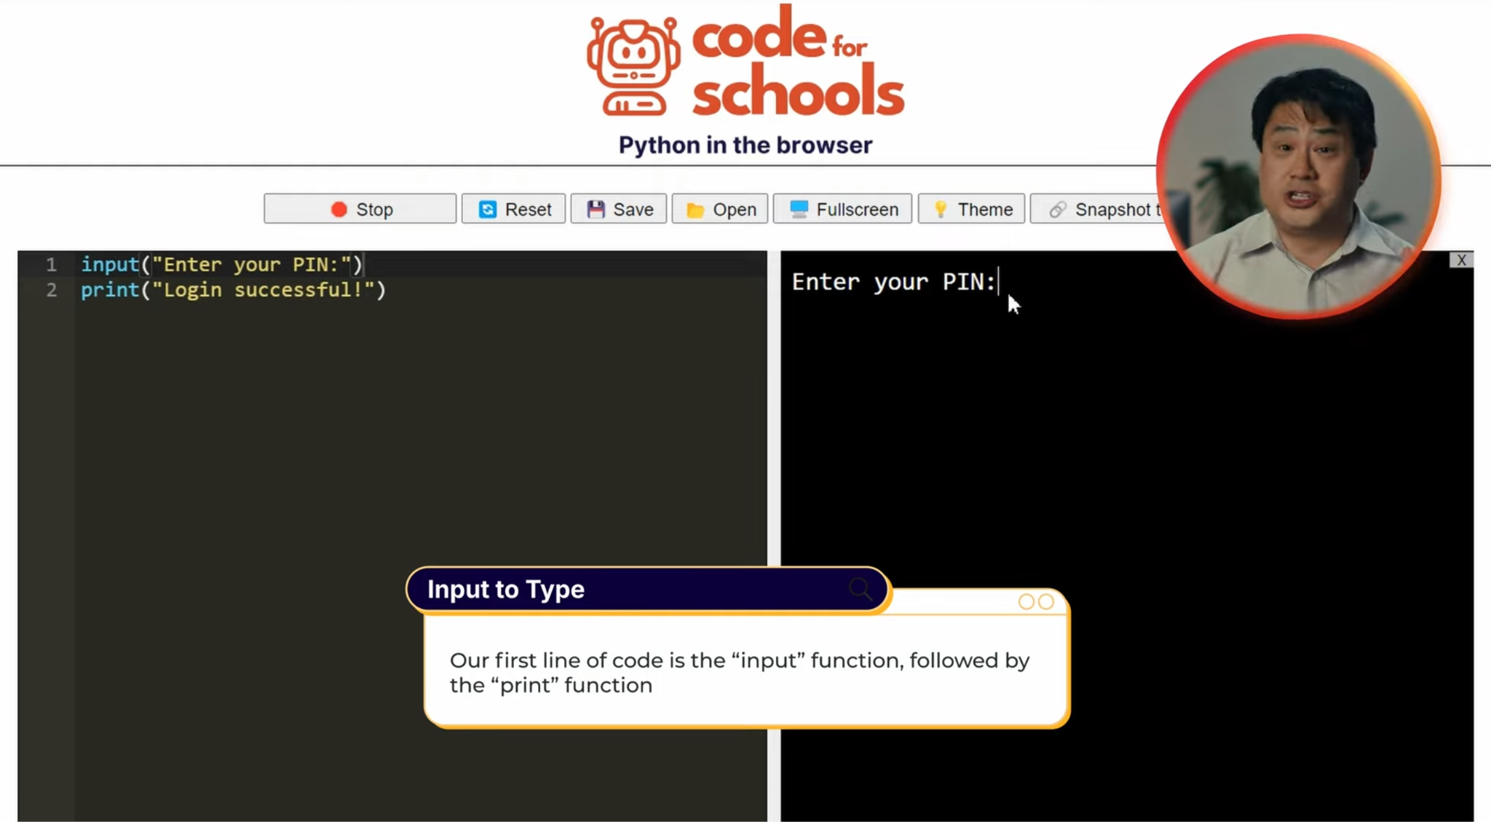
Using input() Let Users Type in Information
1:14 min
Vimeo video link
Link to Accompanying Slides
(PDF, powerpoint)

Slide 29

Coding Activity: TokTik Login
Activity 02.02
TokTik Login
Complete Question 6
(PDF, MS Word)

Slide 30

Coding Activity: Fuzzy Hedgehog
Activity 02.03
Fuzzy Hedgehog
Complete Question 7
(PDF, MS Word)

Slide 31

Coding Activity: Ribbit! (Extension)
Activity 02.04
Ribbit!

Slide 32
Review of Learning Objectives
I can understand how spaces and lines are used in Python
I can write Python programs with multiple lines of code
I can use input() in my programs to pause, and wait for the [ENTER] key to be pressed before continuing

Slide 33


Reflection: Exit pass
What is the name of a function that you’ve learnt about or seen on a worksheet?
Write it on a sticky note and stick it on the board before you leave the classroom
Notes:
Students would have seen the following functions in the slides and/or worksheets:
print
input
sleep (on the worksheet)
slowPrint (on the worksheet)

Slide 34
License Information
These lessons plans, worksheets, and other materials were created by Code for Schools. They are licensed under a Creative Commons Attribution-ShareAlike 4.0 International License.

