Slide 1
Lesson 1
Introduction to Coding

Slide 2
Learning objectives
By the end of this lesson:
I can access the course resources, and use them
I can play a text adventure game
I can understand what a programming language is
I can write my first program in Python!
I can play a graphical game and explore how to modify it

Slide 3


Introduction Worksheet & Scavenger Hunt
Complete the worksheet below by yourself, or together as a class.
When you're done, share what you wrote with the person next to you.
Review as a class.
Complete worksheet here

Slide 4


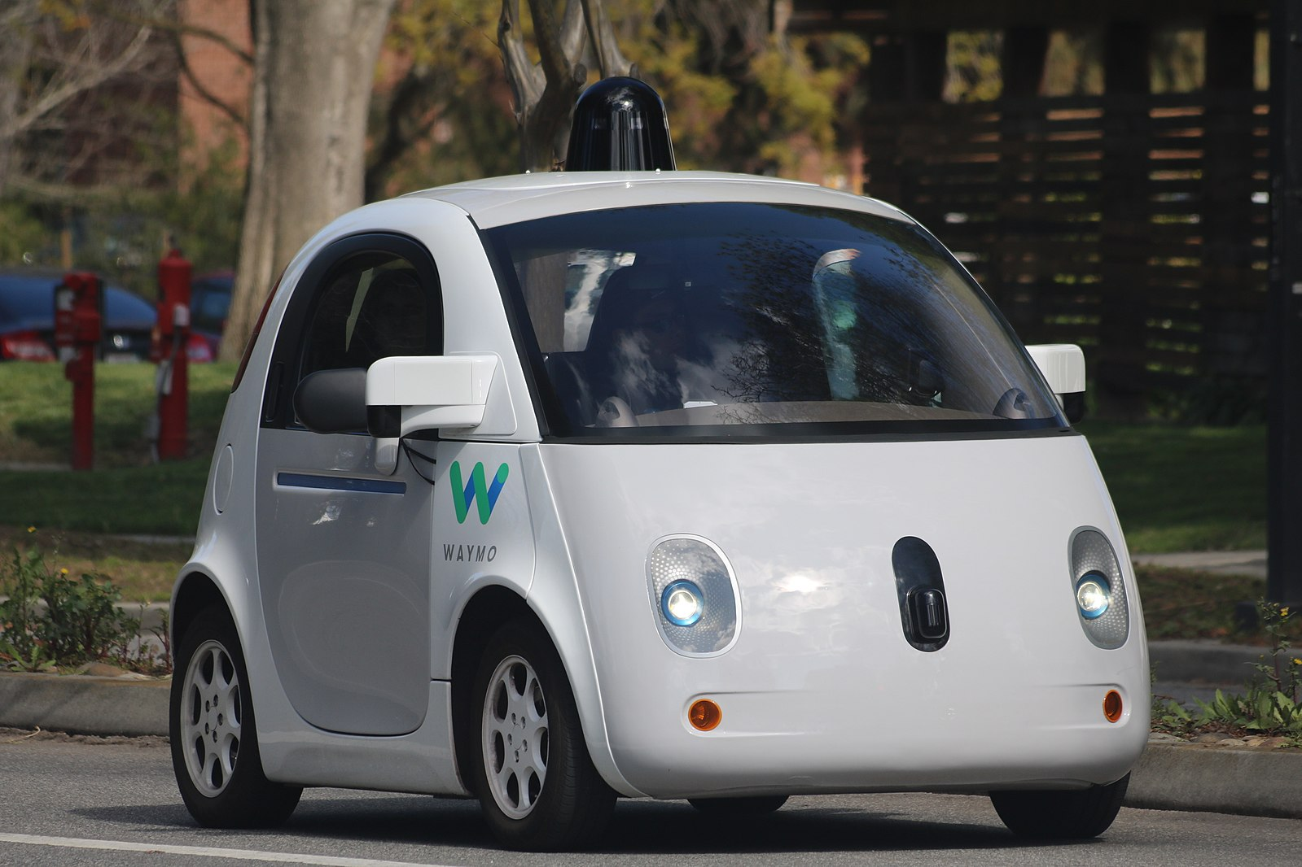


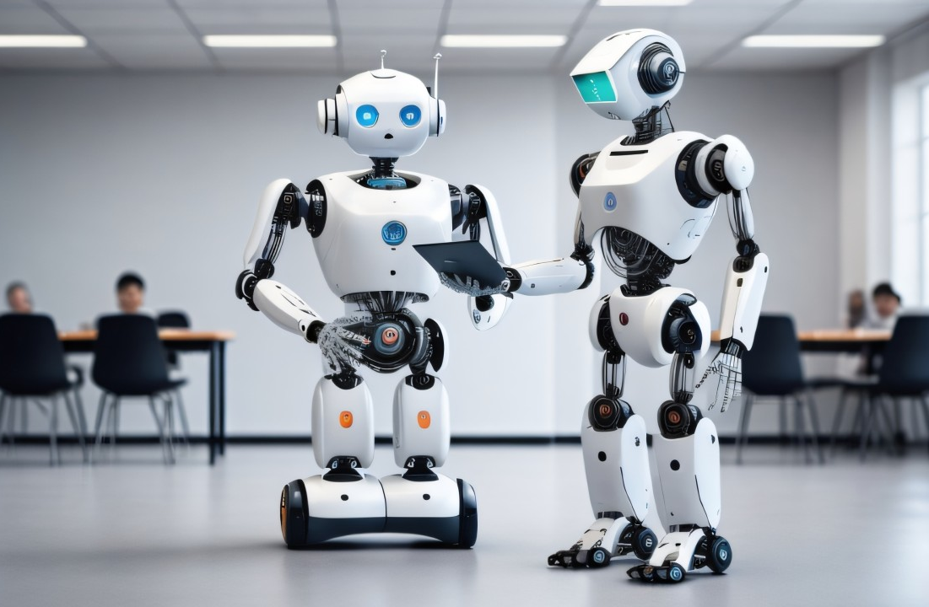
Have you ever wanted to...
Create an app or website?
Create amazing new photo and video filters?
Cure cancer or help make scientific discoveries?
Make smart robots or self-driving vehicles?
Make video games?

Slide 5
What You Can Produce With Coding
Software that drives cars
Apps like Instagram, Snapchat, and TikTok
Online shopping apps
Study tools
Hairstyling and fashion simulations
Games
Smart robots
… and loads more!

Slide 6
Skills that you will develop as you learn how to code
Analysing and solving complex problems
Being confident at using and developing computer applications
Being resourceful, investigative, and creative
Making maths come alive
Improving your personal and technical communication skills
Working in teams
Building resilience with learning and using new skills

Slide 7




Activity 1.01: City of Gold!
Helpful Hints
  On the editor, click on the run button to play the game!
You’ll make a game like this in your final assignment!
Click here to play a Text Based Adventure Game

Slide 8
How computers work
Computers can operate very fast
However, they need to be told what to do
  They need instructions that are step-by-step
  They do exactly as they are told and they’re very strict with spelling!
When we give instructions to a computer, we must also communicate in a language that the computer understands
There are many languages that have been invented for computers
What computer "programming languages" do you know?

Slide 9

How computers work
Computers can operate very fast
However, they need to be told what to do
  They need instructions that are step-by-step
  They do exactly as they are told and they’re very strict with spelling!
When we give instructions to a computer, we must also communicate in a language that the computer understands
There are many languages that have been invented for computers
What computer "programming languages" do you know?
Notes:
Students may have heard of or used programing languages such as:
Scratch
Javascript
Python
Java
C, C++, C#
HTML (not formally a programming language but it counts here!)

Slide 10
Using the Python programming language
We are going to use the Python programming language in this course
Python looks a bit like English and is quite readable
There are lots of code already written in Python that you can borrow in your programs
Python is a very popular programming language in software engineering and science
  It is used in companies such as Amazon, Google, Facebook, and Microsoft, as well as many schools and universities around the world!
It does require typing though. It may be trickier to get started than some other languages (such as Scratch), but soon enough, you will be able to do things much more quickly!

Slide 11
Let’s Write Our First Program in Python!

Slide 12



Your First Python Program!
1:43 min
Vimeo video link
Link to Accompanying Slides
(PDF, powerpoint)

Slide 13

Activity 1.02: Hello World!
Helpful Hints
  This is your very first program!
  You’ll need to use:
  print()
Activity 01.02
Hello, World!

Slide 14
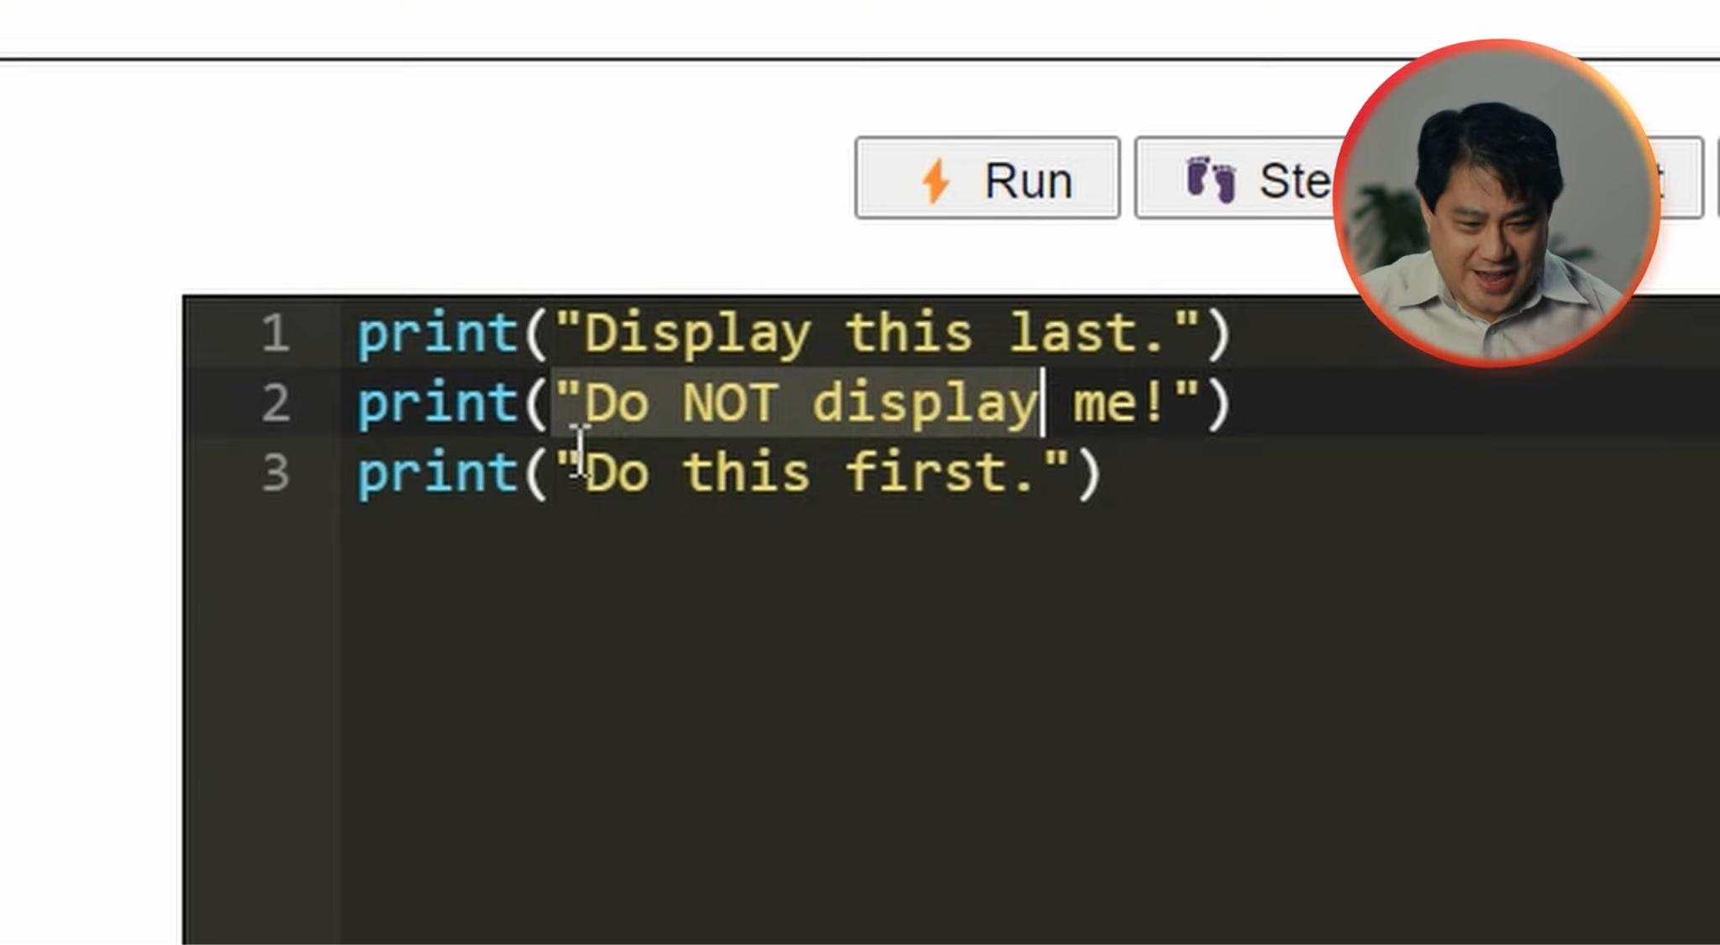
One Line At a Time
2:09 min
Vimeo video link
Link to Accompanying Slides
(PDF, powerpoint)

Slide 15

Activity 1.03: A Conversation in Python!
Activity 01.03
A Conversation in Python

Slide 16
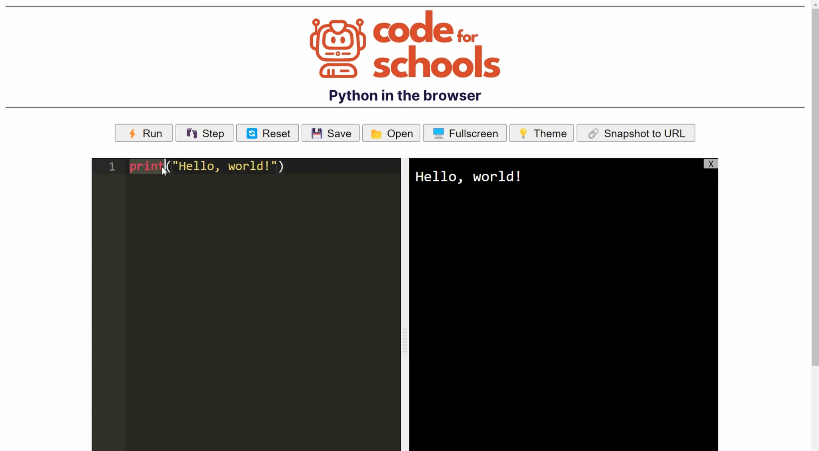
Another Function: say
2:50 min
Vimeo video link
Link to Accompanying Slides
(PDF, powerpoint)

Slide 17

Activity 1.04: A Spoken Conversation in Python!
Helpful Hints
  You’ll need to use:
  say()
Activity 01.04
A Spoken Conversation in Python

Slide 18
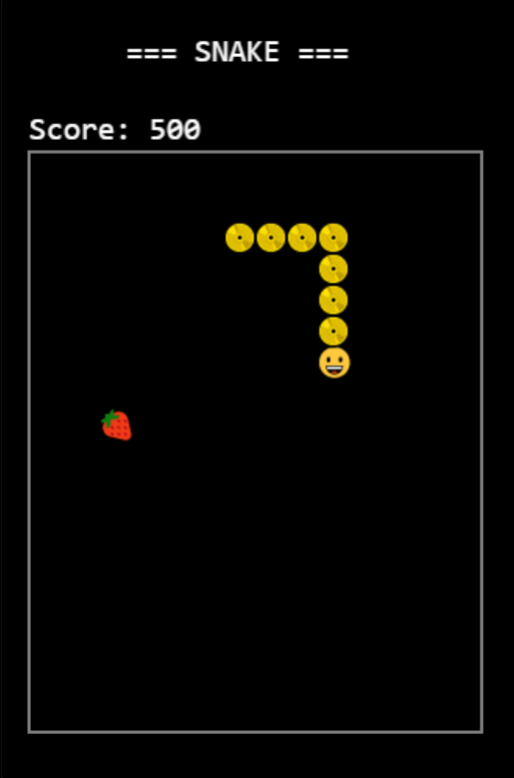
Extension Activity 1.05: Playing Snake!
Helpful Hints
Need some help?
Watch the tutorial video.
Snake is a classic game that you can make with Python!
Extension Activity 01.04
Play Snake here!

Slide 19


Reflection: Exit pass
What is one new thing you learnt today?
Write it on a sticky note and stick it on the board before you leave the classroom

Slide 20
License Information
These lessons plans, worksheets, and other materials were created by Code for Schools. They are licensed under a Creative Commons Attribution-ShareAlike 4.0 International License.

