Slide 1
Introduction to Data Analytics and Data Science
Lesson 1 - Introduction to Spreadsheets and Charts

Slide 2
Learning objectives
By the end of this lesson:
I can experience how data is collected and reported online
I can identify and re-word analytical questions to be more specific
I can represent data as tables, column charts and pie charts in a spreadsheet
I understand the advantages of each type of data representation
I can make an informed decision about how to visually represent a dataset

Slide 3




Hook Activity: Playing Snake!
Teacher Notes
  First, go to the dashboard
  Click on “Generate New Session”
  Then give the students the generated link
While you are play, data is being collected about how you play the game.
What data do you think is being recorded?
Play Snake here!

Slide 4


Hook Activity: Playing Snake - Video Overview
4:34 min
Vimeo video link

Slide 5
Hook Activity: Playing Snake
Teacher Notes
Use the dashboard opened with the generated session link from the previous slide
Check out the data dashboard here
Play Snake here!

Slide 6

Reflection on the Game and Data
Who scored the highest in the class?
Who played the most number of games?
What was the longest snake length?
What do you think the purpose behind collecting all this data might be?

Slide 7
Possible Reasons for Collecting and Using Data
Use to score players for competitions
Identify players to give awards and place on online leaderboards
Identify advertisements to target to players for extra $$$
Use to monitor if the game is working properly online
Provide tutorials and guidance for beginning players

Slide 8
Data Collection and Analysis
You’ve just seen how, even in the example of a simple game, data about you is being collected
We can then analyse the data in order to reveal insights about how to improve our digital solution
But even before we collect and analyse data, it is important to figure out what question or problem we are trying to answer and solve with data

Slide 9

Fast Food Restaurants in Australia
Let’s think of this question:
“What is the most popular fast food restaurant in Australia?”

Slide 10
Fast Food Restaurants in Australia
Let’s think of this question:
“What is the most popular fast food restaurant in Australia?”
How would we define popular?

Slide 11
Fast Food Restaurants in Australia
Let’s think of this question:
“What is the most popular fast food restaurant in Australia?”
How would we define popular?
  How many restaurants location? How much money it makes? How many orders does it fulfil?

Slide 12
Fast Food Restaurants in Australia
Let’s think of this question:
“What is the most popular fast food restaurant in Australia?”
How would we define popular?
  How many restaurants location? How much money it makes? How many orders does it fulfil?
What is the time frame?

Slide 13
Fast Food Restaurants in Australia
Let’s think of this question:
“What is the most popular fast food restaurant in Australia?”
How would we define popular?
  How many restaurants location? How much money it makes? How many orders does it fulfil?
What is the time frame?
  Since the beginning of time? This year only? For a range of years?

Slide 14
Fast Food Restaurants in Australia
Let’s think of this question:
“What is the most popular fast food restaurant in Australia?”
How would we define popular?
  How many restaurants location? How much money it makes? How many orders does it fulfil?
What is the time frame?
  Since the beginning of time? This year only? For a range of years?
How might we rewrite this question to make it more specific?

Slide 15
Fast Food Restaurants in Australia
Let’s ask a more focused question:
“What are the top 5 fast food restaurants with the most locations in Australia in 2024?”

Slide 16
Fast Food Restaurants in Australia
Let’s ask a more focused question:
“What are the top 5 fast food restaurants with the most locations in Australia in 2024?”
Restaurant | Number of Locations
Subway | 1,243
McDonald's | 1,053
KFC | 782
Dominos Pizza | 726
Hungry Jack's | 476
Source: ScrapeHero. (2024). 10 largest food chains in Australia in 2024. https://www.scrapehero.com/location-reports/10-largest-food-chains-in-australia/

Slide 17
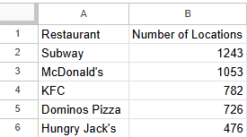

Activity 1.01: Data Entry into a Spreadsheet!
“What are the top 5 fast food restaurants with the most locations in Australia in 2024?”
Restaurant | Number of Locations
Subway | 1,243
McDonald's | 1,053
KFC | 782
Dominos Pizza | 726
Hungry Jack's | 476
Complete Worksheet Question 1
(PDF, MS Word)

Slide 18
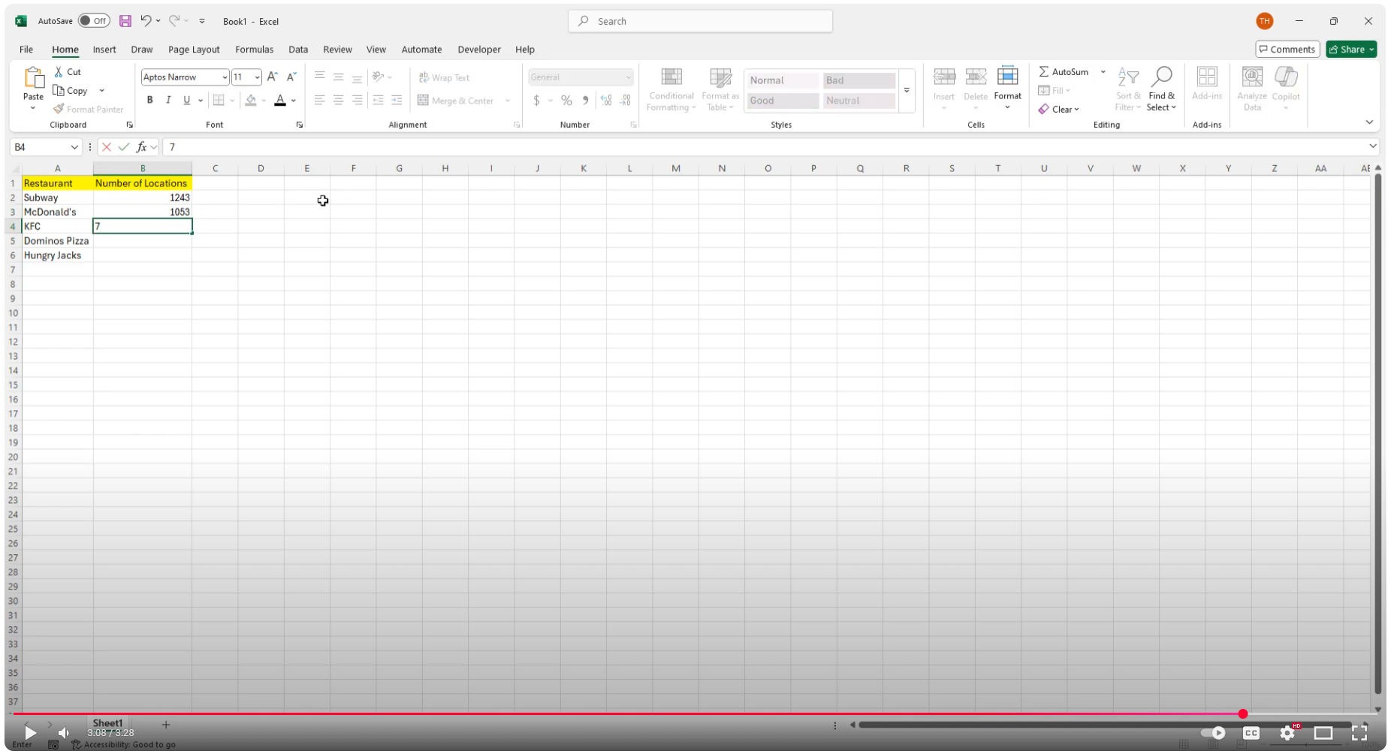
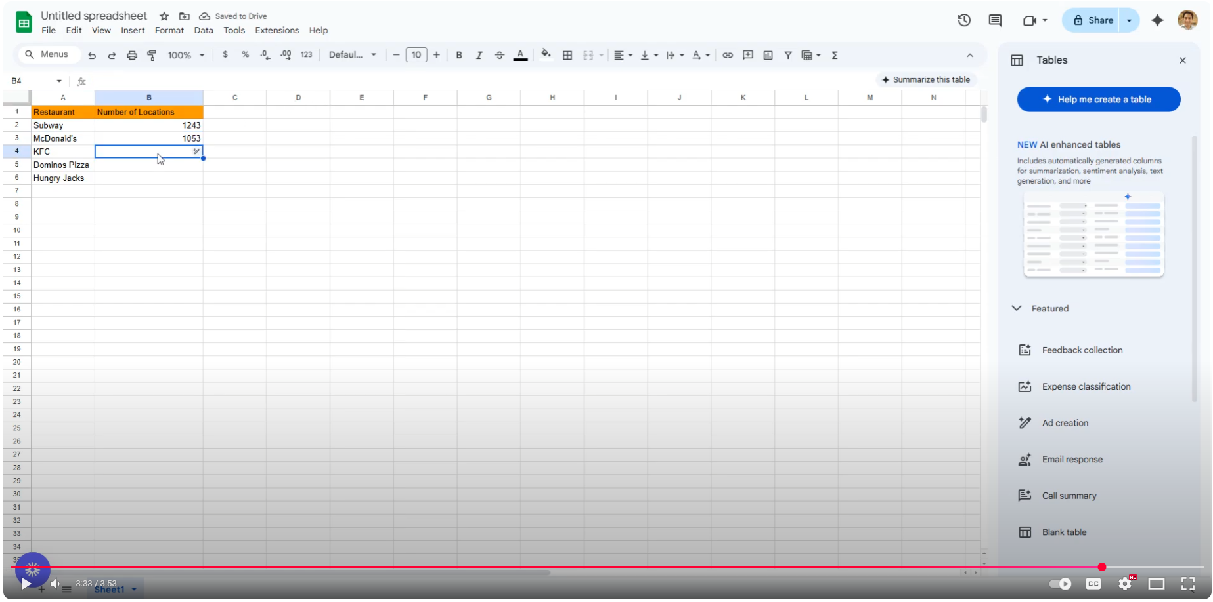


Introduction to Spreadsheets - Video Overview
3:28 min
3:54 min
Vimeo video link
Vimeo video link
Microsoft Excel Version
Google Sheets Version
Google Sheets Version

Slide 19
Spreadsheet Terminology

Slide 20
Spreadsheet Terminology
cell

Slide 21
Spreadsheet Terminology
row

Slide 22
Spreadsheet Terminology
column

Slide 23
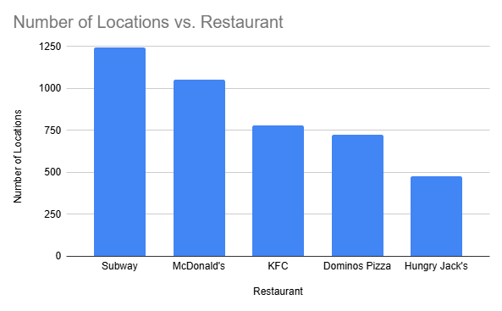
Activity 1.02: Generating a Column Chart!
“What are the top 5 fast food restaurants with the most locations in Australia in 2024?”
Restaurant | Number of Locations
Subway | 1,243
McDonald's | 1,053
KFC | 782
Dominos Pizza | 726
Hungry Jack's | 476
Complete Worksheet Question 2
(PDF, MS Word)

Slide 24
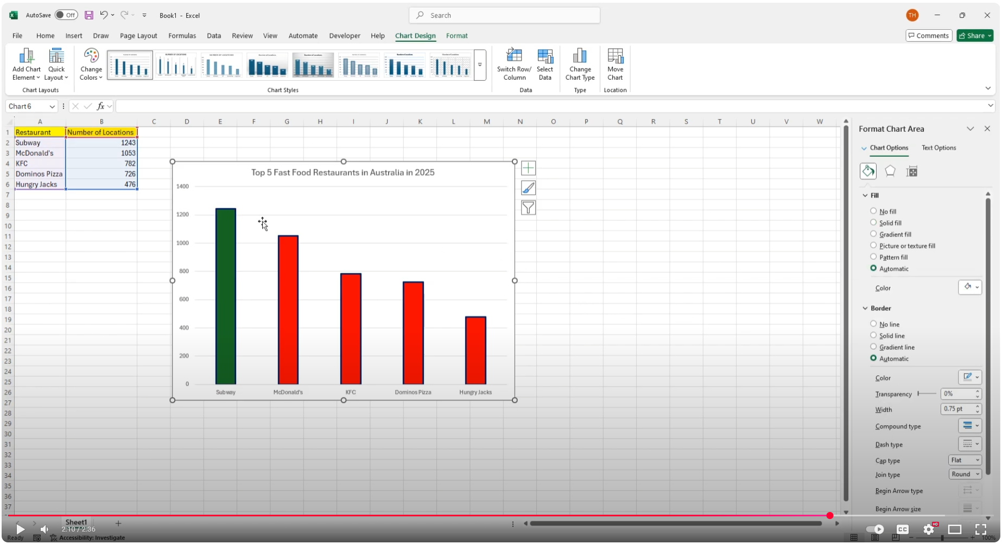
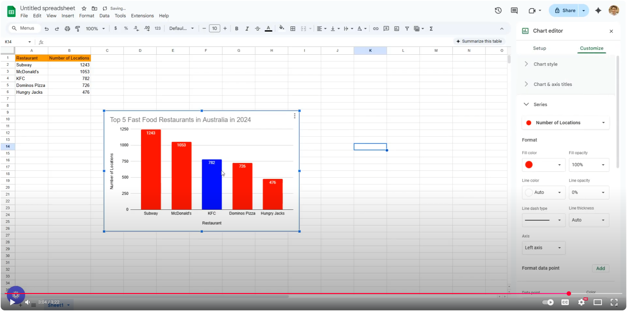
Generating Column Charts - Video Overview
2:37 min
3:23 min
Vimeo video link
Vimeo video link
Microsoft Excel Version
Google Sheets Version
Google Sheets Version

Slide 25
Data in Tables vs Column Charts
Restaurant | Number of Locations
Subway | 1,243
McDonald's | 1,053
KFC | 782
Dominos Pizza | 726
Hungry Jack's | 476
Advantages of Tables | Advantages of Column Charts
Provides detailed and precise figures | Easier to visually identify patterns, trends and outliers

Slide 26
Activity 1.03 - Your Own Data
Now it’s time to ask and answer the question:
“What are the types of food most enjoyed by students in my class?”
As a class, count the number of students who like certain types of food (e.g. Italian, Chinese, Fast Food etc.)
Fill in this table:
Type of Food | Number of Students

Slide 27
Activity 1.03 - Your Own Data
Now it’s time to ask and answer the question:
“What are the types of food most enjoyed by students in my class?”
As a class, count the number of students who like certain types of food (e.g. Italian, Chinese, Fast Food etc.)
Fill in this table:
Type of Food | Number of Students
Italian | 12
Thai | 7
Fast food | 5
Indian | 2
Write the answers down in order of highest count to lowest count (descending order)
EXAMPLE

Slide 28
Worksheet Activity
Complete Worksheet Question 3
(PDF, MS Word)

Slide 29
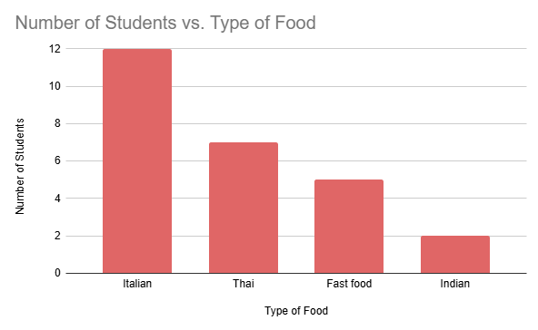
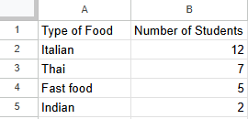
Activity 1.04 - Spreadsheet and Chart
Now it’s time to ask and answer the question:
“What are the types of food most enjoyed by students in my class?”
Now enter the data onto a new spreadsheet, and then generate a column chart for it.
Type of Food | Number of Students
Italian | 12
Thai | 7
Fast food | 5
Indian | 2
EXAMPLE
EXAMPLE
EXAMPLE

Slide 30
Worksheet Activity
Complete Worksheet Question 4
(PDF, MS Word)

Slide 31

Spotify Members
Let’s consider this question:
“What is the number of paid (premium) Spotify members compared to free Spotify members?”

Slide 32
Spotify Members
Let’s consider this question:
“What is the number of paid (premium) Spotify members compared to free Spotify members?”
Premium: 236 million
Free: 379 million
Source: Exploding Topics. (2024). Music streaming stats. https://explodingtopics.com/blog/music-streaming-stats

Slide 33
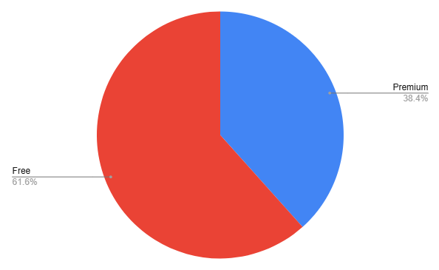

Activity 1.05 - Spotify Members Pie Chart
Let’s consider this question:
“What is the number of paid (premium) Spotify members compared to free Spotify members?”
Premium: 236 million
Free: 379 million
Complete Worksheet Question 5
(PDF, MS Word)

Slide 34
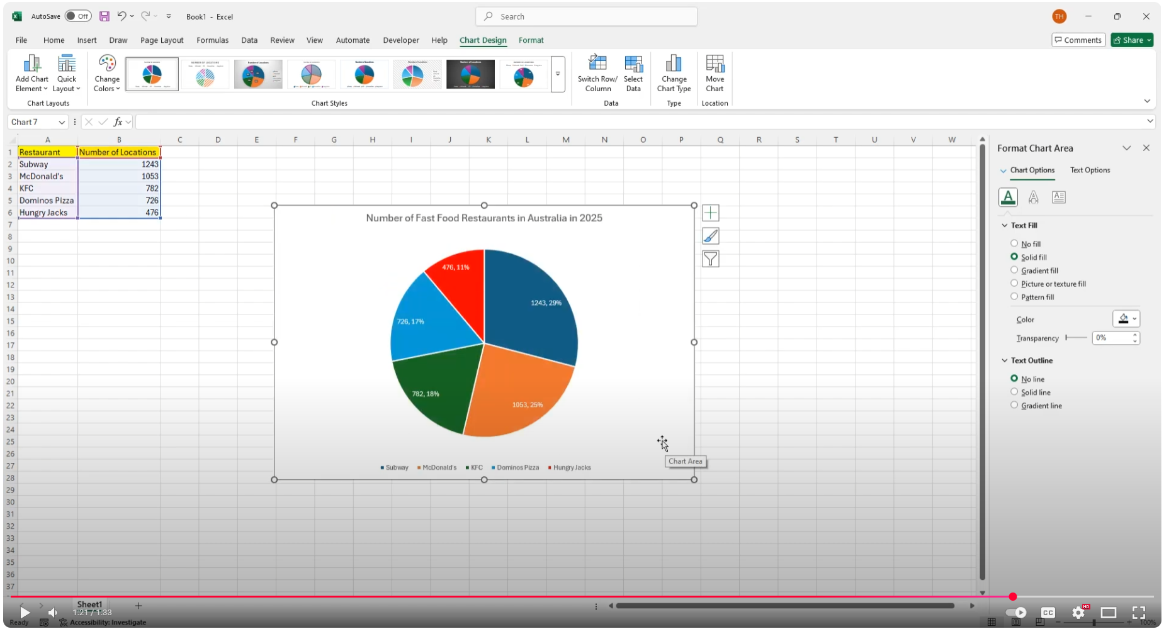
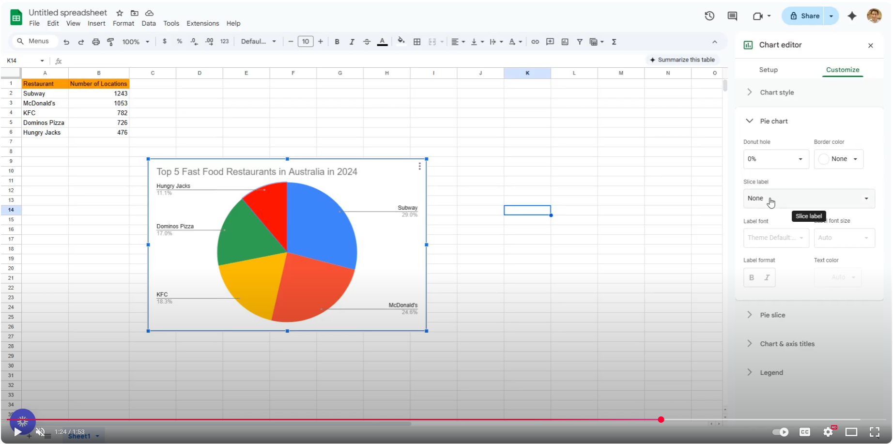
Generating Pie Charts - Video Overview
1:34 min
1:54 min
Vimeo video link
Vimeo video link
Microsoft Excel Version
Google Sheets Version
Google Sheets Version

Slide 35
Data in Column vs Pie Charts
Advantages of Column Charts | Advantages of Pie Charts
Better for showing trends or patterns over time | Better for showing proportions
Handles many categories well | Better for fewer categories

Slide 36

School Enrollments in Australia
Let’s consider this question:
“What is the difference in enrollments between different Australian school affiliations (e.g. public, private, Catholic)?”

Slide 37
School Enrollments in Australia
Let’s consider this question:
“What is the difference in enrollments between different Australian school affiliations (e.g. public, private, Catholic)?”
Rewrite the above question so that it is more specific.

Slide 38
School Enrollments in Australia
Focus question:
“What is the number of student enrollments across Australian school affiliations in 2024?”

Slide 39
School Enrollments in Australia
Focus question:
“What is the number of student enrollments across Australian school affiliations in 2024?”
School Affiliation | Number of Enrollments
Government | 2,619,513
Catholic | 820,222
Independent | 692,271
Source: Australian Bureau of Statistics. (2024, February 6). Schools. Australian Government. https://www.abs.gov.au/statistics/people/education/schools/latest-release

Slide 40
School Enrollments in Australia
Focus question:
“What is the number of student enrollments across Australian school affiliations in 2024?”
Which type of chart: column or pie, would better visualise this data?
School Affiliation | Number of Enrollments
Government | 2,619,513
Catholic | 820,222
Independent | 692,271
Source: Australian Bureau of Statistics. (2024, February 6). Schools. Australian Government. https://www.abs.gov.au/statistics/people/education/schools/latest-release

Slide 41
Activity 1.06: School Enrollments in Australia
“What is the number of student enrollments across Australian school affiliations in 2024?”
Enter this data into a spreadsheet and visualise it as both a column chart and a pie chart.
Answer the questions in the worksheet.
School Affiliation | Number of Enrollments
Government | 2,619,513
Catholic | 820,222
Independent | 692,271
Source: Australian Bureau of Statistics. (2024, February 6). Schools. Australian Government. https://www.abs.gov.au/statistics/people/education/schools/latest-release

Slide 42
Worksheet Activity
Complete Worksheet Question 6
(PDF, MS Word)

Slide 43
Lesson Recap
I can now:
Experience how data is collected and reported online
Identify and re-word analytical questions to be more specific
Represent data as tables, column charts and pie charts in a spreadsheet
Understand the advantages of each type of data representation
Make an informed decision about how to visually represent a dataset

