Slide 1

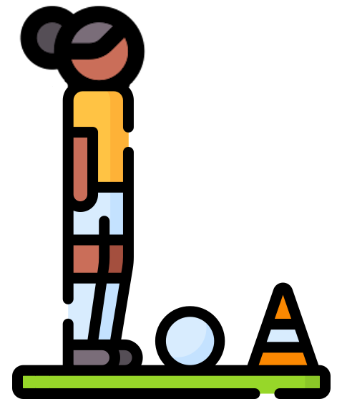
Lesson 5
Training and Testing
csinschools.com

Slide 2

Learning objectives
By the end of this lesson, you should be able to:
Understand how to formally test a classifier for accuracy
Draw a confusion matrix and generate summary statistics
Train, test and evaluate an image classifier

Slide 3




Demo: Let There Be Light!
Exploratory Activity
What other sounds might trigger the light bulb to turn on / off?
Double Clap to Turn The light On or Off!

Slide 4

Tests
Play Video
1:59 min
Slide 3 - 10
Have you ever wondered why you have to sit tests at the end of topics?
What do you think makes a good test - from the teachers’ perspective!

Slide 5

Tests
Have you ever wondered why you have to sit tests at the end of topics?
What do you think makes a good test - from the teachers’ perspective!

Slide 6
Tests
Have you ever wondered why you have to sit tests at the end of topics?
What do you think makes a good test - from the teachers’ perspective!
  Doesn’t have exactly the same questions as you covered in class exercises!
  Contains questions which require to you extend and build upon learning in class

Slide 7
Tests
Let’s pretend our “student” is the classifier, and we are the “teacher”
We’ve trained it using our training images
Now we want to test how well it did.
What type of images would we use?

Slide 8
Data: Training Set vs Testing Set
Test set: You “hold back” a set of labelled samples to “test” the quality of your prediction
What might happen if you just reuse all the training data, and test the classifier with the same data you trained on?

Slide 9
Data: Training Set vs Testing Set
Test set: You “hold back” a set of labelled samples to “test” the quality of your prediction
What might happen if you just reuse all the training data, and test the classifier with the same data you trained on?
  What happens if your maths teacher gives you all the test questions as a practice exercise to do before the test?

Slide 10





Population vs Sampling Frame vs Sample
Training Samples
Testing Samples
Sample
Sampling Frame
(Entire) Population

Slide 11

Population vs Sampling Frame vs Sample
Randomly divide
Training Samples
Randomly divide
Testing Samples
Sample
Sampling Frame
(Entire) Population

Slide 12

Worksheet Activity
Complete Question 1
(PDF, MS Word)

Slide 13
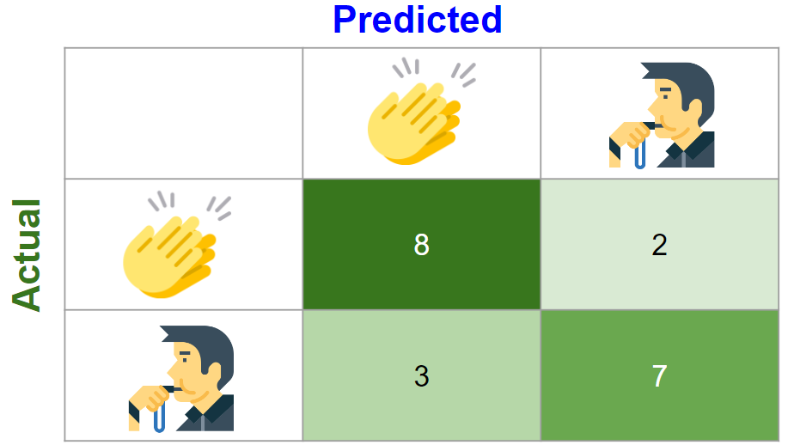
Confusion Matrix
Play Video
3:42 min
Slide 12 - 48
We now have our testing data separated from our training data
How can we measure how well our classifier is performing?
To quantify testing measurements (just like how you get scores from a test) we use a confusion matrix

Slide 14
Confusion Matrix
Below we see an example confusion matrix recorded for a classifier which predicts clap and whistle sounds

Slide 15


Confusion Matrix
Predicted
 | 8 | 2
 | 3 | 7
Actual

Slide 16
Predicted
 | 8 | 2
 | 3 | 7
Actual
This is what the actual, correct classification is…

Slide 17
Predicted
 | 8 | 2
 | 3 | 7
Actual
There were 8 + 2 = 10 actual claps sounds used to test this classifier.

Slide 18
Predicted
 | 8 | 2
 | 3 | 7
Actual
There were 3 + 7 = 10 actual whistle sounds used to test this classifier.

Slide 19
Predicted
 | 8 | 2
 | 3 | 7
Actual
This is what the classifier predicted…

Slide 20
Predicted
 | 8 | 2
 | 3 | 7
Actual

Slide 21
Predicted
 | 8 | 2
 | 3 | 7
Actual
There were 8 actual claps…

Slide 22
Predicted
 | 8 | 2
 | 3 | 7
Actual
There were 8 actual claps which were predicted as claps!

Slide 23
Predicted
 | 8 | 2
 | 3 | 7
Actual
There were 8 actual claps which were predicted as claps!
It got these correct!

Slide 24
Predicted
 | 8 | 2
 | 3 | 7
Actual

Slide 25
Predicted
 | 8 | 2
 | 3 | 7
Actual
There were 2 actual claps…

Slide 26
Predicted
 | 8 | 2
 | 3 | 7
Actual
There were 2 actual claps which were predicted as whistles!

Slide 27
Predicted
 | 8 | 2
 | 3 | 7
Actual
There were 2 actual claps which were predicted as whistles!
It got these incorrect!

Slide 28
Predicted
 | 8 | 2
 | 3 | 7
Actual

Slide 29
Predicted
 | 8 | 2
 | 3 | 7
Actual
There were 3 actual whistles …

Slide 30
Predicted
 | 8 | 2
 | 3 | 7
Actual
There were 3 actual whistles which were predicted as claps!

Slide 31
Predicted
 | 8 | 2
 | 3 | 7
Actual
There were 3 actual whistles which were predicted as claps!
It got these incorrect!

Slide 32
Predicted
 | 8 | 2
 | 3 | 7
Actual

Slide 33
Predicted
 | 8 | 2
 | 3 | 7
Actual
There were 7 actual whistles …

Slide 34
Predicted
 | 8 | 2
 | 3 | 7
Actual
There were 7 actual whistles which were predicted as whistles!

Slide 35
Predicted
 | 8 | 2
 | 3 | 7
Actual
There were 7 actual whistles which were predicted as whistles!
It got these correct!

Slide 36
Predicted
 | 8 | 2
 | 3 | 7
Actual
There were 8 actual claps which were predicted as claps.
There were 2 actual claps which were predicted as whistles.
10 clap sounds were used to test this classifier.
There were 3 actual whistles which were predicted as claps.
There were 7 actual whistles where were predicted as whistles.
10 whistle sounds were used to test this classifier.

Slide 37
The Ideal Classifier Confusion Matrix
Predicted
 | 10 | 0
 | 0 | 10
Actual
In the ideal classifier, the confusion matrix would have values only on a diagonal. This would mean all the classes were correctly classified.

Slide 38
The Ideal Classifier Confusion Matrix
Predicted
 | 10 | 0
 | 0 | 10
Actual
In the ideal classifier, the confusion matrix would have values only on a diagonal. This would mean all the classes were correctly classified.

Slide 39


Another Confusion Matrix
Below we see another example of a confusion matrix.
This one is for a classifier which predicts images of parrots or eagles
Predicted
 | 12 | 3
 | 4 | 16
parrot
eagle
parrot
Actual
eagle

Slide 40
Predicted
 | 12 | 3
 | 4 | 16
parrot
eagle
parrot
Actual
eagle

Slide 41
Predicted
 | 12 | 3
 | 4 | 16
parrot
eagle
parrot
Actual
eagle
This is what the actual, correct classification is…

Slide 42
Predicted
 | 12 | 3
 | 4 | 16
parrot
eagle
12 + 3 = 15 images of parrots were used to test this classifier.
parrot
Actual
eagle

Slide 43
Predicted
 | 12 | 3
 | 4 | 16
parrot
eagle
parrot
Actual
4 + 16 = 20 images of eagles were used to test this classifier.
eagle

Slide 44
Predicted
 | 12 | 3
 | 4 | 16
parrot
eagle
parrot
Actual
eagle
This is what the classifier predicted…

Slide 45
Predicted
 | 12 | 3
 | 4 | 16
parrot
eagle
parrot
Actual
There were 12 actual parrots which were predicted as parrots!
eagle
It got these correct!

Slide 46
Predicted
 | 12 | 3
 | 4 | 16
parrot
eagle
parrot
Actual
There were 3 actual parrots which were predicted as eagles!
eagle
It got these incorrect!

Slide 47
Predicted
 | 12 | 3
 | 4 | 16
parrot
eagle
parrot
Actual
There were 4 actual eagles which were predicted as parrots!
eagle
It got these incorrect!

Slide 48
Predicted
 | 12 | 3
 | 4 | 16
parrot
eagle
parrot
Actual
eagle
There were 16 actual eagles which were predicted as eagles!
It got these correct!

Slide 49
Predicted
 | 12 | 3
 | 4 | 16
parrot
eagle
parrot
Actual
eagle
There were 12 parrot images which were predicted as parrots.
There were 3 parrot images which were predicted as eagles.
15 parrot images were used to test this classifier.
There were 16 eagle images which were predicted as eagles.
There were 4 eagle images which were predicted as parrots.
20 eagle images were used to test this classifier.

Slide 50
Worksheet Activity
Complete Questions 2 - 4
(PDF, MS Word)

Slide 51

Summary
You should now be able to:
Understand how to formally test a classifier for accuracy
Draw a confusion matrix and generate summary statistics
Train, test and evaluate an image classifier

Slide 52
License Information
These CS in Schools lessons plans, worksheets, and other materials were created by the CS in Schools team. They are licensed under a Creative Commons Attribution-ShareAlike 4.0 International License.
Images all taken from flaticon.

