Slide 1


Lesson 3
Generative AI
csinschools.com

Slide 2

Learning objectives
By the end of this lesson, you should be able to:
Understand what Generative AI is
Explore the types of images and text produced by Generative AI
Understand how Generative AI is an extension of Predictive AI
Understand how ChatGPT is a based on text prediction
Demonstrate how text prediction works
Understand how ChatGPT extends upon text prediction
Understand how Generative AI is used to produce images

Slide 3



Demo: ChatGPT… the Poet
Exploratory Activity
Can you make the poem rhyme?
Let me be your own personal poet

Slide 4

Generative AI
Play Video
4:39 min
Slide 4 - 71
Remember how one form of pattern-based AI is used for prediction
  That is, given a bunch of images and their labels, what does the system predict a new image to be?
This can be applied to words and sentences…
  Given a bunch of words and the next word, what does the system predict the next word in the sentence to be?
One recent development in AI systems is to extend prediction systems into Generative AI systems - which can produce new works of text, art, music etc.
We’ll now look at how Generative text AI is actually a form of predictive AI

Slide 5
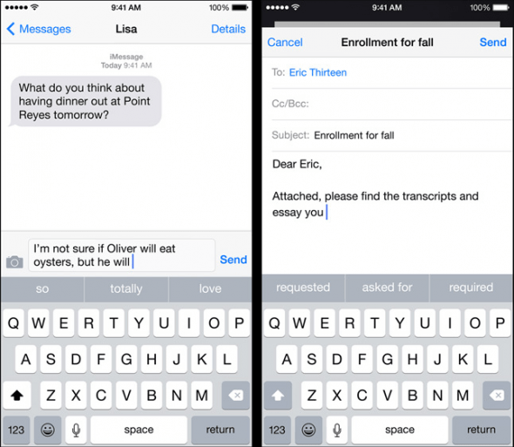
Text Prediction on your phones!
Uses the same type of technology as ChatGPT!

Slide 6
Text Prediction on your phones!
Uses the same type of technology as ChatGPT!

Slide 7
Text Prediction on your phones!
The text prediction feature on your phone is continually “learning” based on the types of messages and words that you type.

Slide 8
Text Prediction on your phones!
for real bro it was like so embarrassing
he thought he ate that up for real
for real bro like how do you recover
no like actually for reals
he really thought he wasnt gonna die doing that like be for real
like bro he actually thought I was gonna go through with it like be for real
Let’s imagine you’ve typed the above types of messages…

Slide 9
Text Prediction on your phones!
for real bro it was like so embarrassing
he thought he ate that up for real
for real bro like how do you recover
no like actually for reals
he really thought he wasnt gonna die doing that like be for real
like bro he actually thought I was gonna go through with it like be for real
We’re going to look for pairs of words (bigrams)
Let’s start with pairs of words starting with the word “for”
Let’s imagine you’ve typed the above types of messages…

Slide 10
Text Prediction on your phones!
for real bro it was like so embarrassing
he thought he ate that up for real
for real bro like how do you recover
no like actually for reals
he really thought he wasnt gonna die doing that like be for real
like bro he actually thought I was gonna go through with it like be for real
We’re going to look for pairs of words (bigrams)
Let’s start with pairs of words starting with the word “for”
Let’s imagine you’ve typed the above types of messages…

Slide 11
Text Prediction on your phones!
for real bro it was like so embarrassing
he thought he ate that up for real
for real bro like how do you recover
no like actually for reals
he really thought he wasnt gonna die doing that like be for real
like bro he actually thought I was gonna go through with it like be for real
We’re going to look for pairs of words (bigrams)
Let’s start with pairs of words starting with the word “for”
Let’s imagine you’ve typed the above types of messages…

Slide 12
Text Prediction on your phones!
for real bro it was like so embarrassing
he thought he ate that up for real
for real bro like how do you recover
no like actually for reals
he really thought he wasnt gonna die doing that like be for real
like bro he actually thought I was gonna go through with it like be for real
Let’s imagine you’ve typed the above types of messages…

Slide 13
Text Prediction on your phones!
for real bro it was like so embarrassing
he thought he ate that up for real
for real bro like how do you recover
no like actually for reals
he really thought he wasnt gonna die doing that like be for real
like bro he actually thought I was gonna go through with it like be for real
Next word | Count
real | 5
reals | 1
Current word
for
Let’s imagine you’ve typed the above types of messages…

Slide 14
Text Prediction on your phones!
for real bro it was like so embarrassing
he thought he ate that up for real
for real bro like how do you recover
no like actually for reals
he really thought he wasnt gonna die doing that like be for real
like bro he actually thought I was gonna go through with it like be for real
Next word | Count
real | 5
reals | 1
Current word
for
Let’s imagine you’ve typed the above types of messages…

Slide 15
Text Prediction on your phones!
for real bro it was like so embarrassing
he thought he ate that up for real
for real bro like how do you recover
no like actually for reals
he really thought he wasnt gonna die doing that like be for real
like bro he actually thought I was gonna go through with it like be for real
Next word | Count
real | 5
reals | 1
Current word
for
Let’s imagine you’ve typed the above types of messages…

Slide 16
Text Prediction on your phones!
for real bro it was like so embarrassing
he thought he ate that up for real
for real bro like how do you recover
no like actually for reals
he really thought he wasnt gonna die doing that like be for real
like bro he actually thought I was gonna go through with it like be for real
Next word | Count
real | 5
reals | 1
Current word
for
Let’s imagine you’ve typed the above types of messages…

Slide 17
Text Prediction on your phones!
for real bro it was like so embarrassing
he thought he ate that up for real
for real bro like how do you recover
no like actually for reals
he really thought he wasnt gonna die doing that like be for real
like bro he actually thought I was gonna go through with it like be for real
Next word | Count
real | 5
reals | 1
Current word
for
Let’s imagine you’ve typed the above types of messages…

Slide 18
Text Prediction on your phones!
for real bro it was like so embarrassing
he thought he ate that up for real
for real bro like how do you recover
no like actually for reals
he really thought he wasnt gonna die doing that like be for real
like bro he actually thought I was gonna go through with it like be for real
Next word | Count
real | 5
reals | 1
Current word
for
Let’s imagine you’ve typed the above types of messages…

Slide 19
Text Prediction on your phones!
for real bro it was like so embarrassing
he thought he ate that up for real
for real bro like how do you recover
no like actually for reals
he really thought he wasnt gonna die doing that like be for real
like bro he actually thought I was gonna go through with it like be for real
Next word | Count
real | 5
reals | 1
Current word
for
We’re going to use this table later to construct our new sentences…
Let’s imagine you’ve typed the above types of messages…

Slide 20
Text Prediction on your phones!
for real bro it was like so embarrassing
he thought he ate that up for real
for real bro like how do you recover
no like actually for reals
he really thought he wasnt gonna die doing that like be for real
like bro he actually thought I was gonna go through with it like be for real
Let’s look at another set of bigrams. This time, with the starting word of “like”.
Let’s imagine you’ve typed the above types of messages…

Slide 21
Text Prediction on your phones!
for real bro it was like so embarrassing
he thought he ate that up for real
for real bro like how do you recover
no like actually for reals
he really thought he wasnt gonna die doing that like be for real
like bro he actually thought I was gonna go through with it like be for real
Let’s look at another set of bigrams. This time, with the starting word of “like”.
Let’s imagine you’ve typed the above types of messages…

Slide 22
Text Prediction on your phones!
for real bro it was like so embarrassing
he thought he ate that up for real
for real bro like how do you recover
no like actually for reals
he really thought he wasnt gonna die doing that like be for real
like bro he actually thought I was gonna go through with it like be for real
Let’s look at another set of bigrams. This time, with the starting word of “like”.
Let’s imagine you’ve typed the above types of messages…

Slide 23
Text Prediction on your phones!
for real bro it was like so embarrassing
he thought he ate that up for real
for real bro like how do you recover
no like actually for reals
he really thought he wasnt gonna die doing that like be for real
like bro he actually thought I was gonna go through with it like be for real
Next word | Count
be | 2
so | 1
bro | 1
how | 1
actually | 1
Current word
like
Let’s imagine you’ve typed the above types of messages…

Slide 24
Text Prediction on your phones!
for real bro it was like so embarrassing
he thought he ate that up for real
for real bro like how do you recover
no like actually for reals
he really thought he wasnt gonna die doing that like be for real
like bro he actually thought I was gonna go through with it like be for real
Next word | Count
be | 2
so | 1
bro | 1
how | 1
actually | 1
Current word
like
Let’s imagine you’ve typed the above types of messages…

Slide 25
Text Prediction on your phones!
for real bro it was like so embarrassing
he thought he ate that up for real
for real bro like how do you recover
no like actually for reals
he really thought he wasnt gonna die doing that like be for real
like bro he actually thought I was gonna go through with it like be for real
Next word | Count
be | 2
so | 1
bro | 1
how | 1
actually | 1
Current word
like
Let’s imagine you’ve typed the above types of messages…

Slide 26
Text Prediction on your phones!
for real bro it was like so embarrassing
he thought he ate that up for real
for real bro like how do you recover
no like actually for reals
he really thought he wasnt gonna die doing that like be for real
like bro he actually thought I was gonna go through with it like be for real
Next word | Count
be | 2
so | 1
bro | 1
how | 1
actually | 1
Current word
like
Let’s imagine you’ve typed the above types of messages…

Slide 27
Text Prediction on your phones!
for real bro it was like so embarrassing
he thought he ate that up for real
for real bro like how do you recover
no like actually for reals
he really thought he wasnt gonna die doing that like be for real
like bro he actually thought I was gonna go through with it like be for real
Next word | Count
be | 2
so | 1
bro | 1
how | 1
actually | 1
Current word
like
Let’s imagine you’ve typed the above types of messages…

Slide 28
Text Prediction on your phones!
for real bro it was like so embarrassing
he thought he ate that up for real
for real bro like how do you recover
no like actually for reals
he really thought he wasnt gonna die doing that like be for real
like bro he actually thought I was gonna go through with it like be for real
Next word | Count
be | 2
so | 1
bro | 1
how | 1
actually | 1
Current word
like
Let’s imagine you’ve typed the above types of messages…

Slide 29
Text Prediction on your phones!
for real bro it was like so embarrassing
he thought he ate that up for real
for real bro like how do you recover
no like actually for reals
he really thought he wasnt gonna die doing that like be for real
like bro he actually thought I was gonna go through with it like be for real
Next word | Count
be | 2
so | 1
bro | 1
how | 1
actually | 1
Current word
like
Let’s imagine you’ve typed the above types of messages…

Slide 30
Text Prediction on your phones!
for real bro it was like so embarrassing
he thought he ate that up for real
for real bro like how do you recover
no like actually for reals
he really thought he wasnt gonna die doing that like be for real
like bro he actually thought I was gonna go through with it like be for real
Next word | Count
be | 2
so | 1
bro | 1
how | 1
actually | 1
Current word
like
Let’s imagine you’ve typed the above types of messages…

Slide 31
Text Prediction on your phones!
for real bro it was like so embarrassing
he thought he ate that up for real
for real bro like how do you recover
no like actually for reals
he really thought he wasnt gonna die doing that like be for real
like bro he actually thought I was gonna go through with it like be for real
Next word | Count
be | 2
so | 1
bro | 1
how | 1
actually | 1
Current word
like
Let’s imagine you’ve typed the above types of messages…

Slide 32
Text Prediction on your phones!
for real bro it was like so embarrassing
he thought he ate that up for real
for real bro like how do you recover
no like actually for reals
he really thought he wasnt gonna die doing that like be for real
like bro he actually thought I was gonna go through with it like be for real
Next word | Count
be | 2
so | 1
bro | 1
how | 1
actually | 1
Current word
like
Let’s imagine you’ve typed the above types of messages…

Slide 33
Text Prediction on your phones!
for real bro it was like so embarrassing
he thought he ate that up for real
for real bro like how do you recover
no like actually for reals
he really thought he wasnt gonna die doing that like be for real
like bro he actually thought I was gonna go through with it like be for real
Let’s look at another set of bigrams. This time, with the starting word of “bro”.
Let’s imagine you’ve typed the above types of messages…

Slide 34
Text Prediction on your phones!
for real bro it was like so embarrassing
he thought he ate that up for real
for real bro like how do you recover
no like actually for reals
he really thought he wasnt gonna die doing that like be for real
like bro he actually thought I was gonna go through with it like be for real
Let’s imagine you’ve typed the above types of messages…

Slide 35
Text Prediction on your phones!
for real bro it was like so embarrassing
he thought he ate that up for real
for real bro like how do you recover
no like actually for reals
he really thought he wasnt gonna die doing that like be for real
like bro he actually thought I was gonna go through with it like be for real
Let’s imagine you’ve typed the above types of messages…

Slide 36
Text Prediction on your phones!
for real bro it was like so embarrassing
he thought he ate that up for real
for real bro like how do you recover
no like actually for reals
he really thought he wasnt gonna die doing that like be for real
like bro he actually thought I was gonna go through with it like be for real
Next word | Count
like | 1
it | 1
he | 1
Current word
bro
Let’s imagine you’ve typed the above types of messages…

Slide 37
Text Prediction on your phones!
for real bro it was like so embarrassing
he thought he ate that up for real
for real bro like how do you recover
no like actually for reals
he really thought he wasnt gonna die doing that like be for real
like bro he actually thought I was gonna go through with it like be for real
Let’s look at another set of bigrams. This time, with the starting word of “he”.
Let’s imagine you’ve typed the above types of messages…

Slide 38
Text Prediction on your phones!
for real bro it was like so embarrassing
he thought he ate that up for real
for real bro like how do you recover
no like actually for reals
he really thought he wasnt gonna die doing that like be for real
like bro he actually thought I was gonna go through with it like be for real
Let’s imagine you’ve typed the above types of messages…

Slide 39
Text Prediction on your phones!
for real bro it was like so embarrassing
he thought he ate that up for real
for real bro like how do you recover
no like actually for reals
he really thought he wasnt gonna die doing that like be for real
like bro he actually thought I was gonna go through with it like be for real
Let’s imagine you’ve typed the above types of messages…

Slide 40
Text Prediction on your phones!
for real bro it was like so embarrassing
he thought he ate that up for real
for real bro like how do you recover
no like actually for reals
he really thought he wasnt gonna die doing that like be for real
like bro he actually thought I was gonna go through with it like be for real
Next word | Count
wasnt | 1
actually | 1
thought | 1
really | 1
ate | 1
Current word
he
Let’s imagine you’ve typed the above types of messages…

Slide 41
Text Prediction on your phones!
for real bro it was like so embarrassing
he thought he ate that up for real
for real bro like how do you recover
no like actually for reals
he really thought he wasnt gonna die doing that like be for real
like bro he actually thought I was gonna go through with it like be for real
Let’s look at another set of bigrams. This time, with the starting word of “be”.
Let’s imagine you’ve typed the above types of messages…

Slide 42
Text Prediction on your phones!
for real bro it was like so embarrassing
he thought he ate that up for real
for real bro like how do you recover
no like actually for reals
he really thought he wasnt gonna die doing that like be for real
like bro he actually thought I was gonna go through with it like be for real
Current word
be
Next word | Count
for | 2
Let’s imagine you’ve typed the above types of messages…

Slide 43
Summarising the Bigrams…
Next word | Count
be | 2
so | 1
bro | 1
how | 1
actually | 1
Next word | Count
real | 5
reals | 1
Current word
like
Current word
for
Next word | Count
like | 1
it | 1
he | 1
Current word
bro
Next word | Count
wasnt | 1
actually | 1
thought | 1
really | 1
ate | 1
Current word
he
Current word
be
Next word | Count
for | 2

Slide 44
Text Prediction on your phones!
We’re now going to use our bigram counts to generate a brand new sentence in technique similar to ‘text-prediction’
To start off, we’re going to select a word to start the sentence with.
In this case we’re going to use ‘bro’

Slide 45
Text Prediction on your phones!
Current word
bro

Slide 46
Text Prediction on your phones!
Current word
bro
Let’s now inspect the table of words with follow ‘bro’ in our bigrams tables

Slide 47
Text Prediction on your phones!
Current word
bro
Next word | Count
it | 1
like | 1
he | 1

Slide 48
Text Prediction on your phones!
Current word
bro
Next word | Count
it | 1
like | 1
he | 1
The idea is to pick the next word with the highest count.
However…

Slide 49
Text Prediction on your phones!
Current word
bro
Next word | Count
it | 1
like | 1
he | 1
When counts are equal, randomly pick a candidate

Slide 50
Text Prediction on your phones!
Current word
bro
Next word | Count
it | 1
like | 1
he | 1
When counts are equal, randomly pick a candidate

Slide 51
Text Prediction on your phones!
Current word
bro
Next word
like

Slide 52
Text Prediction on your phones!
Current word
bro
Next word
like
Let’s now lock in the first word.
And use the ‘next word’ as our current word.

Slide 53
Text Prediction on your phones!
Locked-in word
bro
Current word
like
Let’s now lock in the first word.
And use the ‘next word’ as our current word.

Slide 54
Text Prediction on your phones!
Locked-in word
bro
Current word
like
Let’s now inspect the table of words with follow ‘like’ in our bigrams tables

Slide 55
Text Prediction on your phones!
Locked-in word
bro
Current word
like
Next word | Count
be | 2
so | 1
bro | 1
how | 1
actually | 1

Slide 56
Text Prediction on your phones!
Locked-in word
bro
Current word
like
Next word | Count
be | 2
so | 1
bro | 1
how | 1
actually | 1
Pick the next word with the highest count.

Slide 57
Text Prediction on your phones!
Locked-in word
bro
Current word
like
Next word
be

Slide 58
Text Prediction on your phones!
Locked-in word
bro
Locked-in word
like
Current word
be

Slide 59
Text Prediction on your phones!
Locked-in word
bro
Locked-in word
like
Current word
be
Next word | Count
for | 2

Slide 60
Text Prediction on your phones!
Locked-in word
bro
Locked-in word
like
Current word
be
Next word | Count
for | 2

Slide 61
Text Prediction on your phones!
Locked-in word
bro
Locked-in word
like
Current word
be
Next word
for

Slide 62
Text Prediction on your phones!
Locked-in word
bro
Locked-in word
like
Locked-in word
be
Current word
for

Slide 63
Text Prediction on your phones!
Locked-in word
bro
Locked-in word
like
Locked-in word
be
Current word
for
Next word | Count
real | 5
reals | 1

Slide 64
Text Prediction on your phones!
Locked-in word
bro
Locked-in word
like
Locked-in word
be
Current word
for
Next word | Count
real | 5
reals | 1
For variation in responses, don’t always pick the top counted word

Slide 65
Text Prediction on your phones!
Locked-in word
bro
Locked-in word
like
Locked-in word
be
Locked-in word
for
Current word
reals

Slide 66
Text Prediction on your phones!
Locked-in word
bro
Locked-in word
like
Locked-in word
be
Locked-in word
for
Locked-in word
reals

Slide 67
Text Prediction on your phones!
Locked-in word
bro
Locked-in word
like
Locked-in word
be
Locked-in word
for
Locked-in word
reals
Final sentence fragment:
“bro like be for reals”

Slide 68
Text Prediction on your phones!
for real bro it was like so embarrassing
he thought he ate that up for real
for real bro like how do you recover
no like actually for reals
he really thought he wasnt gonna die doing that like be for real
like bro he actually thought I was gonna go through with it like be for real
Final sentence fragment:
“bro like be for reals”
Notice how this sentence fragment is not anywhere to be found in the training data…

Slide 69
Text Prediction on your phones!
for real bro it was like so embarrassing
he thought he ate that up for real
for real bro like how do you recover
no like actually for reals
he really thought he wasnt gonna die doing that like be for real
like bro he actually thought I was gonna go through with it like be for real
Final sentence fragment:
“bro like be for reals”
Notice how this sentence fragment is not anywhere to be found in the training data…

Slide 70
Text Prediction on your phones!
for real bro it was like so embarrassing
he thought he ate that up for real
for real bro like how do you recover
no like actually for reals
he really thought he wasnt gonna die doing that like be for real
like bro he actually thought I was gonna go through with it like be for real
Final sentence fragment:
“bro like be for reals”
Notice how this sentence fragment is not anywhere to be found in the training data…

Slide 71
Text Prediction on your phones!
for real bro it was like so embarrassing
he thought he ate that up for real
for real bro like how do you recover
no like actually for reals
he really thought he wasnt gonna die doing that like be for real
like bro he actually thought I was gonna go through with it like be for real
Final sentence fragment:
“bro like be for reals”
It’s new! But generated “in the style of” the training data.

Slide 72

Worksheet Activity
Complete Question 1 (Parts 1 and 2)
(PDF, MS Word)

Slide 73
How is GPT different from text prediction?
Play Video
3:48 min
Slide 73 - 94
We’ll go through each of the words in the GPT acronym to understand how it relates to the type of text prediction we just explored:
Generative
Pre-Trained
Transformer

Slide 74

Generative
Generative AI produces new types of data which doesn’t necessarily appear in the training data set.
As we saw, “bro like be for reals” doesn’t exist in the previous user text.
This predictive text was newly “generated”.

Slide 75

Pre-Trained
The ChatGPT system was trained on a LOT of data, including the entire internet.
Version 3.5 cost 4.3 millions dollars to train! Later versions cost more!
But, unlike your phone prediction, all the training was done in advance (pre-trained).
For each version of ChatGPT, it needs to be ‘re-trained’ in a lengthy and costly again.

Slide 76
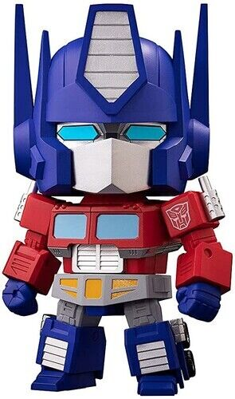
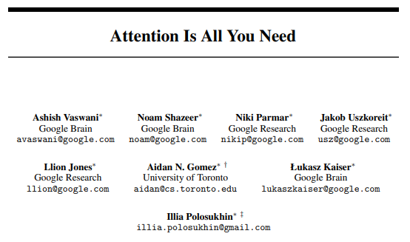
Transformer
This is a new type of AI architecture which provided the biggest improvements over previous generative AI technologies.
It was actually conceived by Google AI researchers back in 2017, in their research paper, “Attention Is All You Need”:

Slide 77
Transformer
But it was actually OpenAI (the creators of ChatGPT) who saw the potential to apply this variation of the Transformer technology to create ChatGPT.

Slide 78
Overview of how ChatGPT improves over your phones…
Locked-in word
bro
Locked-in word
like
Current word
be
Next word | Count
for | 2
In our example earlier, the prediction of the next word is only using information from the previous word…

Slide 79
Overview of how ChatGPT improves over your phones…
Locked-in word
bro
Locked-in word
like
Current word
be
Next word | Count
for | 2
But how can this be improved?

Slide 80
Overview of how ChatGPT improves over your phones…
Locked-in word
bro
Locked-in word
like
Current word
be
Next word | Count
for | 2
What if we used all the previous words as well?

Slide 81
Overview of how ChatGPT improves over your phones…
Locked-in word
bro
Locked-in word
like
Current word
be
Next word | Count
for | 2
not | 1
What if we used all the previous words as well?

Slide 82
Overview of how ChatGPT improves over your phones…
Locked-in word
bro
Locked-in word
like
Current word
be
Next word | Count
for | 2
not | 1
New and/or different predictions will result!
What if we used all the previous words as well?

Slide 83
Overview of how ChatGPT improves over your phones…
Locked-in word
bro
Locked-in word
like
Current word
be
Next word | Count
for | 2
not | 1
… and …

Slide 84
Overview of how ChatGPT improves over your phones…
Locked-in word
bro
Locked-in word
like
Current word
be
Next word | Count
for | 2
not | 1
What if the previous words had different levels of ‘importance’ assigned to them?

Slide 85
Overview of how ChatGPT improves over your phones…
important
not very important
very important!
Locked-in word
bro
Locked-in word
like
Current word
be
Next word | Count
for | 2
not | 1
What if the previous words had different levels of ‘importance’ assigned to them?

Slide 86
Overview of how ChatGPT improves over your phones…
important
not very important
very important!
Locked-in word
bro
Locked-in word
like
Current word
be
Next word | Count
for | 3
srsly | 2
not | 2
What if the previous words had different levels of ‘importance’ assigned to them?

Slide 87
Overview of how ChatGPT improves over your phones…
important
not very important
very important!
Locked-in word
bro
Locked-in word
like
Current word
be
Next word | Count
for | 3
srsly | 2
not | 2
What if the previous words had different levels of ‘importance’ assigned to them?
More new and/or different predictions!

Slide 88
Overview of how ChatGPT improves over your phones…
important
not very important
very important!
Locked-in word
bro
Locked-in word
like
Current word
be
Next word | Count
for | 3
srsly | 2
not | 2
… and …

Slide 89
Overview of how ChatGPT improves over your phones…
important
not very important
very important!
Locked-in word
bro
Locked-in word
like
Current word
be
Next word | Count
for | 3
srsly | 2
not | 2
What if the order of the words make a difference?

Slide 90
Overview of how ChatGPT improves over your phones…
important
not very important
very important!
Locked-in word
like
Locked-in word
bro
Current word
be
Next word | Count
for | 3
srsly | 2
not | 2
What if the order of the words make a difference?

Slide 91
Overview of how ChatGPT improves over your phones…
important
not very important
very important!
Locked-in word
like
Locked-in word
bro
Current word
be
Next word | Count
for | 3
cool | 3
srsly | 1
What if the order of the words make a difference?

Slide 92
Overview of how ChatGPT improves over your phones…
important
not very important
very important!
Locked-in word
like
Locked-in word
bro
Current word
be
Next word | Count
for | 3
cool | 3
srsly | 1
What if the order of the words make a difference?
More new and/or different predictions!

Slide 93
Training Samples
important
Very important
unimportant
unimportant
important
important
important
Very important
unimportant
Prediction
Previous word
an
Previous word
orange
Previous word
likes
Previous word
and
Previous word
eating
Previous word
an
Previous word
many
Previous word
types
Previous word
of
label: apple
label: apple
label: apple
Very important
Very important
Very important
Very important
unimportant
Very important
important
unimportant
important
Unimportant
important
unimportant
Previous word
a
Previous word
Renaissance
Previous word
Michelangelo
Previous word
artist?
Previous word
the
Previous word
a
Previous word
Renaissance
Previous word
very
Previous word
creative
Previous word
paintings
Previous word
by
Previous word
the
label: artist
label: artist
label: artist
Prediction: Michelangelo
unimportant
important
Very important
important
Very important
unimportant
unimportant
important
unimportant
Previous word
go
Previous word
sharpen
Previous word
my
Previous word
the
Previous word
trustworthy
Previous word
battle
Previous word
my
Previous word
sword
Previous word
and
label: axe
label: axe
label: axe

Slide 94
Transformer
It’s not the like original technology didn’t consider using past words, word positioning, and the relative importance of each word (self-attention).
It’s just that no one had come up with an algorithm to do this in a fast and accurate way.
…Until the Transformer network was conceived by the Google AI researchers!

Slide 95
Worksheet Activity
Complete Question 2
(PDF, MS Word)

Slide 96
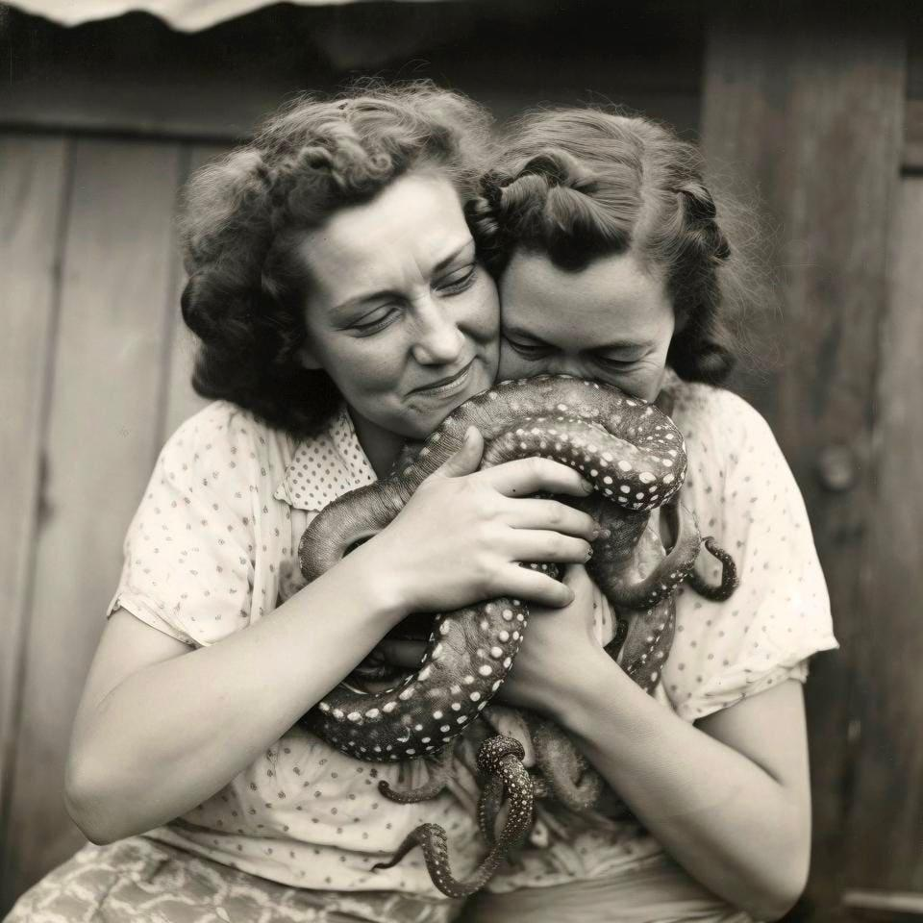
What is Diffusion and Generative AI art?
Play Video
6:55 min
Slide 96 - 147
You may have seen in the media recently that AI is now able to generate complex artwork
All AI needs to generate artwork is a text description of what you want!
The Generative AI systems use a learning technique called “Diffusion”
https://www.forbes.com/sites/lesliekatz/2023/10/08/see-the-surreal-image-that-just-won-an-ai-art-contest/?sh=168d2fc54df8

Slide 97
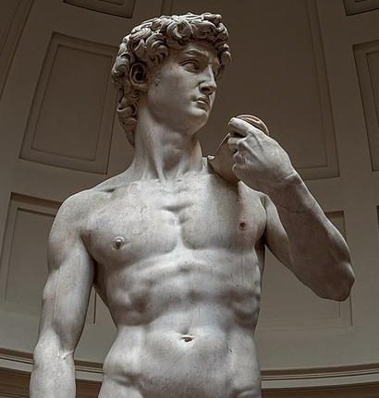
What is Diffusion and Generative AI art?
Diffusion can be explained with the following analogy:
Imagine carving a statue - you would start with a big block of marble, and slowly chip away until the masterpiece you envisioned appears
“I created a vision of David in my mind and simply carved away everything that was not David.”
― Michelangelo

Slide 98

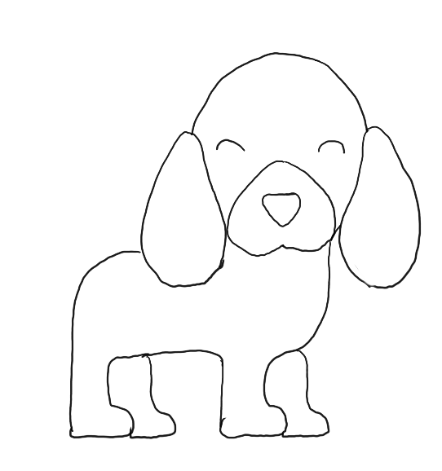
How does AI learn to create art?
Just like you, AI needs to practice and train to create good artwork
We train AI by providing it with thousands of images of what we want our AI to be able to draw
For example, if we want our AI to draw dogs, we need to teach it what a dog looks like

Slide 99
Image

Slide 100
How does AI learn to create art?
We also need to let the system know the text that describes this image of a dog
This is called a “prompt”
In this case, let’s say the prompt is “dog”

Slide 101
Prompt
“dog”
Image

Slide 102
How does AI learn to create art?
Here is a simplified explanation of what happens next…
The original image is slowly changed by adding more and more “random” information (“noise)
This “noise” can be represented by mathematical equations, and it is recorded as part of the training process

Slide 103

How does AI learn to create art?
Here is some mathematical “noise” that is added to the original image

Slide 104

How does AI learn to create art?
And more…

Slide 105

How does AI learn to create art?
And more…

Slide 106

How does AI learn to create art?
And more…

Slide 107

How does AI learn to create art?
And more…

Slide 108
How does AI learn to create art?
Until we get an image that appears to be totally “noisy” (random)
This is known as the forward diffusion process

Slide 109
Forward Diffusion Process
Prompt
“dog”
Image

Slide 110
Forward Diffusion Process
Prompt
add ‘noise’
“dog”
Image

Slide 111
Forward Diffusion Process
Prompt
add ‘noise’
“dog”
Image

Slide 112
Forward Diffusion Process
Prompt
add ‘noise’
“dog”
Image
“Random” noisy image

Slide 113
Text prompt: “dog”
add
noise
add
noise
add
noise
add
noise
add
noise

Slide 114
Text prompt: “dog”
add
noise
add
noise
add
noise
add
noise
add
noise
In the analogy of the statue of David, this is like starting with the statue and slowly turning it back into a block of marble!

Slide 115
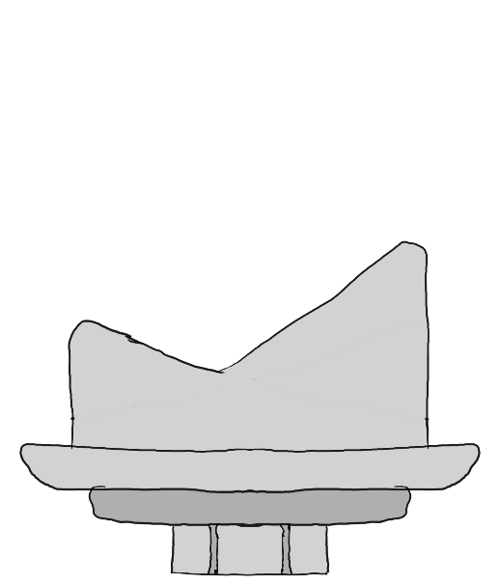

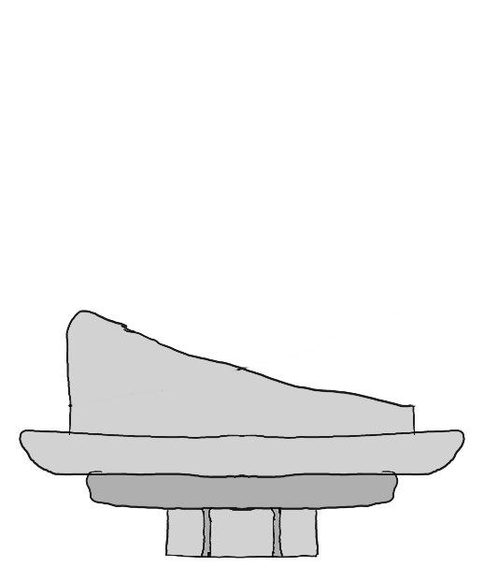
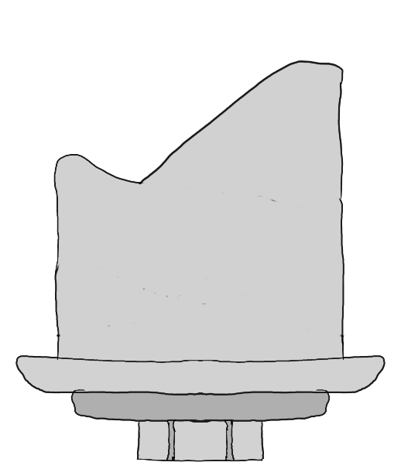
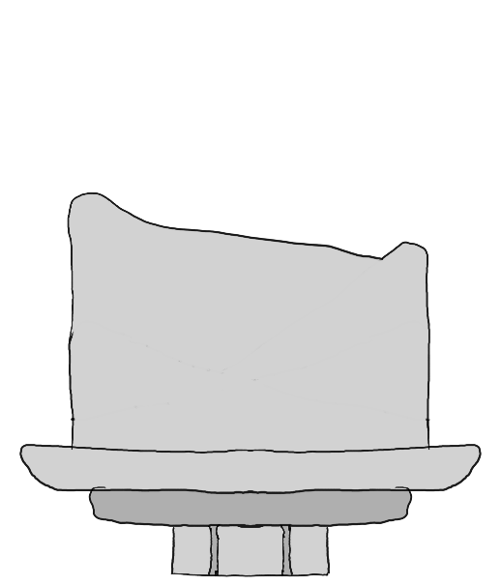
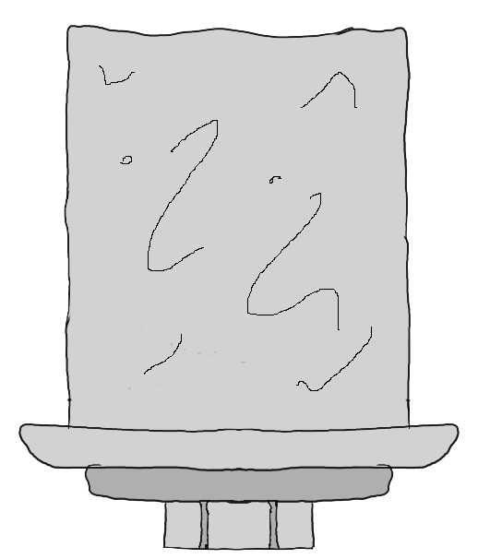
Text prompt: “dog”
add
noise
add
noise
add
noise
add
noise
add
noise
Forward Diffusion Process
add
noise
add
noise
add
noise
add
noise
add
noise

Slide 116
How does AI learn to create art?
This forms the “training” part of the Generative AI system.

Slide 117
How does AI learn to create art?
This forms the “training” part of the Generative AI system.
Here is another example of using another starting image of another dog, with the same prompt of “dog”

Slide 118
How does AI learn to create art?
This forms the “training” part of the Generative AI system.
Here is another example of using another starting image of another dog, with the same prompt of “dog”

Slide 119
How does AI learn to create art?
Adding noise…

Slide 120
How does AI learn to create art?
Adding noise…

Slide 121
How does AI learn to create art?
Adding noise…

Slide 122
How does AI learn to create art?
Adding noise…

Slide 123
How does AI learn to create art?
Adding noise…

Slide 124
How does AI learn to create art?
Another “random” noisy image is created at the end.

Slide 125
Forward Diffusion Process
Prompt
add ‘noise’
“dog”
Image
“Random” noisy image

Slide 126
Forward Diffusion Process
Prompt
add ‘noise’
“dog”
Image
“Random” noisy image

Slide 127
How does AI learn to create art?
We keep repeating this over and over, using many, many different images of dogs and prompts for dogs
We end up with lots of “random” noisy images that are related to the original prompt
AND we also keep track of the type of “noise” we added to the original image to produce the final random image

Slide 128
How does AI learn to create art?
What the system is learning is the type of noise which is added to an image of a dog to turn it into a random image at the end

Slide 129
How does AI learn to create art?
What the system is learning is the type of noise which is added to an image of a dog to turn it into a random image at the end
Why is this useful?

Slide 130
How does AI learn to create art?
Let’s see what happens when the system generates a brand new image of a dog!

Slide 131
How does AI learn to create art?
Let’s see what happens when the system generates a brand new image of a dog!
It will start with an actual random image

Slide 132
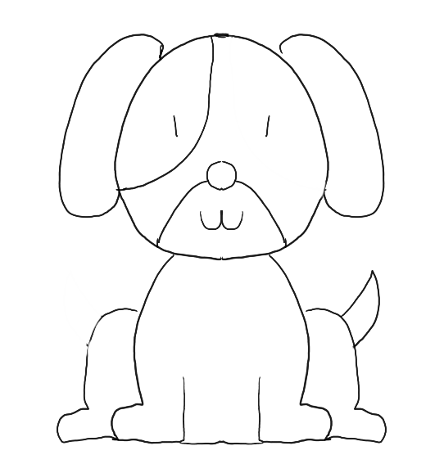
How does AI learn to create art?
Let’s see what happens when the system generates a brand new image of a dog!
It will start with an actual random image

Slide 133
How does AI learn to create art?
To generate a new image of a “dog”, it will recall the “noise” that it added to the original training images of dogs to produce the “random” images

Slide 134
How does AI learn to create art?
To generate a new image of a “dog”, it will recall the “noise” that it added to the original training images of dogs to produce the “random” images
And then it will subtract this learned noise from the new, truly random image it started with

Slide 135
How does AI learn to create art?
Subtracting noise…

Slide 136
How does AI learn to create art?
Subtracting noise…

Slide 137
How does AI learn to create art?
Subtracting noise…

Slide 138
How does AI learn to create art?
Subtracting noise…

Slide 139
How does AI learn to create art?
Subtracting noise…

Slide 140
How does AI learn to create art?
A brand new image that matches the prompt of “dog”!
This is known as the backward diffusion process

Slide 141
Backward Diffusion Process
Prompt
“dog”
A true, random image

Slide 142
Backward Diffusion Process
Prompt
remove ‘noise’
“dog”
A true, random image

Slide 143
Backward Diffusion Process
Prompt
remove ‘noise’
“dog”
A true, random image

Slide 144
Backward Diffusion Process
Prompt
remove ‘noise’
“dog”
New Generated Image
A true, random image

Slide 145
Text prompt: “dog”
subtract
noise
subtract
noise
subtract
noise
subtract
noise
subtract
noise

Slide 146
Text prompt: “dog”
subtract
noise
subtract
noise
subtract
noise
subtract
noise
subtract
noise
In the analogy of the statue of David, this is like starting with the block of marble and chipping away everything that is not David!

Slide 147
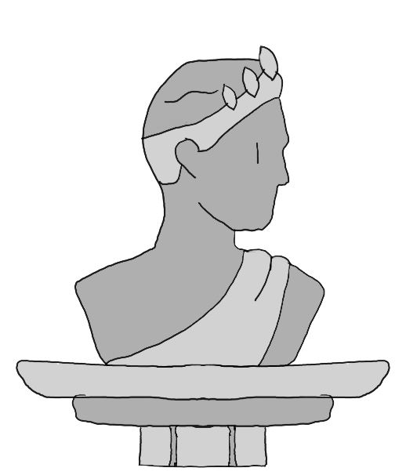
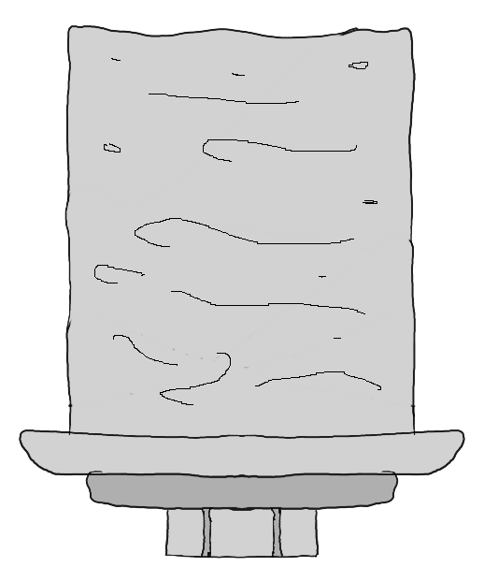
Text prompt: “dog”
subtract
noise
subtract
noise
subtract
noise
subtract
noise
subtract
noise
Backward Diffusion Process
subtract
noise
subtract
noise
subtract
noise
subtract
noise
subtract
noise

Slide 148
Worksheet Activity
Complete Questions 3 - 5
(PDF, MS Word)

Slide 149

Summary
You should now be able to:
Understand what Generative AI is
Explore the types of images and text produced by Generative AI
Understand how Generative AI is an extension of Predictive AI
Understand how ChatGPT is a based on text prediction
Demonstrate how text prediction works
Understand how ChatGPT extends upon text prediction
Understand how Generative AI is used to produce images

Slide 150
License Information
These CS in Schools lessons plans, worksheets, and other materials were created by the CS in Schools team. They are licensed under a Creative Commons Attribution-ShareAlike 4.0 International License.
Images all taken from flaticon.

