Slide 1


Lesson 2
Pattern Based AI and Classification
csinschools.com

Slide 2
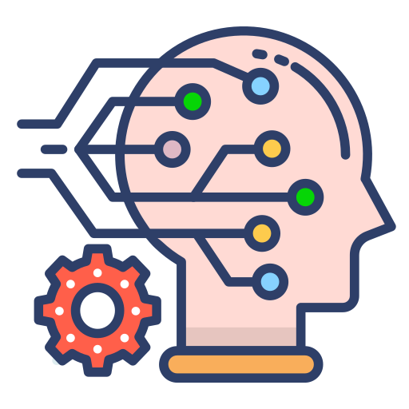
Learning objectives
By the end of this lesson, you should be able to:
Understand how pattern-based AI works
Understand the difference between AI and Machine Learning (ML)
Understand classification as a form of machine learning
Identify terms in data used to train a classifier
Understand the importance of data in ML
Build your own classifier online!

Slide 3
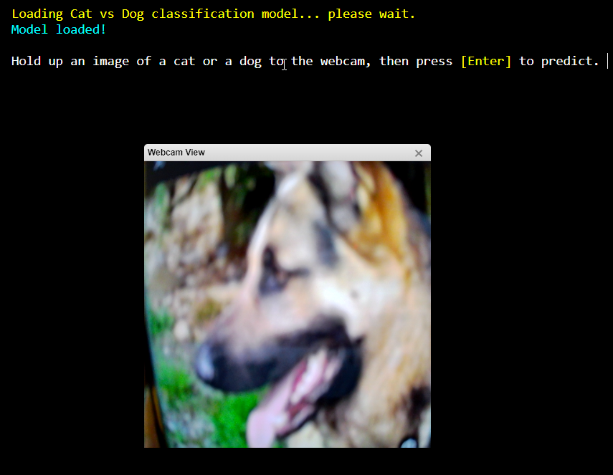
Demo: The Cat and Dog classifier
Can AI Tell Apart a Cat or a Dog?

Slide 4
Artificial Intelligence vs Machine Learning
Would you regard the dogs vs cats classifier at the start as “intelligent”?
Why or why not?

Slide 5

Artificial Intelligence vs Machine Learning
Would you regard the dogs vs cats classifier at the start as “intelligent”?
Why or why not?

Slide 6

Patterns-based AI
Play Video
5:48 min
Slide 5 - 31
When all the rules aren’t known in advance, we can use another form of AI called “Pattern-based” AI
Here, the AI system doesn’t follow exact rules, but makes predictions based on patterns in examples it has seen before.
It is also able to learn to make better predictions by being shown more and more examples.

Slide 7
Let’s try to see if you can do some pattern matching…

Slide 8

Here is a Blapp

Slide 9
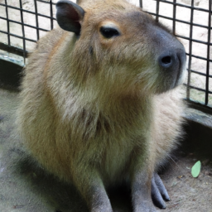
Here is a Blapp

Slide 10

Here is a Blapp

Slide 11

Here is a Plupp

Slide 12

Here is a Plupp

Slide 13

Here is a Plupp

Slide 14
Plupps
Blapps

Slide 15

Is this a Plupp or a Blapp?

Slide 16
Plupps
Plupp or Blapp?
Blapps
Out of a score of 0.0 - 1.0, how confident would you say you are?
(0.0 = not confident, 1.0 = certain)

Slide 17
Classification
How did you “learn” to identify Plupps and Blapps?
How did you come up with a “confidence” number at the end?

Slide 18
Classification
How did you “learn” to identify Plupps and Blapps?
How did you come up with a “confidence” number at the end?

Slide 19
Rules Based AI vs Pattern Based AI
Did anyone tell you the “rules” to determine what was a “Plupp” or what was a “Blapp”?
How did you come up with your own rules?

Slide 20
Rules Based AI vs Pattern Based AI
Did anyone tell you the “rules” to determine what was a “Plupp” or what was a “Blapp”?
How did you come up with your own rules?

Slide 21
Rules Based AI vs Pattern Based AI
Did anyone tell you the “rules” to determine what was a “Plupp” or what was a “Blapp”?
How did you come up with your own rules?
  You probably needed lots of examples!
  And your brain did some “pattern-matching” and “pattern-recognition” based on those examples
  This is the main difference between Rules-Based AI and Pattern-Based AI!

Slide 22
Pattern Based AI
In Pattern-Based AI, there are no firm set of rules that we tell the computer to follow
Why not?

Slide 23
Pattern Based AI
In Pattern-Based AI, there are no firm set of rules that we tell the computer to follow
Why not?

Slide 24
Pattern Based AI
In Pattern-Based AI, there are no firm set of rules that we tell the computer to follow
Why not?
  We might not know all the rules
  It is too difficult to list out all the rules
  The rules might change over time

Slide 25
Pattern Based AI
One form of pattern-based AI is used for prediction
Prediction systems can be used to classify data into different categories. For example:
  Classifying an image as either containing a fleep or a bloop
  Classifying music according to the genre
  Classifying audio segments according to the word heard
  Classifying text as news or gossip

Slide 26
Pattern Based AI
Pattern-Based AI systems need to be able to “learn” the rules by giving them lots of data
When a computer system “learns” how to accomplish a task by using data and algorithms, this is called machine learning
But not all AI systems use machine learning (e.g. the rules-based systems where humans supply the rules as seen in the last lesson)

Slide 27
Classification
Let’s consider the case of classification.
Classification is only one form of predictive AI which uses machine learning.
In order to learn, we need to supply data samples with labels to tell the system what the “correct” answers are first

Slide 28
Plupp or Blapp?
Training Samples
Prediction
Label: Plupp
Label: Plupp
Label: Plupp
Out of a score of 0.0 - 1.0, how confident would you say you are?
(0.0 = not confident, 1.0 = certain)
Label: Blapp
Label: Blapp
Label: Blapp

Slide 29
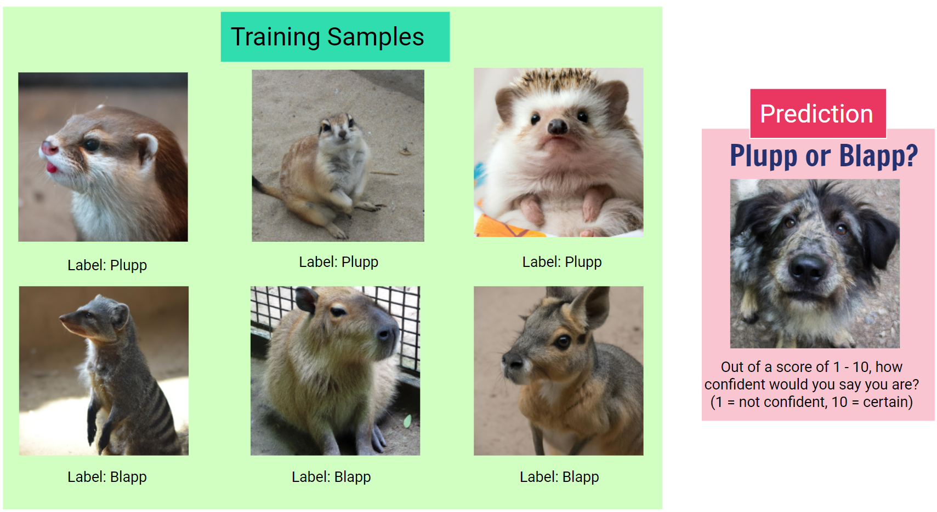

Slide 30
Sample
Image Data
label: Plupp
Label

Slide 31
Sample
Image Data
label: Plupp
Label
Sample
Image Data
label: Blapp
Label

Slide 32
Sample
Image Data
label: Plupp
Label
Prediction
Sample
Image Data
Image Data
Predicted Class
Predicted Class:
Blapp
label: Blapp
Label
Confidence Score
Confidence: 0.84

Slide 33

Worksheet Activity
Complete Question 1 - 3
(PDF, MS Word)

Slide 34

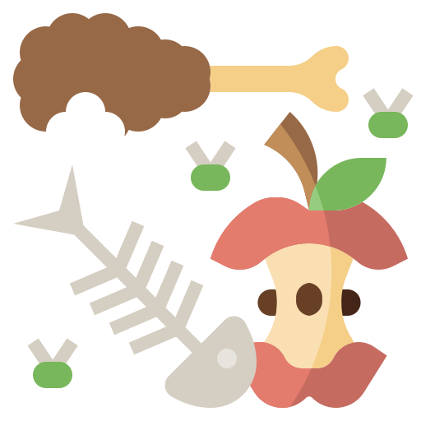
Classification
Play Video
3:13 min
Slide 33 - 38
Data is important!
The GIGO principle: Garbage In, Garbage Out
The system will only learn based on the samples you give it
It may learn the wrong thing if:
  You give it samples with the wrong labels
  You don’t give it enough samples

Slide 35

Maths textbook analogy
Think about when you are doing math exercises
You see a problem in the maths textbook
You have a go at it
You check your answers (at the back of the book) - or your teacher tells you
If you got it right, you confirm your understanding
If you got it wrong, you adjust your understanding as required
The more problems you do, the more your understanding improves
At the end of the unit, your teacher gives you a “test” - with no answers!

Slide 36
Maths textbook analogy
You use the answers at the end of the book (labels) to better improve your understanding (model) of how to solve the problem (prediction)
Imagine if the answers at the end of the book were wrong…
  For example, the + sign was interpreted as subtraction instead of addition
What might happen?

Slide 37
Maths textbook analogy
You use the answers at the end of the book (labels) to better improve your understanding (model) of how to solve the problem (prediction)
Imagine if the answers at the end of the book were wrong…
  For example, the + sign was interpreted as subtraction instead of addition
What might happen?

Slide 38
Maths textbook analogy
You use the answers at the end of the book (labels) to better improve your understanding (model) of how to solve the problem (prediction)
Imagine if the answers at the end of the book were wrong…
  For example, the + sign was interpreted as subtraction instead of addition
What might happen?
  When you check your answers and see that they are wrong… you might realise that the way to get the correct answer is to interpret the sign + as subtraction
  And you’ll begin to learn that + means subtraction, which is the wrong thing
  Once again, data is important! GIGO

Slide 39
Classes
So far, we’ve only considered classifications involving 2 classes (e.g. dogs vs cats, blapp vs plupp)
But classifiers can work with many, many more classes!
However, building classifiers with more classes also means:
  More data is required to train / learn
  It will take longer to train / learn
  It might not be as accurate as classifiers with fewer classes to choose from

Slide 40
Worksheet Activity
Complete Question 4
(PDF, MS Word)

Slide 41
Generative AI
You may have also heard of “Generative AI” systems.
  E.g. ChatGPT, DALL.E, Midjourney, Gemini, Claude, Stable Diffusion
These systems are based on, and extend upon, prediction systems to produce new works of text, art, music etc.
We’ll discuss this further in the next lesson.

Slide 42
Worksheet Activity
Complete Question 5
(PDF, MS Word)

Slide 43

Summary
You should now be able to:
Understand how pattern-based AI works
Understand the difference between AI and Machine Learning (ML)
Understand classification as a form of machine learning
Identify terms in data used to train a classifer
Understand the importance of data in ML
Build your own classifier online!

Slide 44
License Information
These CS in Schools lessons plans, worksheets, and other materials were created by the CS in Schools team. They are licensed under a Creative Commons Attribution-ShareAlike 4.0 International License.
Images all taken from flaticon.

