Slide 1


Lesson 7
Dictionaries and Getting Data
csinschools.com

Slide 2



Previously, on CS in Schools...
What is the purpose of a database?
‹#›
Notes:
Answer: To permanently store data, to allow data to be stored and retrieved efficiently, to provide security to your data

Slide 3
Learning objectives
By the end of this lesson, you should be able to:
understand what a dictionary is in Python
to read data from a data table in Anvil
‹#›

Slide 4



Ice-Cream Flavour Voting Booth
Vote for your favourite ice cream flavour! Vote as many times as you like!
Vote Here!

Slide 5

Think, Pair, Share - Ice Cream Flavours and Variables
How could we store this information?
Variables? Lists? Something else?
‹#›
Notes:
Could we use multiple variables? Could we use a list? Is there a better way?

Slide 6
Option 1 - Individual Variables
vanilla = 0
chocolate = 5
strawberry = 3
Are there any issues with this?
What if we want to add another flavour?
What if we have 100 flavours?
‹#›

Slide 7
Option 1 - Individual Variables
vanilla = 0
chocolate = 5
strawberry = 3
Are there any issues with this?
Easy to lose track of all the variables!
What if we want to add another flavour?
We have to add another variable
What if we have 100 flavours?
So, so, so many variables...
‹#›

Slide 8
Option 2 - Lists
flavours = [“chocolate”, “strawberry”, “vanilla”]
counts = [0, 5, 3]
We could create 2 lists:
The first list stores the flavours
The second list stores the counts
Are there any issues with this?
‹#›

Slide 9
Option 2 - Lists
flavours = [“chocolate”, “strawberry”, “vanilla”]
counts = [0, 5, 3]
To add a flavour, we have to add a new element to each list
We need to ensure that we use the same index for both lists, meaning:
Chocolate is 0 - flavours[0], counts[0]
Strawberry is 1 - flavours[1], counts[1]
What would vanilla be?
There must be a better way!
‹#›

Slide 10
Option 3 - Introducing Dictionaries
In Python, there is a data structure called a dictionary
Just like a traditional dictionary, it allows you to lookup the meaning of a word
Let’s say someone gives you the word “cheese”, how would you find out what this means?
‹#›

Slide 11

Option 3 - Introducing Dictionaries
First, you would search for the word.
cheese - a delicious food.
milk - a nutritious liquid.
apple - one a day will keep the doctor away!
‹#›

Slide 12
Option 3 - Introducing Dictionaries
Then, you move across and read the definition.
cheese - a delicious food.
milk - a nutritious liquid.
apple - one a day will keep the doctor away!
‹#›

Slide 13
Option 3 - Introducing Dictionaries
When you make a dictionary in Python, you can “define” whatever you like, however you like
These are called key/value pairs
Taking our ice cream flavours example, the dictionary would look like this...
‹#›

Slide 14
Option 3 - Introducing Dictionaries
Each flavour is paired with its amount of votes.
chocolate - 0
strawberry - 5
vanilla - 3
‹#›

Slide 15
Option 3 - Introducing Dictionaries
chocolate - 0
strawberry - 5
vanilla - 3
So, if we need the amount of votes for chocolate, we can look for the word, also known as the key...
‹#›

Slide 16
Option 3 - Introducing Dictionaries
chocolate - 0
strawberry - 5
vanilla - 3
...then read across and find the definition, known as the value.
‹#›

Slide 17
Option 3 - Defining Dictionaries
Our icecream dictionary is created in Python with the following code:
flavours = {
“chocolate”: 0,
“strawberry”: 5,
“vanilla”: 3
}

Slide 18
Option 3 - Defining Dictionaries
First, we name the dictionary
flavours = {
“chocolate”: 0,
“strawberry”: 5,
“vanilla”: 3
}

Slide 19
Option 3 - Defining Dictionaries
Then, we assign it with “=”
All key/value pairs are then contained within curly braces { }
flavours = {
“chocolate”: 0,
“strawberry”: 5,
“vanilla”: 3
}

Slide 20
Option 3 - Defining Dictionaries
All key/value pairs are defined using the format:
“key” : value,
Values can be any data type you like - integers, strings, lists...
flavours = {
“chocolate”: 0,
“strawberry”: 5,
“vanilla”: 3
}

Slide 21
Option 3 - Defining Dictionaries
Just like with lists, all key/value pairs are separated by a comma “,”
NOTE: you don’t need a comma between the last item and the last curly brace!
flavours = {
“chocolate”: 0,
“strawberry”: 5,
“vanilla”: 3
}

Slide 22
Option 3 - Using Dictionaries
Now our dictionary is defined, we access the values using the key
Line 7 shows us how to display the number of votes for chocolate
What would be displayed for flavours[“vanilla”]?
flavours = {
“chocolate”: 0,
“strawberry”: 5,
“vanilla”: 3
}
print(flavours[“chocolate”])
0

Slide 23
Option 3 - Using Dictionaries
This section of code tells Python to look inside the flavours dictionary for the key strawberry, and extract the value - in this case it is 5
The print function then puts this into the console for us
flavours = {
“chocolate”: 0,
“strawberry”: 5,
“vanilla”: 3
}
print(flavours[“strawberry”])
5

Slide 24
Option 3 - Using Dictionaries
NOTE: To tell Python to look up a key, we use square braces [ ]
This is similar to how we get values from a list - here the key is like the index
flavours = {
“chocolate”: 0,
“strawberry”: 5,
“vanilla”: 3
}
print(flavours[“strawberry”])
5

Slide 25
Option 3 - Using Dictionaries
We can also add a new key/value pair to the dictionary
Use the code on line 6 to do this
flavours = {
“chocolate”: 0,
“strawberry”: 5,
“vanilla”: 3
}
flavours[“lemon”] = 0
print(flavours)
flavours = {
“chocolate”: 0,
“strawberry”: 5,
“vanilla”: 3,
“lemon”: 0
}

Slide 26
Option 3 - Using Dictionaries
In a similar way, we can modify key/value pairs after defining the dictionary
We use the same code on line 6 to do this
flavours = {
“chocolate”: 0,
“strawberry”: 5,
“vanilla”: 3
}
flavours[“vanilla”] = 0
print(flavours)
flavours = {
“chocolate”: 0,
“strawberry”: 5,
“vanilla”: 0
}

Slide 27
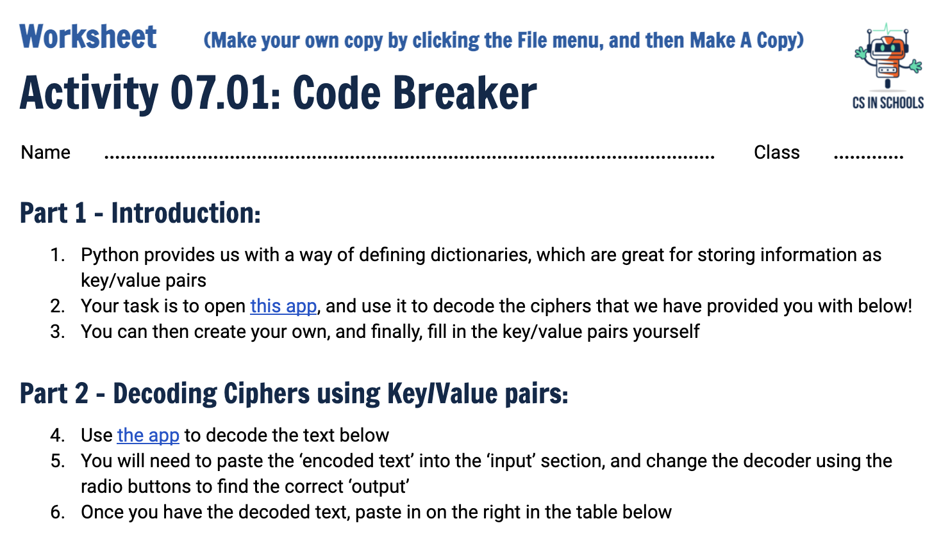
Activity 07.01 - Code Breaker
Awesome! Now let’s explore dictionaries a little more using a Code Breaker App.
Complete this worksheet: 07.01 - Code Breaker
‹#›

Slide 28
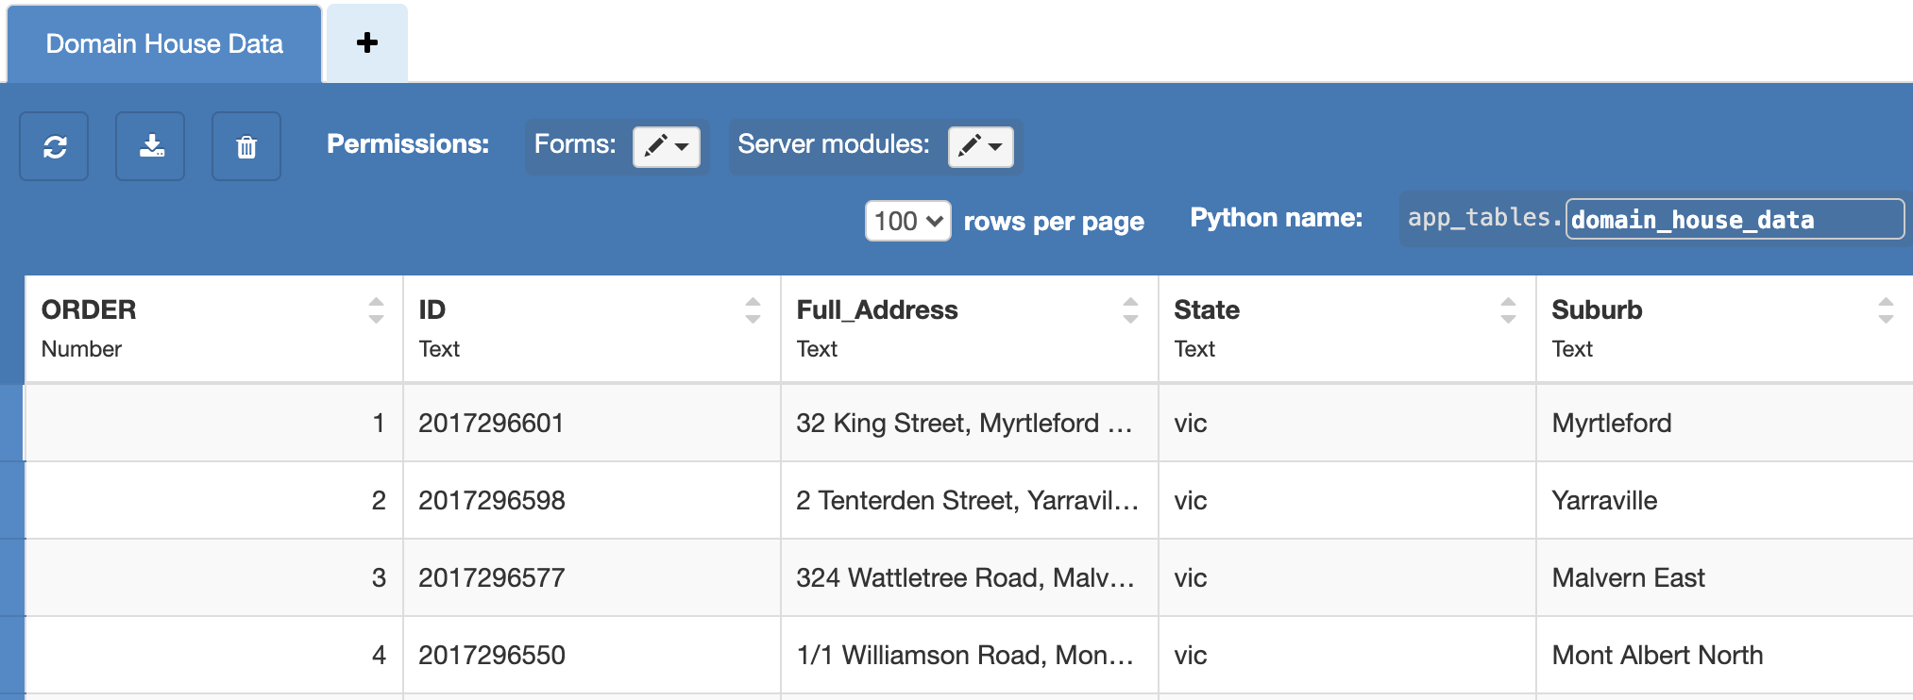
Anvil Data Tables - Getting Data
This is the data table you will be given for your next assignment
When you explore it, you will find there are many more rows and columns

Slide 29
Anvil Data Tables - Getting Data
Suppose we want to extract the 3rd row, how could we do this?

Slide 30
Anvil Data Tables - Getting Data
There are approximately 250 rows in this table
They are ordered 1 to ~250, so for the 3rd row, we know that ORDER = 3

Slide 31
Anvil Data Tables - Getting Data: The code
The line of code you will need to extract a particular row is shown below
row = app_tables.domain_house_data.get(ORDER = 3)
This is the variable that the result will be stored within

Slide 32
Anvil Data Tables - Getting Data: The code
row = app_tables.domain_house_data.get(ORDER = 3)
This tells Python to look within the data tables.

Slide 33
Anvil Data Tables - Getting Data: The code
row = app_tables.domain_house_data.get(ORDER = 3)
This tells Python which data table to look for.

Slide 34
Anvil Data Tables - Getting Data: The code
row = app_tables.domain_house_data.get(ORDER = 3)
This tells Python to execute the get method, where it will search for the number 3 in the ORDER column.

Slide 35
Anvil Data Tables - Getting Data: The code
The highlighted section returns a dictionary, which is then stored in row
row = app_tables.domain_house_data.get(ORDER = 3)
So, if we printed row, we would get the following...

Slide 36
Anvil Data Tables - Showing Data
print(row)
row = {
ORDER = 3,
ID = 2017296577,
Full_Address = 324 Wattletree Road, Malvern East
... }

Slide 37
Anvil Data Tables - Showing Data
As this is a dictionary, what would row[“ORDER”] show us?
row = {
ORDER = 3,
ID = 2017296577,
Full_Address = 324 Wattletree Road, Malvern East
... }

Slide 38
Anvil Data Tables - Showing Data
How about row[“Full_Address”]?
row = {
ORDER = 3,
ID = 2017296577,
Full_Address = 324 Wattletree Road, Malvern East
... }

Slide 39

Project 2: House Hunter
Domain have been trying to up their house sales, as such, have turned to an idea where users can either “like” or “dislike” houses based on their profile.
The app has been started, but the functionality is not complete.
A rival app has recently hit the market, you can check it out here!

Slide 40
Project 2: House Hunter
This is the assignment description and assignment rubric.
Don’t worry if this seems like a lot of information - we will step you through each lesson, just like last time!

Slide 41
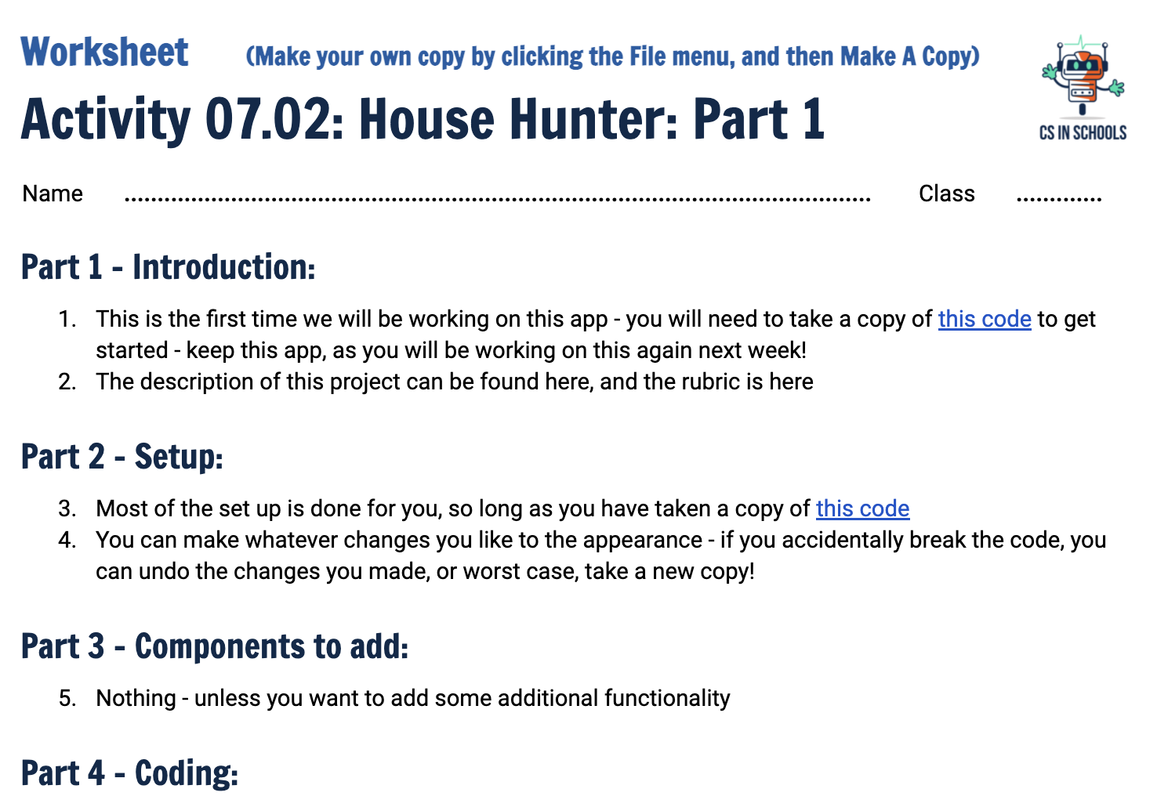
Activity 07.02 - House Hunter: Part 1
Now that you know how to get data from a data table, and extract information from dictionaries, let’s complete some of the functionality in Domain’s version of the app.
Complete this worksheet: 07.02 - House Hunter: Part 1

Slide 42
Summary
Dictionaries are used to store key/value pairs
When creating a dictionary we use curly brackets { }
When accessing a dictionary we use square brackets [ ]
Each row retrieved from an Anvil data table can be treated like a dictionary
‹#›

