Slide 1


Lesson 6
Databases and Storing Data
csinschools.com

Slide 2



Learning objectives
By the end of this lesson, you should be able to:
understand what a database is
able to save data to a database
‹#›

Slide 3

Think, Pair, Share - Websites and Data
What data do websites store?
Why do they need that data?
‹#›

Slide 4



Ice-Cream Flavour Voting Booth
Vote for your favourite ice cream flavour! Vote as many times as you like!
Vote Here!

Slide 5
Think, Pair, Share - Where is Data Stored
Where is the survey data stored?
‹#›

Slide 6


Storing Data - Variables
In our programs we have used variables to store information. However, variables are:
stored in a computer’s memory
lost when the program finishes or power is turned off
only used to store data temporarily
car_type

Slide 7
Storing Data - Databases
A database is required to store data permanently.
A database stores information on a physical disk drive
A database runs on a computer
It can be the same computer as a web server or a different one
It is the web server’s job to communicate with the database
  Everytime you use the web, you are using a database, so let’s see how one might work...
‹#›

Slide 8




How a Google Search works
“How to bake bread?”
Client
Google Server
Database
1. A message is typed, the client clicks “search”, and the request is sent to the google server.

Slide 9
How a Google Search works
“Bread Recipe Websites”
Client
Google Server
Database
2. The server processes the message, decides what it needs to extract from the database, and makes this request to the database.

Slide 10
How a Google Search works
How to make sourdough
How to make white bread
The best bread ever!
So, you want to cook bread?
How to bake bread
French style baguette
Italian sourdough
Bread 4 health, cook it now!
Client
Google Server
Database
3. The database finds and returns all results that match what the server is after.

Slide 11
How a Google Search works
How to make sourdough
How to make white bread
French style baguette
Italian sourdough
How to bake bread
Client
Google Server
Database
4. The server then sorts all the returned results, and presents you with the best ones!

Slide 12

So, why use a database?
Databases allow for the storage and retrieval of data sets (big and small)
  Making it very easy to find bread recipes online!
They don’t erase when the power is turned off
They free up the server, or computer, to do other work
Data is so valuable that it is now worth more than gold and oil!
  No wonder databases are so important…
https://www.economist.com/leaders/2017/05/06/the-worlds-most-valuable-resource-is-no-longer-oil-but-data

Slide 13
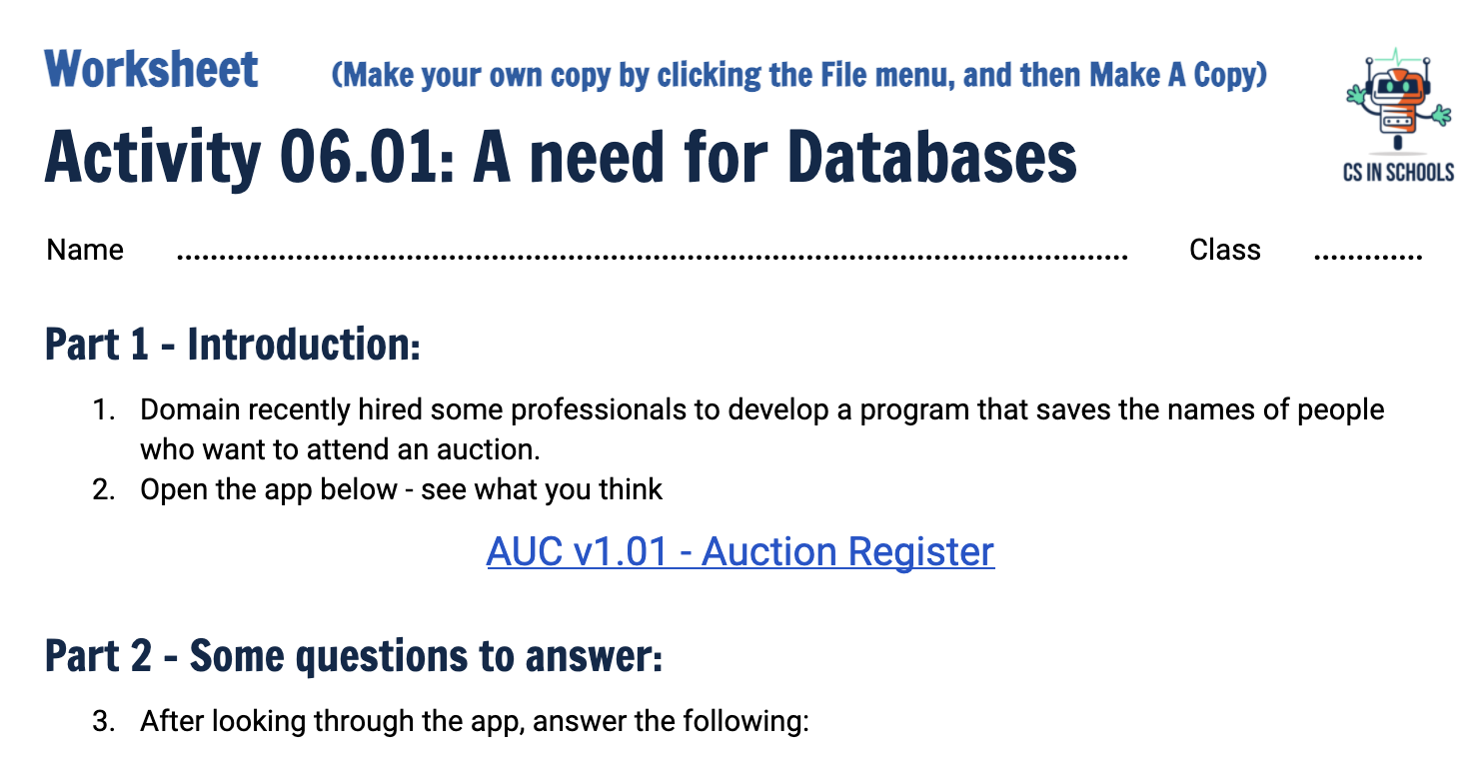
Activity 06.01 - A need for Databases
Let’s investigate what a database is, and why we need one!
Complete the Activity:
06.01 - A need for Databases
‹#›

Slide 14

You might be wondering...
Why doesn’t a database delete when it loses power?
Well, simply, we have two types of storage; Volatile and Non-volatile
  Volatile Memory: Erases when power is lost
  Non-volatile Memory: Does not erase when power is lost
Do you know if the following are volatile or non-volatile?
  USB
  Hard Drive
  CD
  RAM
Notes:
Non-volatile: USB, Hard Drive, CD
Volatile: RAM

Slide 15
You might be wondering...
Why doesn’t a database delete when it loses power?
RAM (Random Access Memory) is what is used to store variables when you run a Python program, hence, is volatile
Disk Storage is what we would use to store a database, and this is non-volatile
  This includes hard drives, USBs and CDs

Slide 16
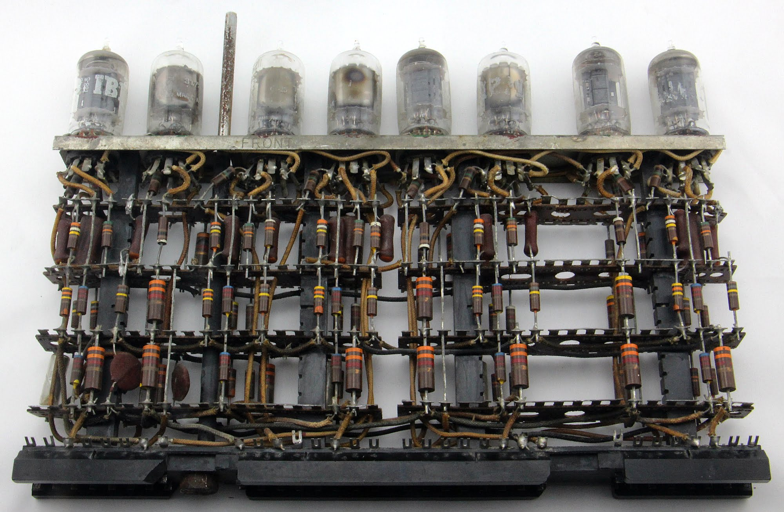
You might be wondering...
Why doesn’t a database delete when it loses power?
RAM in the first computer:
Data in the first computers was stored on these massive contraptions called vacuum tubes
These required electricity to work - and lot’s of it!
Although we have now shrunk similar devices down to 2 nanometers, they still need power
We could fit 50 billion of these on your fingernail now!
http://www.righto.com/2018/01/examining-1954-ibm-mainframes-pluggable.html

Slide 17
You might be wondering...
Why doesn’t a database delete when it loses power?
Inventors eventually realised we need to save data, so they discovered many new ways to store data when power is turned off
The most recent advancement is Solid State Drives
These store data using a semiconductor, typically silicon, which can retain the information even when the power is off!

Slide 18
Data Tables - Anvil’s Database for us to use!
Now that you know a little more about databases, let’s make the Auction app (from Activity 06.01) much better!
To do this, we will use Anvil, and the Data Table service that it provides
The documentation on how to use Data Tables can be found here:
https://anvil.works/docs/data-tables
The next few slides will walk you through how to set up, and store data into, a Data Table, which will be very useful for your next activity!
‹#›

Slide 19
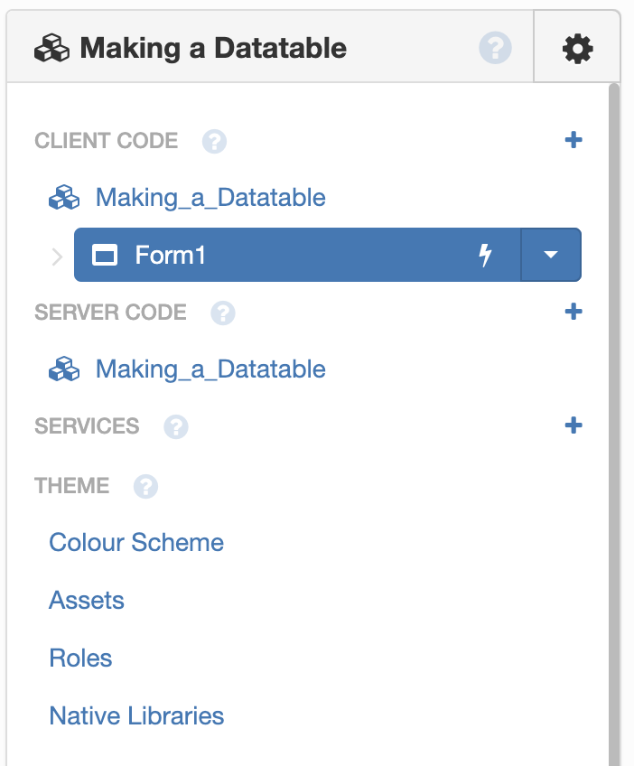
Data Tables - A ‘how to’ guide
1. Create a new application, this one is called “Making a Datatable”
2. On the left hand side, click the “+” next to “SERVICES”

Slide 20
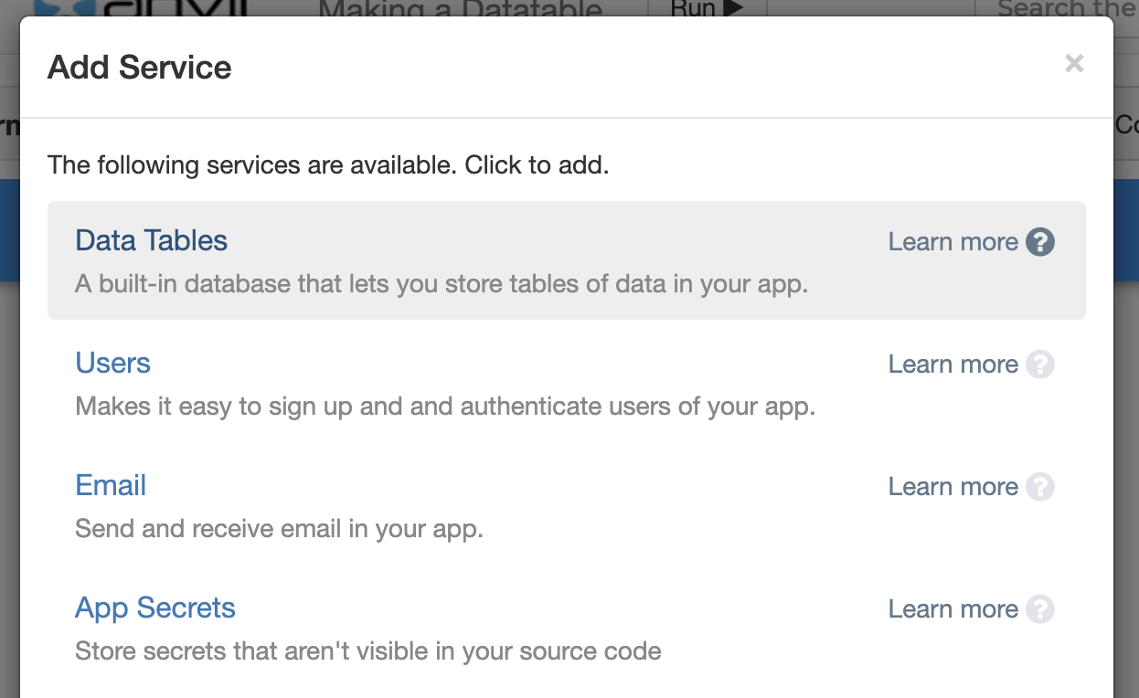
Data Tables - A ‘how to’ guide
3. Next up, you want to click on “Data Tables”

Slide 21
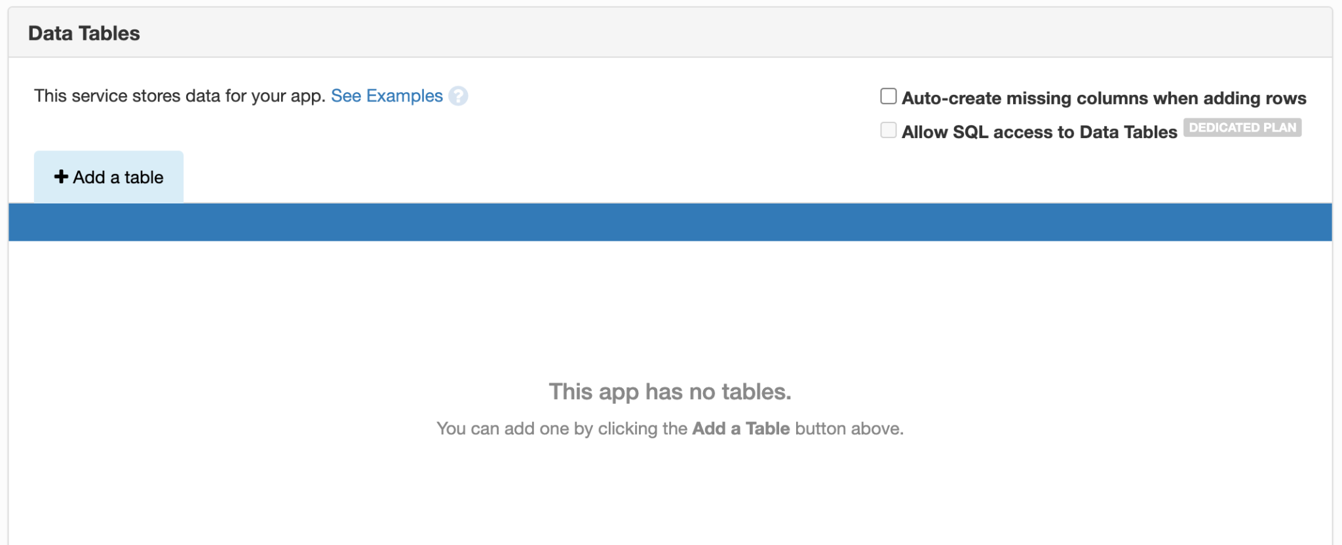

Data Tables - A ‘how to’ guide
4. You should get a screen that looks like this, ask for help if you don’t!
5. Let’s click on “Add a table”, then “Create new table” in the drop down that appears

Slide 22
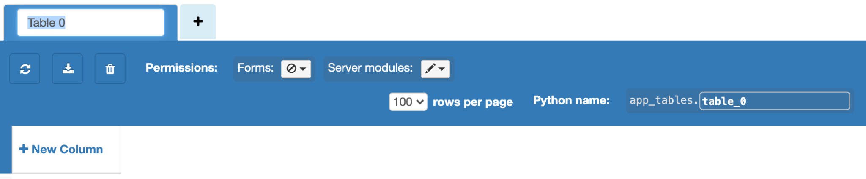
Data Tables - A ‘how to’ guide
6. Now we have a table to edit, you can name it by replacing “Table 0”
7. We also have to change this to the pencil, like it is for the “Server modules”
This will let us edit this table from our app!

Slide 23
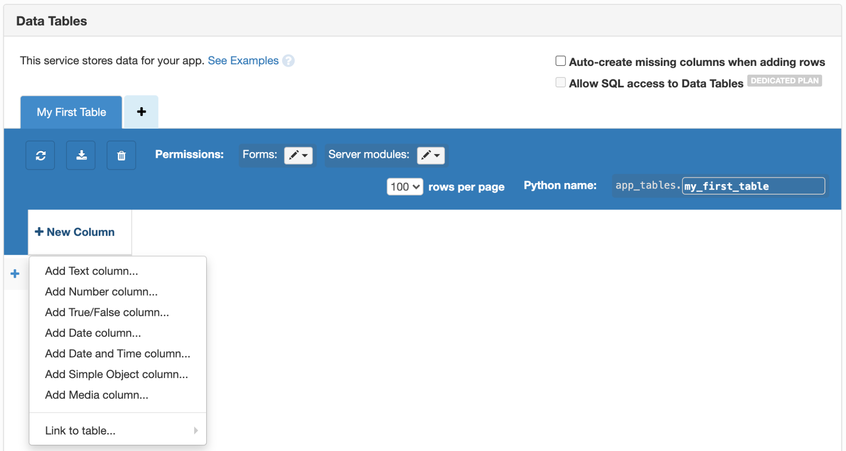

Data Tables - A ‘how to’ guide
8. You can make as many columns as you need, but let’s start with 1 column, to store names. Click “New Column”, then “Add Text Column” - let’s call it “name”.
Remember your data types? Make sure you choose the right type for the data you need to store! The data types in the column are slightly different to the terms we are used to.

Slide 24
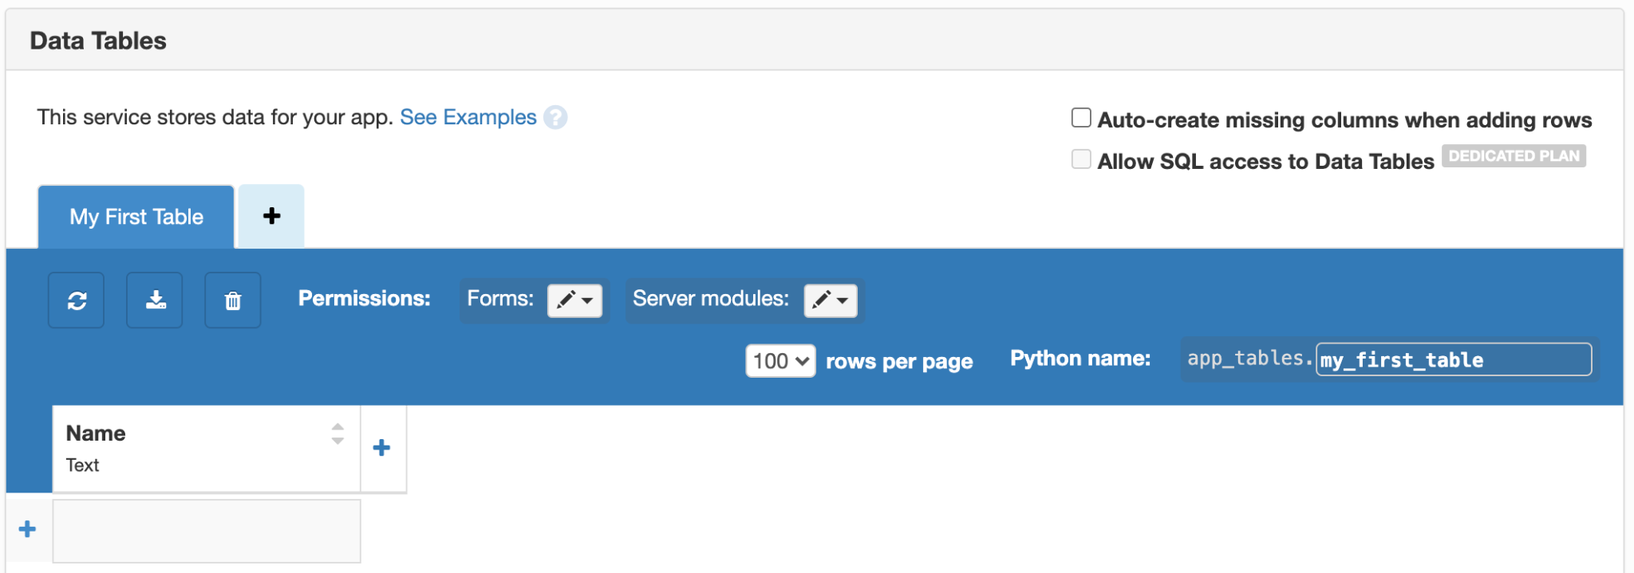
Data Tables - A ‘how to’ guide
9. Your table should look something like this now...

Slide 25
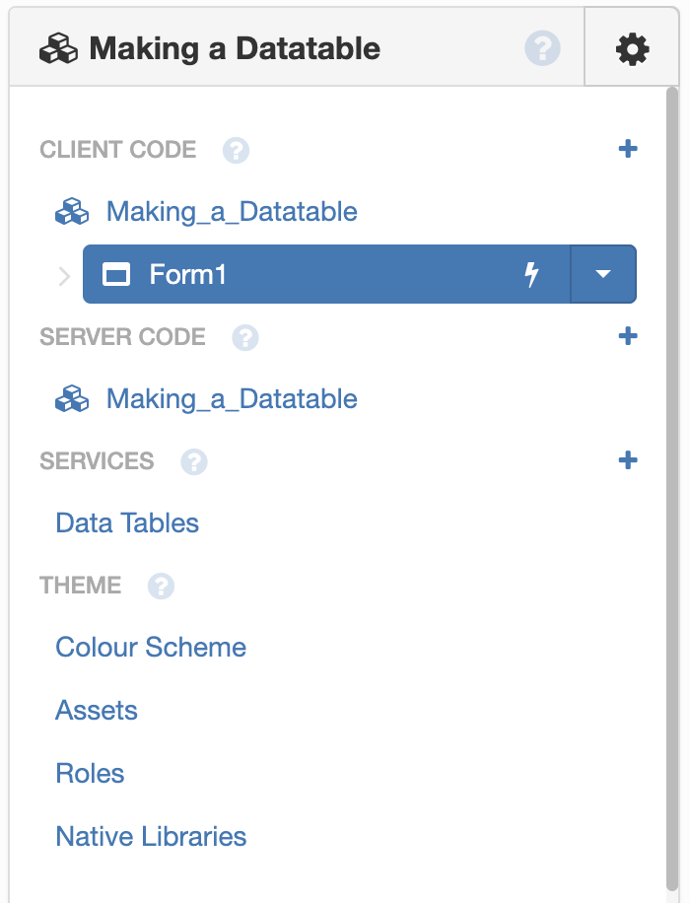
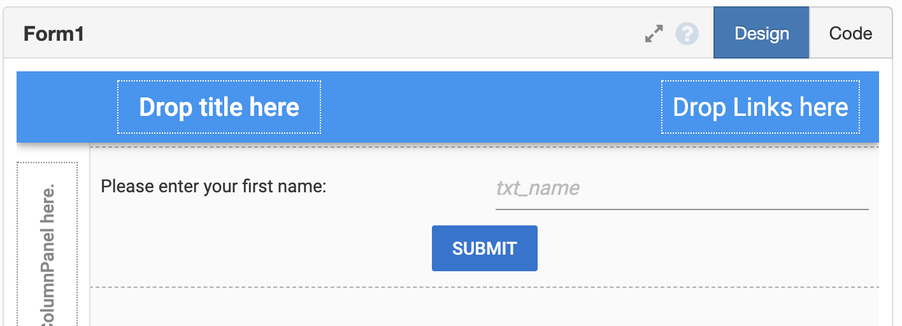
Data Tables - A ‘how to’ guide
10. Click back on “Form” and add in some components - I’ve chosen a simple label, text box and a button (you must have at least one text box & button!)

Slide 26
Data Tables - A ‘how to’ guide
11. I want to store whatever is in the textbox when the user presses “submit” - so now I will double click the “submit” button to edit the button function code

Slide 27
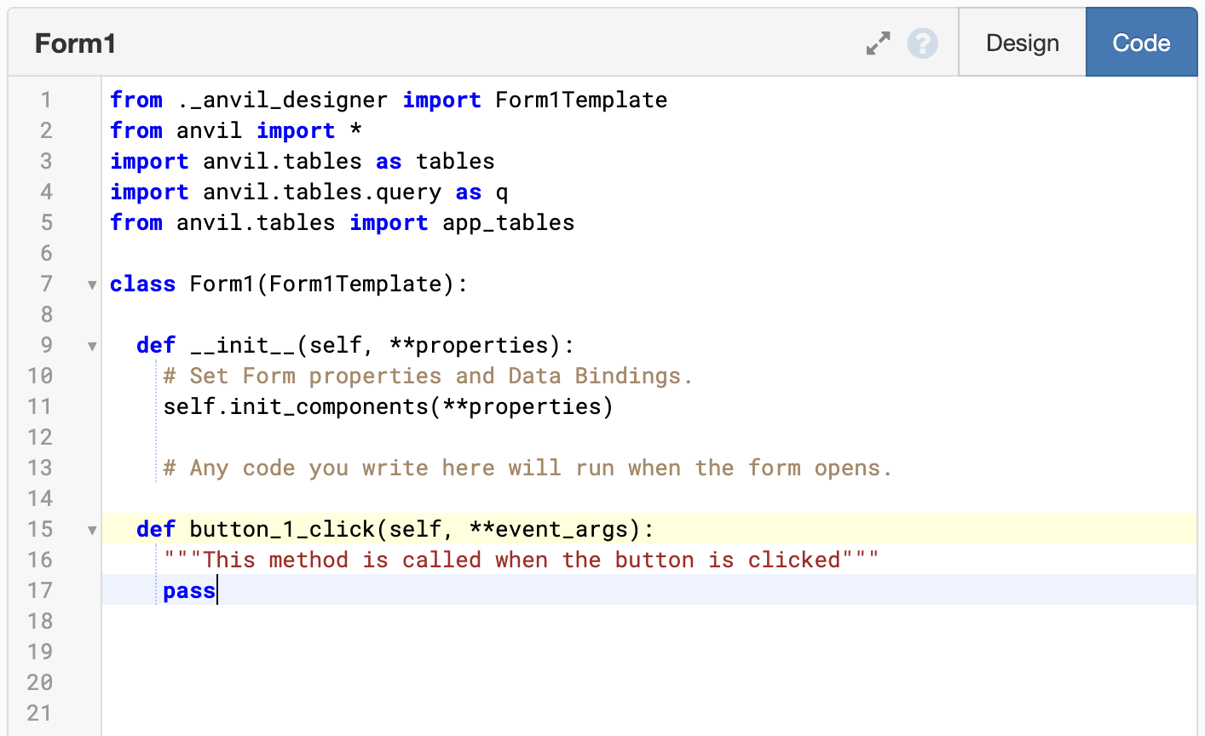
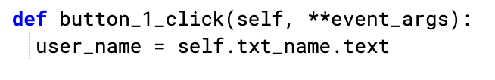
Data Tables - A ‘how to’ guide
12. The code start out like this, let’s replace it to obtain the text from within the textbox...

Slide 28
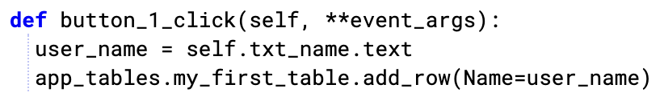
Data Tables - A ‘how to’ guide
13. Now, let’s add the line that stores this to the data table!

Slide 29
Data Tables - A ‘how to’ guide
13. Now, let’s add the line that stores this to the data table!
Tells Python to look for the app’s Data Tables

Slide 30
Data Tables - A ‘how to’ guide
13. Now, let’s add the line that stores this to the data table!
Tells Python to look for “my_first_table”

Slide 31
Data Tables - A ‘how to’ guide
13. Now, let’s add the line that stores this to the data table!
Executes the “add_row” method, to add a row!
This is done with the parameter “add_row” and value “user_name”.

Slide 32
Data Tables - A ‘how to’ guide
‘Methods’ are the same as ‘functions’.
13. Now, let’s add the line that stores this to the data table!
Finally, assign the variable “user_name” to the column “Name” (in our table!)

Slide 33
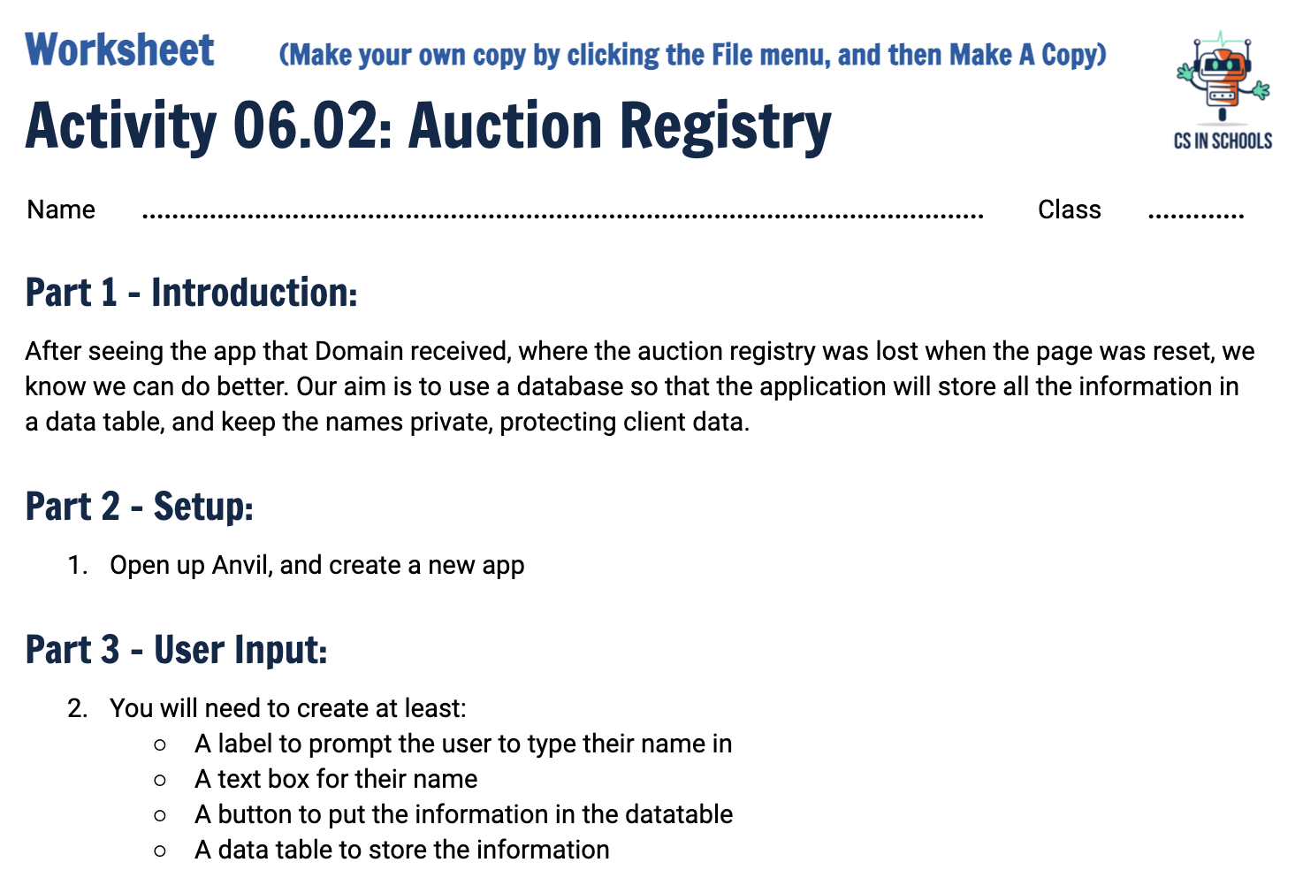
Activity 06.02 - Auction Registry
Now, let’s go ahead and provide Domain with a better Auction Register App.
Complete the Activity:
06.02 - Auction Registry
‹#›

Slide 34
Summary
Variables are stored in a computer’s memory and are only available when the program is running
To store data permanently it must be stored on a physical disk drive
To store data, we take the information from our program’s variables and write them to the database
If we need the data from the database, we read it back into our program’s variables so they can be used
‹#›

