Slide 1

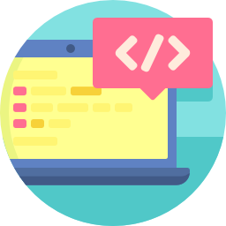
Lesson 4
Functions and Loops
csinschools.com

Slide 2

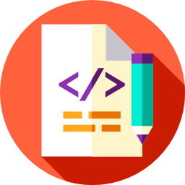
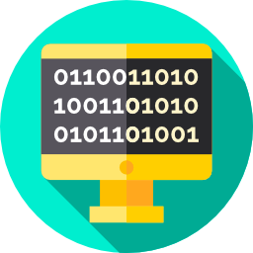
Previously, on CS in Schools...
How many items are in the following list?
houses = [
"Gryffindor",
"Hufflepuff",
"Ravenclaw",
"Slytherin"
]
‹#›
Notes:
Answer: 4

Slide 3
Previously, on CS in Schools...
What function tells us the length of the list?
houses = [
"Gryffindor",
"Hufflepuff",
"Ravenclaw",
"Slytherin"
]
‹#›
Notes:
Answer: len
Example: len(houses) would return 4

Slide 4
Previously, on CS in Schools...
How would you print out the first item in this list?
houses = [
"Gryffindor",
"Hufflepuff",
"Ravenclaw",
"Slytherin"
]
‹#›
Notes:
Answer: print(houses[0])
Remember that the index used to access a list starts at 0

Slide 5
Previously, on CS in Schools...
How would you print out the last item in this list?
houses = [
"Gryffindor",
"Hufflepuff",
"Ravenclaw",
"Slytherin"
]
‹#›
Notes:
Answer: print(houses[3])
Remember that the index used to access a list starts at 0

Slide 6
Learning objectives
By the end of this lesson, you should be able to:
research information about loans
implement loops in Python
understand the definition of a function
write functions in Python
‹#›

Slide 7
If Statements Revisited
if answer < 1:
print(“Yes!”)
if the boolean expression is True, the statement(s) in the indented block of code are executed.
if the boolean expression is False, the indented block of code is not executed.

Slide 8
If Statements Revisited
if answer < 1:
print(“Yes!”)
if the boolean expression is True, the statement(s) in the indented block of code are executed.
if the boolean expression is False, the indented block of code is not executed.

Slide 9
If Statements Revisited
if answer < 1:
print(“Yes!”)
if the boolean expression is True, the statement(s) in the indented block of code are executed.
if the boolean expression is False, the indented block of code is not executed.

Slide 10
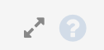
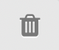
If Statements Revisited
Worked_Example |  |  | Design | Code
1 | i = 1
2 | if i < 4:
3 | print(i)
>_Output
1 | 1
2
3
1
i is set to 1
1 is less than 4
the indented block of code is run and the the value of i is printed to the screen (in this case 1).
‹#›

Slide 11
While loops
while answer < 1:
print(“Yes!”)
A while loop is very similar to an if statement
The boolean expression is tested
If it is false, indented code is skipped
If it is true, indented code is executed
‹#›

Slide 12
While loops
while answer < 1:
print(“Yes!”)
Once the indented code is executed, the program returns to the while statement and tests the expression again
If it is now False, indented code is skipped (while loop terminated)
If it is still True, indented code is executed again
‹#›

Slide 13
While Statements
Worked_Example |  |  | Design | Code
1 | i = 1
2 | while i < 4:
3 | print(i)
4 | i = i + 1
>_Output
1 | 1
2 | 2
3 | 3
i is set to 1
Is i less than 4?
i is printed
i is incremented
Return to step 2
‹#›

Slide 14
Test your understanding
Worked_Example |  |  | Design | Code
1 | a = 0
2 | while a < 5:
3 | print(a)
4 | a = a + 2
>_Output
1 | 0
2 | ...
3 | ...
What will appear in the console (output) now?
What will be the last number printed?
What will be the second number printed?
What is the value of ‘a’ once the loop is terminated?
‹#›

Slide 15
Infinite loops
while True:
print(“lol XD”)
In this example, the boolean expression is set to true
This mean that the while loop will never end, printing “lol XD” to infinity
Although this is fun as an example, we want to avoid infinite loops when coding
‹#›

Slide 16
Ensuring loops will end
Worked_Example |  |  | Design | Code
1 | a = 0
2 | while a < 5:
3 | print(a)
4 | a = a + 1
>_Output
1 | 0
2 | 2
3 | 4
We must make sure at some stage the boolean expression becomes false
This is usually done using the following steps:
Initialise a variable before the while loop (line 1)
Test the variable in the while statement (line 2)
Update the variable (line 4)
‹#›

Slide 17
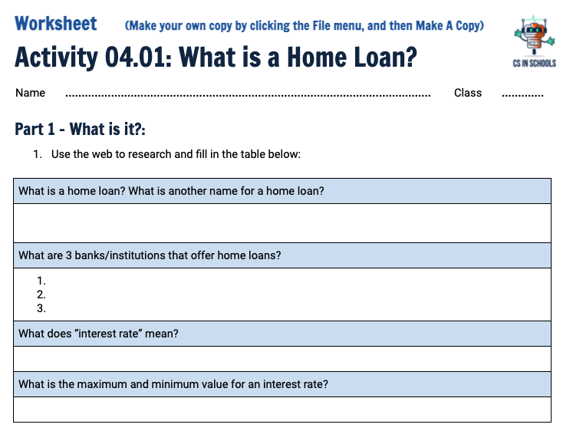
Activity 04.01 - What is a Home Loan?
Have a go at the following worksheet!
Complete this worksheet: 04.01 - What is a Home Loan?
‹#›

Slide 18
Sneezing 3 Times
When I sneeze, I always sneeze 3 times
Let’s write a program to simulate this:
Worked_Example |  |  | Design | Code
1 | print(“achoo!”)
2 | print(“achoo!”)
3 | print(“achoo!”)
>_Output
1 | achoo!
2 | achoo!
3 | achoo!

Slide 19
Sneezing 3 Times
When coding, if you have to repeat something multiple times, always ask yourself “Is there a better way?”
We could rewrite the program like this:
Worked_Example |  |  | Design | Code
1 | i = 0
2 | while i < 3:
3 | print(“achoo!”)
4 | i = i + 1
>_Output
1 | achoo!
2 | achoo!
3 | achoo!

Slide 20
Think, Pair, Share - Sneezing 3 Times
This program is 4 lines of code, whereas before it was 3
Why would this code be a better program than the one with 3 print statements?
Worked_Example 1 |  |  | Design | Code
1 | print(“achoo!”)
2 | print(“achoo!”)
3 | print(“achoo!”)
Worked_Example 2 |  |  | Design | Code
1 | i = 0
2 | while i < 3:
3 | print(“achoo!”)
4 | i = i + 1

Slide 21
Think, Pair, Share - Sneezing 3 Times
The program on the right lets us add more “achoo!”s by simply changing the boolean expression (e.g. i < 50 would produce 50 “achoo!”s)
The program on the left would require 50 print’s to do 50 “achoo!”s
Worked_Example 1 |  |  | Design | Code
1 | print(“achoo!”)
2 | print(“achoo!”)
3 | print(“achoo!”)
Worked_Example 2 |  |  | Design | Code
1 | i = 0
2 | while i < 3:
3 | print(“achoo!”)
4 | i = i + 1

Slide 22
Functions Revisited
Functions allow us to execute many lines of code as a single statement
Some examples we have used are print(“...”) and len(“...”)
Remember: len is short for length, and gives us the number of items in a list
We can pass parameters into a function inside the brackets
len(houses)
Function
Parameter
‹#›

Slide 23
Defining a sneeze function
A function allows us to execute many lines of code as a single statement.
Let’s write our own function that lets us sneeze 3 times
Worked_Example |  |  | Design | Code
1 | def sneeze():
2 | i = 0
3 | while i < 3:
4 | print(“achoo!”)
5 | i = i + 1
6
>_Output
1
2
3
4
5

Slide 24
Defining a sneeze function
The def keyword is used to define a function
We have called this function “sneeze”
Worked_Example |  |  | Design | Code
1 | def sneeze():
2 | i = 0
3 | while i < 3:
4 | print(“achoo!”)
5 | i = i + 1
6
>_Output
1
2
3
4
5

Slide 25
Defining a sneeze function
Empty brackets mean there are no parameters
All code indented under the function definition is included in the function
Worked_Example |  |  | Design | Code
1 | def sneeze():
2 | i = 0
3 | while i < 3:
4 | print(“achoo!”)
5 | i = i + 1
6
>_Output
1
2
3
4
5

Slide 26
Defining a sneeze function
This code only defines the function
It will not execute the function - see, our console is still empty!
Worked_Example |  |  | Design | Code
1 | def sneeze():
2 | i = 0
3 | while i < 3:
4 | print(“achoo!”)
5 | i = i + 1
6
>_Output
1
2
3
4
5

Slide 27
Defining a sneeze function
To execute the function, we write the function and its parameters, without “def”
Now our console is as we expect it to be!
Worked_Example |  |  | Design | Code
1 | def sneeze():
2 | i = 0
3 | while i < 3:
4 | print(“achoo!”)
5 | i = i + 1
6 | sneeze()
>_Output
1 | achoo!
2 | achoo!
3 | achoo!
4
5

Slide 28
Defining a sneeze function
In Python, a function must be defined before it can be called
The code below would cause an error since Python would not know what sneeze() meant when it was called
Worked_Example |  |  | Design | Code
1 | sneeze()
2 | def sneeze():
3 | i = 0
4 | while i < 3:
5 | print(“achoo!”)
6 | i = i + 1
>_Output
1 | Traceback (most recent call last): File "main.py", line 1, in <module> sneeze() NameError: name sneeze is not defined
2

Slide 29
Defining Functions
Once a function is defined, you can call it as many times as you like
How many “achoo!”s would be printed if we wrote this program?
Worked_Example |  |  | Design | Code
1 | def sneeze():
2 | i = 0
3 | while i < 3:
4 | print(“achoo!”)
5 | i = i + 1
6 | sneeze()
7 | sneeze()
>_Output
1 | achoo!
2 | achoo!
3 | ...
4
5

Slide 30
Defining a sneeze function
To make the function better, we can add a parameter to define the number of sneezes
num_sneeze is our parameter that will define the number of sneezes for us
How many “achoo!”s do you think will be printed?
Worked_Example |  |  | Design | Code
1 | def sneeze(num_sneeze):
2 | i = 0
3 | while i < num_sneeze:
4 | print(“achoo!”)
5 | i = i + 1
6 | sneeze(10)
>_Output
1 | achoo!
2 | achoo!
3 | ...
4
5

Slide 31
Defining a sneeze function
num_sneeze is a variable we can now use within the function to define the number of “achoo!”s
When calling the function, we must pass this parameter to the function
Worked_Example |  |  | Design | Code
1 | def sneeze(num_sneeze):
2 | i = 0
3 | while i < num_sneeze:
4 | print(“achoo!”)
5 | i = i + 1
6 | sneeze(10)
>_Output
1 | achoo!
2 | achoo!
3 | ...
4
5

Slide 32
Defining a sneeze function
Notice the “10” on line 6? This is the num_sneeze parameter
We are telling the program num_sneeze = 10
This will let us print 10 “achoo!”s
Worked_Example |  |  | Design | Code
1 | def sneeze(num_sneeze):
2 | i = 0
3 | while i < num_sneeze:
4 | print(“achoo!”)
5 | i = i + 1
6 | sneeze(10)
>_Output
1 | achoo!
2 | achoo!
3 | ...
4
5

Slide 33
Defining a sneeze function
Now we can pass any number of sneezes to the function, for example:
sneeze(99)
sneeze(463)
Worked_Example |  |  | Design | Code
1 | def sneeze(num_sneeze):
2 | i = 0
3 | while i < num_sneeze:
4 | print(“achoo!”)
5 | i = i + 1
6 | sneeze(10)
>_Output
1 | achoo!
2 | achoo!
3 | ...
4
5

Slide 34
Functions That Return Values
The print() function does not return any values, we simply call it and it outputs information to the screen
The len function is different, it takes a list as a parameter and returns the length of the list.
The return value can be used in many ways, for example:
Stored in a variable:
list_length = len(houses)
Used in another function:
randint(0, len(houses)-1)
‹#›

Slide 35
Functions That Return Values
We can return values from our own functions using the return keyword
The return statement terminates the function and no extra code will be run
Worked_Example |  |  | Design | Code
1 | def area_of_circle(radius):
2 | area = 3.14*radius*radius
3 | return area
4
5 | area_of_circle(5)
6
>_Output
1 | 78.5
2
3
4
5

Slide 36
Functions Make Code More Readable
Which piece of code is easier to read and understand what it is doing?
Worked_Example |  |  | Design | Code
1 | area = 3.14*10*10
2
3 | area = area_of_circle(5)
4
‹#›
Notes:
The first is harder to understand as it only has a calculation but without looking in depth it is hard to know what it is calculating
The second explicitly tells us that it is calculating the area of a circle

Slide 37

Functions Make Code More Readable
Which piece of code is easier to read and understand what it is doing?
Worked_Example |  |  | Design | Code
1 | area = 3.14*10*10
2
3 | area = area_of_circle(5)
4
By giving our functions good names, it can help with the readability of our code.
Notes:
The first is harder to understand as it only has a calculation but without looking in depth it is hard to know what it is calculating
The second explicitly tells us that it is calculating the area of a circle

Slide 38
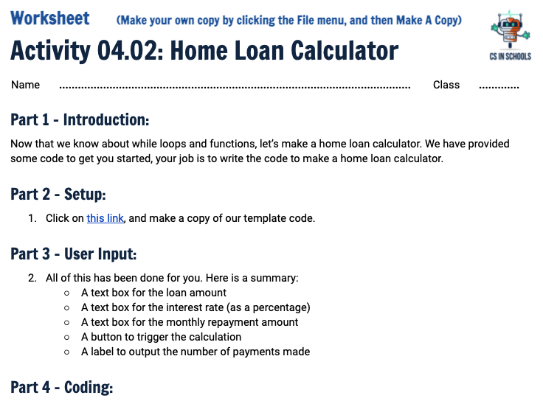
Activity 04.02 - Home Loan Calculator
Let’s make a home loan calculator.
Complete this worksheet: 04.02 - Home Loan Calculator
‹#›

Slide 39
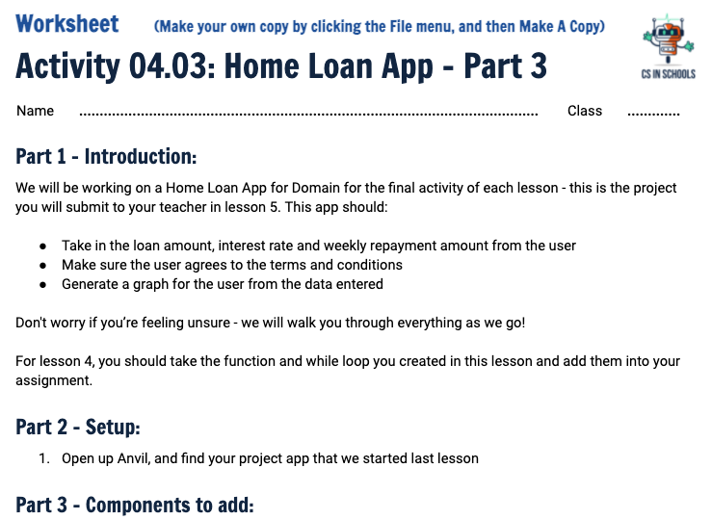
Activity 04.03 - Home Loan App: Part 3
Now, use what you have learned to work on your assignment.
Complete this worksheet: 04.03 - Home Loan App: Part 3
‹#›

Slide 40
Extension - Avoiding infinity!
You may have noticed that sometimes our function gets stuck in an infinite loop
This is because repayment_amount is less than the interest accumulated each month, meaning that the loan increases faster than we can pay it off!
Try to add in some code to prevent this infinite loop
This boolean expression may help in an if statement:
repayment_amount < loan_amount*interest_rate/100/12
‹#›

Slide 41
Summary
A while loop allows you to repeat code until a condition becomes false
Functions allow us to execute many lines of code as a single statement
We can define our own functions
Functions can return values
‹#›

Slide 42
License Information
The slides on functions are based on materials used in Harvard's CS50 course, with this licensing information.
All images have been taken from Flaticon
‹#›

