Slide 1


Lesson 3
If Statements vs Lists
csinschools.com

Slide 2



Previously, on CS in Schools...
What is an example of an event in programming?
‹#›
Notes:
Answer: a button being clicked, the mouse being pressed or moved, a key being pressed

Slide 3
Previously, on CS in Schools...
What is a variable?
‹#›
Notes:
Answer: A variable is a named location in memory where you store a value.

Slide 4
Previously, on CS in Schools...
What data type does Python assign to each of the following variables?
cost = 13.99
score = 0
address_line_1 = “12 Any Street”
age = “13”
fun = True
‹#›
Notes:
Answers: float, int, str, str, and bool in that order

Slide 5
Learning objectives
By the end of this lesson, you should be able to:
revisit conditional statements in Python
understand what the list data type is
understand how a list is helpful in programming
be able to use lists in a program
‹#›

Slide 6
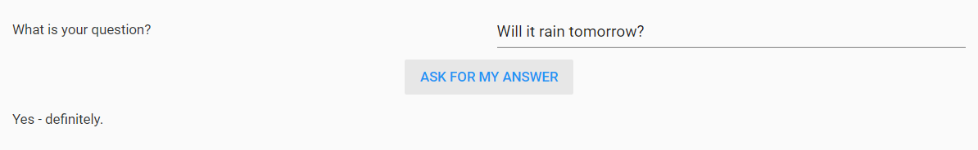
The Magic 8 Ball
The magic eight ball is a fortune telling device that answers any of your yes/no questions. We are going to create a web page that functions a magic eight ball.
Magic 8 Ball Example

Slide 7
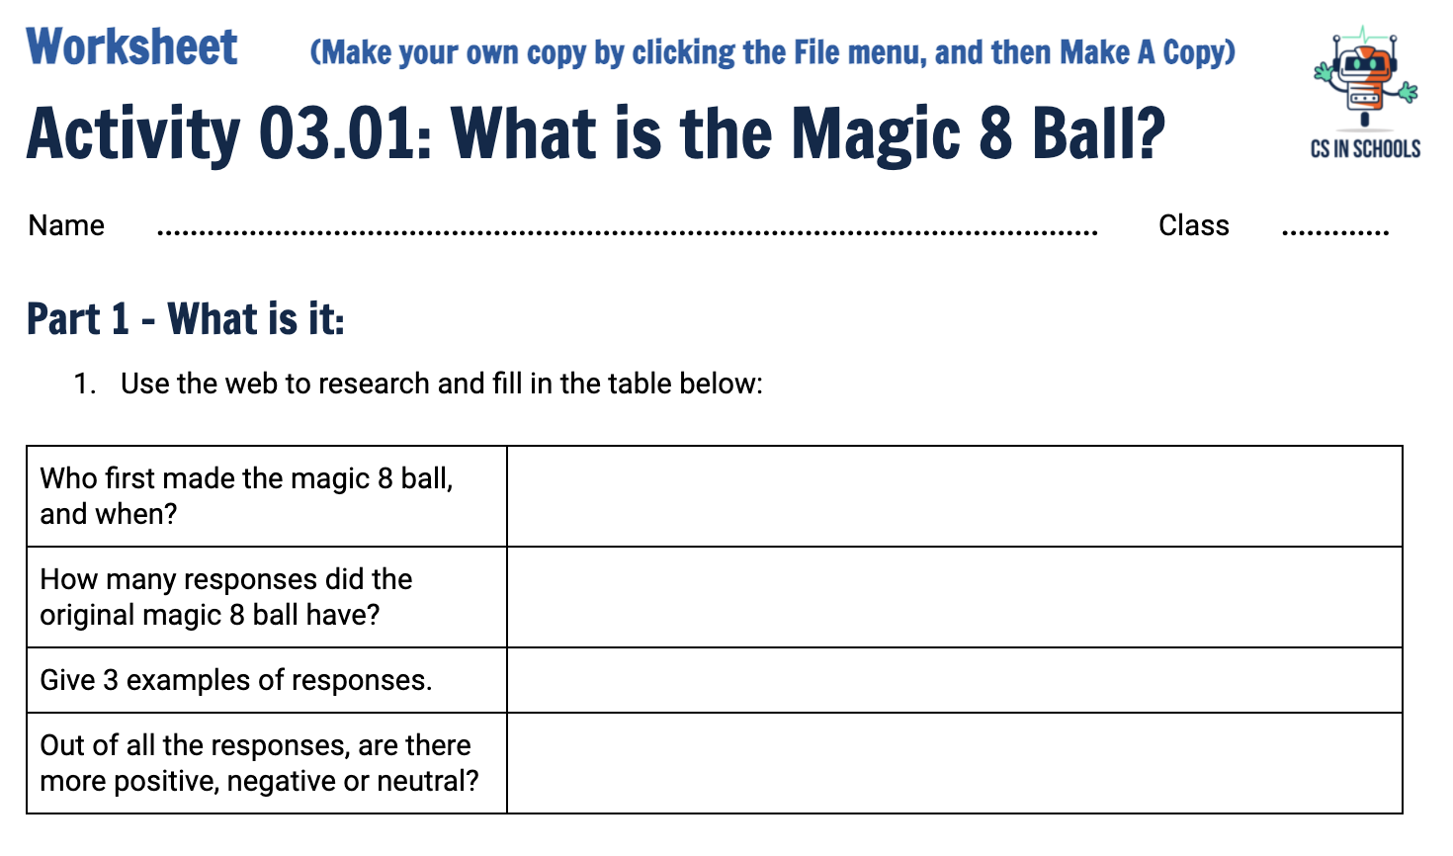
Activity 03.01 - What is the Magic 8 Ball?
Have a go at the following worksheet!
Complete this worksheet:
03.01 - Magic 8 Ball
‹#›

Slide 8
Activity 03.01 - Research the Magic 8 Ball
Some responses you may have found.
● It is certain. ● It is decidedly so. ● Without a doubt. ● Yes – definitely. ● You may rely on it. | ● As I see it, yes. ● Most likely. ● Outlook good. ● Yes. ● Signs point to yes. | ● Reply hazy, try again. ● Ask again later. ● Better not tell you now. ● Cannot predict now. ● Concentrate and ask again. | ● Don't count on it. ● My reply is no. ● My sources say no. ● Outlook not so good. ● Very doubtful.
‹#›

Slide 9

Think, Pair, Share - Magic 8 Ball
How could we program the magic 8 ball using if statements?
Think for 1 minute by yourself
Discuss your idea with the person next to you
Share your ideas with the class
‹#›

Slide 10
Possible Solution - Magic 8 Ball
Pick random number between 1 and 20.
Is number 1?
Display “Yes!”
Is number 2?
Display “Maybe”
‹#›

Slide 11
Possible Solution - Magic 8 Ball
from random import randint
answer = randint(1, 20)
if answer == 1:
print(“Yes!”)
elif answer == 2:
print(“Maybe”)
...
‹#›

Slide 12
Some Questions to Ponder
How many if or elif statements are required?
If we want to add more options, how much more code is required?
Is there a simpler way?
‹#›

Slide 13
Some Questions to Ponder - Answered
How many if or elif statements are required?
  We would need at least one if or elif per response on the magic 8 ball
If we want to add more options, how much more code is required?
  We would need to add at least 2 lines of code
    1x if or elif
    1x print
    We would also have to modify the randint function!
    This much editing can get messy - there is a chance you might miss something!
Is there a simpler way?
  Lists!
‹#›

Slide 14
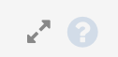
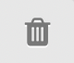
Lists - An alternative to ‘if’ statements!
A list in Python is a collection of values
Lists are written with square brackets
Each item is separated by a comma
fruits = ["apple", "banana", "cherry"]
Worked_Example |  |  | Design | Code
1 | fruits = ["apple", "banana", "cherry"]
2
3 | print(fruits)
>_Output
1 | [‘apple’, ‘banana’, ‘cherry’]
2
3

Slide 15
Lists - An alternative to ‘if’ statements!
A list in Python is a collection of values
Lists are written with square brackets
Each item is separated by a comma
fruits = ["apple", "banana", "cherry"]
Worked_Example |  |  | Design | Code
1 | fruits = ["apple", "banana", "cherry"]
2
3 | print(fruits)
>_Output
1 | [‘apple’, ‘banana’, ‘cherry’]
2
3

Slide 16
Lists - An alternative to ‘if’ statements!
A list in Python is a collection of values
Lists are written with square brackets
Each item is separated by a comma
fruits = ["apple", "banana", "cherry"]
Worked_Example |  |  | Design | Code
1 | fruits = ["apple", "banana", "cherry"]
2
3 | print(fruits)
>_Output
1 | [‘apple’, ‘banana’, ‘cherry’]
2
3

Slide 17
Lists - Accessing an individual element
You can access individual elements by its position in the list
We call the position the index
Indexes begin at 0
To access an individual element, specify the variable, and then the index in between square brackets [ ] - as you can see on line 3!
Worked_Example |  |  | Design | Code
1 | fruits = ["apple", "banana", "cherry"]
2
3 | print(fruits[0])
>_Output
1 | apple
2
3

Slide 18

But why start our index at 0?
houses = ["Gryffindor", "Hufflepuff", "Ravenclaw", "Slytherin"]
If we take each spot in the list as a box, we can see why…
How many boxes from the start is Gryffindor?
How many boxes from the start is Ravenclaw?
Gryffindor
Hufflepuff
Ravenclaw
Slytherin
START
END

Slide 19
But why start our index at 0?
houses = ["Gryffindor", "Hufflepuff", "Ravenclaw", "Slytherin"]
If we take each spot in the list as a box, we can see why…
How many boxes from the start is Gryffindor? 0
How many boxes from the start is Ravenclaw? 2
Notice here that there are 4 items in the list, but the last one is at position 3
Gryffindor
Hufflepuff
Ravenclaw
Slytherin
0
1
2
3

Slide 20
But why start our index at 0?
houses = ["Gryffindor", "Hufflepuff", "Ravenclaw", "Slytherin"]
If we take each spot in the list as a box, we can see why…
How many boxes from the start is Gryffindor? 0
How many boxes from the start is Ravenclaw? 2
Notice here that there are 4 items in the list, but the last one is at position 3
This means the final element in any list is at the position length - 1
Gryffindor
Hufflepuff
Ravenclaw
Slytherin
0
1
2
3

Slide 21
Lists - Check Your Understanding
What will the following code print to the output console?
Worked_Example |  |  | Design | Code
1 | houses = ["Gryffindor", "Hufflepuff", "Ravenclaw", "Slytherin"]
2
3 | print(houses[3])
>_Output
1
2

Slide 22
Lists - Check Your Understanding
What will the following code print to the output console?
Worked_Example |  |  | Design | Code
1 | houses = ["Gryffindor", "Hufflepuff", "Ravenclaw", "Slytherin"]
2
3 | print(houses[3])
>_Output
1 | Slytherin
2
Notes:
Answer: Slytherin - remember indexes start at 0

Slide 23
Lists - Check Your Understanding
What will the following code print to the output console?
Worked_Example |  |  | Design | Code
1 | houses = ["Gryffindor", "Hufflepuff", "Ravenclaw", "Slytherin"]
2
3 | print(houses[4])
>_Output
1
2

Slide 24
Lists - Check Your Understanding
If you try to index an item that doesn’t exist, you’ll get this error message!
Worked_Example |  |  | Design | Code
1 | houses = ["Gryffindor", "Hufflepuff", "Ravenclaw", "Slytherin"]
2
3 | print(houses[4])
>_Output
1 | IndexError: list index out of range
2

Slide 25
Lists - Getting the length of a list
The len() - short for length - function returns the number of items in a list
Worked_Example |  |  | Design | Code
1 | houses = ["Gryffindor", "Hufflepuff", "Ravenclaw", "Slytherin"]
2 | print(len(houses))
3 | print(len(houses)-1)
>_Output
1 | 4
2 | 3

Slide 26
How does this help with the Magic 8 ball?
We can create a list that contains all of the responses
We can then choose a random number that is between 0 and the length of the list -1
Then we display that element of the list
See the next slide for an example of the code!
‹#›

Slide 27
Selecting a random value from a list
Worked_Example |  |  | Design | Code
1 | from random import randint
2 | houses = ["Gryffindor", "Hufflepuff", "Ravenclaw", "Slytherin"]
3 | choice = randint(0, len(houses) - 1)
4 | print(houses[choice])
>_Output
1 | Gryffindor
2

Slide 28
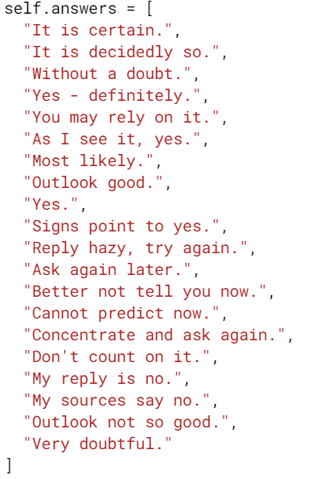
Smarter Programming - the Magic 8 Ball
Here are some hints for your next activity:
Store all the answers in a list
Select a random number between 0 and the length of the list minus one (why minus 1?)
Display the selected element from the list
Refer back to the last slide if you need help with the code
‹#›

Slide 29
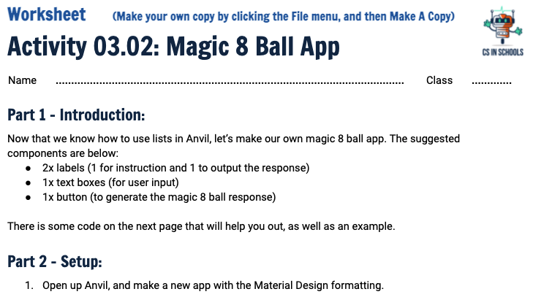
Activity 03.02 - Magic 8 Ball
Now, it’s time for you to make a Magic 8 Ball app.
Complete this worksheet:
03.02 - Magic 8 Ball App
‹#›

Slide 30
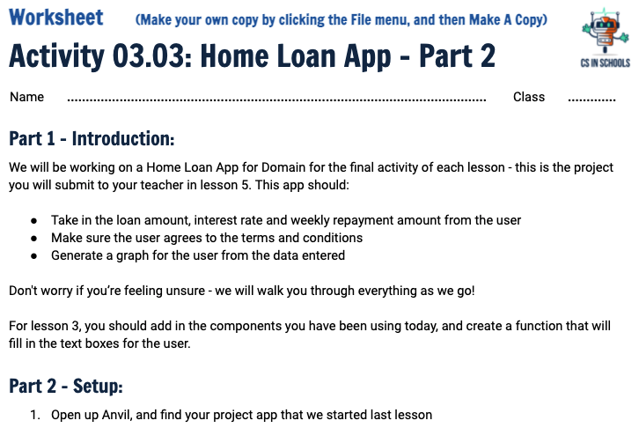
Activity 03.03 - Home Loan App
Each week we will add some more components to our first project for domain. Follow the worksheet to add in some new functionality!
Complete this worksheet:
03.03 - Home Loan App
‹#›

Slide 31
Extension - Magic 8 Ball Reflection Task
How many lines of code did we reduce in the button clicked function?
  Instead of using a bunch of if statements to present the Magic 8 Ball answers
What happens if we wish to add more responses to the Magic 8 Ball?
Would this help reduce possible bugs in our code?
Now, go ahead and add more responses to your Magic 8 Ball task.
‹#›
Notes:
Answer: To add more responses we simply add another item to our list. No other code than that is required.

Slide 32
Summary
A list in Python is a collection of variables
Lists are written with square brackets with each variable separated by a comma
You can access individual elements by via it’s position in the list
The first element is at position 0
The last element has an index equal to the length of the list - 1
The len() function returns the number of items in a list
‹#›

