Slide 1


Lesson 2
Anvil Basics
csinschools.com

Slide 2



Previously, on CS in Schools...
Which of the following variables are written in snake case?
  customers_age
  CarBrand
  Fave_Colour
  Persons_AGE_andgender
  dog_breed
‹#›
Notes:
Answer:
Snake case: Use lower case letters and separate each word with an underscore

Slide 3
Previously, on CS in Schools...
What is a good name for a label component that is meant to display first names?
What is a good name for an image component that shows a car?
‹#›
Notes:
Answers:
lbl_first_name
img_car

Slide 4
Previously, on CS in Schools...
How would you describe the domain.com.au website?
Name 2 good things about the domain.com.au website and one thing that could be improved
‹#›

Slide 5
Learning objectives
By the end of the lesson, you should be able to:
understand the programming terms sequence and events
understand how Python uses data types
use Python code to change components on a web page
use Python code to respond to events such as a button click
‹#›

Slide 6

Why do we need to run code for a website?
To check if a user is logged in
To save a user’s preferences
To show the user different features based on their preferences
To be able to respond to a user’s actions
‹#›

Slide 7
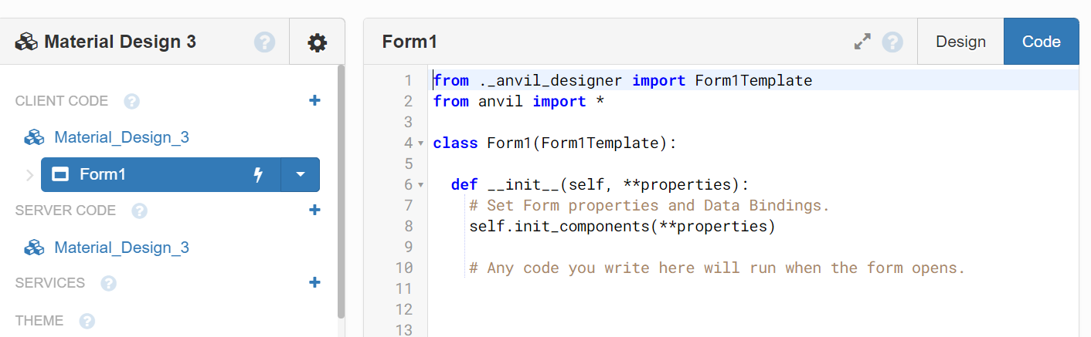
Running Code in Anvil
So far, we have only used the “Design” tab in Anvil. If we click the “Code” tab we are presented with an editor where we can write Python code.

Slide 8
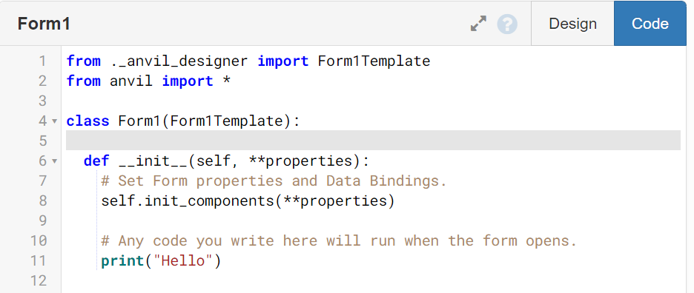
What about ‘print’?
From what we have seen previously, print displays text in the console, but where is the console on a website?
In Anvil, ‘print’ will write text into the Output console
Below we can see a print command on line 11...
‹#›

Slide 9
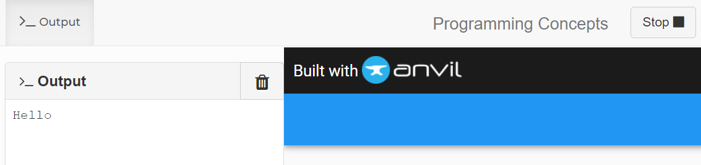
The output window
Running the app in Anvil will open the output window on the left of your screen
You can toggle whether this is open or closed
This is where ‘print’ will display text

Slide 10

The output window
The output window should only be used by the programmer for debugging
If you wish to add text to the webpage, use a label component
The user can’t even see the output window once you publish your app
‹#›

Slide 11

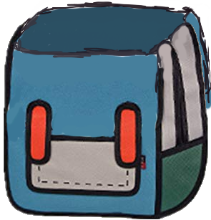
Variables
Allow you store data of different types
Have a name which allows you to access it
You can think of a variable as a backpack
Below, the age “13” is stored in our backpack called “age”
13
age
‹#›

Slide 12
Assignment Operator
age = “13”
In Python, “=” is an assignment operator
In this example, “13” is assigned to the variable age
This is different from mathematics
It means take the value on the right hand side and store it in the variable on the left hand side.
age
=
13
‹#›

Slide 13

Data Types: int
In Python a whole number is represented by an int data type.
Examples
age = 18
score = 100
int stands for integer, meaning a whole number.
‹#›

Slide 14
Data Types: float
Python has the float data type to store numbers with decimals.
Examples
price = 13.99
average = 100 / 3
float refers to floating point, which is similar to a decimal number.
‹#›

Slide 15
Data Types: str
Python uses the str data type to store one or more characters.
Examples
name = “Melanie”
fave_team = “Geelong”
str means string. This is a set of characters, including letters, numbers and symbols.
‹#›

Slide 16
Data Types: boolean
Python uses the bool data type to hold a value of True or False.
Examples
game_over = True
boring = False
bool means Boolean, which can be True or False.
‹#›

Slide 17
What is the Data Type of the Following Variables?
age = 13
price = 15.29
school = “Alfred Deakin HS”
favourite_number = “13”
amazing = True
‹#›

Slide 18
What is the Data Type of the Following Variables?
age = 13 # int
price = 15.29 # float
school = “Alfred Deakin HS” # str
favourite_number = “13” # str
amazing = True # boolean
‹#›

Slide 19

Adding Integers Together
x = 2
y = 3
z = x + y
After these lines of code z stores the value 5.
The variables x, y, and z all have an int data type.
We know we can add numbers, but did you know that you can ‘add’ strings?
2+3=5
‹#›

Slide 20
Adding Strings Together - Concatenation
name = “Jeff”
greeting = “Hello ” + name
Adding strings is also known as concatenation
After these lines of code, greeting stores the value “Hello Jeff”
The variables name and greeting both have a str data type
‹#›

Slide 21
Casting an Integer to a String
age = 18
name = “Jeff”
message = name + “ you are ” + str(age) + “ y.o.”
You must cast an int to a str data type in order to concatenate it with another str variable
  You use the str() function for this
After these lines of code message stores the value “Jeff you are 18 years old”
The variables name and message both have a str data type, whereas age is an int

Slide 22
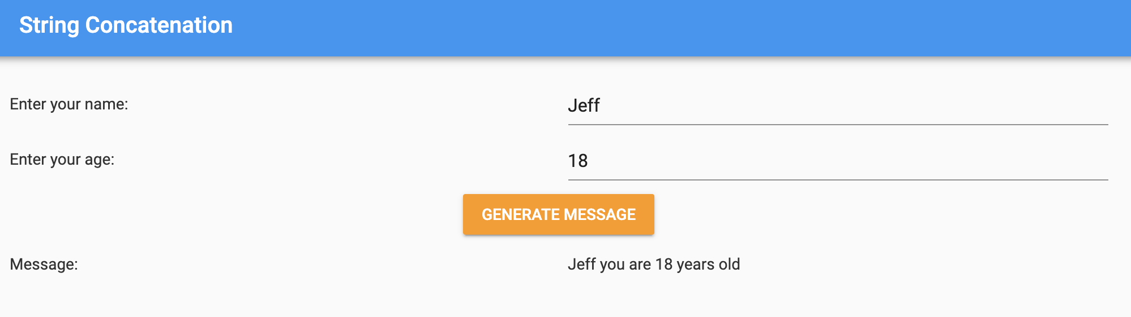
Let’s create this program in Anvil...
In the example on the previous slide, we can design a form to display that information as follows:

Slide 23

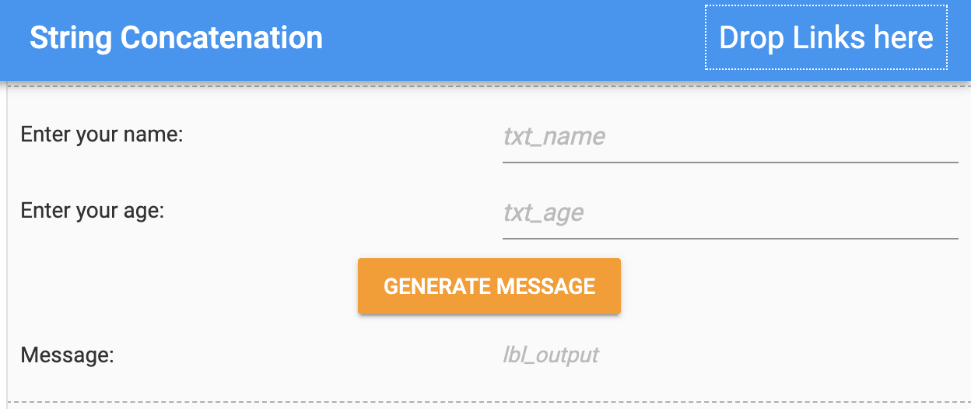







Let’s create in Anvil: setting up the form
In mode, we can add all the following elements to our form:
All the element names are indicated by the yellow borders below

Slide 24
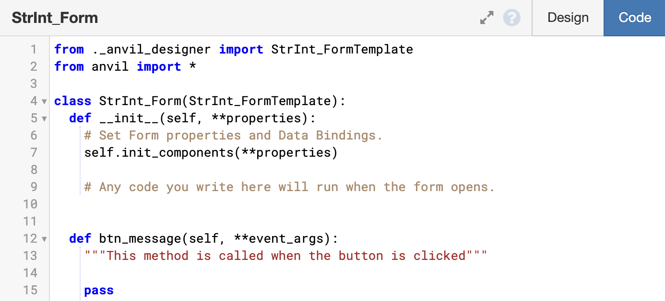
Let’s create in Anvil: Coding a button

Slide 25


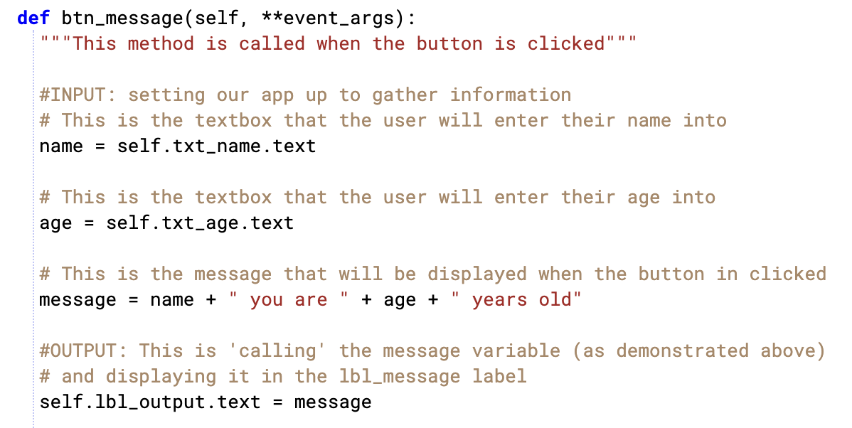
What about the code?
Let’s take a look at the code to
def btn_message(self, **event_args):
STEP 1:
Define the variables name and age.
Note: name and age are equal to whatever the user enters into the text boxes txt_name and txt_age.

Slide 26
What about the code?
Let’s take a look at the code to
def btn_message(self, **event_args):
STEP 2:
Define the variable message.
message will contain the contents of the variables name and age, as well as the other strings you concatenate.

Slide 27
Let’s create in Anvil: Generate Message
name
age
message
name + “you are ” + age + “ years old”

Slide 28


Python Automatically Determines the Data Type
Python does a lot of work for us and determines data types by itself
Other programming languages require the coder to tell it what data type they are using for a variable!
int
str
float
‹#›

Slide 29

Activity 02.01: How a name for your property adds value
JACQUI HAMMERTON JUN 5, 2014
“Give your house a name, a personality and a provenance to increase buyer interest and possibly resale value, say real-estate agents.”
Value always comes with a name! Think of Oreo biscuits; they were invented in 1912, 4 years after the original sandwich biscuit Hydrox.
You might ask yourself now, “What even is Hydrox?” - that’s the power of a name!
Let’s take a look at Australia’s top 3 mansions and explore their names!
‹#›

Slide 30

3. “La Mer”
Property Profile:
Name: “La Mer”, Vaucluse
Price: $70 million
Year: 2015
Suburb: Vaucluse, NSW
‹#›

Slide 31

2. “Elaine Estate”
Property Profile:
Name: “Elaine Estate”
Price: $71 million
Year: 2017
Suburb: Point Piper, NSW
‹#›

Slide 32

1. “Fairwater Mansion”
Property Profile:
Name: “Fairwater Mansion”
Price: $100 million
Year: 2018
Suburb: Point Piper, NSW
‹#›

Slide 33

Other property names ideas...
NAUTICAL Driftwood The Anchorage Jolly Roger Grasmere Loch Ness White Caps Seaspray | FLORAL The Elms Ivy Crest Roseberry Moss Vale Rosebank Cherry Hill The Laurels | GEOGRAPHICAL Highgrove Greenacres Parkside Grandview Lakeside Fairmount Hillcrest
‹#›

Slide 34
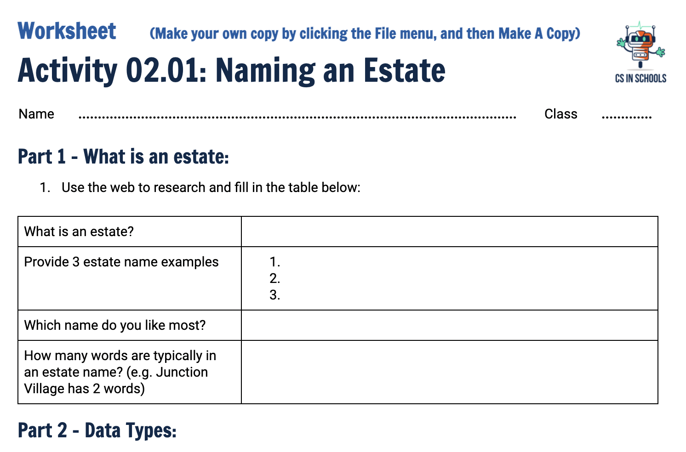
Activity 02.01 - Estate Names
Let’s spend some time searching for an estate name for your dream home.
Complete this worksheet:
02.01 - Estate Names
‹#›

Slide 35

Think, Pair, Share - Events
What happens in Anvil when you click on a button?
‹#›

Slide 36

Events
When you click on a button in Anvil, an event is triggered
An event is an action that our software can respond to
Other examples include:
  The mouse being moved
  The mouse being clicked
  A key being pressed
  A checkbox being ticked
‹#›

Slide 37
Think, Pair, Share - Sequence
What will be printed to the console, and in what order?
done = True
if done == True:
print(“First, clean your room.”)
print(“Last, wash the dishes.”)
print(“Second, walk the dog.”)
‹#›

Slide 38
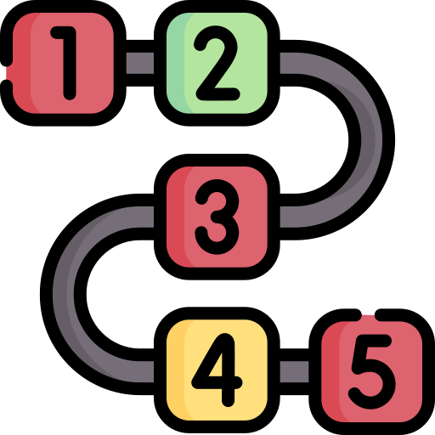
Sequence
The order of the last slide is called the sequence
The rules of Python, which determine the sequence, are:
  read code one line at a time
  read code from top to bottom
Computers will always follow your instructions, even if your instructions are wrong or don’t do what you intended
‹#›

Slide 39
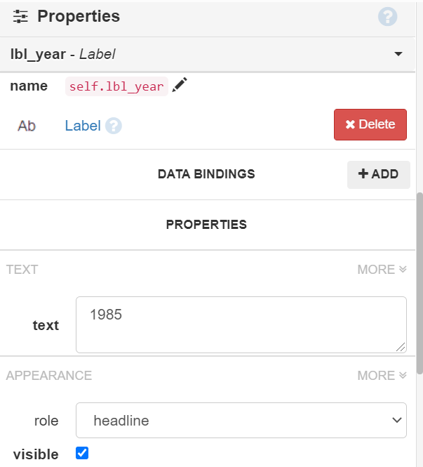
Label Properties
We know Anvil has a label component
We can set the text and appearance of the label using the properties panel
What is the name of the label component on the right?
What is its text value?
self refers to the form. We will always have to write self.___ when using component properties in the code.
‹#›

Slide 40
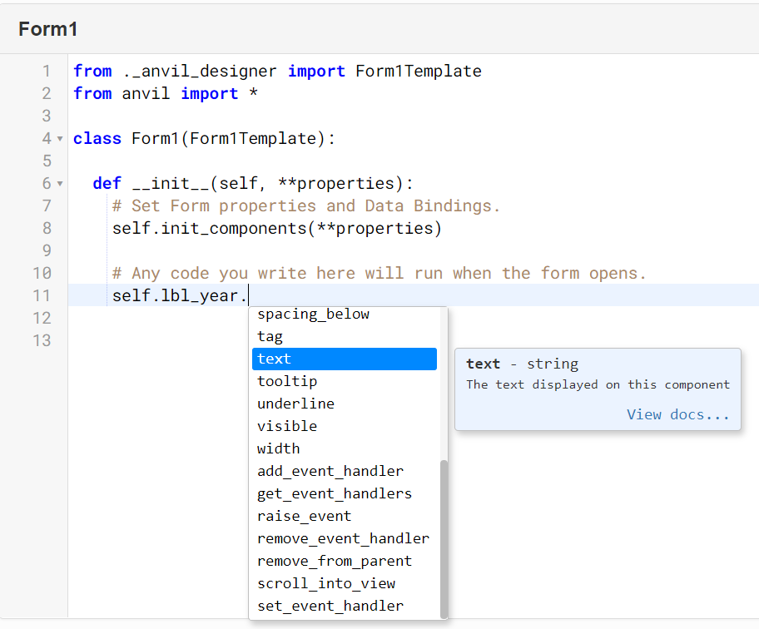
Label Properties
We can also set the properties in our code
By typing “self.lbl_year.”, we see the list of properties appear
We can store “1985” in the text property by typing:
self.lbl_year.text = “1985”
‹#›

Slide 41
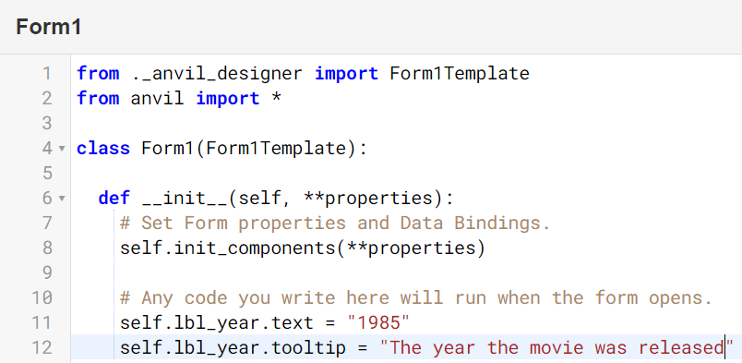
Label Properties
We can set other properties in a similar way
A useful property is “tooltip”
This will make some text appear when we hover over the component
The code we use is below, and an example on the next slide
self.lbl_year.tooltip = “The year the movie was…”
‹#›

Slide 42

Label Properties
Can you spot the tooltip text below?
‹#›

Slide 43

Think, Pair Share: Programming vs Properties Panel
Why would we need to set any attribute using Python code when we can simply use the properties panel?
‹#›

Slide 44
Think, Pair Share: Programming vs Properties Panel
By using code, we can change the website dynamically when an event occurs, for example:
  the user pressing a button
  the user moving their mouse
This makes our web page more engaging since it can respond to changes
‹#›

Slide 45

If Statements in Python
Click here to play a fair game against your teacher
Do you think this game is really fair?
‹#›

Slide 46
If Statements in Python
If the number is above 20, why does the program not print “The teacher wins.” and “The students win.”?
roll = randint(1,100)
self.lbl_roll.text = "The roll was {roll}."
# Check who won
if roll > 20:
self.lbl_outcome.text = "The teacher wins."
elif roll > 10:
self.lbl_outcome.text = "The students win."
else:
self.lbl_outcome.text = "It was a draw!"
‹#›

Slide 47
Checkbox Component
Anvil has a Checkbox component
This component has a property named “checked” which is set to:
  True, when it is checked
  False, when it is not checked
When we use a checkbox component we should use the check prefix as part of it’s name for consistency.
The code we would typically use is:
if self.check_1.checked == True:
‹#›

Slide 48




Today’s Anvil Components
Before we show you how to use them, here are the components we will use.
Checkbox
Textbox
Dropdown
Part 1 | Part 2
Button
User to tick
User to type in
To include functionality
Selection from a list
‹#›

Slide 49
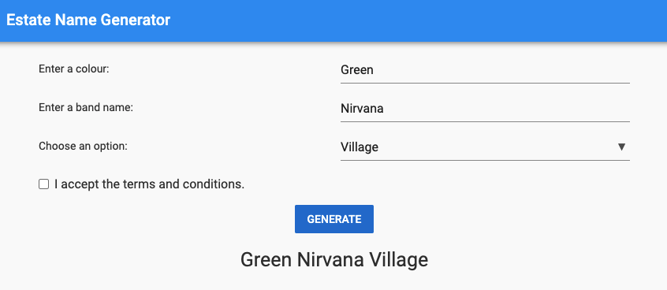
Activity 02.02 - Estate Name Generator
Let’s make an app that can help people choose an estate name!
Complete this worksheet:
02.02 - Estate Name Generator
‹#›

Slide 50
Activity 02.02 - Estate Name
lbl_app_name
txt_colour
lbl_colour
lbl_band
txt_band
lbl_suffix
drop_suffix
chk_TCs
btn_generate
lbl_estate_name
‹#›

Slide 51
Activity 02.03 - Home Loan App
Domain Real Estate conducted some research and found many customers were wanting a way of determining the total repayments they would have to make on a home, if they purchased it.
Domain have asked us to develop a prototype app that is capable of doing this.
Each week we will add some components to our first project for domain. You can see the rubric and the assignment sheet, however, we will provide you with weekly tasks in the form of a worksheet (see the next slide)!
‹#›

Slide 52
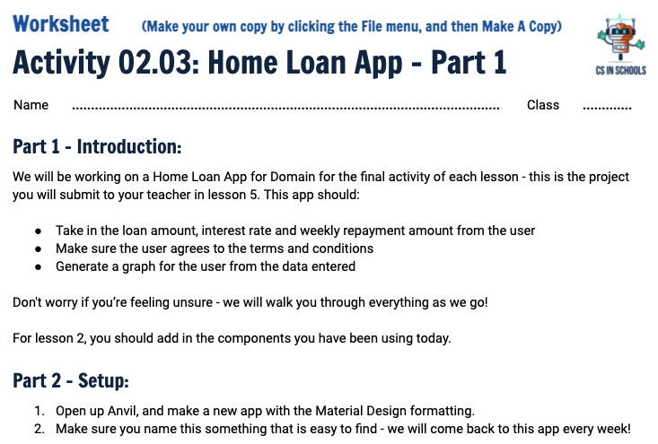
Activity 02.03 - Home Loan App
Each week we will add some more components to our first project for domain. Follow the worksheet to add in your first components!
Complete this worksheet:
02.03 - Home Loan App
‹#›

Slide 53
Summary
A function is a group of statements that perform a specific task.
By sequencing statements, you can control the order in which they are executed.
A variable is a named location in memory where you store a value
An event can trigger some code to run
Data types determine the type of information a variable can hold
The print function is used to display information to an Output console in Anvil
‹#›

Slide 54
Extension - Styling
You should go ahead and experiment with the properties panel to style the app you have made, either for activity 02.02 or your project (02.03).
‹#›

Slide 55
References
Articles:
How a name for your property adds value
AFR Rich List 2020: Property tycoons Harry Triguboff, Frank Lowy among Australia’s richest people
Australia’s Top 10 Mansions
Ceramic Nameplates
More information on mentioned properties:
La Mer
Phoenix Acres
Altona
Images
Beach Huts
Cottage

