Slide 1


Lesson 1
Introduction to Anvil
csinschools.com

Slide 2



Learning objectives
By the end of this lesson, you should be able to:
Sign up to Anvil
Explore the domain.com.au website
Build your first web page
‹#›

Slide 3

Domain.com.au
Domain is Australia’s home of property and they need your help throughout this unit to help them develop some features for their website.
Before we can begin work, we will do some research to find out:
How the website works
What you like about the website
What you don’t like about the website
What can be improved on the website

Slide 4
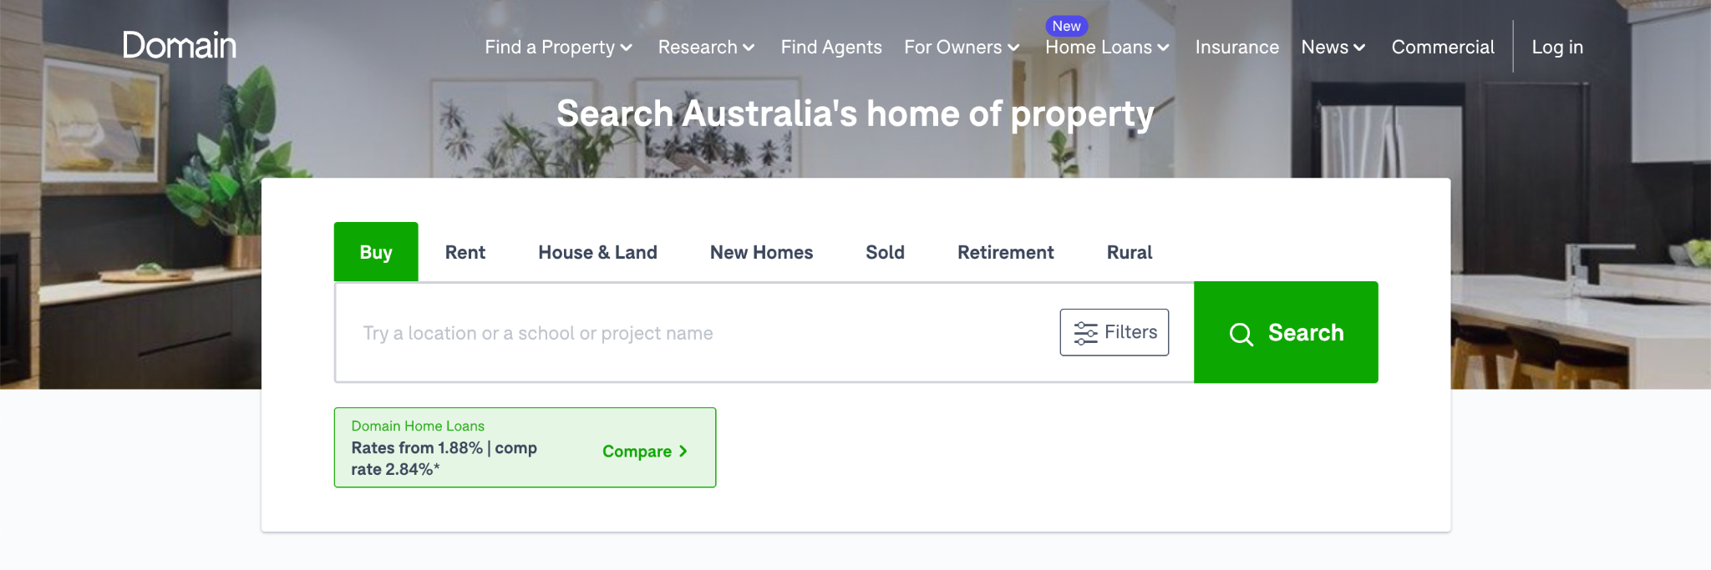
Activity 01.01 - Finding Your Dream home
Let’s spend some time searching for your dream home.
Complete this worksheet:
01.01 - Finding Your Dream Home
‹#›

Slide 5

Signing Up to Anvil
Visit the URL https://anvil.works
Click the “Start Building” link
Click the “Sign up for free” button
Enter your school email address, a password, and agree to the T's & C's
Click the “Sign up” button
Important: You must remember the email address and password you have used to sign up. Only you know the password so make sure you remember it!
Having trouble? Watch this video guide.
‹#›

Slide 6
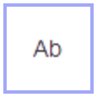


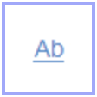
Basic Anvil Components
Before we show you how to use them, here are the components we will use.
Label
Image
Button
Link
Shows text
Shows an image
To include functionality
To link to other pages
Click the link for each component to watch a tutorial video!
‹#›

Slide 7

Snake Case
Snake case is a naming convention we can use to identify our components and variables
Snake case specifies that each word should be in lowercase and an underscore ( _ ) should be used to separate_multiple_words.
In addition, if we are naming a component we will use the following prefixes:
  Label: lbl
  Image: img
  Button: btn
‹#›

Slide 8

Snake Case - Examples
Here are some sample names you could use:
Component | Purpose | Prefix
Label | To display house price | lbl_price
Image | To showcase the house | img_showcase_house
Button | To submit information | btn_submit
‹#›

Slide 9
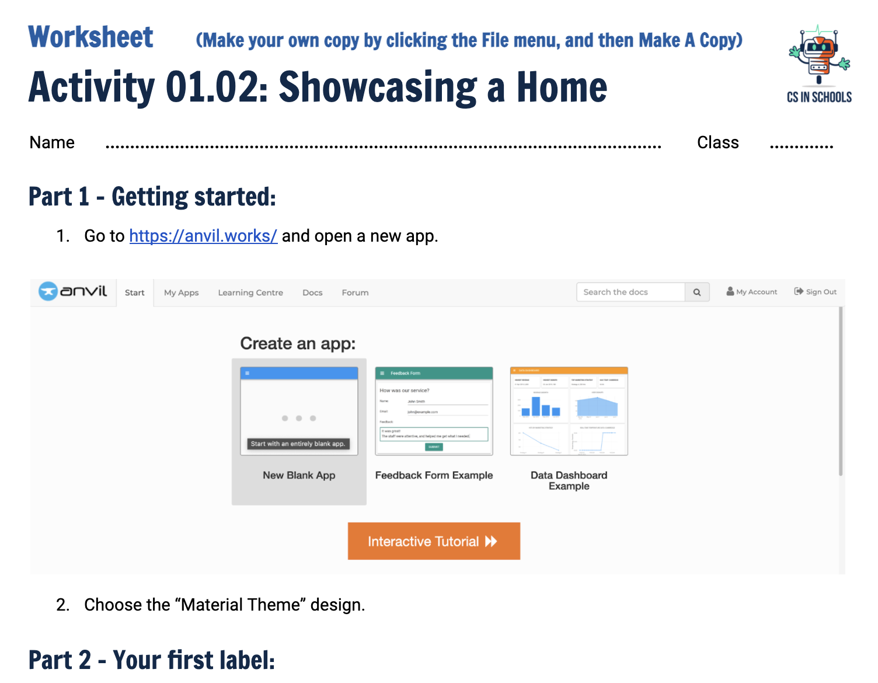
Activity 01.02 - Showcasing a Home
The first website you will build is one that showcases your dream home that you found on the Domain website. Here’s an example of a page you might build.
Complete this worksheet:
01.02 - Showcasing a Home
‹#›

Slide 10
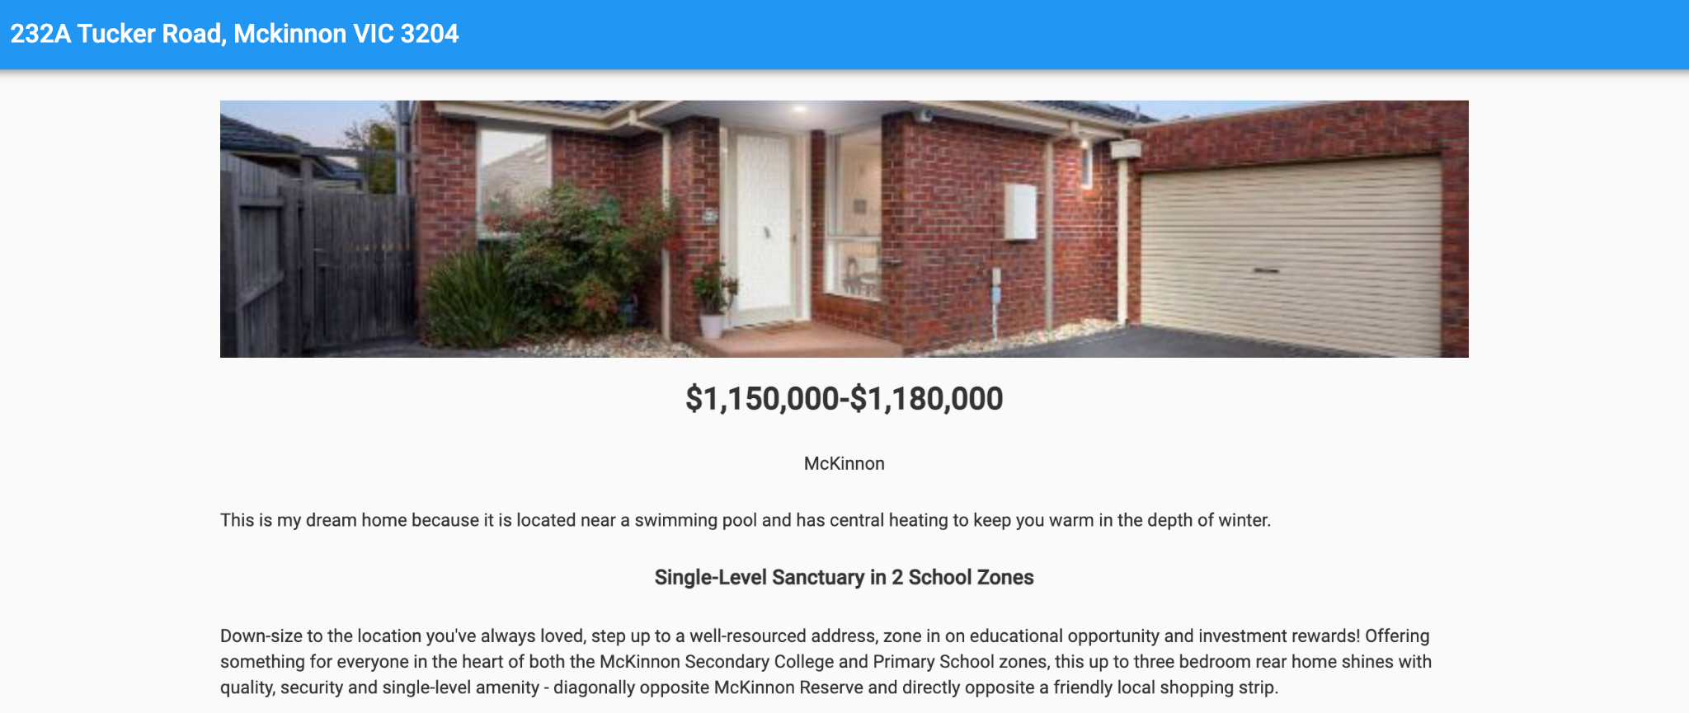
Activity 01.02 - Snake Case Suggestions
lbl_address
img_home
lbl_suburb
lbl_price
lbl_why
lbl_blurb
lbl_summary

Slide 11

Privacy
Who can access your website? Anyone one the internet!
Ensure anything you publish on the internet passes the Grandma test
  Don't publish any material you would not be proud to show your Grandmother!
Make sure to never post anything that identifies you personally
  Home address
  Full name
  Gamertag
  Phone number
Always make sure to get permission from anyone before posting their image online
‹#›
Notes:
Anyone with the URL

Slide 12
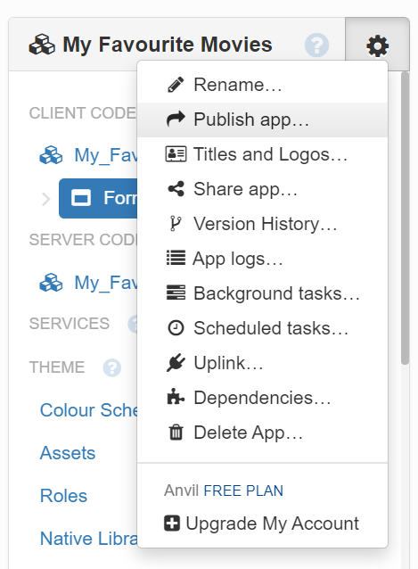
Activity 1.03 - Share Your Website
Anvil provides you with a private URL to enable you to share your web pages. Click on the settings icon, and then select “Publish app...”
Then click the “copy” button under the heading “Share via private link”.
‹#›

Slide 13
Summary
Anvil is a platform that lets us build web apps with Python
You can add components to your web page via the toolbox
The label component allows you to display text
The image component allows you to display an image
The button component gives the user an interactive element to use
The link component allows you to link to any other page on the Internet
The properties box lets you set many properties of a component
‹#›

Slide 14
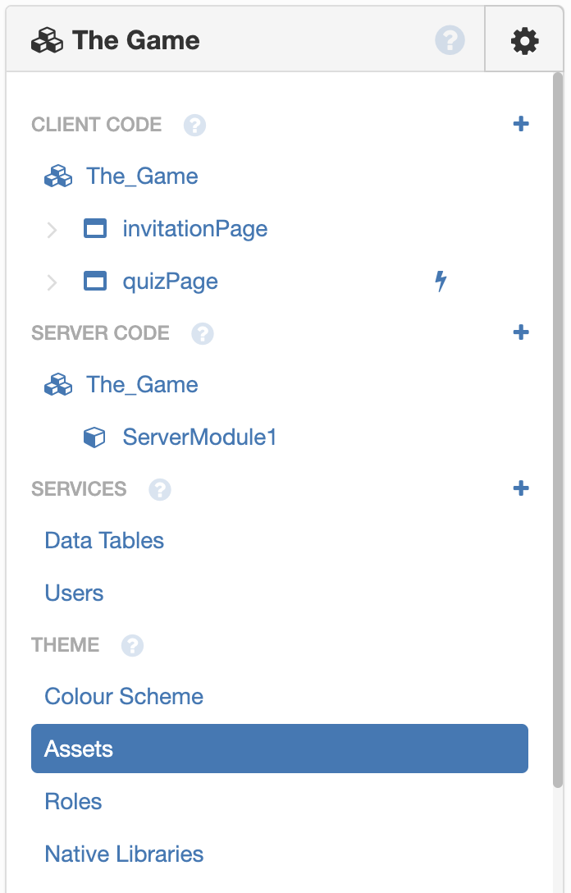
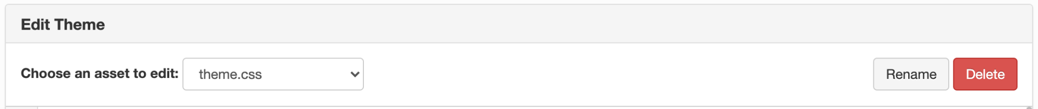
Extension: Modify the CSS directly
Anvil lets you modify the HTML and CSS of your web page through the assets menu
Make sure you change the asset to theme.css
Have a read through and see what changes when you make adjustments!
‹#›

